Slide 1
Today’s topic
Other server design alternatives
Preforked servers
Threaded servers
Prethreaded servers

Slide 2
Sequential server
socket()
bind()
Handle one
connection at
a time
listen()
accept()
read()
write()
read()
close()

Slide 3
Sequential server
Concurrent server (example2.c)
socket()
socket()
bind()
bind()
listen()
listen()
Loop forever
accept()
accept()
read()
fork
Close
accepted
socket
Close listen
socket
write()
read()
write()
read()
close()
close()
read()

Slide 4
Multiplexed server
socket()
bind()
listen()
Loop forever
select
If listen socket is active → accept, book keeping
If data socket is active: read/write
If read returns 0, close the socket, book keeping
If standard input is active: act accordingly

Slide 5
Multiplexed server (example4.c):
Multiplexed server/concurrent server: which one is more efficient?
Can we have the best of both worlds?

Slide 6
Preforked server:
Main limitation with the concurrent server
fork overheads.
Is context switching a big problem?
*5678TGREPCHECK1%%&$
Removing the fork overheads
Pre-fork N processes and use them forever.

Slide 7
Sequential server
Prefork server (example5.c)
socket()
socket()
bind()
bind()
listen()
listen()
accept()
N Fork()’s
read()
accept()
accept()
read()
read()
write()
write()
write()
close()
close()
close()

Slide 8
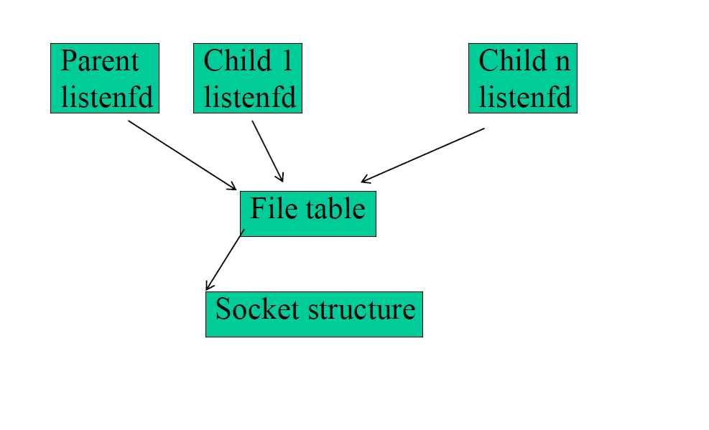
Preforked Servers
Accept: It extracts the first connection request on the queue of pending
connections, creates a new connected socket, and returns a new file
descriptor referring to that socket. The newly created socket is not in
the listening state. The original socket sockfd is unaffected by this call.
*5678TGREPCHECK1%%&$
Only one will return!!

Slide 9
Preforked server:
Disadvantages
Not easy to guess the “right” number of child processes. *5678tgrepcheck1%%&$
Comparison to other server implementation techniques: *5678TGREPCHECK1%%&$
Single CPU, multiple CPU’s
Concurrent, multiplex, and prefork are building blocks for server implementation. One can use a combination of techniques.
E.g. pre-fork N multiplexed servers.

Slide 10
IO multiplexing with threads
IO mutiplexing at the process level requires the select call.
Multi-threading can achieve the same effect
Idea: use one thread to process one input stream
Multiplexing is implicit at the systems level
See echo_client_thread.cpp
getaddrinfo – a network address and service translation method.

Slide 11
Threaded Server
Limitations with process-based concurrent servers
Fork is expensive
Inter-process communications are hard
Threads *5678tgrepcheck1%%&$
Lightweight process
Crashing one thread will kill all program
See echo_server_thread.cpp
Not robust
implemented like concurrent server.
Can share data structures

Slide 12
Prethreaded Servers
A number of threads are precreated to handle clients
Only one thread can be blocked on accept()
Access to accept () controlled by a mutex
See echo_server_prethread.cpp *5678tgrepcheck1%%&$

