Slide 1
Client-Server Paradigm
Concurrent and multiplexed servers
*5678TGREPCHECK1%%&$
Readings
UNP Section 4.8, Section 5.18, Ch6, Ch30

Slide 2
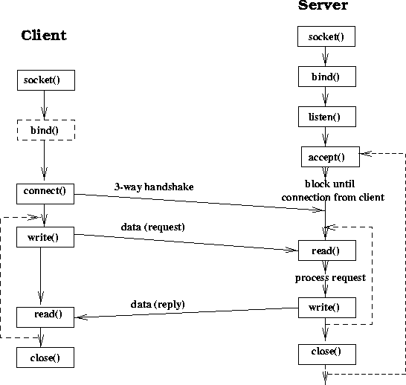
Sequential Server

Slide 3
Concurrent Server (Process-Based)
Use a new child process to handle a new connection request.
When to fork?
After accept() function call
Advantages
simple program, most of the servers are implemented this way. *5678TGREPCHECK1%%&$
Almost no limits on the number of connection.
Main limitations: too much overhead.

Slide 4
Sequential server
Concurrent server (example2.c)
socket()
socket()
bind()
bind()
listen()
listen()
Loop forever
accept()
accept()
read()
fork
Close
accepted
socket
Close listen
socket
write()
read()
write()
read()
close()
close()
read()

Slide 5
I/O Multiplexing
What happens to the client when the server crashes?
How to make the client to anticipate the problem (example1.c)?
Compare the behavior of example1.c to telnet
The real problem of this client:
The client has two places that can block. May not be able to detect that something is wrong.
Solution?
I/O multiplexing – check the file descriptor before performing a blocking operation.
Mechanism: select() system call

Slide 6
The select() System Call
The select() function that allows:
To detect any of the descriptors in the read set that are ready for reading.
To detect any of the descriptors in the write set that are ready for writing
To detect any of the descriptors in the error set that have exception conditions pending.
To wait for a period for something to happen.
#include <sys/select.h>
#include <sys/time.h>
int select (int maxfdp1, fd_set *readset,
fd_set *writeset, fd_set *exceptset, struct timeval *timeout)

Slide 7
select()
Set the set of file descriptors value:
void FD_ZERO(fd_set *fdset) /* fdset = {} */
void FD_SET(int fd, fd_set *fdset) /* fdset = fdset + {fd} */
void FD_CLR(int fd, fd_set *fdset) /* fdset = fdset – {fd} */
void FD_ISSET(int fd, fd_set *fdset) /* fd in fdset? */
Maxfdp1: the maximum file descriptor number plus 1. (can just specify a big number (64) if unknown).
Select() clears the uninteresting file descriptors in the fd_sets when it returns – always reset the fd_sets before calling select.

Slide 8
select()
Set the timeout value:
struct timeval {
long tv_sec; /* seconds */
long tv_usec; /* microseconds */
} *5678tgrepcheck1%%&$
Wait forever (blocking select): timeout = NULL
Non blocking select (return right away): tv_sec = 0; tv_usec = 0;
Wait for a certain amount of time: tv_sec and tv_usec
#include <sys/select.h>
#include <sys/time.h>
int select (int maxfdp1, fd_set *readset,
fd_set *writeset, fd_set *exceptset, struct timeval *timeout)

Slide 9
Select()
When is a socket ready for read/write/exception?
Read:
The number of bytes in the socket is more than the low-water mark (can be set, default 1 for TCP/UDP socket)
Read half of the connection is closed
Listening socket with nonzero of completed connections
Socket error.
Write:
The available buffer space is larger than the low-water mark
Write half the connection is closed
Error pending
Exception: *5678tgrepcheck1%%&$
Out of band data exists.

Slide 10
I/O Multiplexing Using select()
Now with the select function, how can we improve the client (example1.c)?
If server crashes, the client should know it right away!!
Trick: make a single point for blocking (program is sequential in nature).
Block at select (allows monitoring many files and sockets), never block in reading.
See example3.c *5678tgrepcheck1%%&$

Slide 11
Multiplexed Server Using select()
A single server thread to handle everything including connection requests, data transmissions and inputs from keyboard.
Block on select to check on all descriptors, and react accordingly
Listen socket is active → accept
Data socket is active
Read/write *5678tgrepcheck1%%&$
Close socket if the other end has been closed
Standard input is active → read and act accordingly

Slide 12
Multiplexed Servers
See example4.c (and example4_1.cpp)
socket()
bind()
listen()
Loop forever
select
If listen socket is active → accept
If data socket is active: read/write or close the socket
If standard input is active: act accordingly

Slide 13
Multiplexed vs. Concurrent Servers
Which one is more efficient?
Something to think about:
Can we have a connection that is shared by multiple processes?
What is the semantics of the communication in this case?

Slide 14
Questions to Consider
After a server accepts a new connection, what is the port number of the new connection at the server side?

