Slide 1
Basic TCP Socket API
Basic APIs
socket, bind, listen, connect, accept, close, read, write
Other helpful functions
6543tgrepcheck2&&**(11
Readings
UNP Ch3, Ch4, and Ch11

Slide 2
Connection-Oriented Application
Server gets ready to service clients
Creates a socket
Binds a local address to the socket
Server’s address should be made known to clients
Client contacts the server
Creates a socket 6543tgrepcheck2&&**(11
Connects to the server
Client has to supply the address of the server
Server accepts connection requests from clients
Further communication is specific to application

Slide 3
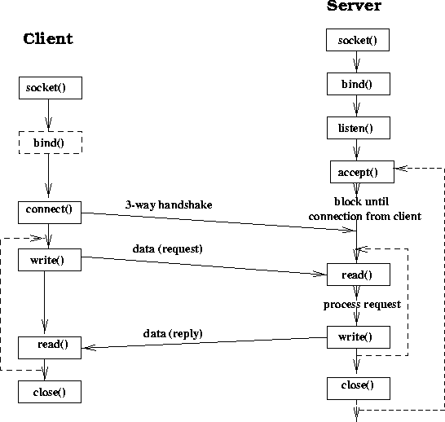
Sequential Server

Slide 4
Creating a Socket
#include <sys/socket.h>
int socket(int family, int type, int protocol);
Family: AF_INET, AF_INET6, AF_LOCAL, AF_ROUTE, AF_KEY.
Type: SOCK_STREAM, SOCK_DGRAM, SOCK_RAW
TCP: AF_INET, SOCK_STREAM
UDP: AF_INET, SOCK_DGRAM
IPv4: AF_INET, SOCK_RAW
Protocol: usually 0 except for raw sockets
Return descriptor (like file descriptor), -1 on error.
AF_XXX and PF_XXX 6543tgrepcheck2&&**(11

Slide 5
Binding Socket with a Local Address
int bind(int sd, const struct sockaddr *addr, socklen_t len)
sd: socket descriptor returned by socket()
addr: pointer to sockaddr structure containing local address to be bound to socket
len: length of address structure
Returns 0 if success, -1 otherwise
Optional to client
Servers normally need to bind
system assigns a dynamic port number (when connect or listen is called)

Slide 6
Socket Address Structure
struct in_addr {
in_addr_t s_addr;
}
struct sockaddr_in {
uint8_t sin_len;
sa_family_t sin_family;
in_port_t sin_port;
struct in_addr sin_addr;
char sin_zero[8];
}
struct sockaddr {
uint8_t sa_len;
sa_family_t sa_family;
char sa_data[14];
}

Slide 7
bind()
Controlling IP addresses and port numbers
when filling the socket address
Address port result
INADDR_ANY 0 system selects addr and port
INADDR_ANY !=0 system selects addr, user selects port
Local IP address 0 user selects addr, system selects port
Local IP address !=0 user selects both addr and port
See example1.c and example2.c

Slide 8
Client: Connecting to a Server
#include <sys/socket.h>
int connect(int sockfd, const struct sockaddr *servaddr, socklen_t addrlen);
Servaddr: socket address structure (ip address and port)
connect() actively starts the TCP connection establishment phase.
Possible errors:
No response: retry a number of times before it quits.
Get response RST (not SYN/ACK), ECONNREFUSED, nobody is listening in that port
Get ICMP response, keep trying, EHOSTUNREACH or ENETUNREACH.

Slide 9
listen()
Convert an active socket into a passive socket
#include <sys/socket.h>
int listen(int sockfd, int backlog)
Backlog: number of connections that the kernel should queue for the socket.
Two kind of queues (incomplete and complete)
Backlog not well defined.
E.g: backlog= 5: AIX 4.2(8), Linux2.0.27(5), SunOS4.1.4(8), Solaris2.5.1(6).

Slide 10
Server: Accepting Connection Request
#include <sys/socket.h>
int accept (int sockfd, struct sockaddr *cliaddr, socklen_t *addrlen);
Return client’s address in cliaddr
Blocking by default
See example2.c
After accept, the TCP connection between client and server is established. You can then use the write/read to communicate data.
Read and write have the same semantics as the read and write for file operation.

Slide 11
Network Byte Order
What happen when we run example2.c as server on oldiablo and example1.c as client on linprog?
sockaddr_in revisit
sin_port and sin_addr must be in network byte order.
Check example3.c, what is the difference between oldiablo and linprog?
What happen when we run example2.c on program?

Slide 12
Some Useful Functions
Converting the byte orders
#include <netinet/in.h>
uint16_t htons(uint16_t host16bitvalue);
uint32_t htonl(uint32_t host32bitvalue);
uint16_t ntohs(uint16_t net16bitvalue);
uint32_t ntohl(uint32_t net32bitvalue);
Some byte manipulation functions:
#include <string.h>
void *memset(void *dst, int c, size_t len);
void *memcpy(void *dst, void *src, size_t nbytes);
void *memcmp(const void *ptr1, const void *ptr2, size_t nbytes);

Slide 13
Some Useful Functions
Address conversion functions
inet_aton/inet_addr/inet_ntoa
inet_pton and inet_ntop // these are newer ones
Information about socket
getsockname and getpeername
getsockopt and setsockopt
Name and address conversions 6543TGREPCHECK2&&**(11
gethostbyname, gethostbyaddr
getservbyname, getservbyport
getaddrinfo, gai_strerror, freeaddrinfo // newer ones

Slide 14
Echo Client and Server
See echo_client.cpp and echo_server.cpp
6543TGREPCHECK2&&**(11
Note that, the client program may be blocked forever, even if the server crashes, if the user does not type anything after the connection has been established.

