Slide 1
Introduction to OpenMP
Introduction
OpenMP basics
OpenMP directives, clauses, and library routines
6543tgrepcheck2&&**(11
Readings
http://openmp.org/
https://computing.llnl.gov/tutorials/openMP/

Slide 2
What is OpenMP?
What does OpenMP stands for?
Open specifications for Multi Processing via collaborative work between interested parties from the hardware and software industry, government and academia.
OpenMP is an API that may be used to explicitly direct multi-threaded, shared memory parallelism.
API components: compiler directives, runtime library routines, environment variables
OpenMP is a directive-based method to invoke parallel computations on share-memory multiprocessors 6543tgrepcheck2&&**(11

Slide 3
What is OpenMP?
OpenMP API is specified for C/C++ and Fortran.
OpenMP is not intrusive to the orginal serial code: instructions appear in comment statements for fortran and pragmas for C/C++.
See mm.c and mm_omp.c
OpenMP website: http://www.openmp.org
Materials in this lecture are taken from various OpenMP tutorials in the website and other places.

Slide 4
Why OpenMP?
OpenMP is portable: supported by HP, IBM, Intel, SGI, SUN, and others
It is the de facto standard for writing shared memory programs.
To become an ANSI standard?
Always supported by gcc
OpenMP can be implemented incrementally, one function or even one loop at a time.
Very nice way to get a parallel program from a sequential program.

Slide 5
How to Compile and Run OpenMP Programs?
Gcc 4.2 and above supports OpenMP 3.0
gcc –fopenmp a.c
To run: ‘a.out’
To change the number of threads:
setenv OMP_NUM_THREADS 4 (tcsh) or
export OMP_NUM_THREADS=4 (bash)

Slide 6
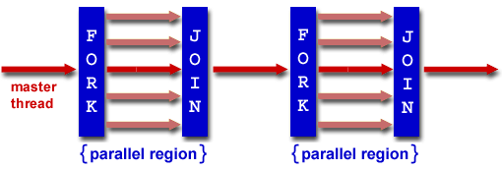
OpenMP Programming Model
OpenMP uses the fork-join model of parallel execution.
All OpenMP programs begin with a single master thread.
The master thread executes sequentially until a parallel region is encountered, when it creates a team of parallel threads (FORK). Master is part of the team with thread id 0.
When the team threads complete the parallel region, they synchronize and terminate, leaving only the master thread that executes sequentially (JOIN).

Slide 7
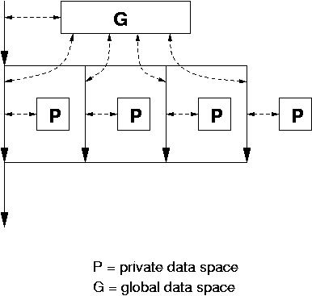
OpenMP Data Model
Private and shared variables
Variables in the global data space are accessed by all parallel threads (shared variables).
Variables in a thread’s private space can only be accessed by the thread (private variables)
several variations, depending on the initial values and whether the results are copied outside the region.

Slide 8
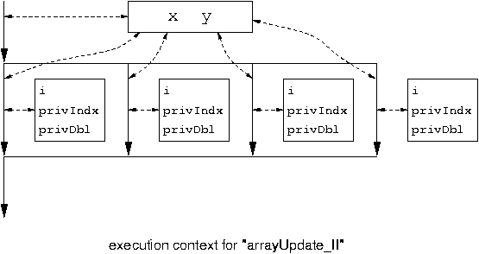
#pragma omp parallel for private( privIndx, privDbl )
for ( i = 0; i < arraySize; i++ ) { 6543TGREPCHECK2&&**(11
for ( privIndx = 0; privIndx < 16; privIndx++ ) {
privDbl = ( (double) privIndx ) / 16;
y[i] = sin( exp( cos( - exp( sin(x[i]) ) ) ) ) + cos( privDbl );
}
}
Parallel for loop index i is
private by default.

Slide 9
OpenMP Terminology
OpenMP Team := Master + Workers
A parallel region is a block of code executed by all threads simultaneously
"if" clause can be used to guard the parallel region; in case the condition evaluates to "false", the code is executed serially
A work-sharing construct divides the execution of the enclosed code region among the members of the team; in other words: they split the work 6543TGREPCHECK2&&**(11

Slide 10
Components of OpenMP
Compiler Directives
Environment Variables
Runtime library routines
Parallel regions
Work sharing
Synchronization
Data scope attributes
Private
Firstprivate
Lastprivate
Shared
Reduction
Orphaning
Number of thread
Scheduling type
Dynamic thread adjustment
Nest parallelism
Number of threads
Thread ID
Dynamic thread adjustment
Nested parallelism
Timers
API for locking

Slide 11
OpenMP General Code Structure
#include <omp.h>
main () {
int var1, var2, var3;
Serial code
. . .
/* Beginning of parallel section. Fork a team of threads. Specify variable scoping*/
#pragma omp parallel private(var1, var2) shared(var3)
{
/* Parallel section executed by all threads */
. . .
/* All threads join master thread and disband*/
}
Resume serial code
. . .
}
See example hello_world.c 6543TGREPCHECK2&&**(11

Slide 12
OpenMP Directives
Format:
#pragma omp directive-name [clause,..] newline
(use ‘\’ for multiple lines)
Example:
#pragma omp parallel default(shared) private(beta,pi)
Scope of a directive is a block of statements { …}

Slide 13
Parallel Region Construct
A block of code that will be executed by multiple threads.
#pragma omp parallel [clause …]
{
……
} (implied barrier)
Example clauses: if (expression), private (list), shared (list), default (shared | none), reduction (operator: list), firstprivate(list), lastprivate(list)
if (expression): only in parallel if expression evaluates to true
private(list): list of variables private to each thread
shared(list): data accessed by all threads
default (none|shared): default scope for all variables in parallel region

Slide 14
Shared Variables
A shared variable exists in only one memory location and all threads can read or write to that address.
It is the programmer's responsibility to ensure that multiple threads properly access SHARED variables (such as via CRITICAL sections).

Slide 15
Parallel Region Construct (Cont’d)
Reduction clause
sum = 0.0;
#pragma parallel default(none) shared (n, x) private (I) reduction(+ : sum)
{
for(I=0; I<n; I++) sum = sum + x(I);
}
Updating sum must avoid racing condition
With the reduction clause, OpenMP generates code such that the race condition is avoided.
See add1.c and add2.c
See example3.c and example3a.c
Firstprivate(list): variables are initialized with the value before entering the block
Lastprivate(list): variables are updated going out of the block.

Slide 16
Realizing Customized Reduction
#pragma omp parallel default(none) shared (n, x) private (I) reduction(f : sum)
{
For(I=0; I<n; I++) sum = sum + x(I);
}
#pragma omp parallel default (none) shared(n, x, localsum, nthreads) private(I)
{
nthreads = omp_get_num_threads();
#pragma omp for
for (I=0; I<n; I++) {
localsum[omp_get_thread_num()] += x(I);
}
For (I=0; I<nthreads; I++) sum += localsum[I];

Slide 17
Work-Sharing Constructs
#pragma omp for [clause …]
#pragma omp sections [clause …]
#pragma omp single [clause …]
The work is distributed over the threads
Must be enclosed in parallel region
No new threads created
No implied barrier on entry, implied barrier on exit (unless specified otherwise)

Slide 18
The omp for Directive: Example

Slide 19
Schedule clause (decide how the iterations are executed in parallel):
schedule (type [, chunk]). Types: static, dynamic, guided, runtime, auto

Slide 20
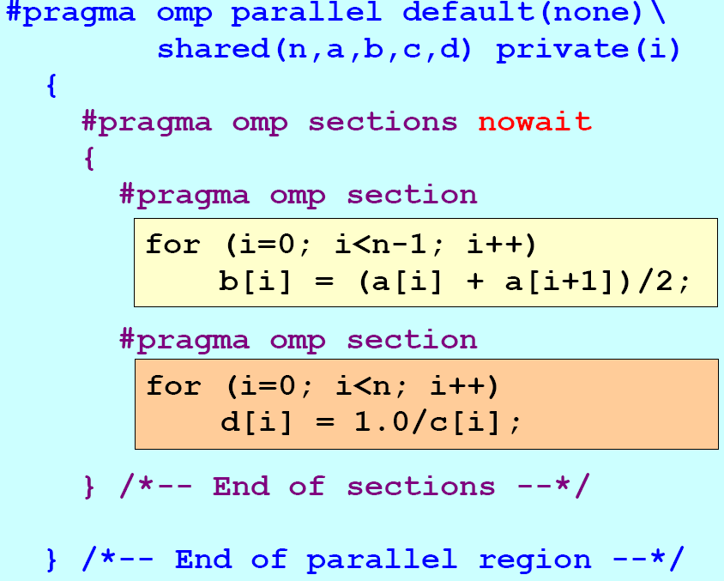
The omp sections Directive - Example

Slide 21
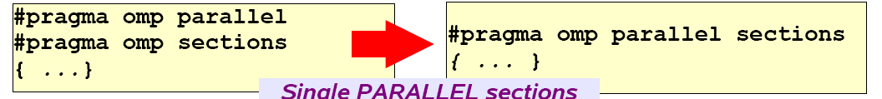
Combined Parallel Work-Sharing Constructs
Parallel region construct can be combined with work-sharing constructs
See add4.c

Slide 22
Synchronization: Barrier
For(I=0; I<N; I++)
a[I] = b[I] + c[I];
For(I=0; I<N; I++)
d[I] = a[I] + b[I]
Both loops are in parallel region
With no synchronization in between.
What is the problem?
Fix:
For(I=0; I<N; I++)
a[I] = b[I] + c[I];
#pragma omp barrier
For(I=0; I<N; I++)
d[I] = a[I] + b[I]

Slide 23
Critical Section
For(I=0; I<N; I++) {
……
sum += A[I];
……
}
Cannot be parallelized if sum is shared.
Fix:
For(I=0; I<N; I++) {
……
#pragma omp critical
{
sum += A[I];
}
……
}
See add3.c

Slide 24
OpenMP Environment Variables
OMP_NUM_THREADS
OMP_SCHEDULE
OMP_THREAD_LIMIT
etc

Slide 25
OpenMP Runtime Environment
omp_get_num_threads()
omp_get_thread_num()
omp_in_parallel()
omp_get_wtime()
Routines related to locks
……

Slide 26
Lock Related Routines
Will only discuss simple lock: may not be locked if already in a locked state.
Simple lock interface:
Type: omp_lock_t
Operations:
omp_init_lock(omp_lock_t *a)
omp_destroy_lock(omp_lock_t *a)
omp_set_lock(omp_lock_t *a)
omp_unset_lock(omp_lock_t *a)
omp_test_lock(omp_lock_t *a)

Slide 27
OpenMP Lock Routines
omp_init_lock
initializes the lock. After the call, the lock is unset.
omp_destroy_lock
destroys the lock. The lock must be unset before this call.
omp_set_lock
attempts to set the lock. If the lock is already set by another thread, it will wait until the lock is no longer set, and then sets it.
omp_unset_lock
unsets the lock. It should only be called by the same thread that set the lock; the consequences of doing otherwise are undefined.
omp_test_lock
attempts to set the lock. If the lock is already set by another thread, it returns 0; if it managed to set the lock, it returns 1.

Slide 28
Loop Carried Dependency
The value of a variable in an iteration depends on a previous iteration in the same loop
See loopcarry_sequential.c
Loopcarry_omp1.c
Loopcarry_omp2.c
Can the lock mechanism used for loop carried dependence?

Slide 29
Challenges in Developing Correct OpenMP Programs
Dealing with loop carried dependence
Removing unnecessary dependencies
Managing shared and private variables

Slide 30
Summary
OpenMP provides a compact, yet powerful programming model for shared memory programming
OpenMP preserves the sequential version of the program
Developing an OpenMP program:
Start from a sequential program
Identify the code segment that takes most of the time.
Determine whether the important loops can be parallelized
Loops may have critical sections, reduction variables, etc
Determine the shared and private variables.
Add directives.
See for example pi.c and piomp.c program.

