Slide 1
Pthread
Some materials and pictures are obtained from the POSIX threads Programming tutorial at https://computing.llnl.gov/tutorials/pthreads
Readings
APUE Chapters 11 and 12
UNP Chapter 26

Slide 2
What is a Thread?
OS view: A thread is an independent stream of instructions that can be scheduled to run by the OS.
Software developer view: a thread can be considered as a “procedure” that runs independently from the main program.
Sequential program: a single stream of instructions in a program.
Multi-threaded program: a program with multiple streams
Multiple threads are needed to use multiple cores/CPUs

Slide 3
Example Multithreaded Programs?
Computer games
Each thread controls the movement of an object.
Scientific simulations
Hurricane movement simulation: each thread simulates the hurricane in a small domain.
Molecular dynamic: each thread simulates a subset of particulars.
……
Web server
Each thread handles a connection.
……

Slide 4
Process and Thread
Process context
Process ID, process group ID, user ID, and group ID
Environment
Working directory
Program instructions
Registers (including PC)
Stack
Heap
File descriptors
Signal actions
Shared libraries
Inter-process communication tools
Which contexts are for running instructions independently? which are for protection from other processes?

Slide 5
Process and Thread
What are absolutely needed to support a stream of instructions?
Process ID, process group ID, user ID, and group ID
Environment
Working directory.
Program instructions
Registers (including PC)
Stack
Heap
File descriptors
Signal actions
Shared libraries
Inter-process communication tools

Slide 6
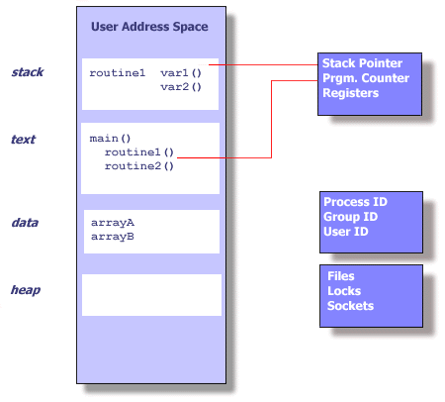
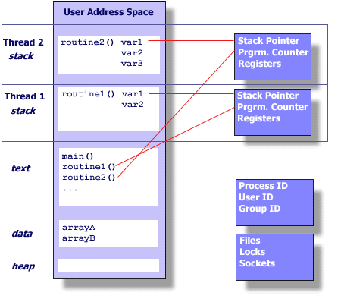
Process and Thread

Slide 7
Threads
Exist within processes
Die if the process dies
Use process resources
Duplicate only the essential resources for OS to schedule them independently
Each thread maintains
Stack
Registers
Scheduling properties (e.g. priority)
Signal mask
Thread specific data

Slide 8
Advantages of Threads
Light-weight
Lower overhead for thread creation
Lower context switching overhead
Fewer OS resources

Slide 9
Platform
fork()
pthread_create()
real
user
sys
real
user
sys
AMD 2.4 GHz Opteron (8cpus/node)
17.6
2.2
15.7
1.4
0.3
1.3
IBM 1.9 GHz POWER5 p5-575 (8cpus/node)
64.2
30.7
27.6
1.7
0.6
1.1
IBM 1.5 GHz POWER4 (8cpus/node)
104.5
48.6
47.2
2.1
1.0
1.5
INTEL 2.4 GHz Xeon (2 cpus/node)
54.9
1.5
20.8
1.6
0.7
0.9
INTEL 1.4 GHz Itanium2 (4 cpus/node)
54.5
1.1
22.2
2.0
1.2
0.6

Slide 10
Advantages of Threads
Shared state
Don’t need IPC-like mechanism to communicate between threads of same process

Slide 11
Disadvantages of Threads
Shared state!
Global variables are shared between threads. Accidental changes can be fatal.
Many library functions are not thread-safe
Library functions that return pointers to static internal memory. E.g. gethostbyname()
Lack of robustness
Crash in one thread will crash the entire process.

Slide 12
Pthreads
Hardware vendors used to implement proprietary versions of threads
Thread programs are not portable
Pthreads = POSIX threads, specified in IEEE POSIX 1003.1c (1995)
We will only discuss the most commonly used APIs of Pthread

Slide 13
The Pthreads API
Three types of routines:
Thread management: create, terminate, join, and detach
Mutexes: mutual exclusion, creating, destroying, locking, and unlocking mutexes
Condition variables: event driven synchronization.
Mutexes and condition variables are concerned about synchronization.
Why not anything related to inter-thread communication?
The concept of opaque objects pervades the design of the API.

Slide 14
The Pthreads API Naming Convention
Routine Prefix | Function
pthread_ | General pthread
pthread_attr_ | Thread attributes
pthread_mutex_ | mutex
pthread_mutexattr | Mutex attributes
pthread_cond_ | Condition variables
pthread_condattr | Conditional variable attributes
pthread_key_ | Thread specific data keys

Slide 15
Thread Management Routines
Creation: pthread_create
Termination:
Return from starting routine
pthread_exit
Can we still use exit?
Wait (parent/child synchronization): pthread_join
Pthread header file <pthread.h>
Compiling pthread programs:
gcc –pthread aaa.c
gcc –lpthread aaa.c

Slide 16
Creation
Thread equivalent of fork()
int pthread_create(
pthread_t * thread,
pthread_attr_t * attr,
void * (*start_routine)(void *),
void * arg
);
Returns 0 if OK, and non-zero (> 0) if error.
Parameters for the routines are passed through void * arg.
Is there anything that you cannot pass to a thread?

Slide 17
Termination
Thread termination
Return from initial function.
void pthread_exit(void * status)
Process termination
exit() called by any thread
main() returns

Slide 18
Waiting for Child Thread
int pthread_join( pthread_t tid, void **status)
Equivalent of waitpid()for processes

Slide 19
Detaching a Thread
The detached thread can act as daemon thread
The parent thread doesn’t need to wait
int pthread_detach(pthread_t tid)
Detaching self :
pthread_detach(pthread_self())

Slide 20
Some Multi-thread Program Examples
A multi-thread program example: example1.c
Making multiple producers: example2.c
What is going on in this program?

Slide 21
Matrix multiply and threaded matrix multiply
Matrix multiply: C = A × B

Slide 22
Matrix multiply and threaded matrix multiply
Sequential code:
For (i=0; i<N; i++)
for (j=0; j<N; j++)
for (k=0; k<N; k++) C[I, j] = C[I, j] + A[I, k] * A[k, j]
See mm.c
Threaded code program
The calculation of c[I,j] does not depend on other C term. mm_pthread.c.

Slide 23
PI Calculation
Sequential code: pi.c
Multi-threaded version: pi_pthread.c

