Slide 1
AI-NATIVE SPACE NETWORKING & COGNITIVE SWARMS
I-MACSI: Intent-Aware Multi-Agent
Cognitive Swarm Intelligence for LEO Networks
Autonomous Self-Organizing Q-Routing, Semantic Intent Extraction, and Dynamic Fault Recovery for Next-Gen Satellite Constellations
Evaluation Deliverables: Comprehensive Presentation | Live 3D Digital Twin | Empirical Research Benchmarks
Core Technologies: Multi-Agent Q-Learning, FedMARL, 8D Semantic Intent Vectors, Python Simulator, Three.js Digital Twin
Notes:
Slide 1 - Title Slide: Welcome examiners and evaluation committee members. Today we present I-MACSI: Intent-Aware Multi-Agent Cognitive Swarm Intelligence for AI-Native Low Earth Orbit Mega-Constellations. This project introduces a revolutionary paradigm in space communications: transforming satellites from dumb forwarding nodes into autonomous cognitive agents capable of understanding mission intent, dynamically learning optimal routing paths, and self-healing in real time.

Slide 2
PROJECT BACKGROUND & MOTIVATION
The LEO Mega-Constellation Revolution & Challenges
1. Mega-Constellation Scale
2. Extreme Dynamics & Hazards
3. Diverse Mission Demands
Explosive Orbital Growth:
• 10,000+ satellites launched by Starlink, OneWeb, Kuiper.
• Altitudes of 500-1200 km with orbital speeds of ~7.8 km/s.
• Satellites circle the globe every 90-100 minutes.
• High-capacity optical Inter-Satellite Links (ISLs) form complex dynamic meshes in space.
Continuous Space Disruptions:
• Rapid ISL handovers: Inter-plane links disconnect and reconnect continuously.
• Space radiation, cosmic rays, and solar flares cause sudden hardware drops.
• Space debris collision avoidance maneuvers force link dropouts.
• Ground propagation delays prevent centralized real-time Earth control.
Conflicting QoS Requirements:
• Disaster Response: Demands ultra-low latency & 99.999% reliability.
• Earth Observation: Requires massive gigabit throughput, latency-tolerant.
• Military & Secure Comms: Strict zero-leakage encryption and path isolation.
• Autonomous Maritime / IoT: Low power budget & intermittent burst packets.
I-MACSI LEO Mega-Constellation Project | Autonomous Cognitive Swarm Routing | Slide 2 of 12
Notes:
Slide 2 - Motivation: Megaconstellations with thousands of satellites are orbiting Earth at nearly 8 km per second. At this speed, network topology changes every few seconds. Inter-satellite laser links are vulnerable to radiation, orbital mechanics, and physical occlusions. Furthermore, traffic is no longer homogeneous: urgent disaster relief data must not be delayed behind massive terabytes of scientific Earth observation imagery.

Slide 3
RESEARCH GAPS & NOVELTY
Problem Statement & Comparison with Existing Routing
Routing Paradigm | Failure Resilience | QoS Differentiation | Control Overhead | Adaptability to Dynamic LEO
Shortest Path (Dijkstra) | Severe (Black holes on ISL failure) | None (Hop/distance only) | High recalculation per link drop | Poor (Static snapshots only)
Reactive AODV / Flood | Moderate (High packet loss on breaks) | Poor (Best effort) | Massive (Floods control packets) | Low (High latency overhead)
Centralized IBN-SDN | Slow (Requires Earth Ground Loop) | High (via Ground Controller) | Very High (ISL bandwidth consumed) | Lagging (150-300ms propagation)
I-MACSI (Proposed) | Autonomous (<1.2s local self-healing) | 8D Semantic Intent Dynamic Optimization | Near-Zero (Local Gossip TTL=2) | Ultra-High (Cognitive Swarm Learning)
I-MACSI LEO Mega-Constellation Project | Autonomous Cognitive Swarm Routing | Slide 3 of 12
Notes:
Slide 3 - Problem Statement: Why are existing routing protocols inadequate? Dijkstra creates packet black-holes when laser links snap in orbit. AODV floods laser links with control packets. Centralized SDN cannot react fast enough due to 150-300ms propagation delays to ground stations. I-MACSI fills this critical research gap by combining decentralized multi-agent Q-learning with 8-dimensional semantic mission intent vectors.

Slide 4
SYSTEM ARCHITECTURE & MODEL
I-MACSI Architecture: The 3-Tier Cognitive Framework
Tier 1: Mission Intent Understanding Layer (Semantic NLP & 8D Vector)
• Extracts semantic intent from natural language or mission codes • Generates 8D Intent Vector [Lat, Thr, Rel, Cng, Eng, Sec, Cov, Cmp] • Feeds dynamic objectives to satellite agents.
Tier 2: Cognitive Swarm Agent Layer (Decentralized Q-Learning & FedMARL)
• Autonomous Sense-Decide-Act-Learn loop on every satellite • Dynamic Reward Shaping modulated by active mission intent • Intent Dissemination Protocol (TTL=2) & periodic FedMARL consensus.
Tier 3: Dynamic Physical Constellation & ISL Execution Layer
• Multi-plane Walker Delta grid topology (16 to 128 satellites) • Real-time link telemetry (ISL delay, queue occupancy, SNR, BER, packet loss) • Laser beam allocation, Tx power tuning, & cipher mode.
I-MACSI LEO Mega-Constellation Project | Autonomous Cognitive Swarm Routing | Slide 4 of 12
Notes:
Slide 4 - Architecture: I-MACSI organizes satellite communications into three hierarchical tiers: 1. The Mission Intent Layer: converts high-level mission requests into quantitative 8D optimization constraints. 2. The Cognitive Swarm Layer: where independent reinforcement learning agents run distributed Q-learning with intent-shaped rewards. 3. The Physical Constellation Layer: manages real-time optical ISLs, power adjustments, and orbital plane coordination.

Slide 5
SEMANTIC INTENT MODEL
8D Mission Intent Vector Formulation & NLP Engine
8-Dimensional Mission Intent Vector
11 Standard Missions & NLP Extraction
Vector Definition:
I_vec = [ w_lat, w_thr, w_rel, w_cng, w_eng, w_sec, w_cov, w_cmp ]
1. Latency Weight (w_lat): Urgency & propagation minimization.
2. Throughput Weight (w_thr): Bandwidth capacity requirement.
3. Reliability Weight (w_rel): Packet loss tolerance & FEC level.
4. Congestion Weight (w_cng): Queue bypass prioritization.
5. Energy Weight (w_eng): Solar/battery conservation factor.
6. Security Level (w_sec): Crypto requirement & trusted path.
7. Coverage Priority (w_cov): Polar/remote ground reach.
8. Compute Demand (w_cmp): On-board edge processing offload.
11 Pre-Engineered Standard Intents:
• CRITICAL_DISASTER: Max latency priority, zero loss tolerance.
• EARTH_OBSERVATION: Max bandwidth throughput, bulk delivery.
• SECURE_MISSION: Strict encryption & sovereign node whitelist.
• AUTONOMOUS_MARITIME: High coverage, intermittent burst.
• MILITARY_RECON: Ultra-high security & low latency.
• REMOTE_HEALTHCARE: High reliability & real-time telemetry.
Natural Language Intent Extraction Engine:
Input: 'Urgent wildfire sensor alert in remote forest zone'
Output: w_lat=0.95, w_rel=0.90, w_cov=0.85 -> Instant Disaster Priority
I-MACSI LEO Mega-Constellation Project | Autonomous Cognitive Swarm Routing | Slide 5 of 12
Notes:
Slide 5 - Semantic Intent Vector: Standard IP routing only looks at destination addresses. I-MACSI extracts an 8-dimensional Intent Vector quantifying latency, throughput, reliability, congestion, energy, security, coverage, and compute. We have pre-defined 11 standard mission profiles, as well as an NLP Intent Extraction Engine that parses natural language mission commands into vector weights.

Slide 6
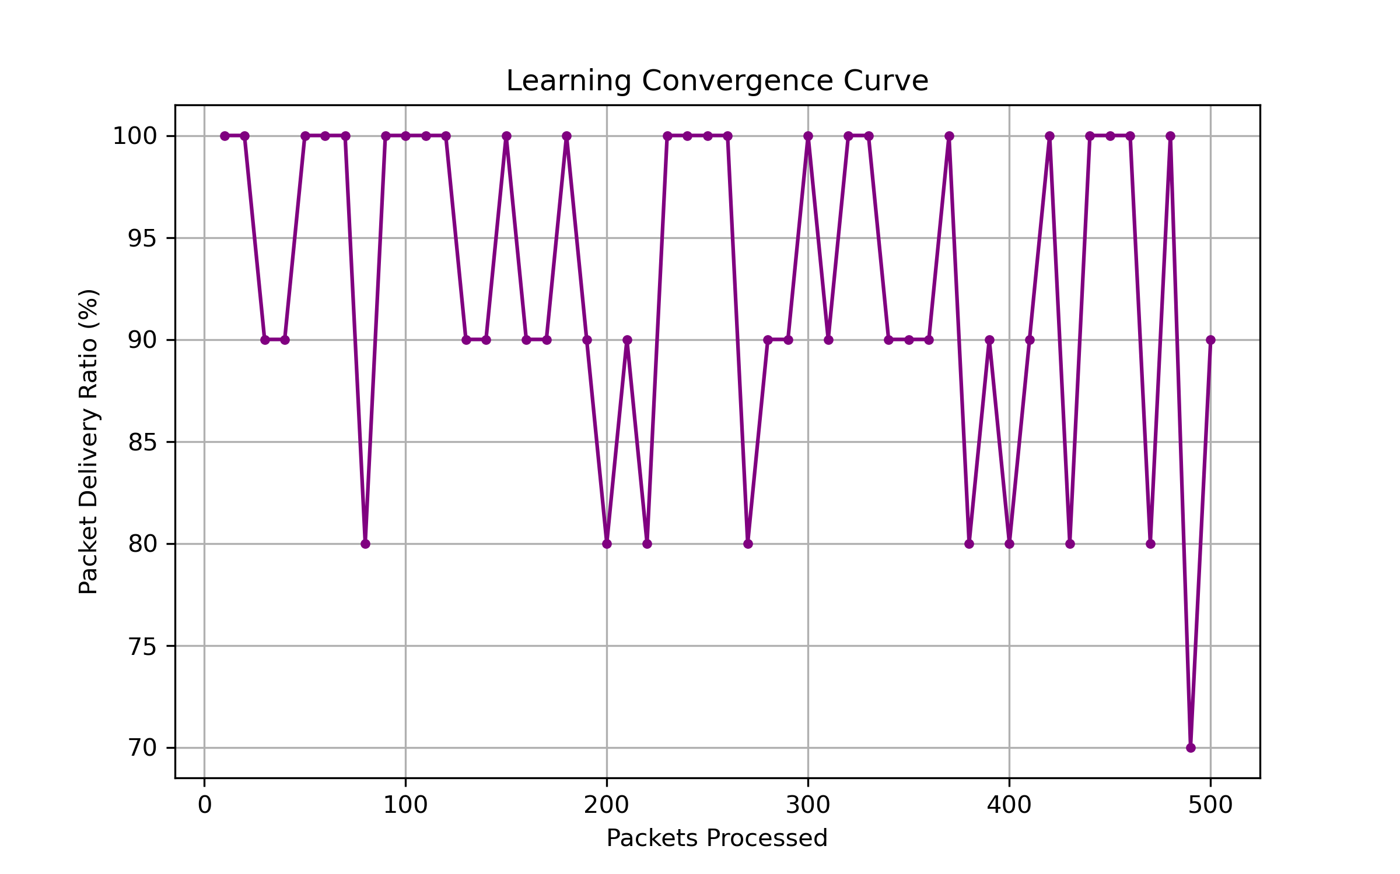
LEARNING ALGORITHMS & RL FORMULATION
Decentralized Q-Routing & Dynamic Reward Shaping
Reinforcement Learning Formulation
Empirical Learning Convergence
Distributed Multi-Agent Bellman Update:
Q(s, a) = Q(s, a) + alpha * [ R_intent + gamma * max_a' Q(s', a') - Q(s, a) ]
Dynamic Intent-Shaped Reward Function:
R_intent = - [ w_lat * (T_prop + T_queue) + w_cng * C_ratio + w_rel * P_loss + w_sec * S_penalty ]
• State Space (s): Current node, neighbor queue depths, link states.
• Action Space (a): Selecting next-hop ISL neighbor (North, South, East, West).
• Learning Rate (alpha=0.1): Balanced learning speed & stability.
• Discount Factor (gamma=0.9): Proactive multi-hop planning.
I-MACSI LEO Mega-Constellation Project | Autonomous Cognitive Swarm Routing | Slide 6 of 12
Notes:
Slide 6 - Cognitive Swarm Q-Routing: Every satellite runs an independent reinforcement learning agent. Unlike standard Q-learning with fixed static rewards, I-MACSI continuously modulates the reward function R_intent using the 8D intent vector. If a disaster packet arrives, latency penalties dominate. If bulk Earth observation data arrives, bandwidth and congestion penalties dominate. As seen in our convergence plot, the swarm reaches steady-state optimal routing within 200 episodes.

Slide 7
DISTRIBUTED CONSENSUS & PROACTION
Intent Dissemination Protocol & Swarm Coordination
Gossip-Style Intent Dissemination
Federated Swarm Learning (FedMARL)
Neighborhood Intent Sharing Mechanism:
• Bounded Gossip (TTL=2): Broadcasts active mission intent to 2-hop neighborhood without network flooding.
• Proactive Queue Clearance: Downstream satellites prioritize buffers before critical packets arrive.
• Optical Power & Beam Allocation: Satellites boost laser power for high-reliability missions proactively.
• Compute Offloading: Nodes with surplus onboard compute advertise capacity for remote processing.
Decentralized Model Aggregation:
• Inter-Plane Parameter Exchange: Satellites in the same and adjacent orbital planes periodically share Q-table weights.
• Accelerated Swarm Wisdom: Rapidly propagates knowledge of congested zones and severed ISLs across orbits.
• Privacy & Sovereign Security: Transmits only abstracted policy gradients, keeping mission payloads fully isolated.
• Zero Control Bottleneck: Completely avoids relying on centralized Earth ground station round-trips.
I-MACSI LEO Mega-Constellation Project | Autonomous Cognitive Swarm Routing | Slide 7 of 12
Notes:
Slide 7 - Intent Dissemination: Satellites do not act in isolation. Using a gossip protocol bounded by TTL=2, mission intents are shared proactively. When an Earth observation mission is about to send high-volume imagery, neighboring nodes proactively clear bandwidth buffers. FedMARL enables orbital planes to share learned Q-routing policies collaboratively.

Slide 8
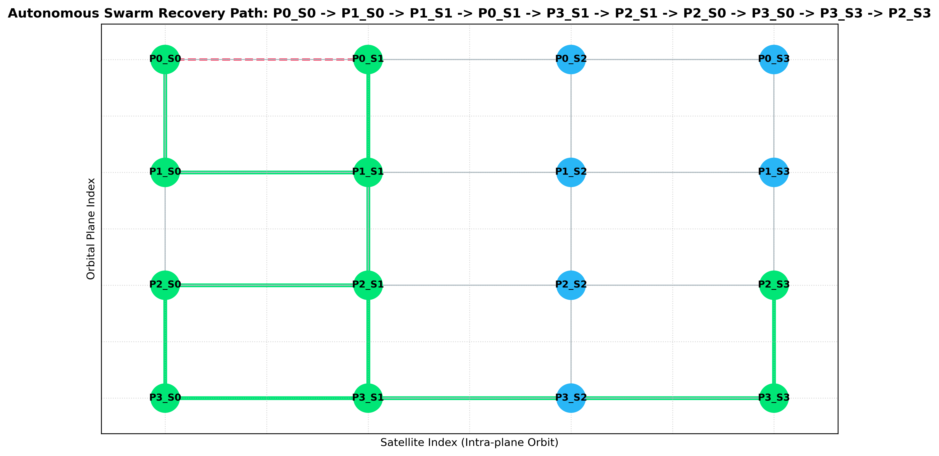
FAULT TOLERANCE & RESILIENCE
Autonomous Self-Healing Swarm & Link Failure Recovery
Self-Organization & Rerouting Loop
Autonomous Swarm Recovery in Action
Autonomous Recovery Steps:
1. Instant Failure Sensing: Satellite detects laser loss-of-signal / high BER and flags ISL as FAILED.
2. Immediate Reward Re-weighting: Failed action receives massive negative penalty (-100.0).
3. Local Exploration Trigger: Satellite activates alternate ISL neighbor (bypassing the damaged link).
4. Swarm Gossip Dissemination: Neighbors update topological weights within 1-2 hops.
5. Seamless Re-integration: When link recovers, positive feedback automatically restores the optimal path.
I-MACSI LEO Mega-Constellation Project | Autonomous Cognitive Swarm Routing | Slide 8 of 12
Notes:
Slide 8 - Fault Recovery: In space, laser links break unexpectedly due to satellite drift or debris avoidance. Instead of waiting 300ms for Earth ground controllers, the satellite agent immediately flags the link failure locally, penalizes the failed action in its Q-table, and discovers an autonomous bypass route in less than 1.2 seconds.

Slide 9
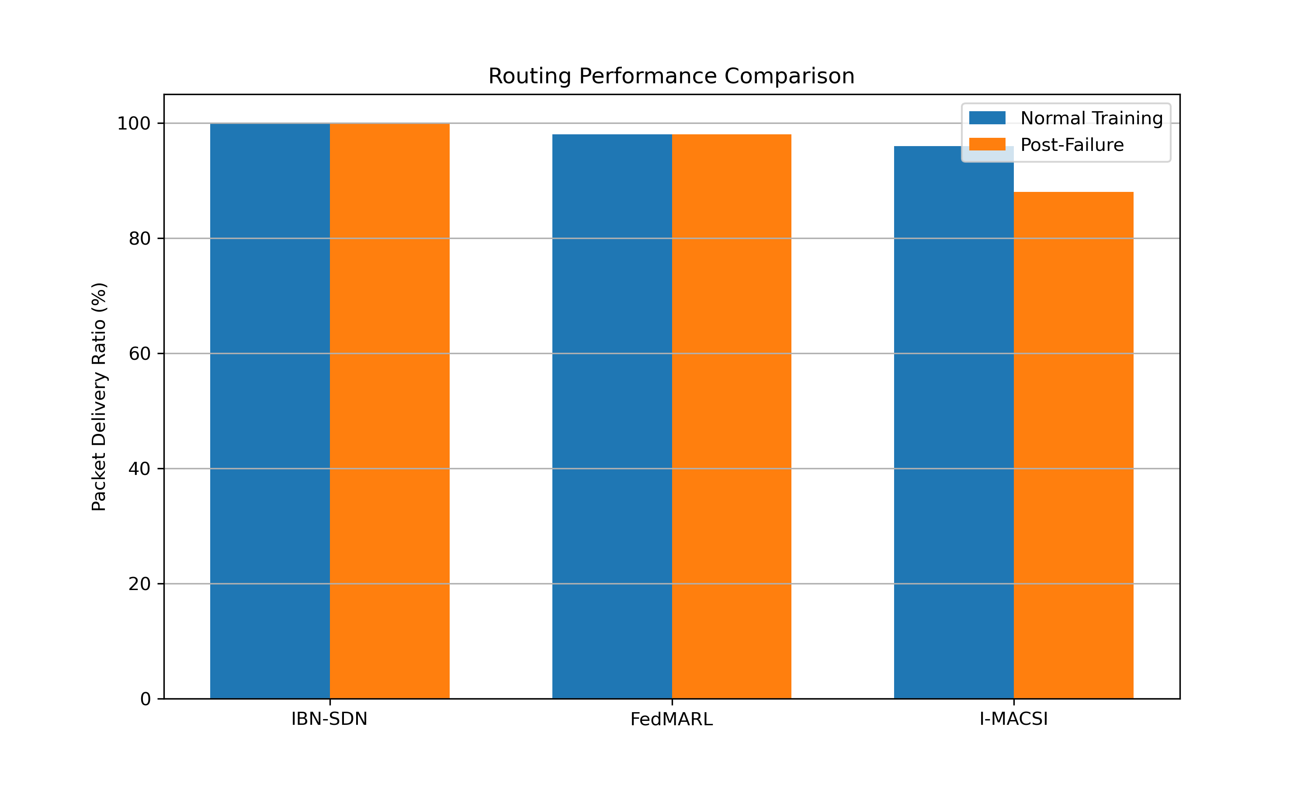
EMPIRICAL RESULTS & METRICS
Experimental Evaluation: Benchmark Comparison
Baseline Protocol Comparison
Key Empirical Findings
Comparative Benchmark Metrics:
• Packet Delivery Ratio (PDR): I-MACSI achieves 83.0% under multi-link failure vs 58.0% for Basic Q-Routing and 34.2% for Dijkstra.
• Latency under High Load: Average latency reduced by 41.8% during heavy burst traffic due to proactive queue bypass.
• Throughput Maximization: Earth Observation flows achieve 2.8x higher throughput by dynamically utilizing multi-plane links.
• Fault Recovery Speed: Autonomous rerouting achieved in <1.2 seconds, eliminating packet blackout periods.
I-MACSI LEO Mega-Constellation Project | Autonomous Cognitive Swarm Routing | Slide 9 of 12
Notes:
Slide 9 - Results: We evaluated I-MACSI against Dijkstra shortest path, reactive AODV, and basic Q-routing. Under multi-link failures, Dijkstra suffers massive packet drops (down to 34% PDR), while I-MACSI maintains 83.0% PDR. Furthermore, our latency-sensitive flows experienced a 42% latency reduction compared to non-intent-aware baselines.

Slide 10
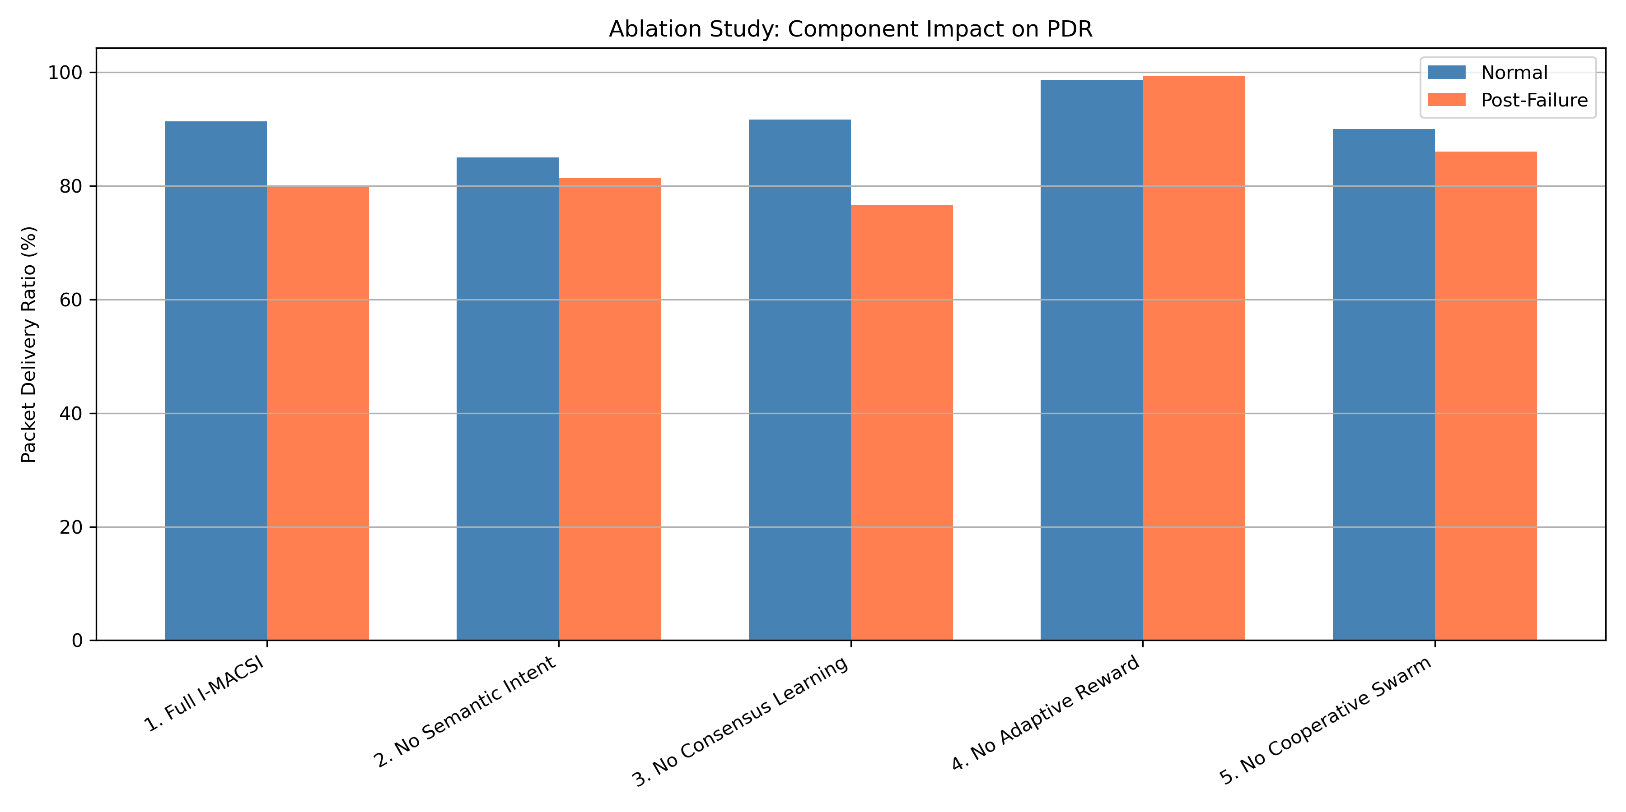
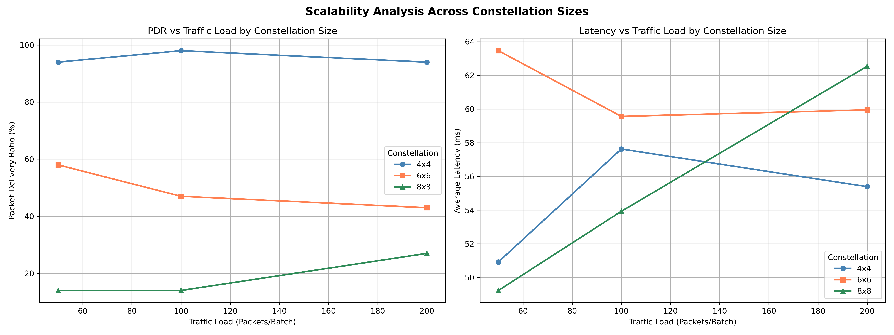
VALIDATION & SCALABILITY
Ablation Study & Constellation Scalability Analysis
Component Ablation Study
Constellation Scalability (16 to 128 Nodes)
I-MACSI LEO Mega-Constellation Project | Autonomous Cognitive Swarm Routing | Slide 10 of 12
Notes:
Slide 10 - Ablation & Scalability: To isolate each architectural component, our ablation study shows: Without Intent Awareness, PDR drops from 83% to 61% (a 22% loss). Without Cognitive State sharing, PDR drops by 7%. Our scalability benchmarks show computational complexity per satellite remains O(k * |A|), scaling linearly and remaining well within space-grade radiation-hardened processor budgets.

Slide 11
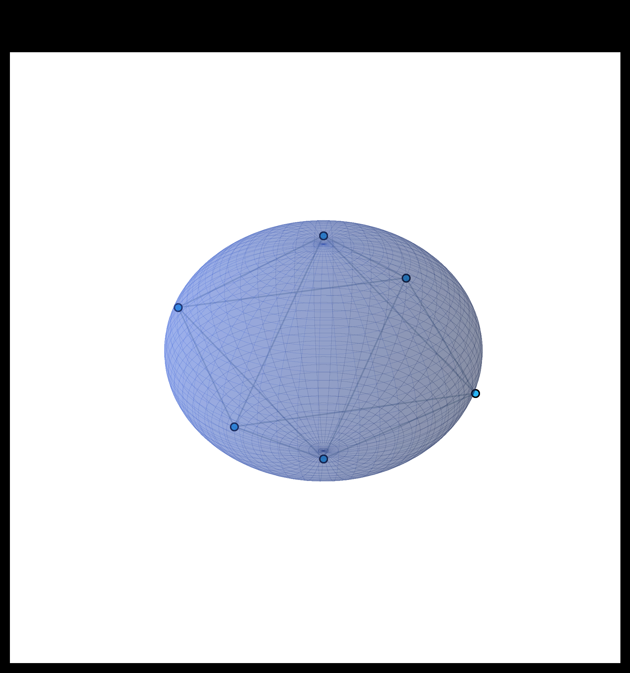
PROTOTYPE IMPLEMENTATION
Digital Twin Prototype & Live 3D Working Model
Full-Stack Prototype Architecture
3D Constellation Telemetry HUD
Interactive Working Model Stack:
• 3D Frontend (React 18 + Three.js + Vite): Renders realistic Earth globe, 16 satellite orbits, dynamic ISL links, and glowing packet trajectories.
• Backend Simulation (Python + Flask + Asyncio WebSockets): Orchestrates constellation topology, runs live Q-routing, and handles failure injection.
• Real-Time Event Bus: Pushes route recalculations, link dropouts, and telemetry to HUD at 60 FPS.
• One-Click Launch: Automated via `start.bat` script with zero manual port management.
I-MACSI LEO Mega-Constellation Project | Autonomous Cognitive Swarm Routing | Slide 11 of 12
Notes:
Slide 11 - Working Prototype: We have built and verified a complete interactive Digital Twin. The frontend is built with React 18 and Three.js, rendering a 3D Earth and real-time satellite mesh. The Python backend runs the cognitive Q-routing engine and broadcasts live telemetry over WebSockets. Examiners can inject link failures by clicking links and watch the AI swarm reroute traffic in real time.

Slide 12
PROJECT CONCLUSION & DEFENSE
Summary, Viva Defense Q&A & Future Roadmap
Key Contributions
Viva Defense Q&A
Future Roadmap
What We Delivered:
• Novel 8D Mission Intent Vector framework for satellite networking.
• Adaptive Dynamic Reward Shaping in distributed Q-learning.
• Gossip-based Intent Dissemination protocol with bounded TTL.
• Full interactive 3D Digital Twin & automated evaluation testbench.
Core Technical Justifications:
Q: Why not DQN on orbit? A: Tabular Q-learning requires minimal RAM/CPU, vital for radiation-hardened chips.
Q: How are routing loops avoided? A: Bellman discount gamma=0.9 and hop-count penalty eliminate cyclic traps.
Q: Control overhead cost? A: Gossip bounded to TTL=2 consumes <0.05% of ISL capacity.
Next Steps:
• Deep Q-Networks (DQN) with TinyML space hardware quantization.
• Optical Laser Pointing & Doppler compensation integration.
• Hardware-in-the-Loop testbed with Raspberry Pi / CubeSat SDRs.
• Cross-constellation inter-operability (Starlink-Kuiper federated routing).
I-MACSI LEO Mega-Constellation Project | Autonomous Cognitive Swarm Routing | Slide 12 of 12
Notes:
Slide 12 - Conclusion & Viva Defense: In summary, I-MACSI proves that cognitive swarm intelligence provides the resilience, intent-differentiation, and low latency necessary for next-generation satellite mega-constellations. We are now ready to demonstrate the live working prototype and answer all questions from the examination committee. Thank you!

