Slide 1
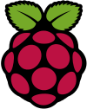
Raspbian Operating System

Slide 2
Raspbian
Raspbian is a Debian-based computer operating system for Raspberry Pi. Since 2015 till now it is officially provided by the Raspberry Pi Foundation as the primary operating system for the family of Raspberry Pi single-board computers.
Raspbian was created by Mike Thompson and Peter Green as an independent project.
The initial build was completed in June 2012.
The operating system is still under active development. Raspbian is highly optimized for the Raspberry Pi line's low-performance ARM CPUs.

Slide 3
Raspbian
Raspbian uses PIXEL, Pi Improved Xwindows Environment, Lightweight as its main desktop environment as of the latest update.
It is composed of a modified LXDE desktop environment and the Openbox stacking window manager with a new theme and few other changes.
The distribution is shipped with a copy of computer algebra program Mathematica and a version of Minecraft called Minecraft Pi as well as a lightweight version of Chromium as of the latest version.

Slide 4
Basic features
Developer
OS family
Raspberry Pi Foundation Unix-like
Source model
Latest release
Open source
Raspbian Jessie with PIXEL / 16.02.2017
Marketing target Raspberry Pi
Update method APT
Package manager dpkg
Platforms ARM
Kernel type Monolithic
Userland GNU
Default user interface PIXEL, LXDE
License Free and open-source software licenses (mainly GPL)
Official website https://www.raspberrypi.org/downloads/raspbian/

Slide 5
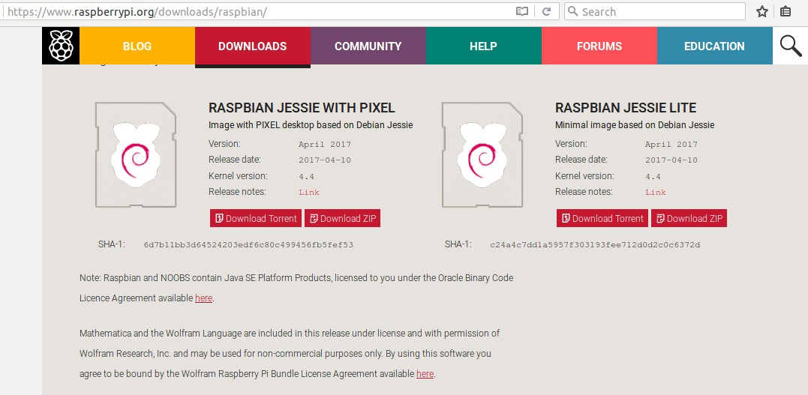
Downloads

Slide 6
How to write image?
Ubuntu
  Startup disk creator
    Default Application Available
Windows
  Win 32 Disk Imager
    Download from sourceforge.net

Slide 7
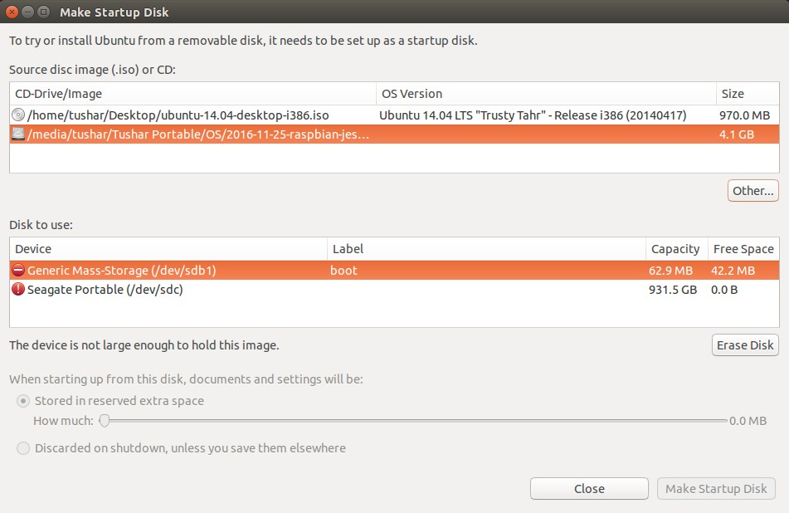
Startup Disk Creator

Slide 8
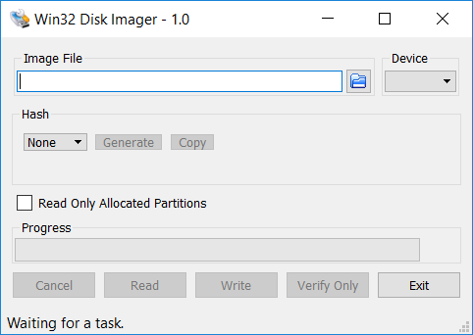
Win 32 Disk Imager

Slide 9
Finalization
Complete the disk image writing process.
Now insert the SD card in Raspberry Pi.
Plug-in the power supply to the kit.
Lets see the OS….

Slide 10
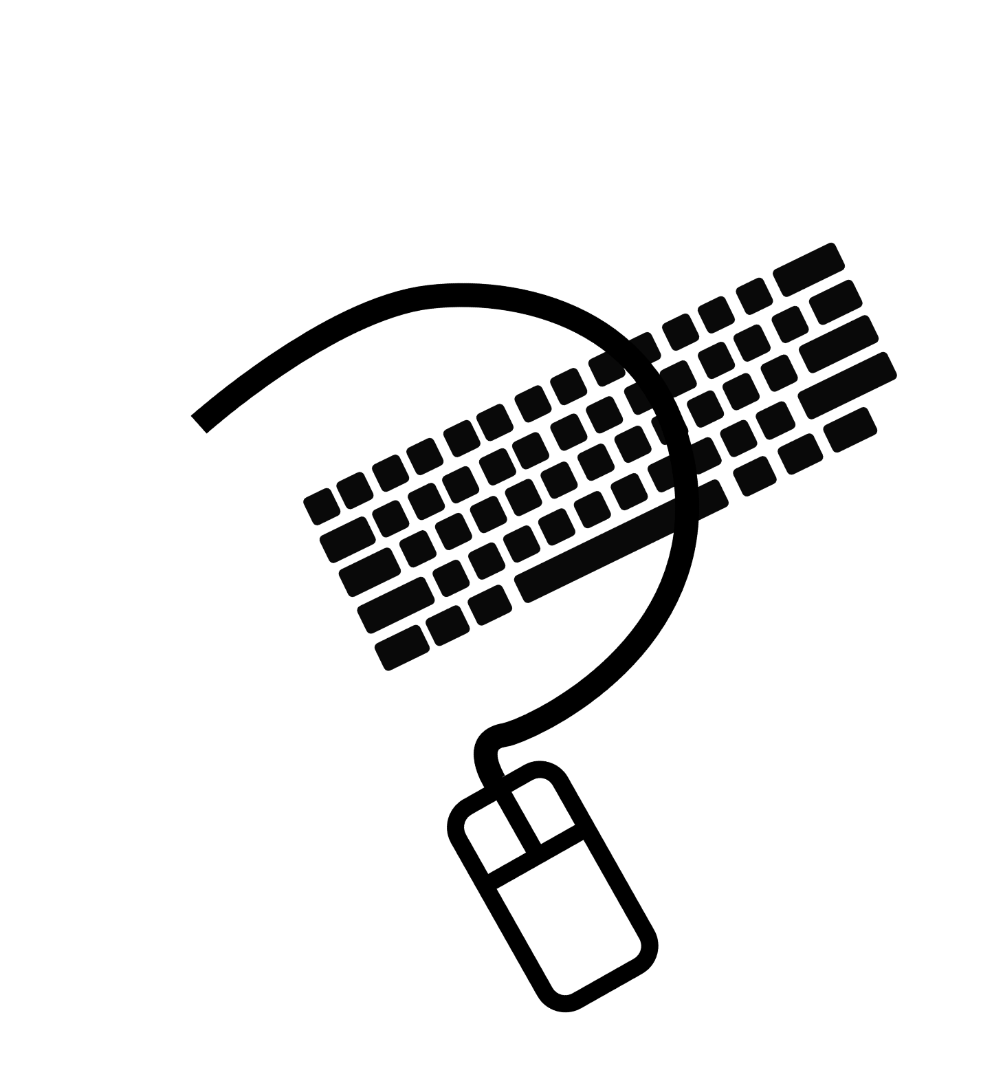
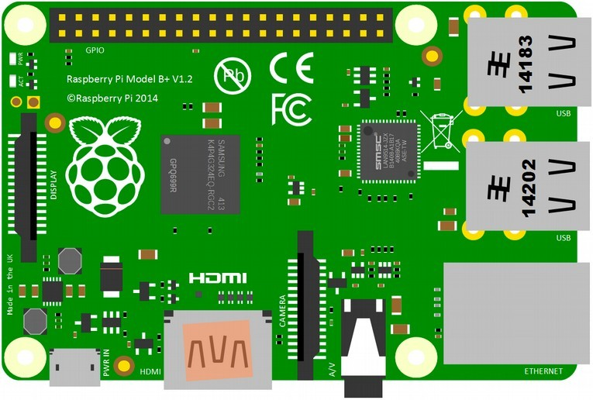

Starting Raspberry Pi
HDMI Cable

Slide 11
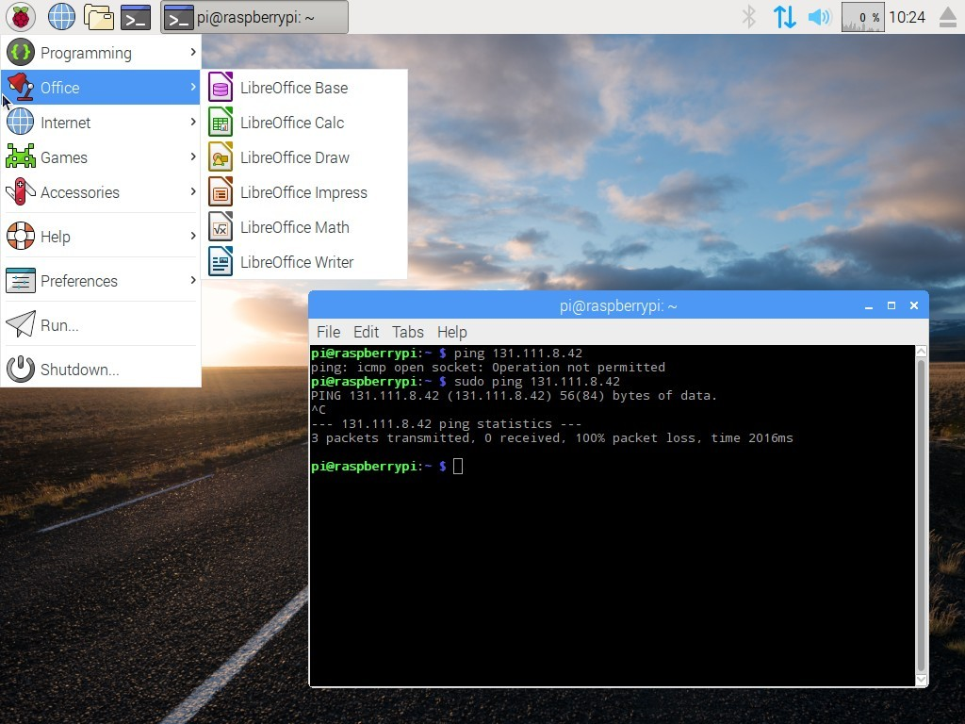
Raspbian Desktop

Slide 12
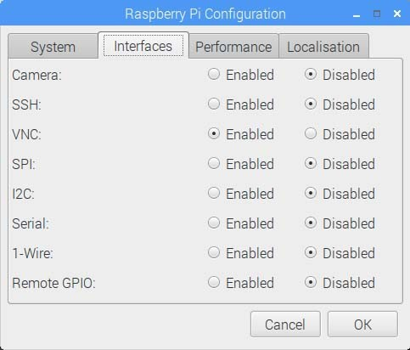
Raspbian Interfaces

Slide 13
Programming Languages
Python [Recommended for coding]
C
C++
Java
Scratch

Slide 14
Software Management on Pi
sudo apt-get update
sudo apt-get upgrade
sudo apt-get install <package>
sudo apt-get download <package>
sudo apt-get remove <package>
sudo apt-get purge <package>
sudo apt-get dist-upgrade

