Slide 1


FoodBridge
Get Started
Food Donation Marketplace
Connecting Food Donors and NGOs in One Place
A MERN-powered platform enabling restaurants, grocers, events, and households to list surplus food for NGOs to claim and distribute to those in need

Slide 2

FoodShare
Network
Explore Features
Key Features of
Food Donation
Marketplace
A MERN-based platform connecting food donors with NGOs — enabling seamless listing of excess food, real-time discovery, and coordinated pickup for those in need.
Food Listing System
NGO Claim & Pickup
Donors can quickly post excess food with details like quantity, type, expiry, and location so NGOs can discover and claim available items instantly.
Verified NGOs can browse listings, claim food parcels, and coordinate pickup schedules directly through the platform for efficient last-mile delivery.

Slide 3


Platform Features
A MERN-powered marketplace connecting food donors with NGOs — making excess food redistribution seamless, fast, and impactful.
Create Food Listings
Browse & Filter Donations
Donors can quickly list excess food with details like quantity, type, expiry, and pickup location in minutes
NGOs can search available donations by food type, location, and availability using smart real-time filters
NGO Matching System
Track & Manage Claims
Algorithm automatically matches food listings with nearby registered NGOs based on need and proximity
Monitor claim status, schedule pickups, and track distribution from donation to delivery in real time
Explore Features

Slide 4
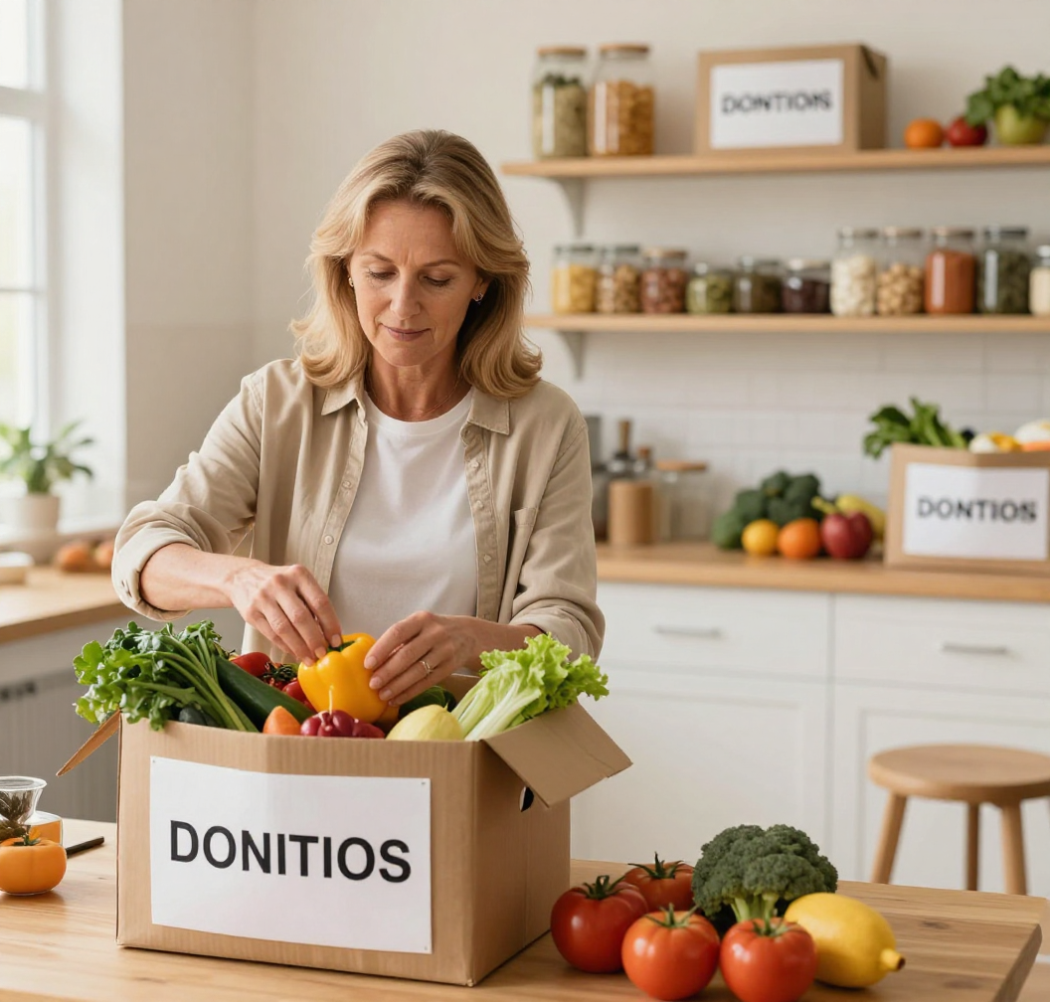
See More
Donation
Workflow
A seamless step-by-step process connecting food donors with NGOs to ensure excess food reaches those in need quickly and efficiently.
Donor Posts Food Details & Quantity
NGOs Discover Suitable Listings
NGO Submits a Claim Request
Donor & NGO Coordinate Pickup

Slide 5


See More
Tips for Donors
Listing food for NGOs is simple—provide safety details, set a pickup window, and track your donation's impact in real time.
Food Safety & Expiry Details
Location-Based Pickup Windows
Track Your Donation Impact
Always include expiry dates, storage conditions, and allergen info so NGOs can safely distribute food to those in need.
Set your location and available pickup times so nearby NGOs can schedule collection quickly and reduce food waste.
Get real-time status updates as your donation moves from listing to pickup to delivery, and see the lives your food has touched.

Slide 6



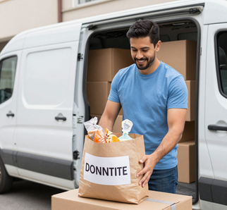
Learn More
Who Uses the Platform?
The MERN food donation marketplace connects multiple participants — each playing a vital role in reducing food waste and feeding communities in need.
Donors: Restaurants, Retailers & Households
Recipients: NGOs & Community Kitchens
Volunteers & Pickup Partners
Platform Administrators

Slide 7
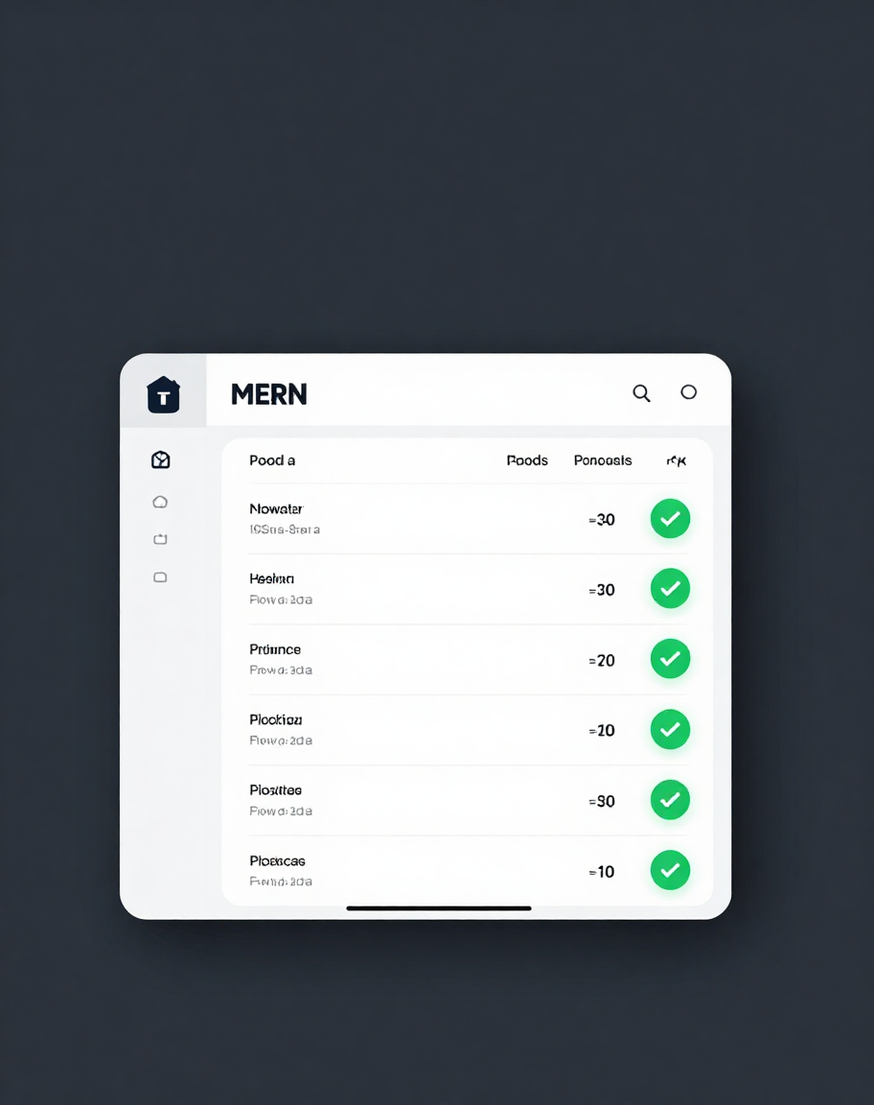
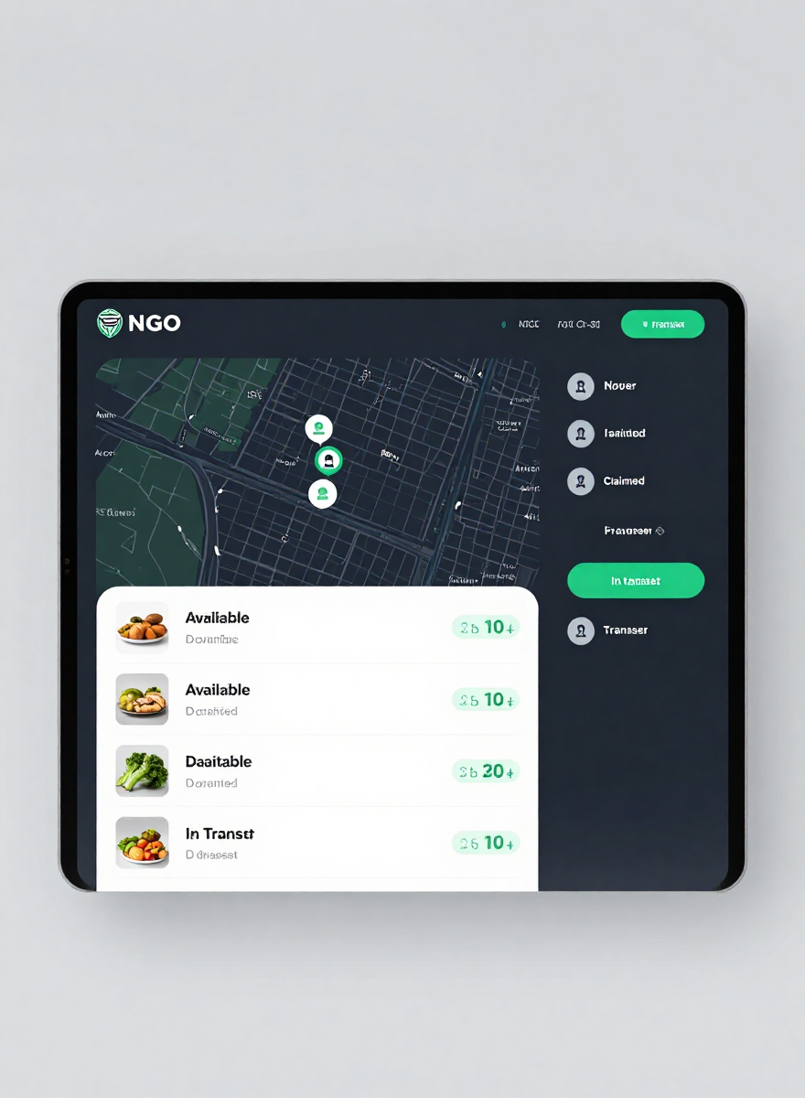
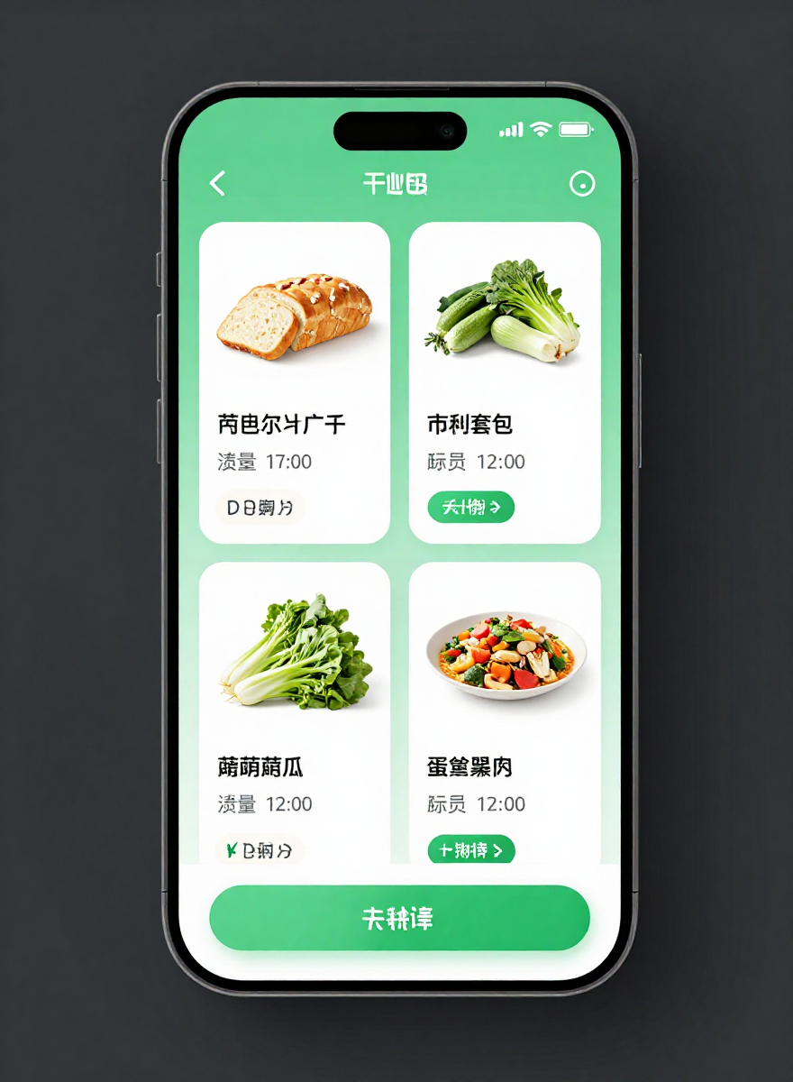
See More
Food Donation Marketplace in Action
Donors list surplus food in seconds — NGOs browse live inventory, claim donations, and coordinate pickups all within one seamless MERN-powered platform.
From donor listings and NGO discovery to pickup scheduling and delivery confirmation — every step is tracked in real time on a single shared dashboard.

Slide 8
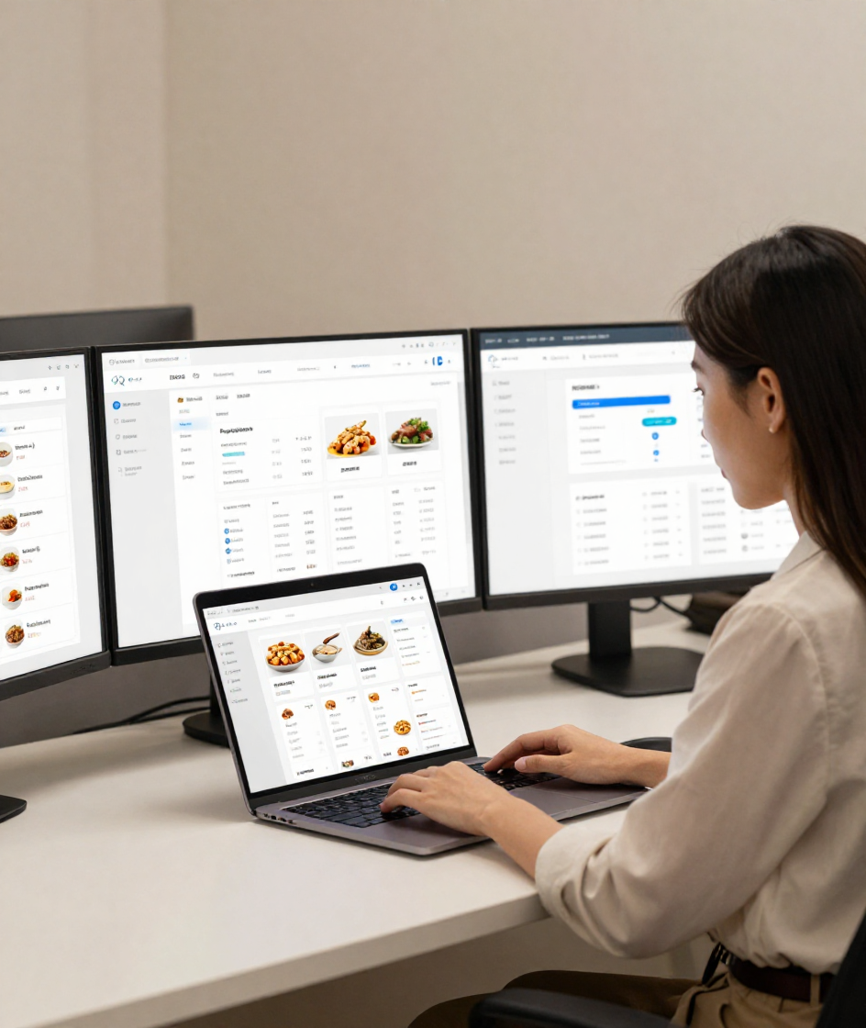


MERN Stack Technical Foundation
The platform is built on a robust MERN architecture — MongoDB stores all user profiles, food listings, NGO claims, and delivery records, while Express and Node.js power the backend APIs and core business logic.
MongoDB: Users, Listings, Claims & Delivery Records
Express & Node.js: REST APIs & Business Logic
React: Donor & NGO Dashboards

Slide 9

FoodBridge
Get Started
Join Us Today!
Partner with us to reduce food waste, support NGOs, and expand local food access in your community.
+1-800-FOODAID
www.foodbridge.org
partner@foodbridge.org

