Slide 1

Project Udyam Digital
Business case · Track A
Digital acquisition and onboarding for small businesses
Working prototype: advisor → quote → Smart KYC → tracker

Slide 2

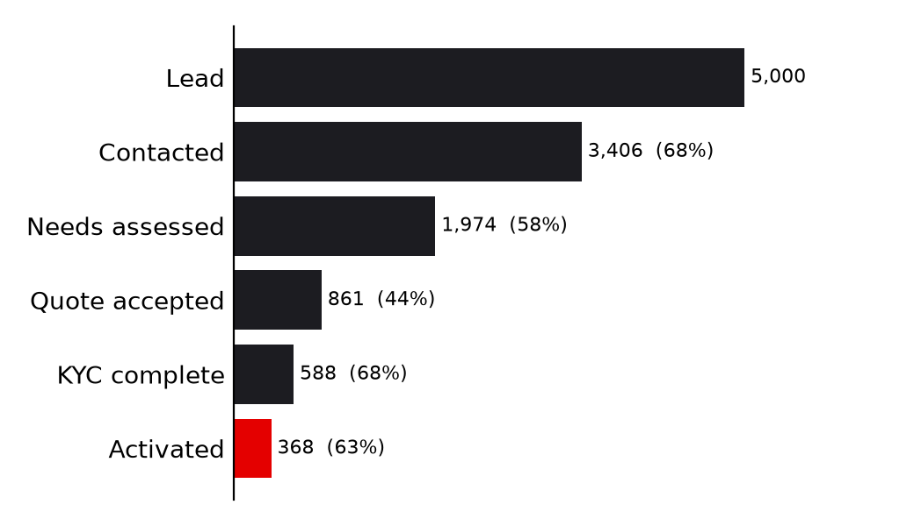
Who we serve and where the journey leaks
6 crore+ MSMEs buy telecom one product at a time through a field force built for large accounts
7.4%
of leads reach activation
17.6 days
lead to activation, 3 status-chase calls each
₹15,053
acquisition cost per activated SMB
9.6% vs 2.0%
activation with vs without a GSTIN
Apr-Jun 2026, 5,000 SMB leads (supplied dataset). Steepest drop: needs assessed → quote accepted (44%).
Target customer: owner-run businesses with 1-150 staff in tier 1-2 cities that need connectivity plus a few digital services on one bill.

Slide 3
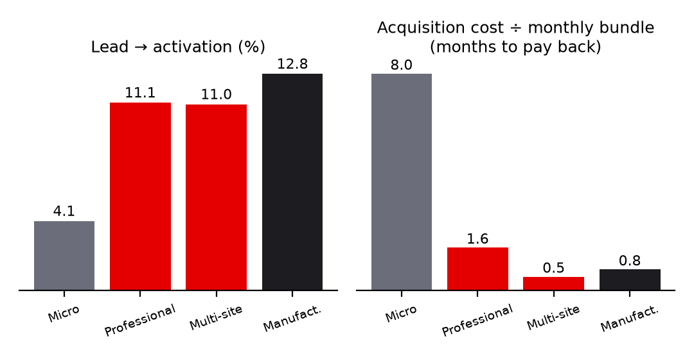
Prioritise professional offices and multi-site businesses first
Where an acquisition rupee earns the most, from 5,000 real lead outcomes
Segment | Share | Conv. | Bundle/mo | Churn 6m
Micro retail | 54% | 4.1% | ₹2,505 | 23%
Professional | 25% | 11.1% | ₹6,796 | 14%
Multi-site | 15% | 11.0% | ₹31,233 | 11%
Manufacturers | 6% | 12.8% | ₹19,980 | 8%
• Wave 1 - Professional offices + multi-site (40% of leads): 11% conversion, payback in 0.5-1.6 months of bundle revenue, churn 11-14%.
• Wave 2 - Manufacturers: highest conversion (12.8%) and lowest churn (8%), small base; needs site surveys, so field-assisted.
• Wave 3 - Micro retail (54% of leads): 4% conversion, ₹2.5k bundles, 23% churn and ~8 months payback today; win with a self-serve starter bundle and referrals, not visits.

Slide 4
What each segment gets: bundle, price point, contract
Produced by the product's own recommender and pricing engine for a typical Pune business (tier 1, prices before GST)
Segment (example) | Recommended bundle | ₹/month | Setup | Contract
Micro retail & services Kirana, 3 staff | Fibre 100, Postpaid 299 ×2 | ₹1,917 (₹1,837 at 24m) | ₹0 | 12 mo (24 cheaper)
Professional offices Dental clinic, 14 staff | Fibre 300, Postpaid 299 ×6, Cloud Email & Office Suite ×14, Endpoint Security ×14, Cloud Backup 1 TB | ₹7,765 (₹7,335 at 24m) | ₹0 | 12 mo (24 cheaper)
Small multi-site businesses Restaurants, 5 sites | Fibre 100 ×5, Postpaid 599 ×5, Backup 4G/5G Failover ×5, Managed SD-WAN ×5, Cloud POS & Billing ×5, Cloud CCTV ×20 | ₹31,960 | ₹81,000 | 24 mo (24 cheaper)
Small manufacturers Textile unit, 85 staff | Internet Leased Line 100, Postpaid 599, Backup 4G/5G Failover, Cloud Email & Office Suite ×85, Endpoint Security ×50 | ₹45,783 | ₹16,500 | 24 mo (24 cheaper)
Pricing rule: the catalogue gives a min-max range per product; longer terms, higher quantities and bigger bundles move the price toward the floor. GST (18%, an assumption - not in the catalogue) is added on top and shown upfront. GSTIN-only products (10 of 25) appear once an active GSTIN is verified.

Slide 5
The journey: five steps, each aimed at a measured drop-off
Working prototype - every step below runs end to end
1 Onboard
2 Advise
3 Quote
4 Smart KYC
5 Track
1 minute. GSTIN checked instantly against the registry.
Chat or voice in 10 languages; only the questions that matter; reasons for every product.
Live price with GST, toggles, 12/24 months, dependency fixes.
Consent, OCR, GSTIN + Udyam lookup, name/address match, exact fix list.
Pay, book slot, live status; no calls.
Drop: unreachable (805), no time for a visit (531)
Drop: not interested, only wanted mobile (280)
Drop: price (414), too complex (206), too slow (179)
Drop: missing doc (94), mismatch (47), paperwork (79)
Drop: install delay (98), payment failed (28)
• LLM interprets and explains; code decides. Eligibility, dependencies, prices and KYC verdicts are deterministic and unit-tested; a guard discards any AI reply containing a price or product the engine did not produce.
• Back-office: funnel, segment and source analytics, a propensity-ranked call list of advisor journeys that did not close, and a KYC queue for human review of borderline cases.

Slide 6
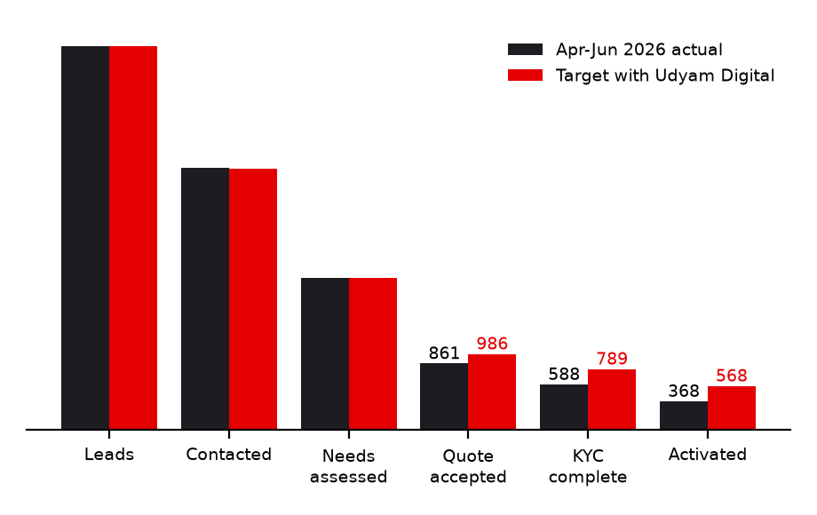
Value: more activations from the same acquisition spend
Target scenario - conversion improvements per stage are assumptions tied to the drop reasons they remove
Stage targets (now → target)
• Needs assessed → quote accepted: 44% → 50% (instant, plain-language, budget-fit quotes address 799 of 1,113 drops)
• Quote → KYC complete: 68% → 80% (instant checks tell the owner exactly what to fix)
• KYC → activated: 63% → 72% (slot booking, 5G fallback, live tracker)
• Result: 368 → ~568 activations per 5,000 leads (+200, 54%), lead→activation 7.4% → 11.4%.
• Same spend (₹55.4 lakh) → ~₹9,754 per activation vs ₹15,053.
• Each extra cohort of ~200 customers adds ~₹24.7 lakh monthly recurring revenue at today's mean bundle.
• Customer value: one bill and one tracker instead of 3-5 vendors; a quote in minutes, not 3-5 days.

Slide 7
Five metrics that matter, with targets
Baseline = Apr-Jun 2026 dataset; targets are for the 12-month rollout
Metric | Baseline | Target | How it moves
Lead → activation conversion | 7.4% | ≥ 11% | Quote, KYC and install stage gains (previous slide)
Time to activate (fibre / wireless bundles) | 17.6 days | ≤ 7 days | Same-day quote + KYC; install per catalogue (1-7 days)
Customer status-chase calls | 3.0 per customer | ≤ 1 | Live tracker, proactive step-by-step status
Acquisition cost per activation | ₹15,053 | ≤ ₹9,000 | More activations per spend; shift to referral/inbound/digital (₹4-6k) from field (₹24k)
6-month churn | 15.2% | ≤ 12% | Right-sized bundles; micro segment churn (23%) is the lever
Guardrails: KYC first-pass rate ≥ 75% with zero wrongful auto-approvals (review queue sampled weekly) · NPS ≥ 7.5 (baseline 6.9) · advisor-to-quote ≥ 50% · share of quotes with a GSTIN ≥ 70%.

Slide 8
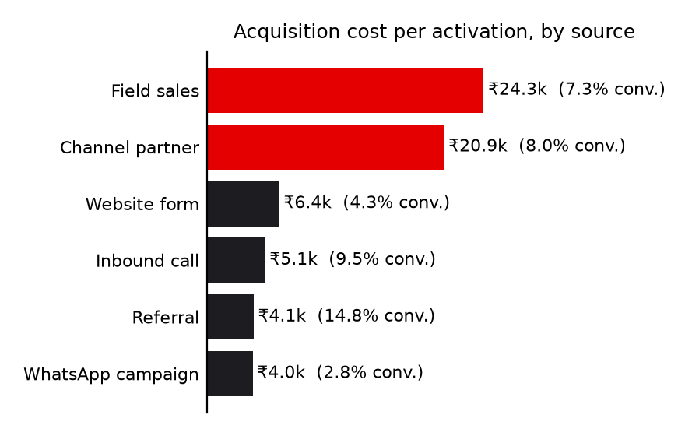
Field force and partners: the digital journey adds to them
Cost per activation today: field sales ₹24k, channel partners ₹21k vs referral ₹4k, website ₹6k
Division of labour
• Digital first for micro and professional offices: advisor, quote, KYC and tracker run without a visit.
• Field force moves up-market: multi-site and manufacturers (avg bundle ₹20-31k/mo) where site surveys, SD-WAN and leased lines need a person. They open the same advisor in 'sell with me' mode - one journey, one quote.
• Partners: assisted KYC (scan documents for the owner), installation and local-language support; paid on activation of orders they initiate, so digital never cannibalises them.
• Call list: advisor journeys that stalled are ranked by propensity (AUC 0.68) and routed to the nearest field/partner owner - a lead the advisor could not close becomes a warm visit.
• Referrals (14.8% conversion) get a share link and a prefilled advisor session.

Slide 9
Rollout and risks
Pilot where the data says we win, then widen
Rollout
• Weeks 0-8, pilot: two cities (one tier 1, one tier 2), professional offices + multi-site, assisted by field staff; weekly KYC-review sampling.
• Months 3-6: all tier 1-2 cities; manufacturers with field-assisted surveys; DigiLocker + e-sign; WhatsApp front end; native-speaker review of the 10 languages.
• Months 6-12: micro self-serve starter bundle through referral and WhatsApp; partner portal; live payment gateway, refunds and recurring billing.
• Prototype status: payments on a sandbox gateway (Razorpay adapter not run live), PostgreSQL and Claude provider not exercised, translations machine-made, KYC tuned on 47 synthetic specimens.
Risk | Mitigation
OCR on real phone photos is worse than clean specimens | Quality gate (blur, tilt), re-upload guidance, human review queue, measure first-pass rate
LLM invents price/product | Engine owns all facts; grounding guard; offline fallback
DPDP non-compliance | Consent screen, minimisation, 30-day purge, erasure, masking, encryption
Install capacity slows activation | Slots from catalogue lead times; 5G fallback; admin visibility
Channel conflict | Assisted-order attribution; field focus on high-value accounts
Price leakage / assumptions (GST, price position) | Config-driven rules; finance sign-off before launch

Slide 10
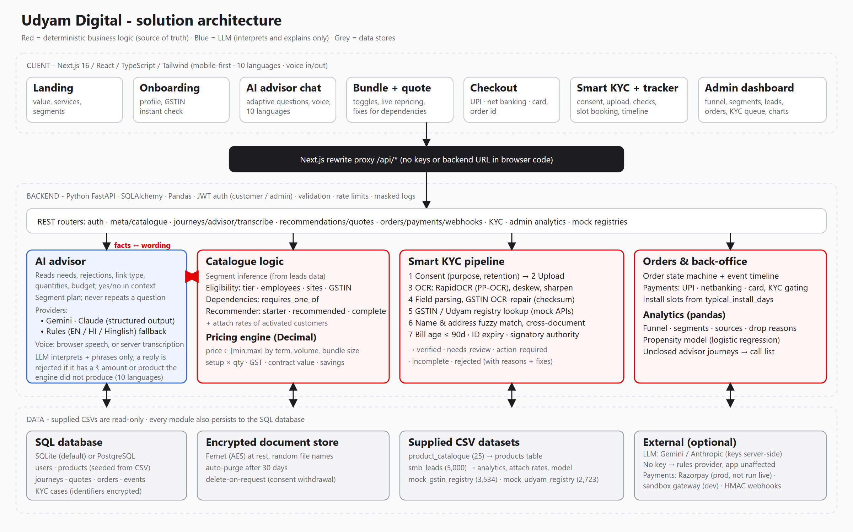
Architecture, privacy and what is built
Next.js + FastAPI + SQL; deterministic core; LLM at the edges; documents never leave the server
Built and tested
• Advisor (chat + voice, 10 languages), bundle, quote, checkout (UPI/net banking/card), KYC, tracker, admin; 190+ automated tests; desktop and phone browser journeys.
Privacy by design
• Consent first · only 4 documents · masked identifiers · encrypted at rest · auto-delete in 30 days · erase on request.
Roadmap
• DigiLocker, e-sign, WhatsApp, live payments + refunds, native-reviewed translations, partner portal.

