Slide 1
YASHASVI’s_BOT
AI Chatbot using Gemini 2.0, AWS EC2, and PostgreSQL

Slide 2
Project Overview
• Chatbot powered by Google's Gemini 2.0 model
• UI built with Streamlit
• PostgreSQL Database on AWS RDS
• Hosted on AWS EC2 Instance
• Logs and manages queries/responses

Slide 3
Tech Stack
Frontend: Streamlit
AI Model: Gemini 2.0 Flash
Database: PostgreSQL (AWS RDS)
Deployment: AWS EC2
Tools: Python, .env, psycopg2, streamlit

Slide 4
Architecture Overview
1. User interacts via Streamlit UI
2. Query sent to Gemini API
3. Bot response displayed and logged
4. Data stored in AWS RDS PostgreSQL
5. App deployed on AWS EC2

Slide 5
Code Highlights
• load_dotenv(): Loads config from .env file
• genai.GenerativeModel(): Calls Gemini API
• psycopg2: Connects to PostgreSQL
• log_query(): Inserts data to DB
• create_table(): Initializes query_logs table

Slide 6
Database Schema
Table: query_logs
id SERIAL PRIMARY KEY
user_input TEXT
bot_response TEXT

Slide 7
User Flow
1. User types input on UI
2. Gemini generates response
3. Bot displays the reply
4. Both query & reply saved to DB

Slide 8
Deployment on AWS
• EC2 instance runs Python/Streamlit app
• RDS provides managed PostgreSQL DB
• Environment variables in .env
• Secure and scalable setup

Slide 9
Challenges Faced
• Handling environment variables securely
• EC2 firewall and port access setup
• psycopg2 connection issues
• Model latency on large queries

Slide 10
Future Scope
• Add authentication system
• Build analytics dashboard for logs
• Support chat history
• Allow switching between AI models

Slide 11
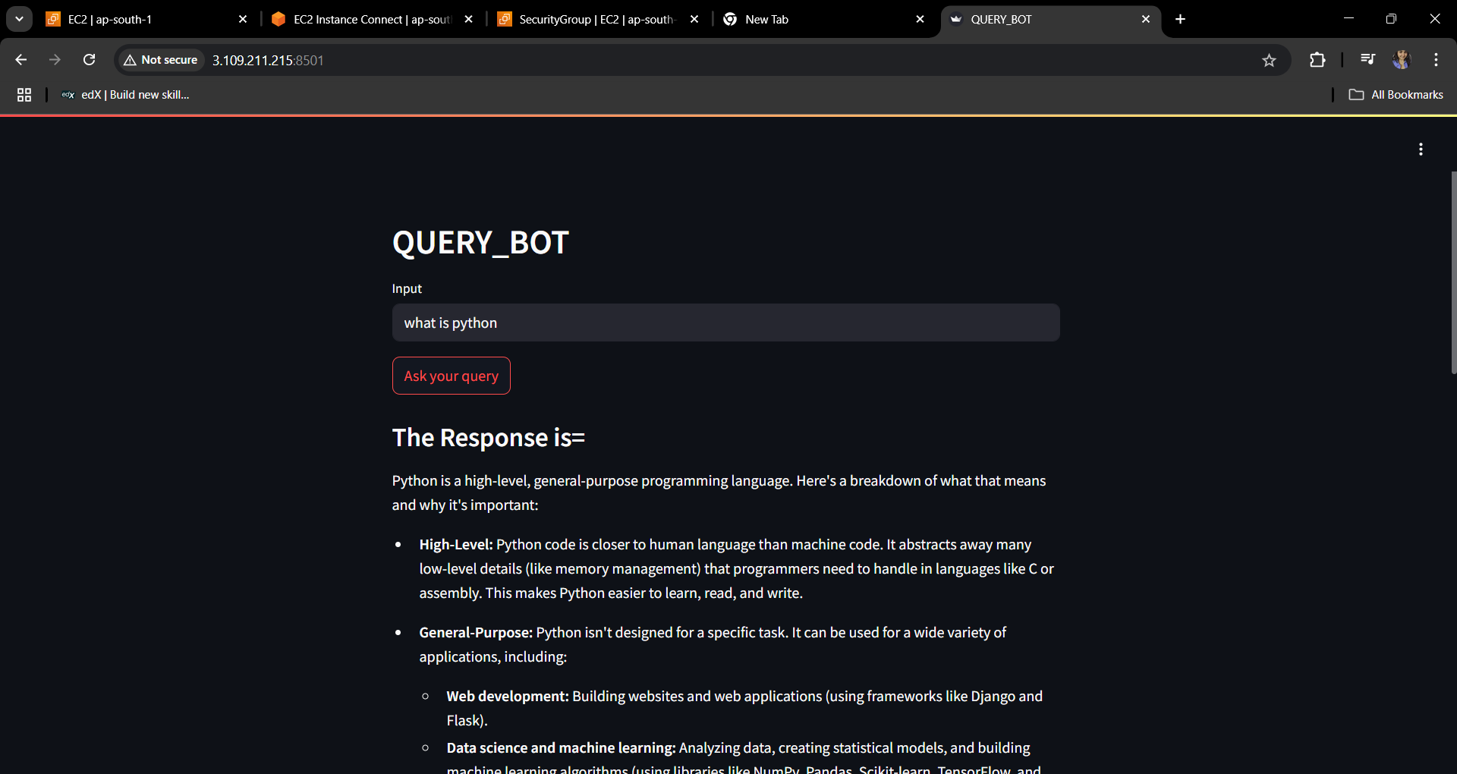
Demo & UI Screenshot
• Chat interface built on Streamlit
• Query → Gemini API → Response
• Screenshot:

Slide 12
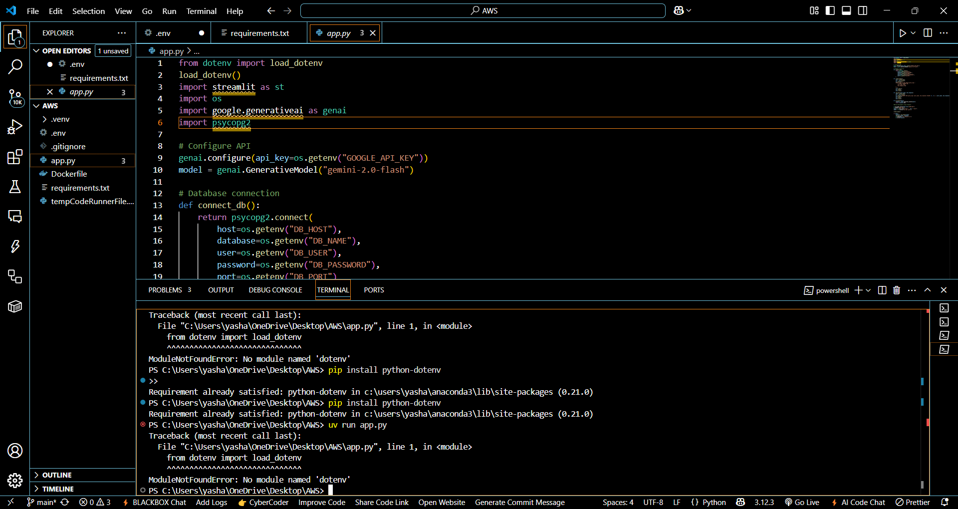
Some screenshots :

Slide 13
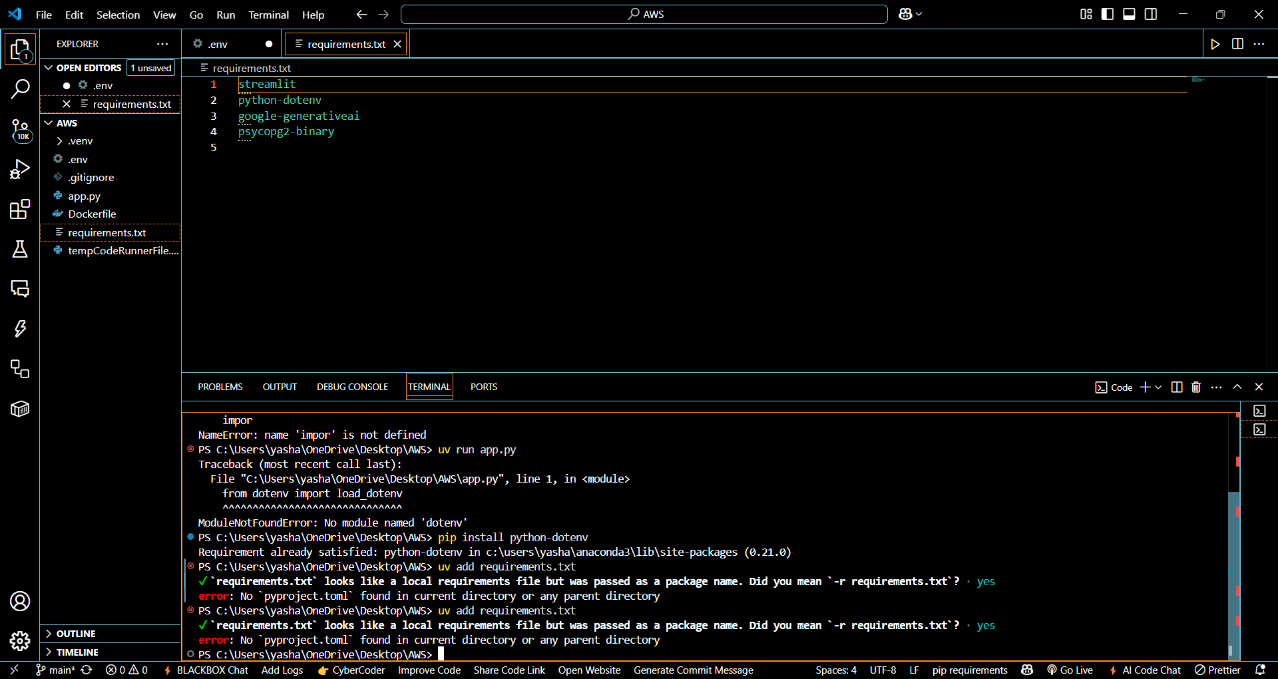
2.

Slide 14
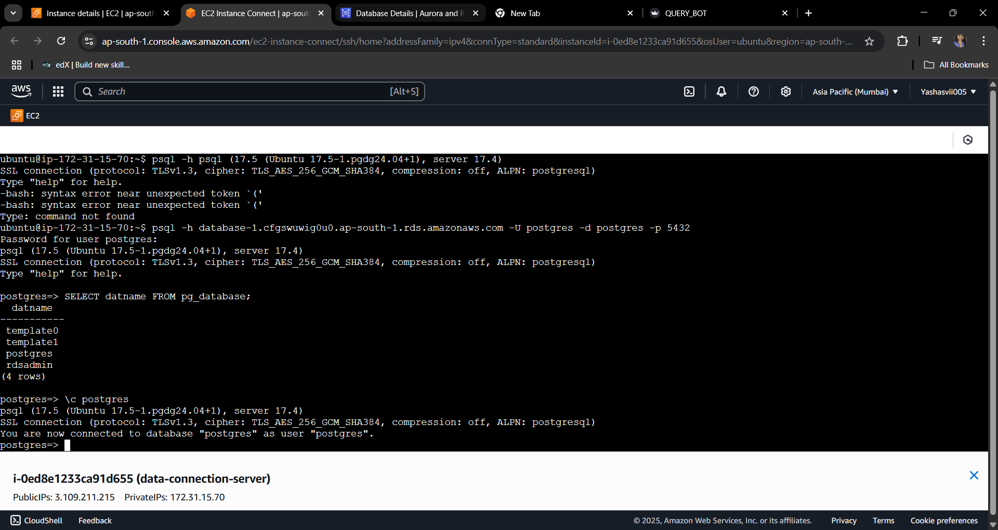
3.

Slide 15
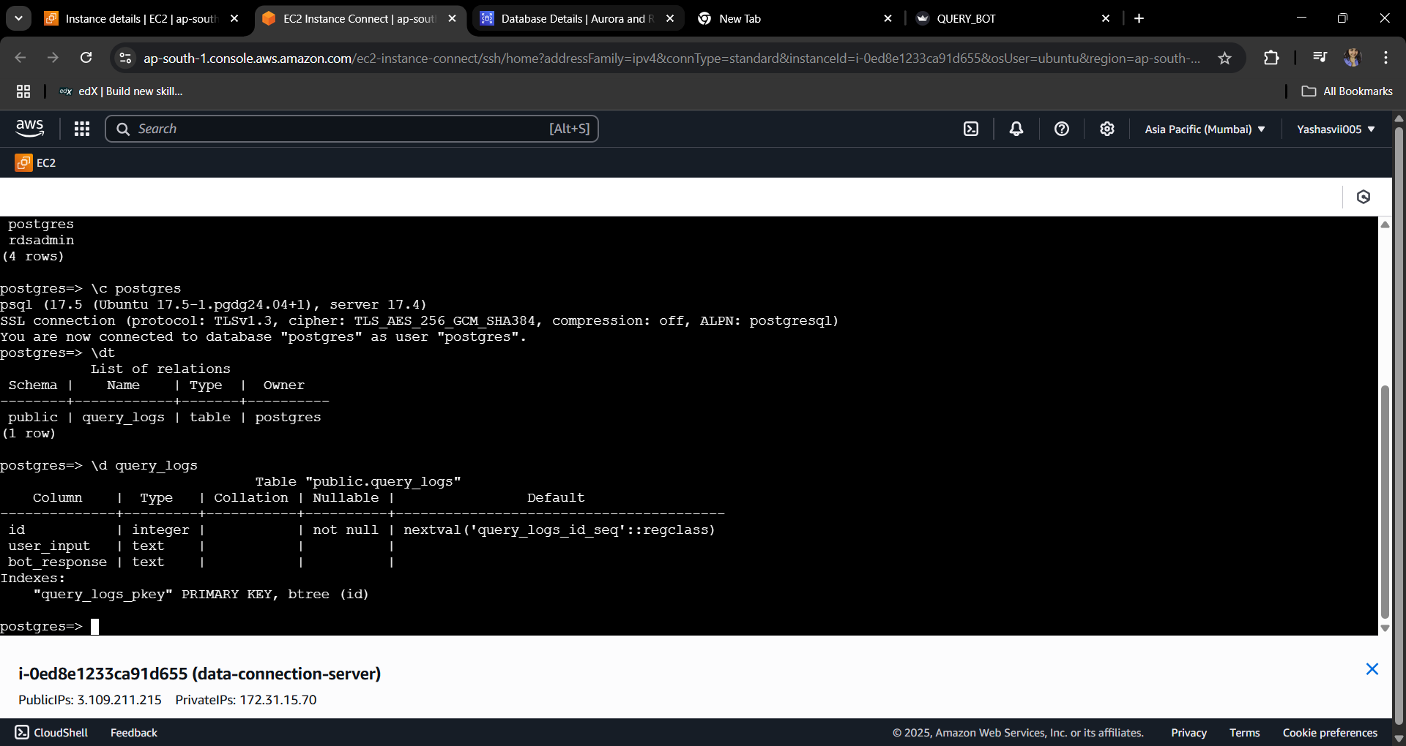
4.

Slide 16
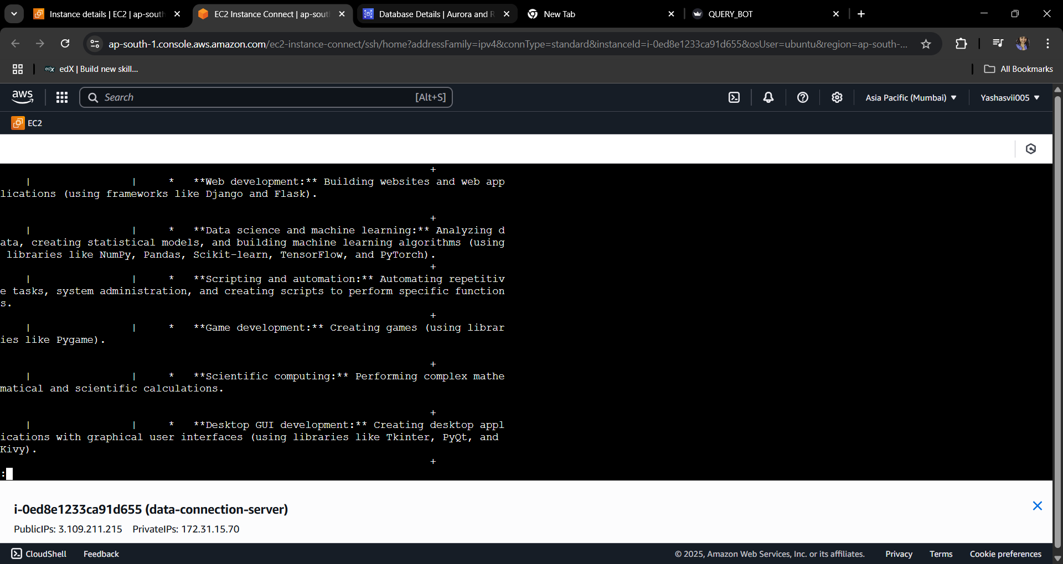
4.

Slide 17
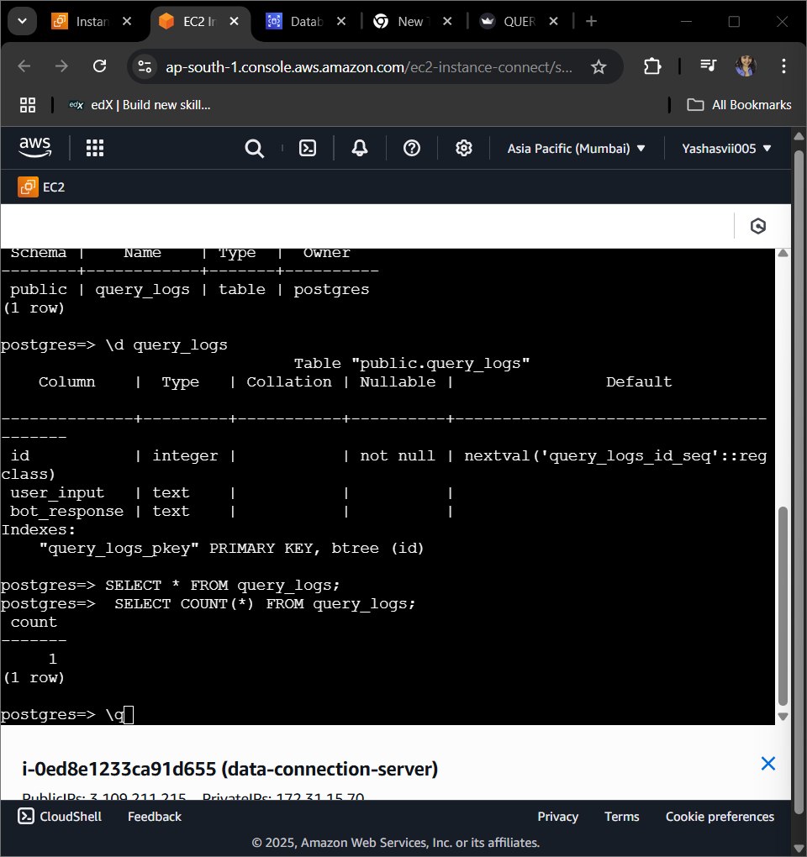
5.

Slide 18
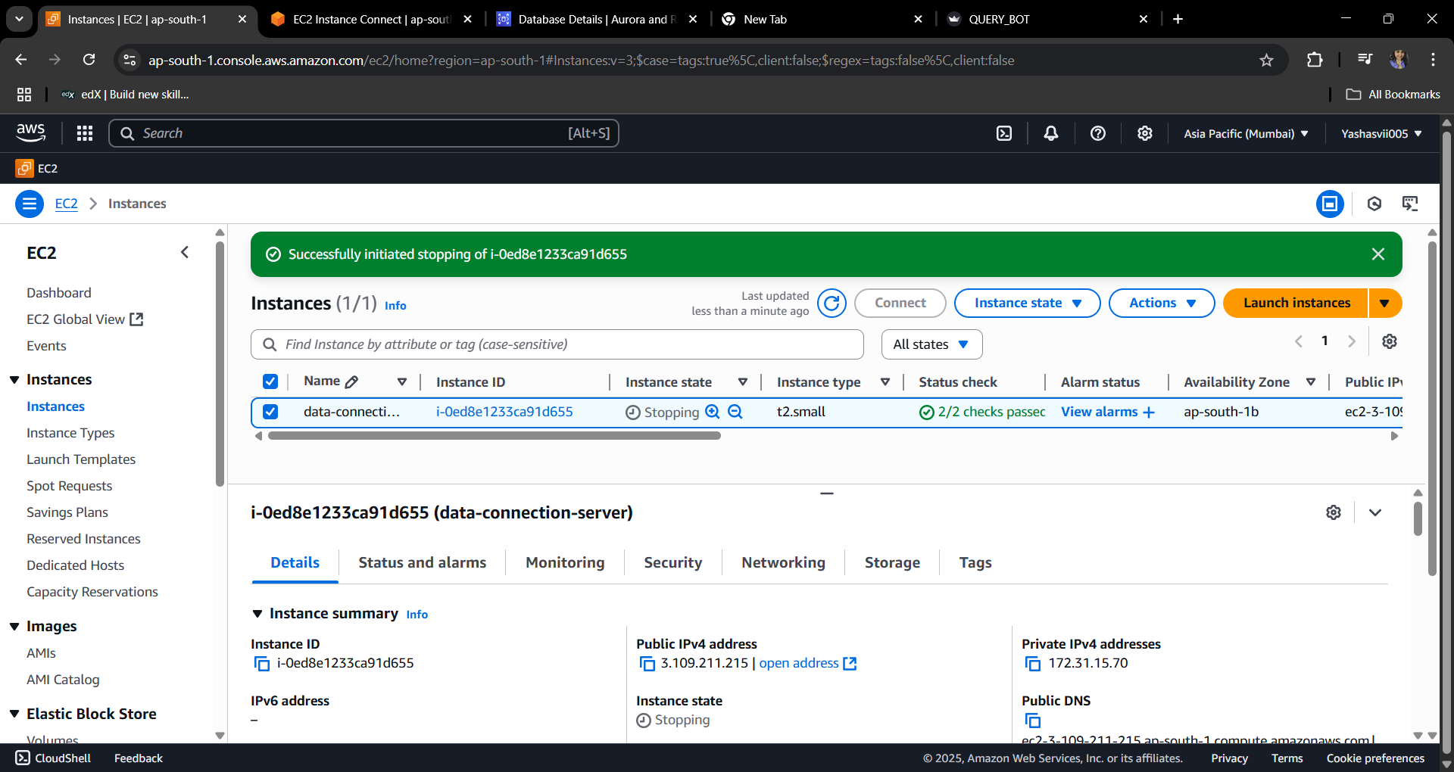
6.

Slide 19
7.

Slide 20
Thank You
Project By: Yashasvi
Contact: yashasviparihar1239@gmail.com
Q&A Welcome!

