Slide 1

Word Quest
Multiplayer Crossword Game
-By Team 6

Slide 2
TEAM
1. Aditya Singh - 21CS8149 2. Abhishek Arya - 21CS8150 3. Shashwat Choudhari - 21CS8151 4. Hritik Kumar - 21CS8152 5. Rashmi Gupta - 21CS8153 6. Shrabanti Mazumdar - 21CS8154 7. Sai Yoshitha Pasagadugula - 21CS8155 8. Challa Venkata Yashaswi - 21CS8156 9. Akash Kumar Singh - 21CS8157

Slide 3

Description
This is a multi player crossword puzzle game for four players. Players take turns answering the hints given and placing corresponding words on the grid. Players earn points for correct word, with different point values based on the question's difficulty level. The player with the highest score wins.
We will use the concepts of OOPs for structuring the game components like crossword grid, hints, etc. Multi threading concept is employed for concurrent player interactions, ensuring an engaging and responsive gaming experience.

Slide 4
SCHEMATIC OVERVIEW OF THE SYSTEM
Login
Rules
Select
Select
Verify
Winner
Question
Board

Slide 5
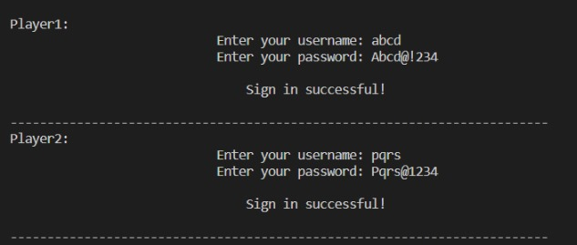
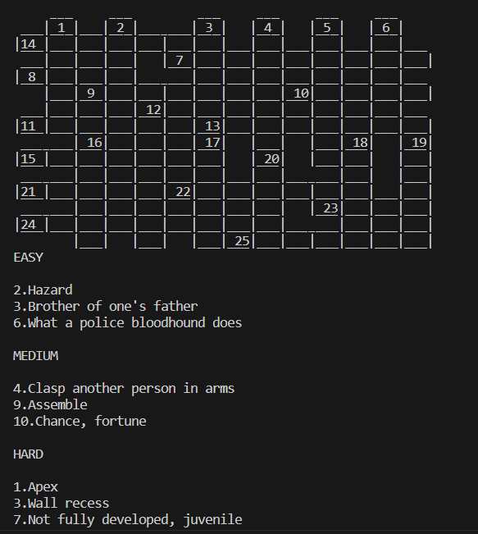
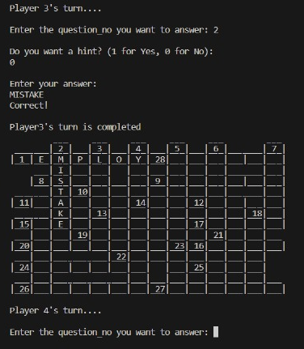
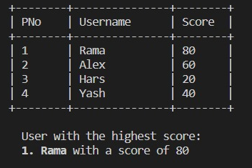
TEXT-BASED INTERFACE

Slide 6
DESIGN PLAN
Board
Type: class
Login
Game
Protocols
Player
Class Members
String: Crossword Q&As
String: Hints
Int: Points
Pair: Answer Co-ordinates
New Player
Void: signUp()
ADD
String: Username
String: Password
Variables:
String: Player ID
Int: Score
Int: Rank
Functions:
Player: findPlayer
Int: chooseQue
Void: checkQue
Void: getHint
Int: findPoints
Void: updatePScore
Void: printScores
Int: Detect No.of hints taken
Void: Reduce points
String:
Display answer
(if no one answered it correctly)
Functions:
Void: updateInfo
Void: removeUser
Old Player
Void: signIn()
VERIFY
String: Username
String: Password
Class Functions
Void: Initialize
Void: Display
Void: updateBoard
Void: Hints

Slide 7

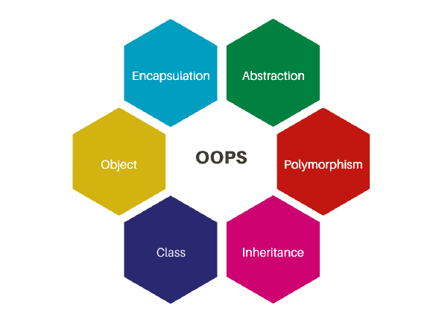


FEATURES IN DIFFERENT MODULES
FILE HANDLING TECHNIQUES
Used for storing the login details & player within a CSV file, and for required updates when necessary.
OOPS
We have designed objects to manage multiple players and game boards, utilizing identical functions while incorporating distinct data members specific to each.
RESOURCE SHARING
All players navigate a shared game board, fostering collaboration, while unique abilities or resources provide individualized strategy.
MULTITHREADING
Used to facilitate the seamless participation of up to four different players, allowing them to take turns and engage with the game in a collaborative manner.

Slide 8



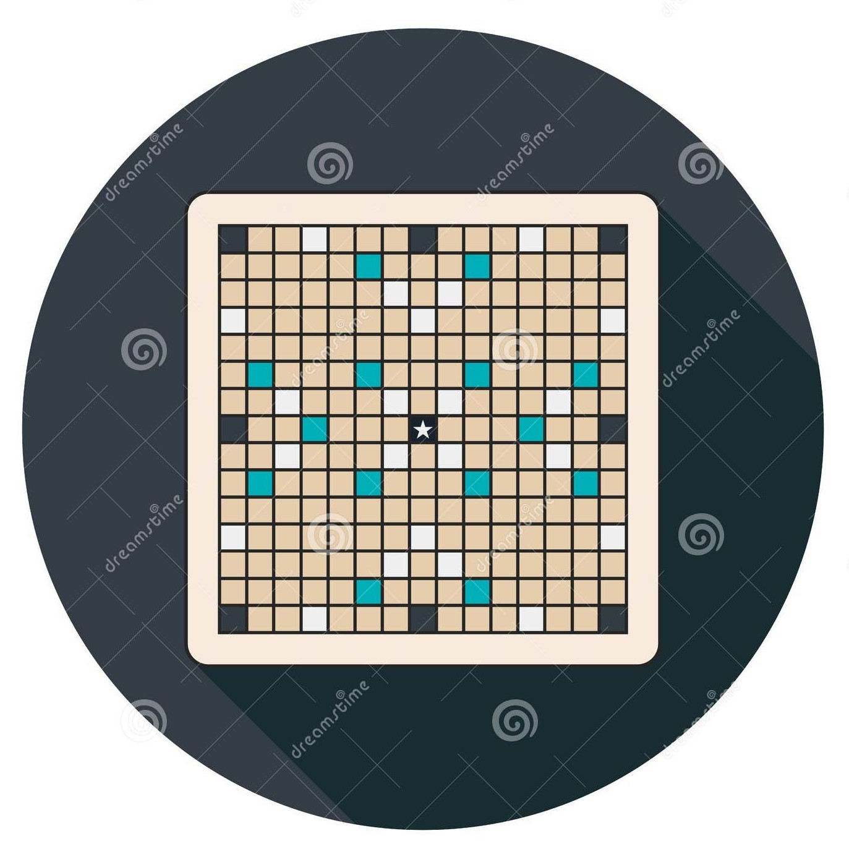

APPLICATION LEVEL FEATURES
USER AUTHENTICATION
We can verify the identity of an individual accessing a application by using credentials, such as usernames and passwords, to ensure secure and authorized access.
SECURITY
Users cannot alter each other's credentials or manipulate scores, Ensuring a secure and fair environment within the system.
SELECTION
Users have the flexibility to choose any question, opt for hints, and decide whether to attempt the same question again.
MULTIPLE BOARDS
Users can choose from a variety of boards offering players a variety of challenges and fun experiences.
TIMERS
Timers in games add pressure by setting time limits, making the gameplay more exciting and fast-paced.

Slide 9



FUTURE GOALS
Formation of Teams
Instead of engaging in one-on-one interactions, we will have the option to assemble teams and participate in competitive activities against other teams.
In-game Chat
In the future, we will add an in-game chat feature that allows players to communicate with each other through text messages while playing.
User friendly Interface
We will implement a user-friendly interface using web technologies to enhance the overall user experience.

Slide 10
TIMELINE
Initial game planning
Assignment of roles
Initial PPT completion
7 Oct–12 Oct
Coding
1. User Interface
2. Game functions &
protocols
15 Oct – 27 Oct
Merging both user interface with game functions & protocols
28 Oct – 5 Nov
29 Nov – 7 Dec
Final testing and corrections
Final PPT completion

Slide 11



TEAM ROLES
GAME DESIGN
& DATA COLLECTION
Aditya
Abhishek
Shashwat
Hritik Kumar
Rashmi
Shrabanti
Yoshitha
Yashaswi
PREPARING PPT
Aditya
Rashmi
Yoshitha
Yashaswi
Akash Kumar
PROGRAMMING
Yashaswi
Yoshitha
UI DESIGN
Shashwat
Hritik Kumar
Shrabanti
Yoshitha
Yashaswi
Akash Kumar

Slide 12
THANK YOU.

