Slide 1
Health Care Insurance Fraud Detection Using Blockchain
Project Advisor: Professor Gokay Saldamli
Team Members: Krishna Sai Siva Bojja
Manjunatha Koni Gururaja
Vamshi Reddy Verama Reddy
Yashaswi Doddaveerappa
Notes:
1

Slide 2
Project Description
Frauds scenarios listed by NHCAA
Theft of Patients Finite Health Insurance Benefits
Usage of multiple insurance to have additional profit.
Notes:
2

Slide 3
Project Requirements
User interface to upload and check the status of application
EDI validators to check HIPPA validations
Etherium for Security measure
Blockchain decentralized distributed system

Slide 4
Project Justification
Central authority over database containing healthcare data can be a major security threat.
Blockchain offers decentralized distributed paradigm making transactions and storing more secure.
Medical records are visible to only the parties involved in the chain.

Slide 5
Baseline Approaches
Rules imposed by HIPAA in order to have data privacy for defending medical information.
Hyperledger composer that can store data in distributed ledger. It also supports multi-layer permission model to provide better control for user on deciding who can access data.

Slide 6
Functional Requirements
Web Application.
Mobile Application
HIPAA EDI Validation

Slide 7
Non Functional Requirements
The system should ensure data integrity.
The system is available to all users and is reliable.
The system should respond within 1 second.
The system must ensure security.

Slide 8
Dependencies
From security point of view, we have to make sure only the authorized users have access to the block chain.
Applying private security access for the application.

Slide 9
Deliverables
Web and mobile based User Interface to access the application.
Validation of the health care records by using HIPAA validation.
Private Security for the application and block chain nodes.

Slide 10
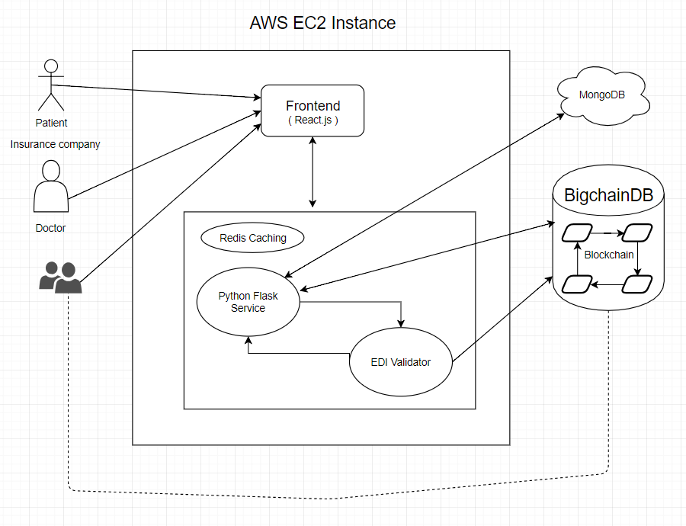
PROJECT ARCHITECTURE

Slide 11
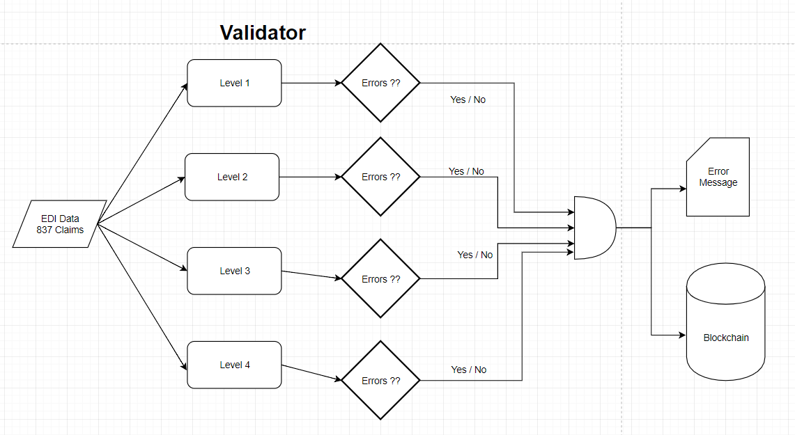

Slide 12
Implementation plan
Setup environment for Development and Block chain.
Design and Develop mobile application.
Implement Backend Server using Python Flask.
Develop Prototypes of security for data.
Design and Implement HIPAA Validator in Python

Slide 13
Exploring Block chain algorithms and the various Toolchain.
Implementing HIPAA for small records.
Setting up the environment.

Slide 14
THANK YOU

