Slide 1
Health Care Insurance Fraud Detection Using Blockchain
Project Advisor: Professor Gokay Saldamli
Team Members: Krishna Sai Siva Bojja
Manjunatha Koni Gururaja
Vamshi Reddy Verama Reddy
Yashaswi Doddaveerappa
Notes:
1

Slide 2
Introduction
Frauds scenarios listed by NHCAA
Theft of Patients Finite Health Insurance Benefits
Usage of multiple insurance to have additional profit.
Notes:
2

Slide 3
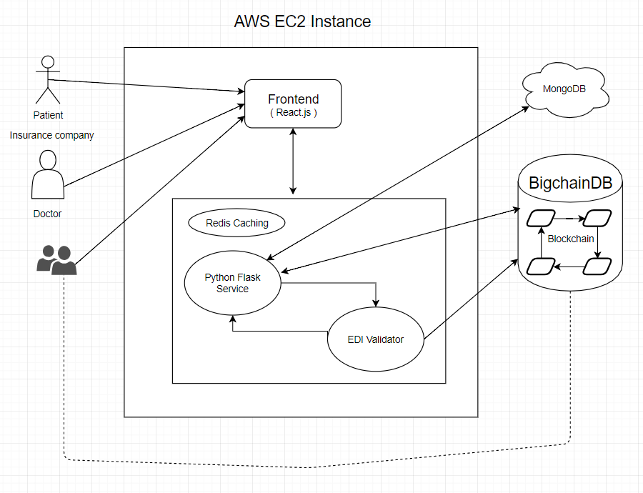
PROJECT ARCHITECTURE

Slide 4
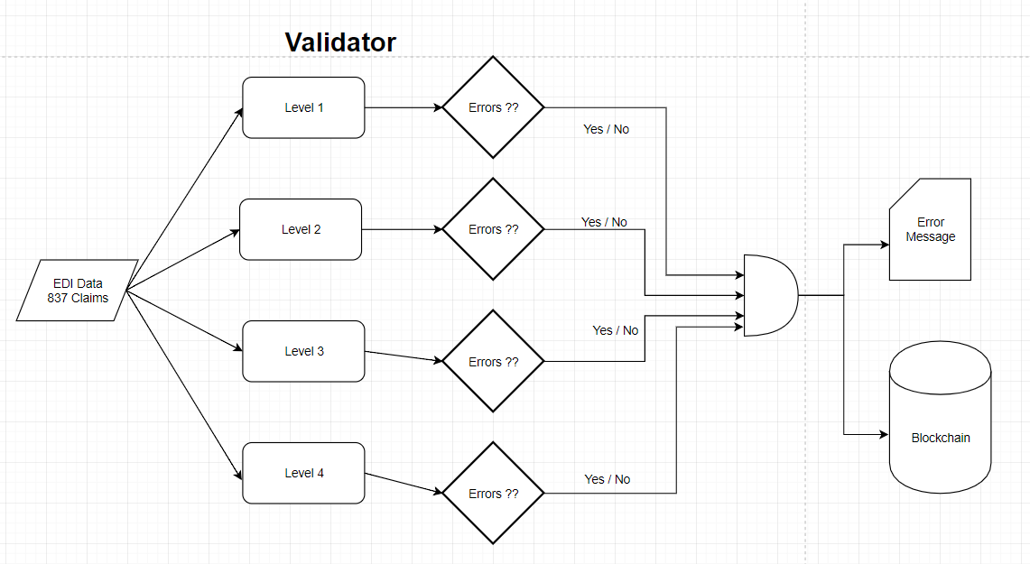

Slide 5
System Design
4 Stages
Develop services which will validate the 837 files.
Neo4j is used to perform level 4 - level 7 HIPAA validation.
Security measure and User Interface.
Addition of Kafka, Redis and deploying the servers in the AWS.

Slide 6
Evaluation
The raw Healthcare Records used in the initial evaluation are from Medicare – Lumeris.
Json records are loaded into neo4j database and retrieving those information proved to be 100% faster than relational databases.

Slide 7
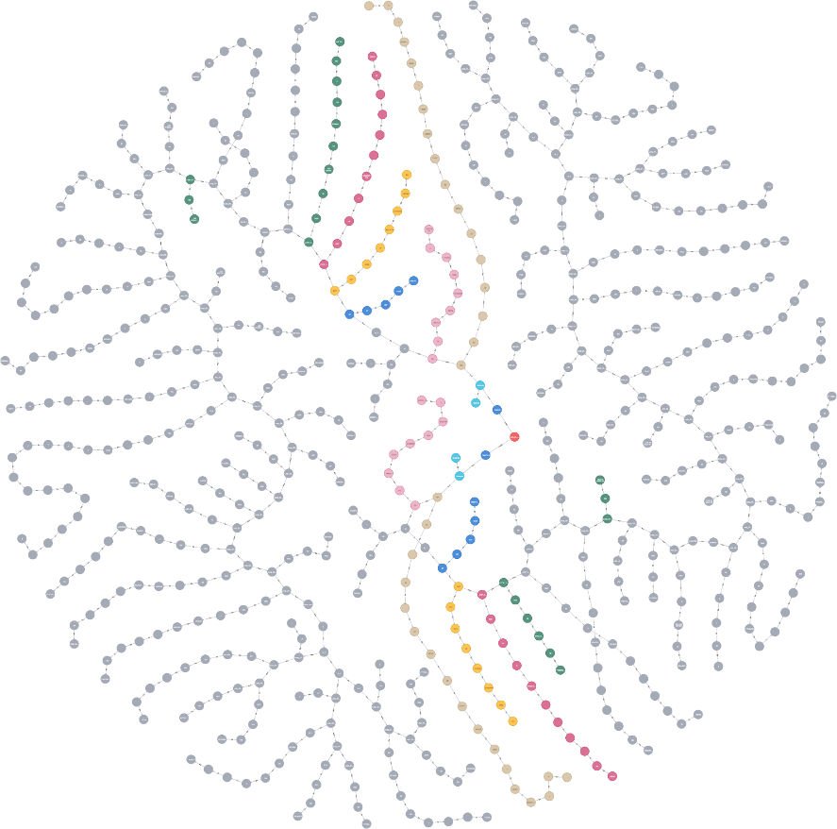
Evaluation
We will be building the block chain distributed system in AWS. It also includes flask backend server.

Slide 8
Implementation plan
Environment Setup.
Designing the User Interface.
Writing HIPAA validations for Level 1 and Level 2.
Implement Backend Server using Python and the HIPPA Validator.

Slide 9
Integration of the validator and Web Application.
Building of block chain and access control for users.
Integration and Testing.

Slide 10
Progress
Environment Setup.
Level 1 HIPAA Validation.
Setting up python flask server in backend.
Converting the raw medical insurance records into structured Json.
Storing initial processed data in MongoDB.

Slide 11
THANK YOU

