Slide 1


Real time research project IOT DISASTER RESPONSE SYSTEM Under the guidance of DR.V.Sandhya
CMR TECHNICAL CAMPUS
UGC AUTONOMOUS Accredited by NBA & NAAC with A Grade Approved by AICTE, New Delhi and Affiliated to JNTU, Hyderabad
Department of CSE(Data Science)
Yashaswi Dasari 247R1A67E8
B.Arun Kumar 247R1A67D7
Avuti Sri Vamshi 247R1A67D4
Konduru Gowtham Kumar 257R5A6717

Slide 2
Contents:
Abstract
Problem Definition
Literature Survey
Objectives
Methodology
Analysis & Design
Conclusion
References

Slide 3
Abstract:
This project is titles as “IOT Based Disaster Response System”.
Natural disasters can cause severe damage due to the lack of early detection systems. This project presents an IoT-based disaster response system using ESP32, DHT11, and a gyroscope sensor to monitor temperature and vibrations in real time. The system detects abnormal conditions by comparing sensor data with predefined thresholds. When a potential hazard is identified, it triggers a buzzer and sends instant alerts to users through the Blynk IoT platform. The solution is cost-effective, reliable, and suitable for improving safety in disaster-prone areas.
Keywords:
Internet of Things (IoT)
Disaster Detection
Real-Time Monitoring
ESP32,DHT11 Sensor,Gyroscope Sensor
Wireless Communication
Blynk IoT
Alert System
Remote Monitoring
Low-Cost Solution

Slide 4
Problem Definition:
Natural disasters such as earthquakes and sudden environmental changes often occur without warning, causing severe damage to life and property. In many regions, especially rural and remote areas, there is a lack of affordable and real-time monitoring systems that can detect early signs of such disasters. Existing solutions are either expensive, complex, or not easily accessible to common users. Moreover, delayed detection and lack of immediate alert mechanisms increase the risk to human safety. Traditional systems do not provide continuous monitoring or instant notifications, making it difficult for people to respond quickly during emergencies. Therefore, there is a need for a low-cost, efficient, and real-time disaster monitoring system that can continuously track environmental conditions, detect abnormal situations, and provide instant alerts both locally and remotely to improve safety and response time.

Slide 5
Literature Survey:
Author Name | Article Name | Research
S.Patel, R.Mehta | IoT Enabled Emergency Response System-2021 | Integrated ESP32 with cloud platforms to monitor temperature and vibrations and send real-time mobile notifications.
Rakshita M.B., Siddharth Sharma | IoT Based Seismic Activity Monitoring-2020 | Designed a seismic monitoring system using gyroscope sensors connected to Blynk IoT platform for real-time alerts.
Priya Sharma, Neha Gupta | Smart Earthquake Detection Using IoT-2019 | Developed an IoT-based earthquake detection system using gyroscope and vibration sensors with mobile application alerts.
 | Alok Jadhav, Vrishali Desai | Cloud Integrated Disaster Monitoring-2018 | Focused on cloud integration for disaster monitoring including remote data storage, visualization, and predictive analysis.

Slide 6
Objectives:
Design and develop a real-time monitoring and alert system using the ESP32 microcontroller.
Provide early detection of abnormal environmental conditions during natural disasters such as earthquakes and extreme temperature events.
Monitor environmental temperature using DHT11 and detect abnormal vibrations/tilts using a gyroscope sensor.
Generate immediate local alerts through a buzzer and send remote notifications via the Blynk IoT application.
Enable timely disaster alerts, rapid evacuation, and precautionary measures through a cost-effective and reliable system suitable for smart buildings, industrial setups, and disaster-prone regions

Slide 7
Methodology:
Hardware Integration: The system is built using ESP32 as the central control unit. DHT11 continuously measures environmental temperature, while the gyroscope sensor detects abnormal vibrations or tilts indicating possible seismic activity. A buzzer is connected for local alerts, and ESP32 is configured to communicate with the Blynk platform.
Data Acquisition & Processing: Sensor data is continuously monitored and processed by the ESP32. The readings are compared with predefined safety threshold values.
Alert & Remote Monitoring: If temperature exceeds the safe limit or abnormal seismic activity is detected, the buzzer is activated and an alert notification is sent to the user’s mobile device via the Blynk cloud using Wi-Fi.
Testing & Calibration: The system is tested under simulated high-temperature and vibration conditions. Threshold values are calibrated to minimize false alarms while ensuring reliable early detection.

Slide 8
Analysis and Design :
DHT11 Sensor
ESP 32
Micro Controller
LCD Display
Gyro Sensor
Buzzer
Fire Sensor
How it works
Sensors collect environmental data.
ESP32 processes and compares values.
If threshold exceeded:
Buzzer activated
Alert sent via Blynk app
Block diagram includes ESP32 connected to sensors, LCD, buzzer, and Wi-Fi cloud.

Slide 9
Future Scope:
Integration of additional sensors (gas, smoke, humidity, flood detection) for multi-disaster monitoring
Use of AI/ML algorithms for better prediction and reduced false alarms
Implementation of solar power for uninterrupted operation during power failures
Expansion to large-scale networks for city-wide disaster monitoring
Integration with government emergency systems for faster response
Development of a dedicated mobile app with advanced features and analytics
Use of GPS module for location-based alerts and tracking
Enhancement of data storage and analytics using cloud platforms
Improving system with edge computing for faster local decision-making

Slide 10
Implementation:
DHT11 measures environmental temperature
Gyroscope detects vibrations/tilt (earthquake signals)
ESP32 processes sensor data continuously
Compared readings with predefined threshold values
If abnormal condition detected:
Buzzer activated (local alert)
Notification sent via Blynk app
Data updated in real-time using cloud connectivity

Slide 11
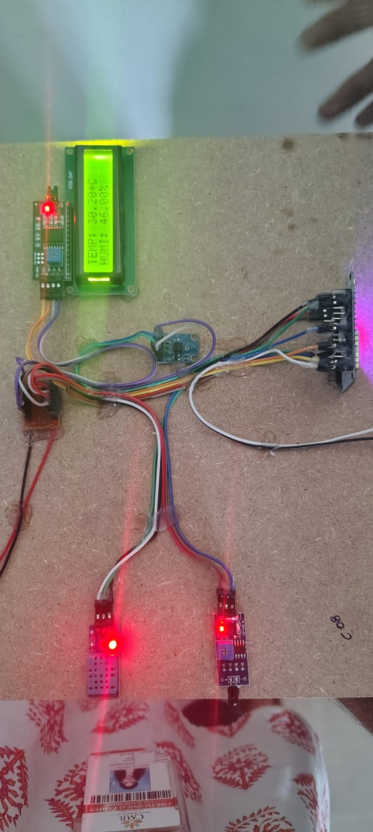
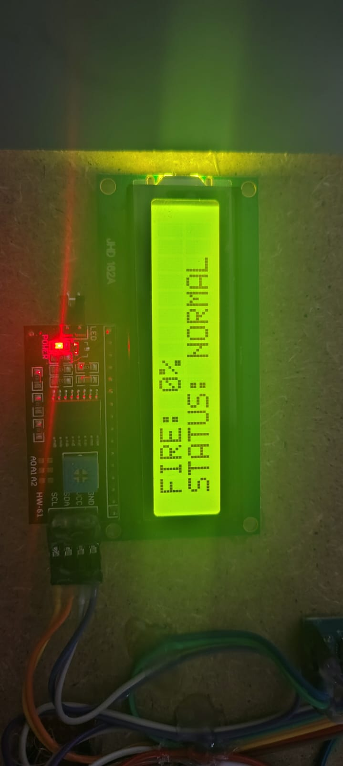
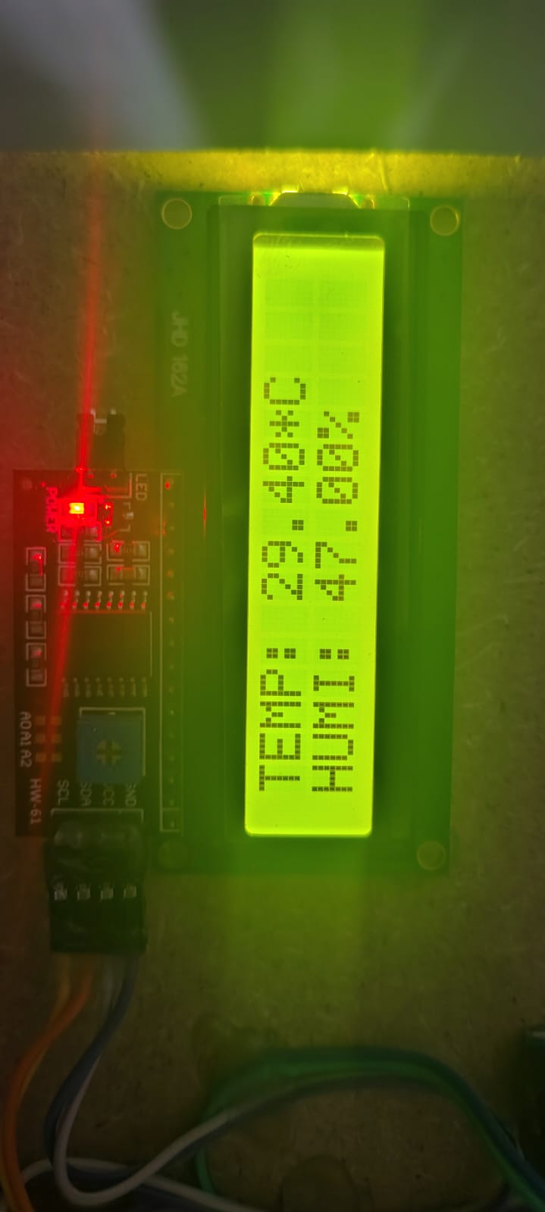
Testing and validation:
Tested under high-temperature conditions
Simulated vibration/tilt for earthquake detection
Verified buzzer activation for alerts
Checked real-time notifications on mobile app
Calibrated threshold values to reduce false alarms
Ensured stable Wi-Fi communication
System performance validated for accuracy and reliability

Slide 12
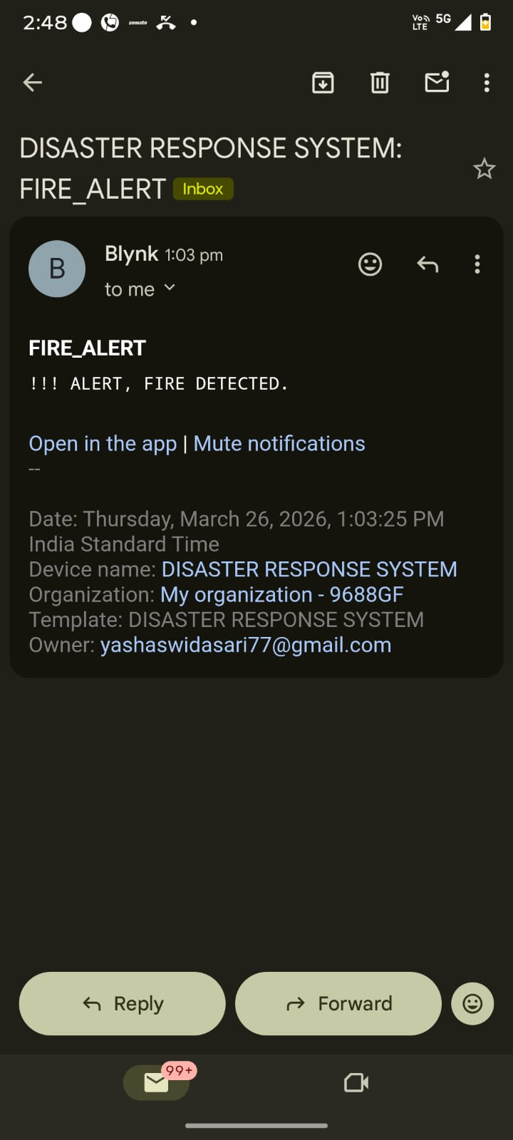
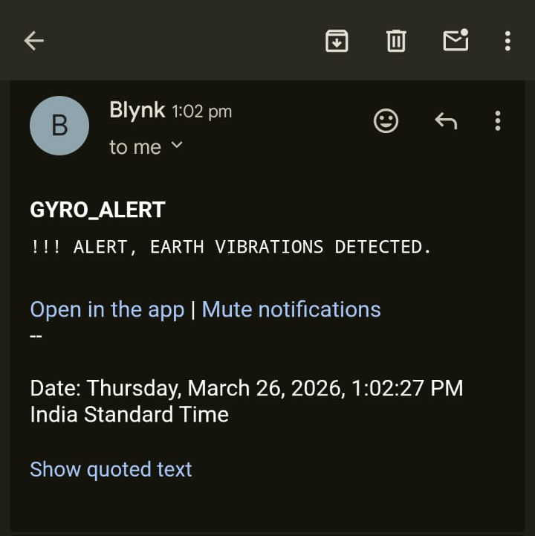
Project Execution:
Selected components: ESP32, DHT11, Gyroscope, Buzzer
Designed circuit and hardware connections
Programmed ESP32 using Arduino IDE
Integrated sensors for continuous data collection
Connected system to Blynk IoT platform via Wi-Fi
Developed mobile interface for real-time alerts
Ensured proper power supply and stability

Slide 13
Conclusion:
The IoT-Based Disaster Response System provides:
Real-time environmental monitoring
Early detection of temperature rise and seismic activity
Immediate local alerts through buzzer
Remote notifications through Blynk IoT
The system is cost-effective, reliable, and suitable for smart buildings, industries, and disaster-prone regions.

Slide 14
References:
A. Zanella, N. Bui, A. Castellani, L. Vangelista, and M. Zorzi, “Internet of Things for smart cities,” IEEE Internet of Things Journal, vol. 1, no. 1, pp. 22–32, Feb. 2014.
N. Sharma and R. Singh, “IoT based earthquake detection and alert system,” International Journal of Engineering Research & Technology (IJERT), vol. 9, no. 4, pp. 155–160, 2020.
Mousavi, F.S., Yousefi, S., Abghari, H., Ghasemzadeh, “A.Design of an IoT-based flood early detection system using machine learning”. In: 2021 26th International Computer Conference, Computer Society of Iran (CSICC), pp. 1–7 (2021)

Slide 15
THANK YOU!!

