Slide 1

FINAL PROJECT DEMO
Minimax Algorithm
Red-Black Tree Implementation
Boyer Moore Algorithm
HITS Algorithm
Group 7

Slide 2
1. MINIMAX ALGORITHM
Minimax is a kind of backtracking algorithm that is used in decision making and game theory to find the optimal move for a player, assuming that the opponent player also plays optimally
In this Mini-Max algorithm two players play the game, one is called Maximizer and other is called Minimizer.
Maximizer will try to get the Maximum possible score, and Minimizer will try to get the minimum possible score
Mini-Max algorithm applies DFS, so we have to go all the way through the leaves to reach the terminal nodes
Mini-Max algorithm proceeds all the way down to the terminal node of the tree, then backtrack the tree as the recursion.

Slide 3
1. MINIMAX ALGORITHM
Problem Statement:
Cat and Mouse: Mouse tries to reach the hole and Cat tries to catch the Mouse.
Conditions:
If Mouse reaches the hole, then return 1(Mouse Wins)
If Cat catches the Mouse, then return -1(Cat Wins)
If both Cat and Mouse return to previous states after multiple iterations, then return 0(DRAW)
Mouse should not reach the hole

Slide 4
MINI-MAX ALGORITHM PSEUDO CODE
if(cat reaches hole)
return 1 //Mouse Wins
if(mouse catches cat)
return -1 //Cat Wins
if(turn == graphLength * 2)
return 0 // Draw
max-value(state) {
Initialize max = -inf;
for each successor of state
max = max(max, min-value(successor)) }
return max; }
min-value(state) {
Initialize min= +inf;
for each successor of state
min = min(min, max-value(successor)) }
return min; }

Slide 5
2. RED-BLACK TREE IMPLEMENTATION
It’s a self-balancing binary tree, but with an extra feature ie, the color(red or black).
Main purpose of these colors is to ensure the tree remains balanced during insertion and deletion.
Rules to be followed by Red-Black tree are as follow:
Every node has to be colored either red or black
The root is always black
Two adjacent nodes cannot be red.
All paths from a node to its descendant’s NULL nodes will have the same number of black nodes.
All leaf nodes are black.

Slide 6
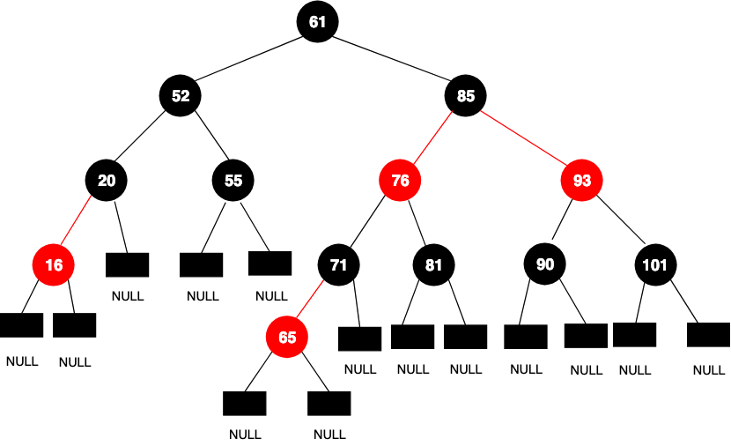
Example of Red Black Tree

Slide 7
3. BOYER MOORE ALGORITHM
Pattern searching is useful in searching a string within another string.
Using the brute force approach we will go through each character, but with boyer-moore, we lower the time consumed by skipping the non-matching characters.
There are 2 way to do:
=> Bad Character Heuristic
=> Good Suffix Heuristics

Slide 8
Example
B I N G H A M T O N
T O N
T O N
T O N
T | 0
O | 1
N | 2
T O N

Slide 9
4. HITS ALGORITHM
Hyperlink-induced topic search
Jon Kleinberg, a professor of the Computer Science department, developed an algorithm that made use of the link structure of the web in order to discover and rank pages based on a particular topic.
Two factors are assigned to each page:
Authority: to estimate the value of the page content.
Hub value: it estimates the value of its links to other pages.
A higher authority weight occurs if the page is pointed to by pages with high hub weights.
A higher hub weight occurs if the page points to many pages with high authority weights.

Slide 10
HITS ALGORITHM
Let the number of iterations be k
Initially, each Hub’s score and Authority’s score will be initialized to n
Repeat the number of iterations k times
Hub Score Updation : Σ (Authority score of each node it points to)
Authority Score Updation : Σ (Hub score of each node it points to)
Normalization : Normalize the scores by dividing each Hub score by square root of the sum of the squares of all Hub scores, and dividing each Authority score by square root of the sum of the squares of all Authority scores

Slide 11
HITS PSEUDO CODE
for(i to iter) {
for(i to n)
Hub = 1; auth = 1
//authority score updation
for(i to n) {
summation of Hub score of each node pointing to it }
//hub score updation
for(i to n) {
summation of authority score of each node pointing to it }
for(i to n) {
hub[i]/sqrt(sum of squares of hub scores) }}
for(i to n) {
hub[i]/sqrt(sum of squares of hub scores) }
for(i to n) {
hub[i]/sqrt(sum of squares of authority scores) }
}

