Slide 1
Hadoop Overview

Slide 2
Data!!!!!!!!!!
Data everywhere??? - Bigdata
Data storage and analysis -Issues
Hardware Failure - Hadoop Distributed File System(HDFS)
Combine the data - Map reduce
Hadoop - Why?
Need to process huge datasets on large clusters of computers
Expensive to build reliability into each application
Handling Failures

Slide 3
Hadoop
Shared nothing
Efficient
Reliable
Scalable
Commodity hardware and opensource

Slide 4
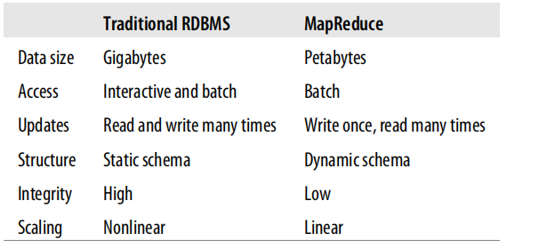
RDBMS vs Mapreduce

Slide 5
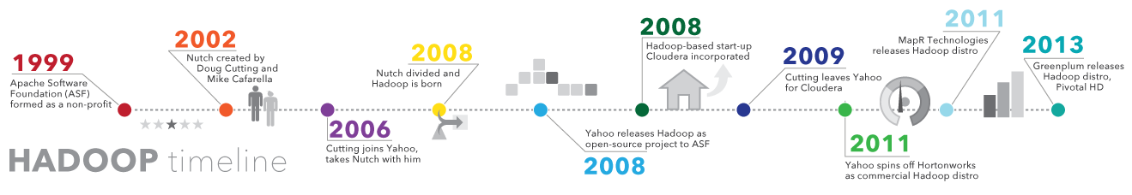
Hadoop History
Introduced by Dough Cutting
Open source in 2008
(source: sas.com)

Slide 6
Hadoop Ecosystem tools
Apache Flume - streaming
Apache Pig - data flow language
Apache Hive - distributed datawarehouse
HBase - no sql
Apache Sqoop - data transfer between hadoop and RDBMS
Zookeeper
etc.

Slide 7
MapReduce
MapReduce is a linearly scalable programming model.
Works large volumes of data using cluster of computers in parallel
Divides the workload into multiple independent tasks and schedule them across cluster nodes
Data distributed in all nodes of cluster
MapReduce functions
map function
reduce function
(map phase, reduce phase, driver phase)

Slide 8
Key and Value
In MapReduce data elements are always structured as key-value (i.e., (K, V)) pairs
The map and reduce functions receive and emit (K, V) pairs

Slide 9
Map and Reduce Function
Map Task- Splits the input data-set into independent chunks(parts of data) which are processed by the map tasks in a completely parallel manner. The mapper output is the intermediate output.
The map() method also provides an instance of Context to write the output to.
Shuffle and Sort- The framework shuffles and sorts the outputs of the maps, which are then input to the reduce tasks. The programmer may supply custom compare functions for sorting and a partitioner for data split.

Slide 10
Partitioner - The partitioner decides which reducer will get a particular key value pair. Default is hash partitioner.
Reduce Task-All values with the same key are presented to a single reducer together.
RecordReader - It actually loads data from its source and converts it into (K, V) pairs suitable for reading by Mappers

Slide 11
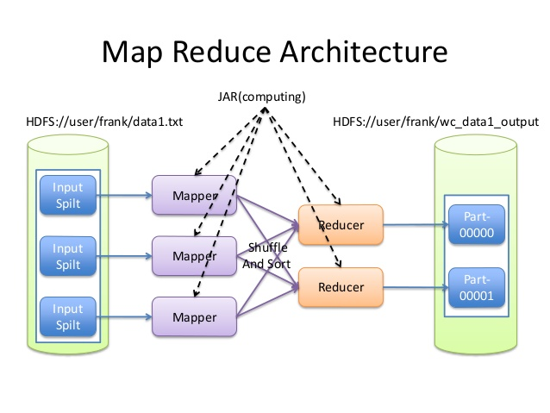
Map Reduce
(source: google images)

Slide 12
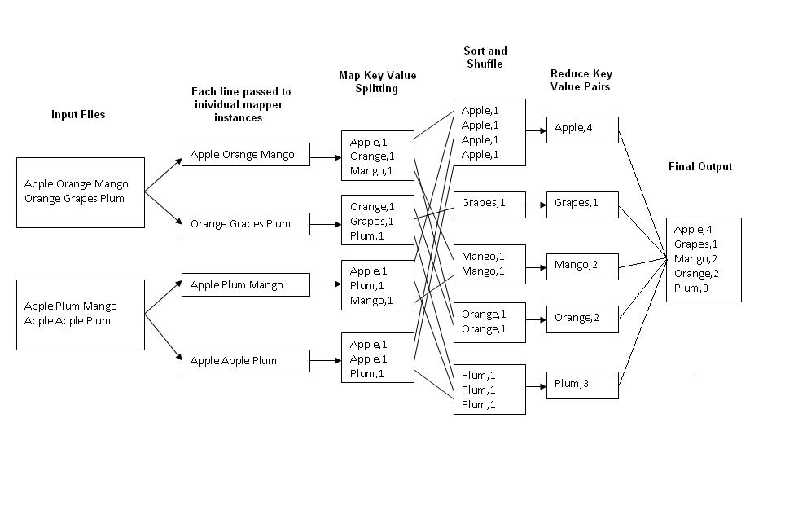
Example
(source: google images)

Slide 13
Job Execution
Job Tracker
The jobtracker coordinates all the jobs run on the system by scheduling tasks to run on tasktrackers.
Task Tracker
Tasktrackers run tasks and send progress reports to the jobtracker, which keeps a record of the overall progress of each job.

Slide 14
An input split will normally be a contiguous group of records from a single input file. It describes a unit of work that comprises a single map task in a MapReduce program
By default, the InputFormat breaks a file into 64MB splits.(HDFS default block size 64 MB)
By dividing the file into splits, several map tasks can operate on a single file in parallel
If the file is very large, this can improve performance significantly through parallelism
Each map task corresponds to a single input split

Slide 15
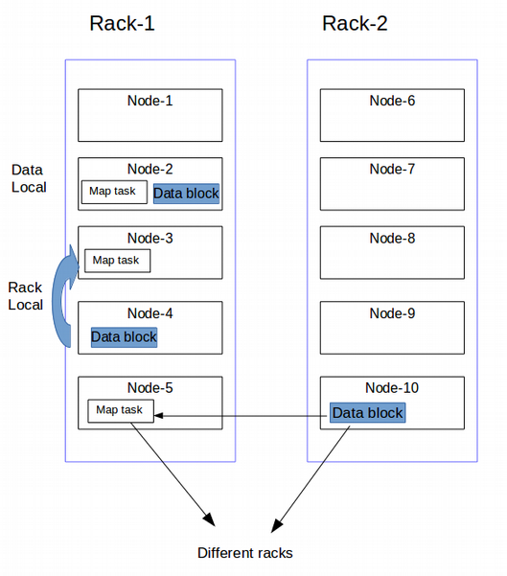
Data Locality Optimization - map tasks
Data local
Rack local
Different racks(off racks)
Reduce tasks don’t have
the advantage of data
locality—the input to a single
reduce task is normally
the output from all mappers
(source: https://www.netjstech.com/2018/04/data-locality-in-hadoop.html)

Slide 16
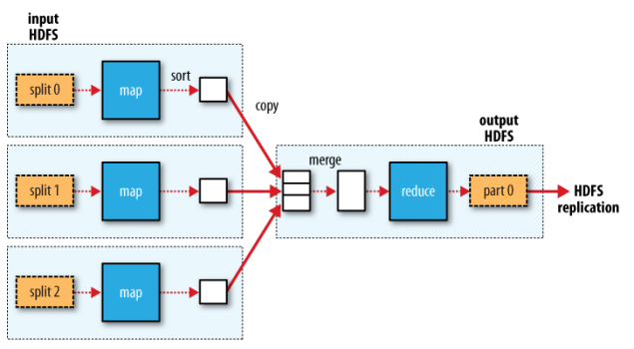
Map reduce workflow with single reduce task

Slide 17
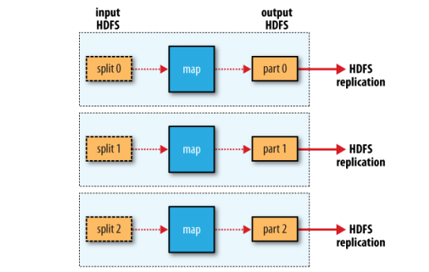
Map reduce workflow with no reduce task

Slide 18
Hadoop can be run in three different modes
Local or Standalone Mode
Pseudo Distributed Mode (Single Node Cluster)
Fully Distributed Mode (Multi Node Cluster)

Slide 19
Local or Standalone Mode
By default, Hadoop is configured to run in a non-distributed mode, as a single Java process. This is useful for debugging.
HDFS is not utilized in this mode
Local file system is used Inputs and Outputs
Used for Debugging/Testing purpose
No custom configuration is required such as (core-site.xml, hdfs-site.xml, mapred-site.xml, masters & slaves)
Standalone mode is much faster than Pseudo-distributed mode.

Slide 20
Pseudo Distributed Mode
Hadoop configured to run on a single-node in a pseudo-distributed mode where each Hadoop daemon runs in a separate Java process.
Custom configuration is required.
Replication factor is set to one for HDFS.
Used for real code to test in HDFS.
HDFS is used for Inputs and outputs.
All the demons should run in background such as (NameNode, JobTracker, DataNode, TaskTracker & Secondary NameNode)
Good for testing, debugging and prototyping.

Slide 21
Fully Distributed Mode
This mode involves the code running on an actual Hadoop cluster.
Replication factor is three.
Data are used and distributed across many nodes.
Different Nodes will be used as NameNode, JobTracker, DataNode & Secondary NameNode.
NameNode, JobTracker, Secondary NameNode demons are run on master nodes.
DataNode & TaskTracker demons runs on the slave nodes.
Data is stored and processed across multiple nodes.

Slide 22
Reference
Hadoop: The Definitive Guide;Tom White; O'Reilly Media, 3rd Edition, 2012 .
Wordpress.com

