Slide 1
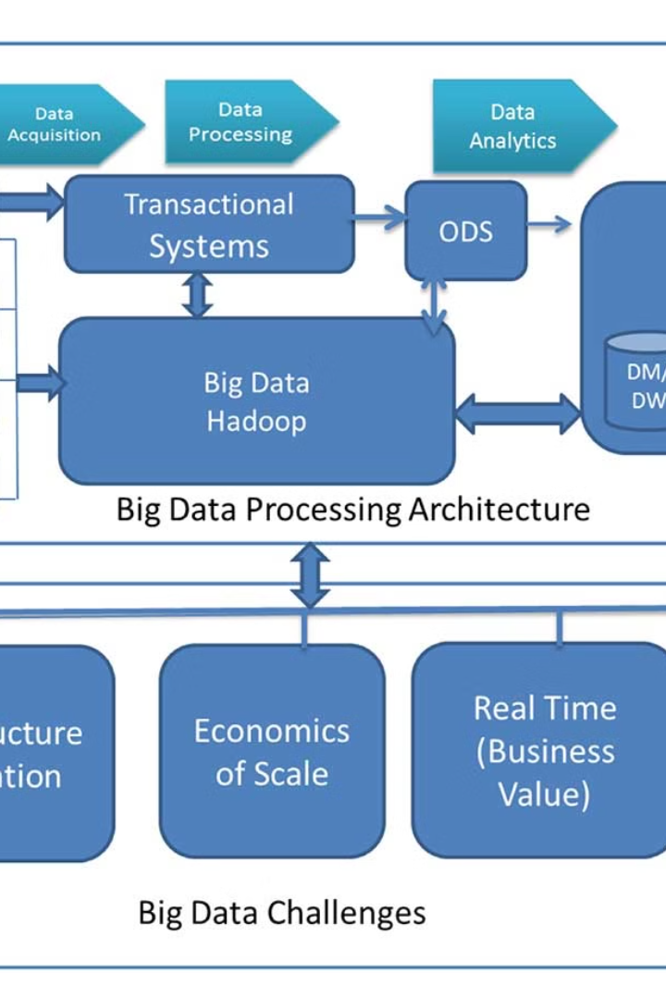


Processing Big Data with Hadoop
Handling and analyzing large-scale data sets with Hadoop's distributed processing system.
by Yashaswini Adepu

Slide 2
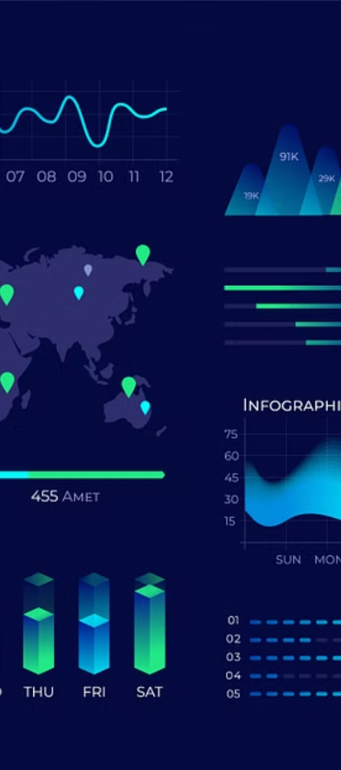
Outline
1
Moving Data into HDFS
Transfer data using commands like put and get into Hadoop Distributed File System (HDFS).
2
Processing Data with MapReduce
Utilize MapReduce for distributed computations, dividing tasks into Map and Reduce phases.
3
Writing MapReduce Programs
Create programs to analyze data with Mapper and Reducer functions.

Slide 3
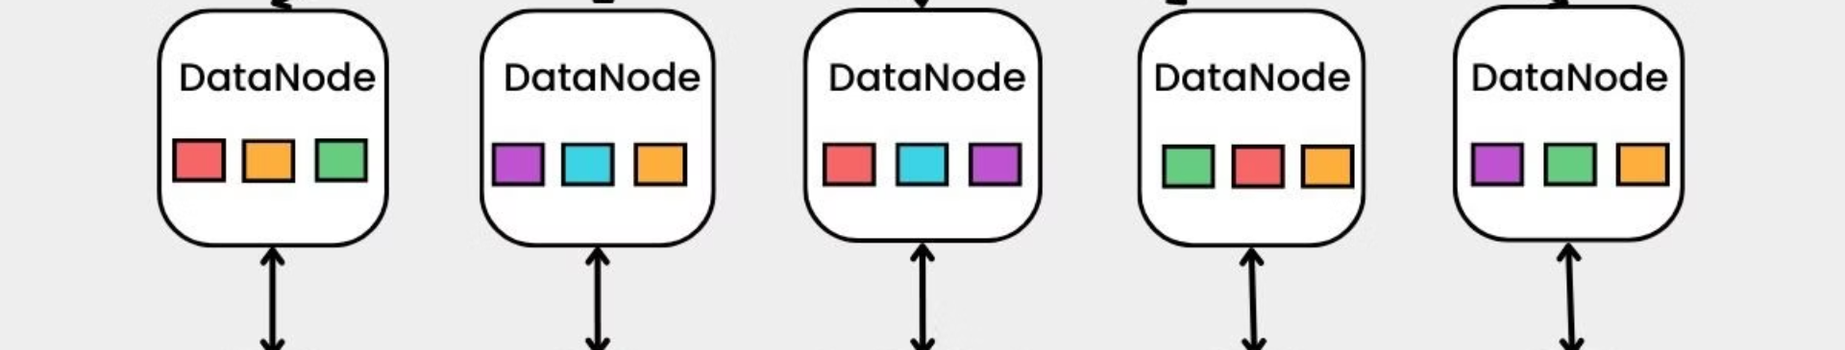
Moving Data into HDFS
1
Use HDFS Commands
2
Scalable Data Storage
3
Data Preparation
Prepare data for analysis using the MapReduce processing framework.
Use HDFS commands like put and get to ingest data into the distributed file system.
Store data in a distributed and scalable manner within the Hadoop ecosystem's file system.

Slide 4
Processing Data with MapReduce
Distributed Framework
Map and Reduce Phases
Utilize the distributed processing framework of MapReduce for parallel computations.
Divide computations into Map and Reduce phases for parallel and aggregated processing.

Slide 5
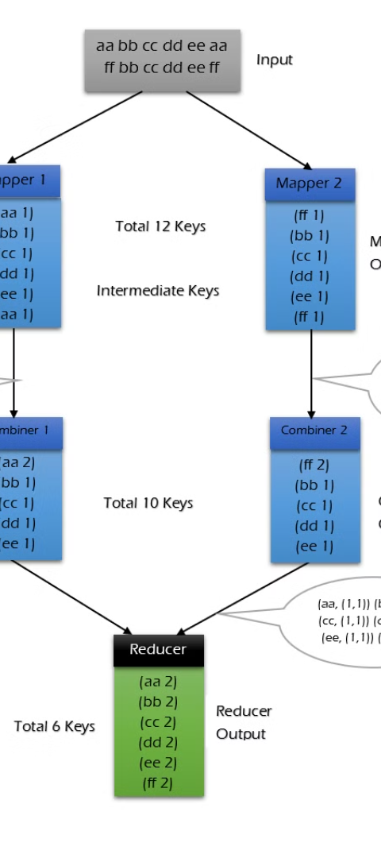
Writing MapReduce Programs
Language Flexibility
Function Definitions
MapReduce programs can be written in various languages, including Java and others.
Define Mapper and Reducer functions to process and analyze the input data.

Slide 6
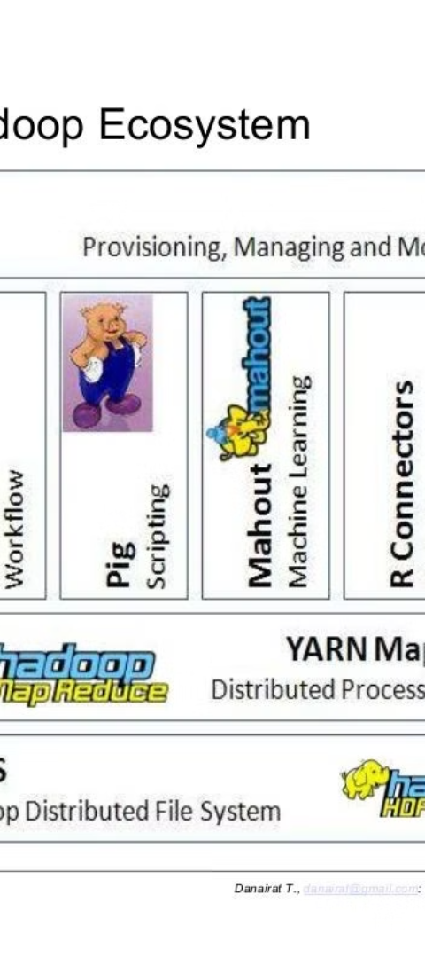
Lab Overview Objective
1
Data Ingestion
2
MapReduce Processing
Learn to ingest data into Hadoop using HDFS commands in a lab-based environment.
Utilize MapReduce for processing ingested data during lab sessions.

Slide 7
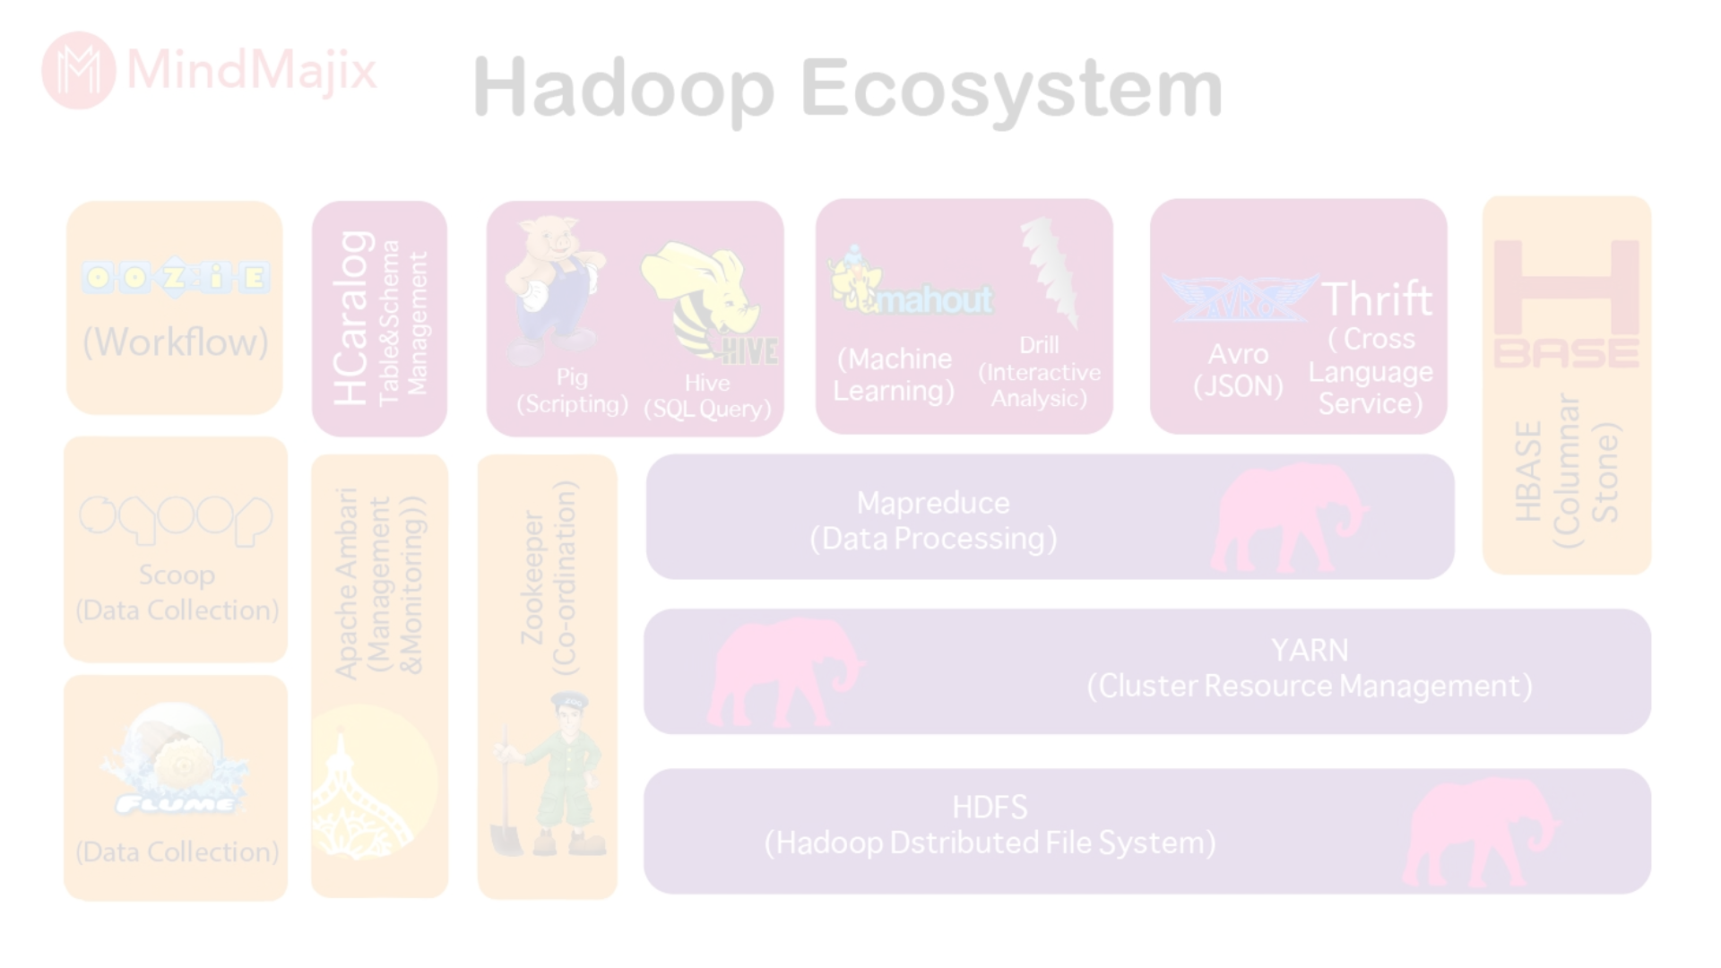
Conclusion
1
Scalable Data Processing
2
Essential Components
3
Wide Application
These technologies are widely used in diverse industry and research applications.
HDFS and MapReduce provide the means for scalable big data processing within the Hadoop ecosystem.
HDFS and MapReduce are critical components of Hadoop's distributed computing framework.

