Slide 1
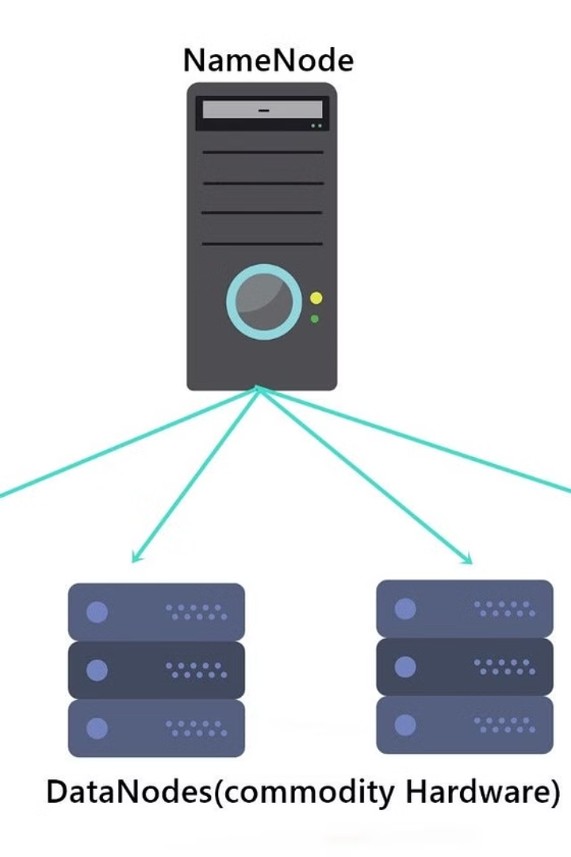


Introduction to HDFS
HDFS, or Hadoop Distributed File System, is a distributed file system designed to run on commodity hardware. It provides high-throughput access to application data and is suitable for applications that have large data sets.
by Yashaswini Adepu

Slide 2
Creating Directories in HDFS
Step 1
Step 2
Step 3
Use the command "hadoop fs -mkdir" to create a directory in HDFS.
Provide the path of the directory you want to create within the Hadoop Distributed File System.
Verify the creation of the directory by listing its contents using "hadoop fs -ls".

Slide 3



Moving Files in HDFS
Step 1
Step 2
Step 3
Transfer files to HDFS using the "hadoop fs -put" command.
Ensure successful transfer using "hadoop fs -ls" to view the files in the target directory.
Verify the integrity of the transferred files using checksums.

Slide 4
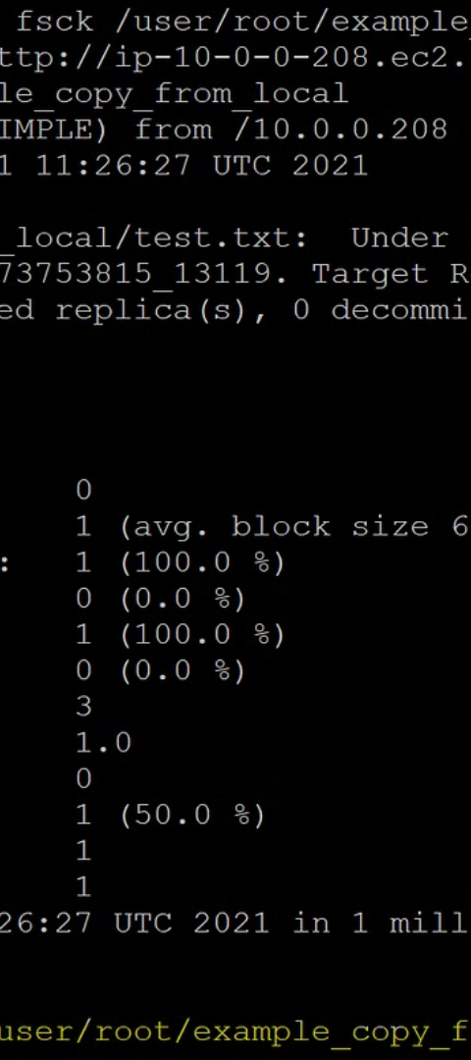
Verifying the File Transfer
1
Checksum Verification
2
File Integrity Check
Calculate and compare checksums to ensure the file transfer's accuracy.
Use hashing algorithms to verify the integrity of transferred files.
3
Data Consistency
Ensure consistent data across distributed systems for reliable file transfers.

Slide 5
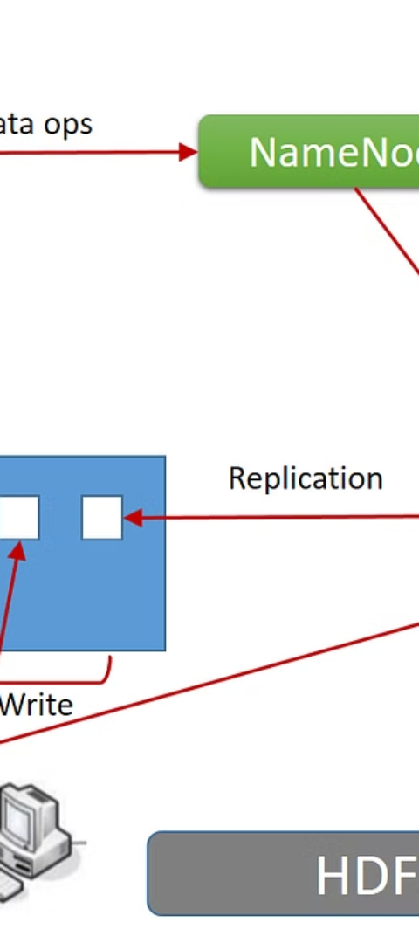
Deleting Files from HDFS
1
Step 1
Locate the file you want to delete within the Hadoop Distributed File System.
2
Step 2
Use the "hadoop fs -rm" command to delete the file from HDFS.
3
Step 3
Confirm deletion by listing the contents of the directory using "hadoop fs -ls".

Slide 6



HDFS Commands Summary
hadoop
hdfs dfs
Terminal
Main Hadoop command-line tool for interacting with HDFS.
Primary command for interacting with Hadoop Distributed File System.
Use the terminal for direct and efficient commands involving HDFS operations.

Slide 7
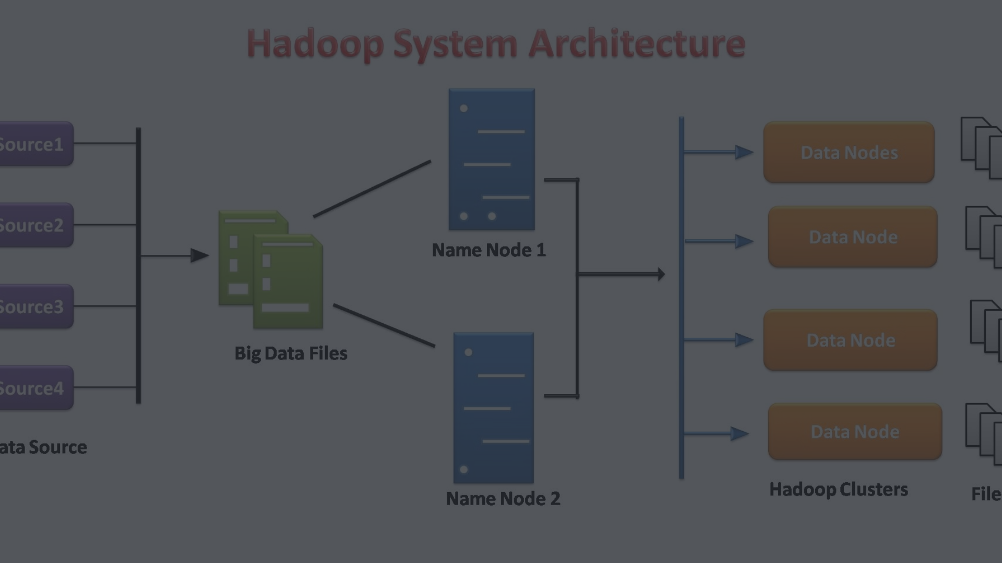
HDFS Best Practices
Replication
Optimization
Security
Ensure adequate replication to safeguard against data loss in HDFS.
Optimize block size and disk throughput for improved HDFS performance.
Implement robust security measures to protect data stored in HDFS.

Slide 8
Security Measures and Data Replication
Data Replication
Replicating data across nodes ensures fault tolerance and high availability.
Encryption
Implement encryption mechanisms to secure data at rest and in transit within HDFS.
Access Control
Set up robust access controls to manage permissions and prevent unauthorized data access.

