Slide 1
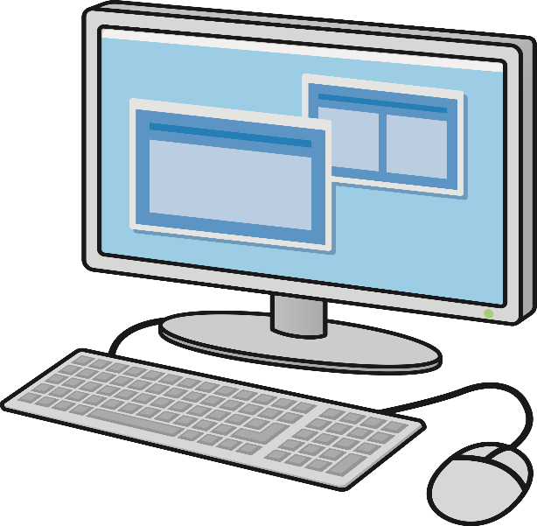
computers
COMPUTER : A Computer system is a set of integrated devices that input , output , process and stored data . Information computer system are currently built around at least one digital processing device.
there are five main hardware components
in a computer system input, output and communication devices

Slide 2
computers
CLASSIFICATION OF COMPUTERS : Based on physical size ,computers can classified into four main groups .
SUPER COMPUTERS
MAIN FRAME COMPUTERS
MINI COMPUTERS
MACRO COMPUTERS

Slide 3
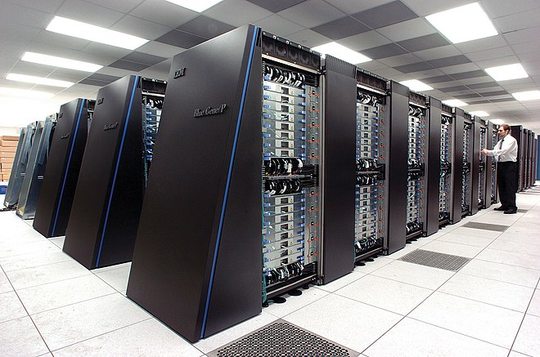
computers
SUPER COMPUTER’S : Super computers are the fastest , largest, most expensive and most powerful computers available.
Characteristics :
fastest computers Generate a lot of heat
huge processing power Largest in size
most expensive use multiple processors
very heavy it can be operated by 500 users

Slide 4
computers
APPLICATION
EXAMPLES
Scientific research
Defense and weapon analysis
Nuclear energy research
Weather forecasting
ENIAC
CCRAY T3D
DC - 6600
NEC – 500

Slide 5
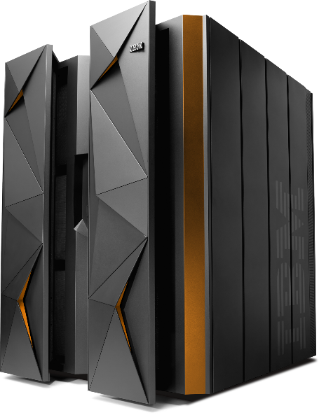
computers
MAIN FRAME COMPUTERS : MAIN FRAME COMPUTERS ARE LESS POWERFUL AND LESS EXPENSIVE THAN SUPER COMPUTERS
CHARACTERISTICS :
Have a large storing capacity Multi processing
Supports a variety of peripherals multi user
APPLICATION :
BANKS
HOSPITALS
AIRPORTS

