Slide 1

VIGNAN'S INSTITUTE OF MANAGEMENT AND TECHNOLOGY FOR WOMEN Department of CSE(AIML)
Project Title :Exploring India’s Culture and Heritage: Musical Instruments of India
Team mates:
G.YASHASWINI-23UP1A6618
G.SHIVANI-23UP1A6621
B.NISHITHA-23UP1A6610
K.MOUNIKA-23UP1A6628
Guide Name : Dr.M.THEJOVATHI
Designation : Associate Professor
Department : CSE(AIML)

Slide 2
Contents:
Abstract
Introduction
Literature Survey
Existing System and its Drawbacks
Problem statement
Hardware and Software requirements
Proposed system
Proposed architecture
UML-design
Algorithm
Code methodology
Result
Conclusion
Reference

Slide 3
Abstract
The project aims to develop an interactive website showcasing India's classical musical instruments through an engaging, user-friendly interface. The website will feature an interactive map of India where users can hover over any state to view detailed information about its unique classical instruments, including their history, cultural significance, and audio samples. This initiative seeks to promote awareness and appreciation of India's rich musical heritage while leveraging modern web technologies for an immersive learning experience.

Slide 4
Introduction
India has a diverse cultural heritage, with each state contributing unique classical musical instruments that reflect its traditions. However, many people, especially the younger generation, are unaware of this rich legacy. This project bridges the gap by creating an interactive platform where users can explore classical instruments state-wise. By integrating an interactive India map with hover able descriptions, audio clips, and images, the website will serve as an educational and engaging resource for students, music enthusiasts, and researchers. With digital technology making information more accessible, this project aims to leverage interactive media to educate and engage users, ensuring that the richness of Indian musical instruments reaches a broader audience, including younger generations.

Slide 5
Literature Survey
S.NO | PLATFORM | DISCRIPTION | LIMITATION
1. | Indian Classical Music Instruments | Provides detailed insights into various traditional instruments used in Indian classical music, covering their history and significance | However, it lacks interactive features and is primarily text-based, making engagement limited.
2. | Musical Instruments of India | A government-backed portal showcasing the diversity of Indian musical instruments, categorized based on ancient classifications | Its content is relatively static, lacking immersive visuals or interactive learning tools.

Slide 6
3. | 17 Traditional Indian Musical Instruments | Offers a curated list explaining the history and cultural importance of key instruments, making it accessible for beginners | However, it does not provide in-depth historical context or interactive exploration features.

Slide 7
Existing System
Currently, information about Indian classical musical instruments is scattered across textbooks, websites, and articles. There is no unified or interactive platform that visually connects instruments to their respective states. As a result, users—especially students—struggle to access and explore this cultural knowledge in an engaging way.
Drawbacks:
Static Content – Most websites use plain text and images without interactivity.
No Regional Classification – Instruments are not mapped to their states of origin.
Lack of Multimedia – Few websites integrate audio samples or videos.
Poor User Experience – Navigation is often cumbersome and not visually appealing

Slide 8
Problem Statement
To create an interactive map of India that showcases key features of classical musical instruments associated with each state.

Slide 9
Hardware requirements
RAM: Minimum 4 GB (8 GB recommended)
Processor: Intel i3 or above
Storage: At least 500 MB free space
Display: 13” or larger screen (for better UI testing)
Input Devices: Keyboard and mouse

Slide 10
Software Requirements
Operating System: Windows / macOS / Linux
Code Editor: Visual Studio Code
Web Technologies:
HTML
CSS
JavaScript
Bootstrap
Browser: Google Chrome / Mozilla Firefox (for testing)

Slide 11
Proposed System:
The interactive website will provide an engaging and comprehensive experience with features like:
Clickable Indian map: Instruments will be mapped to their regions, allowing users to discover their historical and cultural significance.
Hover-based popups: Users will see a brief description and image before clicking for more detailed information.
Dedicated pages: Each instrument will have a unique page detailing its history, usage, significance, and famous musicians.
Educational tool: This platform can be used in schools and cultural studies to promote traditional knowledge.
User-friendly design: Accessible for people of all ages, ensuring widespread engagement.

Slide 12
Architecture design:

Slide 13
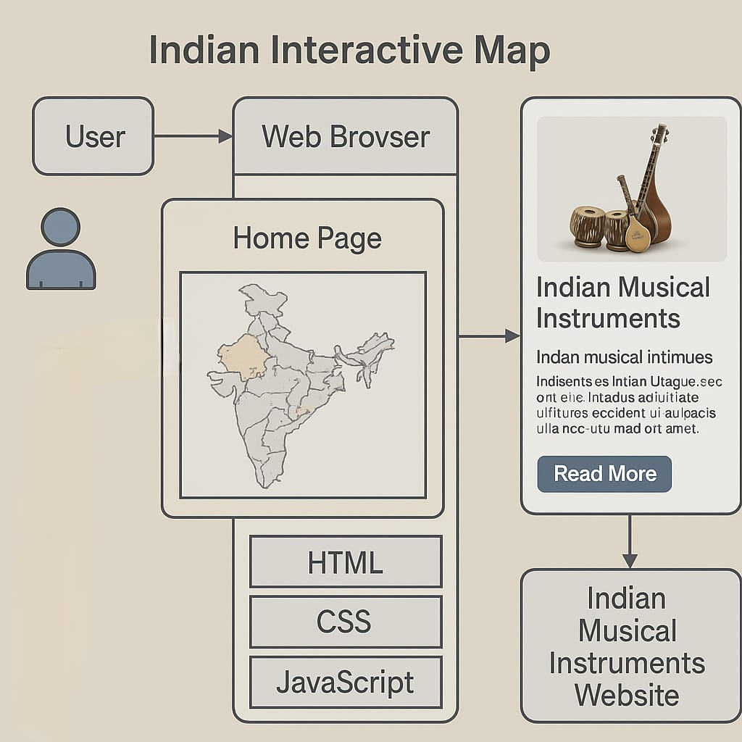

Slide 14
UML diagrams:
Class Diagram
Use case Diagram
Sequence Diagram
Activity Diagram
Deployment Diagram

Slide 15
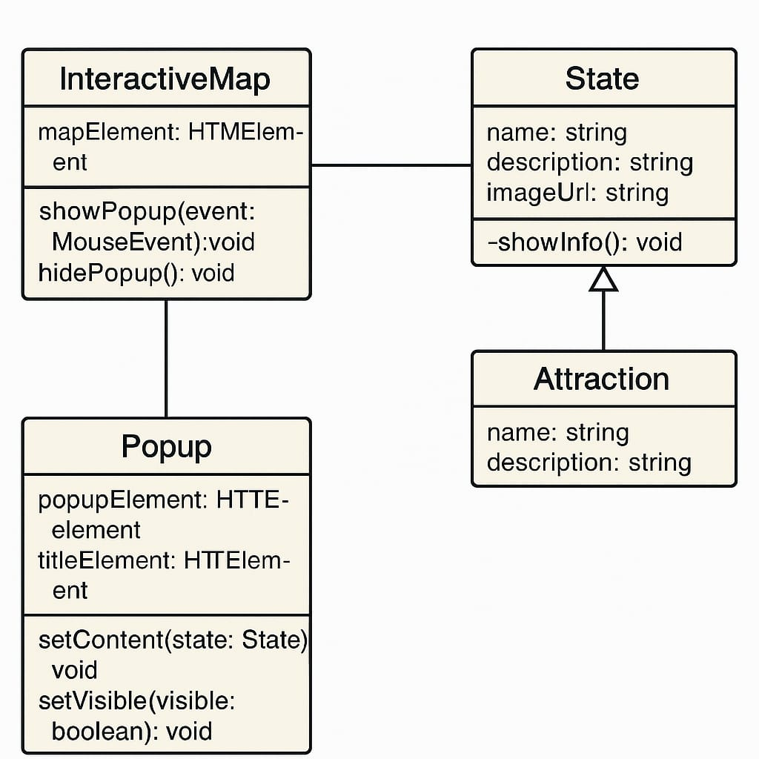

Slide 16
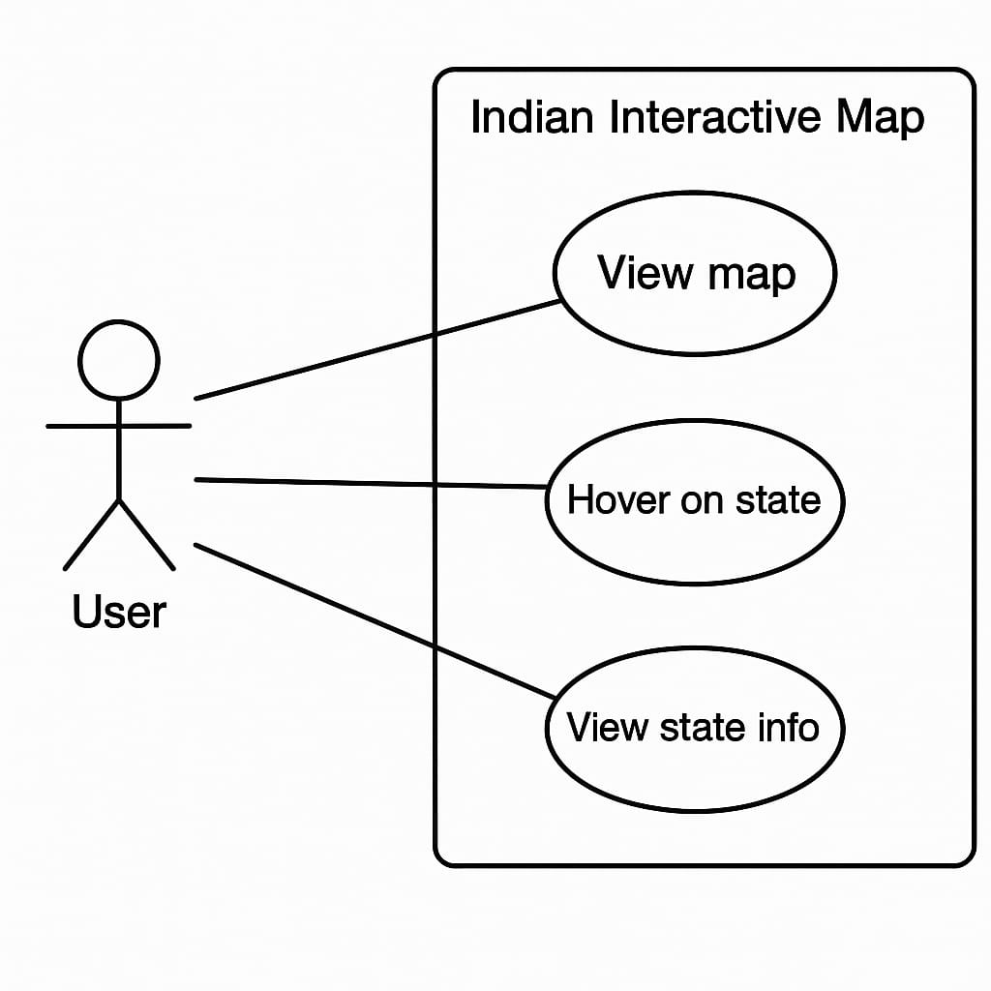

Slide 17
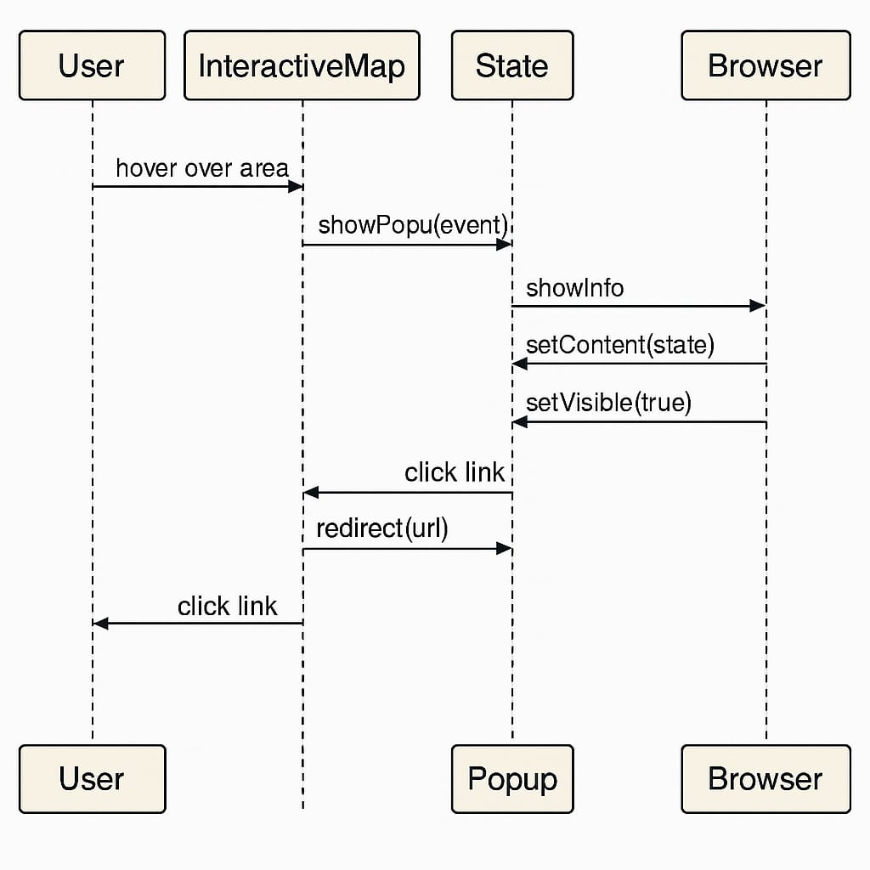

Slide 18
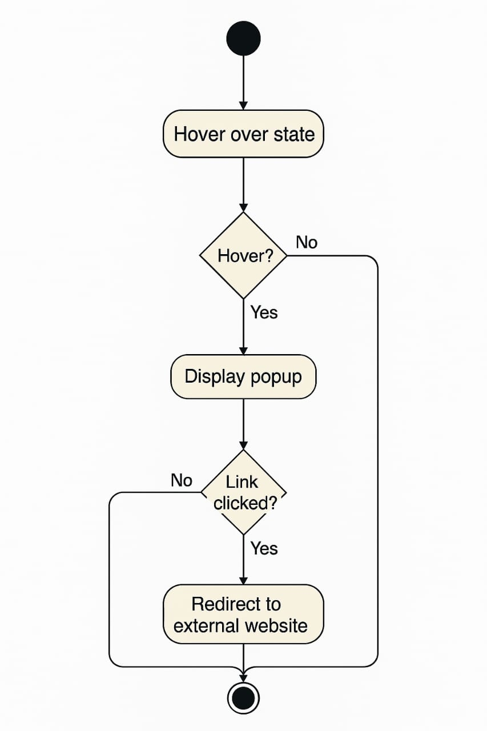

Slide 19
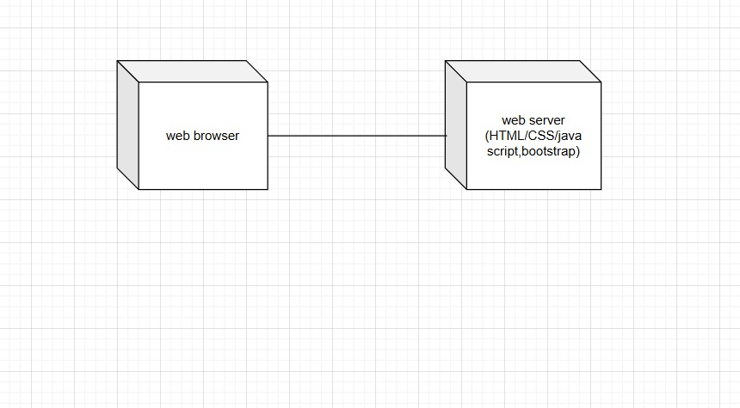

Slide 20
Algorithm:
1.Start the webpage
2.Display the map of India with clickable states.
3.When a user clicks on a state
>Show the classical musical instrument of that state.
4.Display instrument name, image, and short info.
5.Allow user to click on other states to view more instruments.
6.End.

Slide 21
Methodology
User Methodology
Navigate the Map:
Users can interact with the Indian map by clicking on different states.
View Instrument Information:
Upon clicking a state, users can see details about the classical musical instruments specific to that state.
3.Explore Instruments:
Users can explore different instruments and learn about their cultural significance.
Admin Methodology
1.Update Instrument Data:
Admins can add, edit, or remove instrument details for each state.
2.Manage Map Regions:
Admins can modify or update the states in the map if needed.
3.Monitor User Interaction:
Admins can track user interactions and provide updates or notification is required.

Slide 22
Result

Slide 23
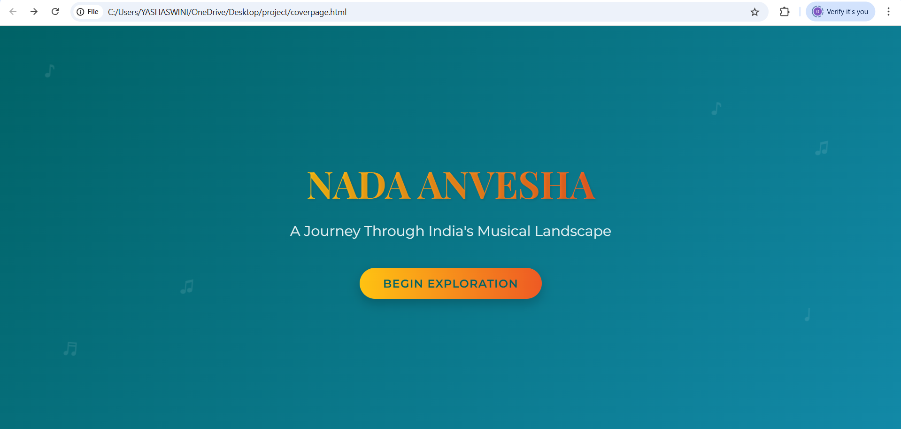

Slide 24
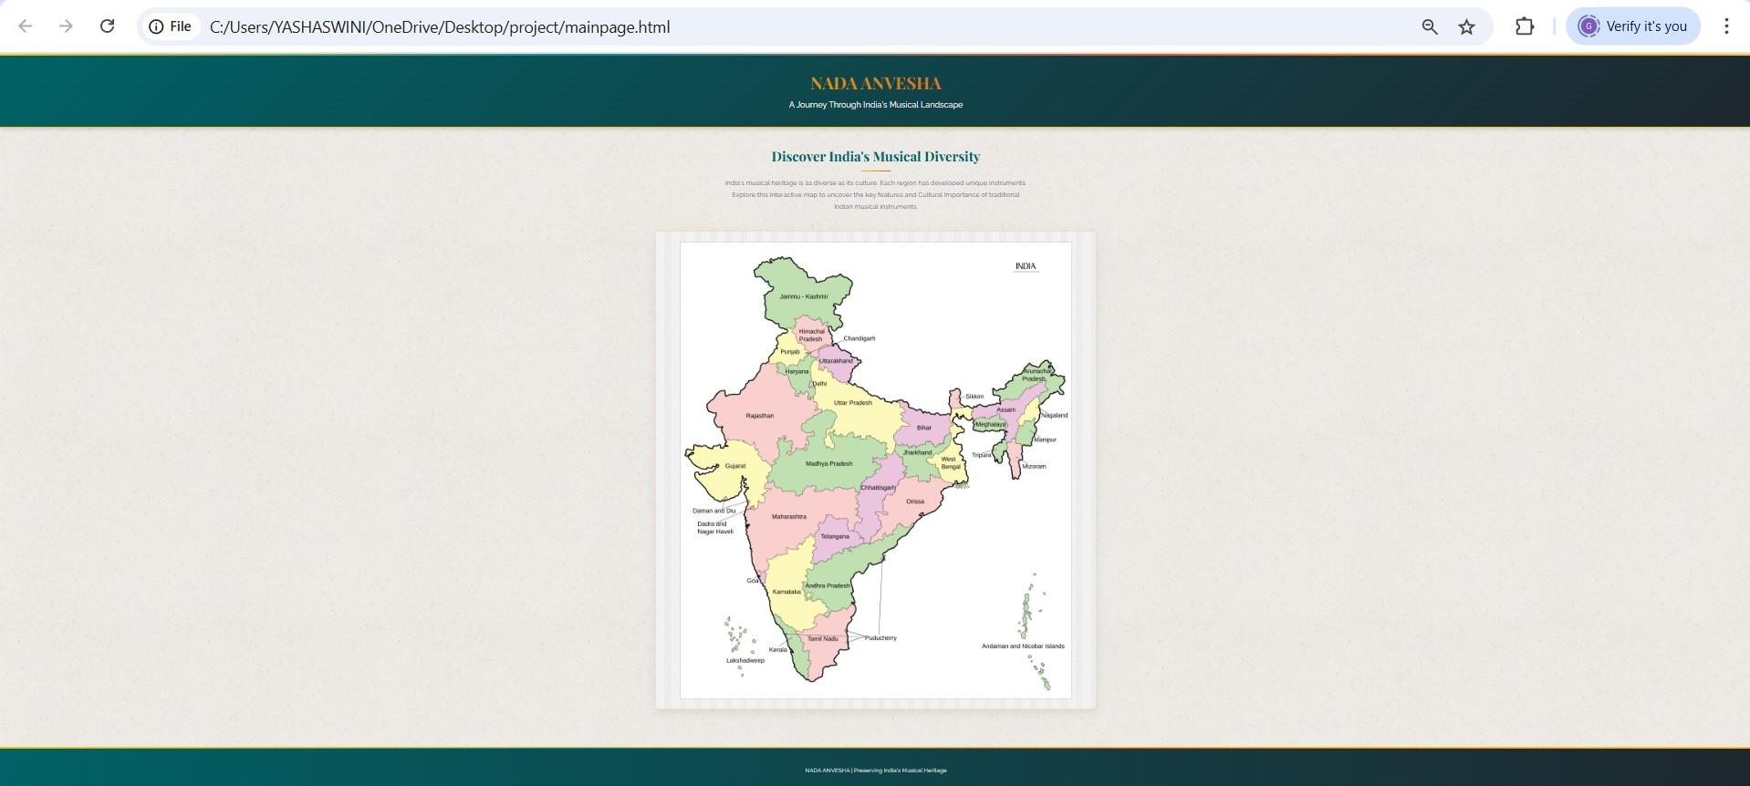

Slide 25
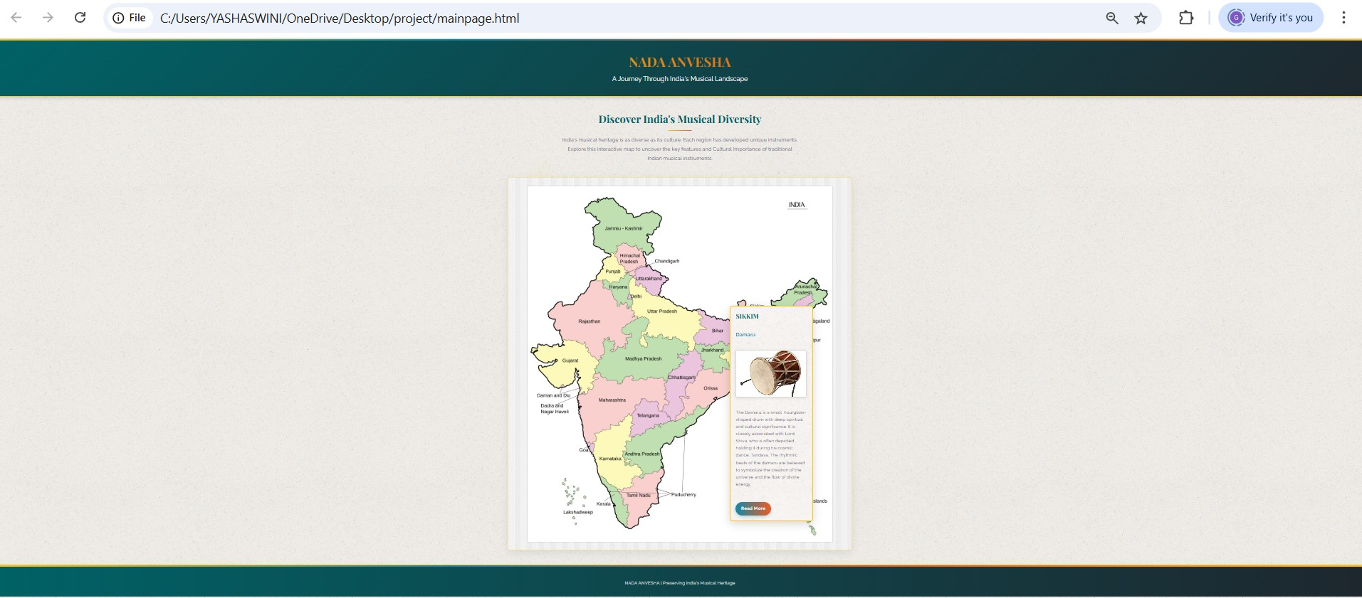

Slide 26
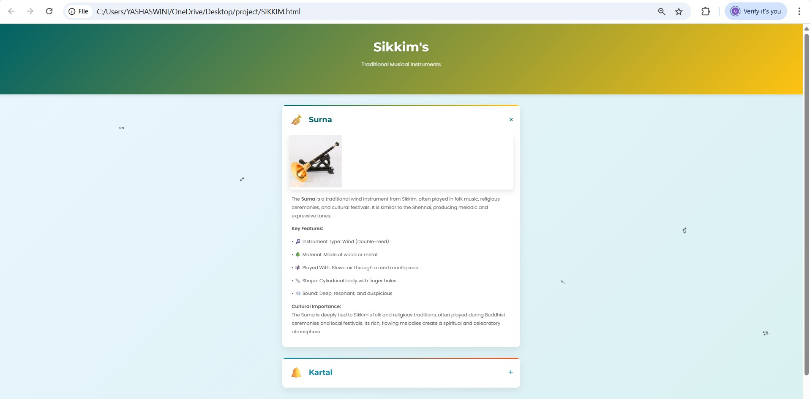

Slide 27
References:
Indian Classical Music Instruments
Musical Instruments of India
17 Traditional Indian Musical Instruments
Wikipedia

Slide 28
Conclusion:
This project will serve as an innovative digital archive of India’s classical musical instruments, combining education with interactivity. By making cultural heritage accessible in an engaging format, it will foster greater appreciation for India’s diverse musical traditions.

Slide 29
Thank You

