Slide 1
GDP Analysis
From: Yashaswini, B. T.

Slide 2
GDP ANALYSIS
Section IA - GDP Analysis of the Indian States
Section II - GDP Analysis of the Indian States except Union Territories
Section III - GDP Analysis of the Categorized Indian States (C1, C2, C3, C4) (excluding Union Territories)
Section IV - Recommendations Section V - GDP and Education Dropout Rates

Slide 3
Section IA - GDP Analysis of the Indian States
This section includes all states, except West Bengal since the data for West Bengal was not available at this stage. Below details are covered:
Average growth rate of all states for 2013-14, 2014-15 and 2015-16 over All India GDP (Page 4)
GDP of the states for the year 2015-16 (Page 5)

Slide 4
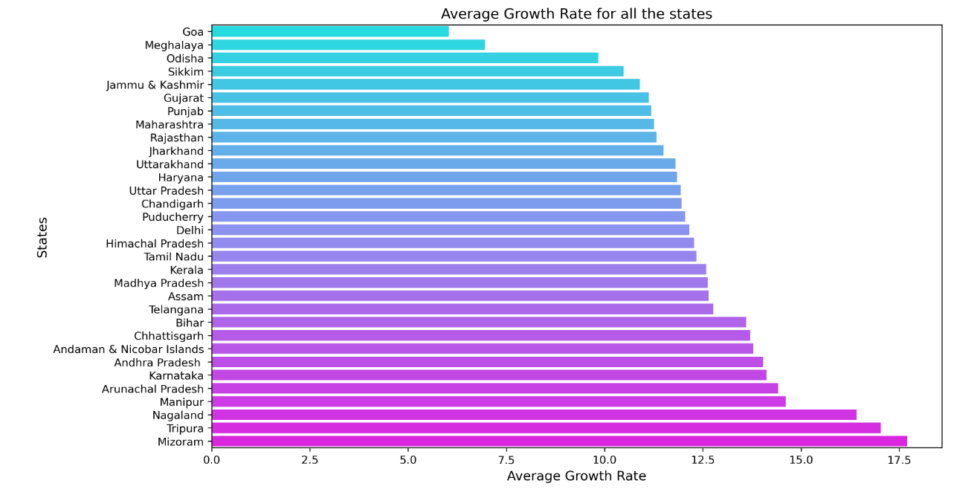
Average growth of states for 2013-14, 2014-15 and 2015-16
Graph is the average growth rate of all states

Slide 5
Top 3 states which are above overall GDP average growth rate (All India) ?
Mizoram - 17.700000
Tripura - 17.03000
Nagaland - 16.415000
Bottom 3 states which are below overall GDP average growth rate (All India)?
Odisha - 9.836667
Meghalaya - 6.953333
Goa - 6.033333
Karnataka’s average growth rate? Above or below national average?
Average Growth Rate of Karnataka: 14.23%
Average Growth Rate of India: 11.87%
Difference in Growth Rate: 2.36%
Average Growth Rate of Karnataka is higher than the Average Growth Rate of India

Slide 6
GDP of the states for the year 2015-16
Top 5 states based on GDP?
Tamil Nadu - 1212668.0
Uttar Pradesh - 1153795.0
Karnataka - 1027068.0
Gujarat - 994316.0
Andhra Pradesh - 609934.0
Bottom 5 states based on GDP?
Chandigarh - 30304.0
Meghalaya - 26745.0
Puducherry - 26533.0
Arunachal Pradesh - 18784.0
Sikkim - 16637.0

Slide 7
Section II - GDP Analysis of the Indian States except Union Territories
This section includes all states, except West Bengal and all Union Territories. This covers for other 28 states This section has majorly focused only for 2014-15 stats and cover below details
GDP per capita for all the states
Contribution of primary, secondary and tertiary sectors as percentage over GDP

Slide 8
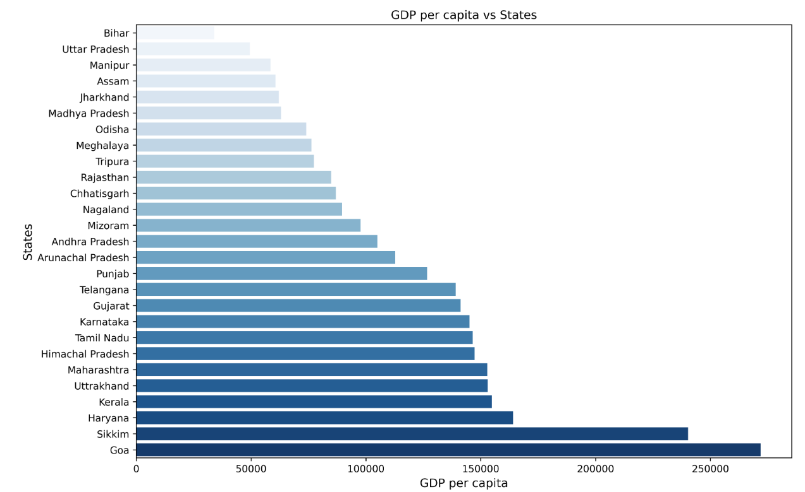
GDP per capita for all the states – 2014-15

Slide 9
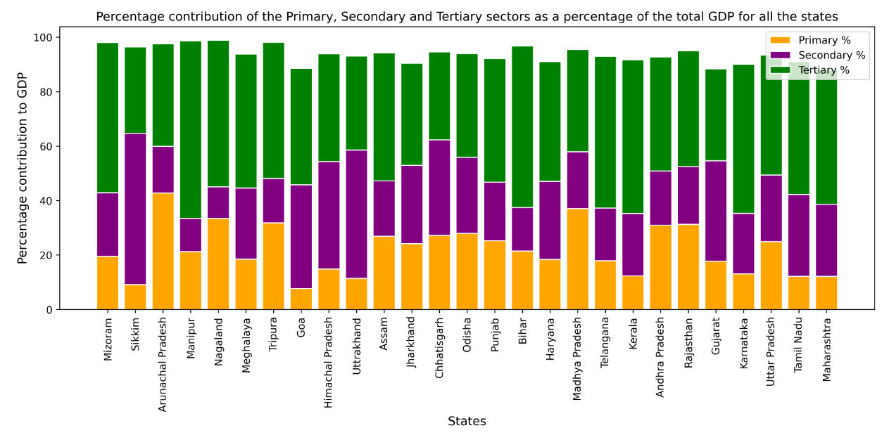
Contribution of primary, secondary and tertiary sectors as percentage over GDP

Slide 10
Section III - GDP Analysis of the Indian States except Union Territories
This section includes all states, except West Bengal and all Union Territories. This covers for other 28 states This section has majorly focused only for 2014-15 stats and cover below details
This section has additionally focused on dividing each states in to categories to understand which states are playing major role in contributing to GDP
Details of category split is covered in page 10 and below other details are captured
C1 States - Sub-Sectors contributing towards GDP (Page 11)
C2 States - Sub-Sectors contributing towards GDP (Page 12)
C3 States - Sub-Sectors contributing towards GDP (Page 13)
C4 States - Sub-Sectors contributing towards GDP (Page 14)

Slide 11
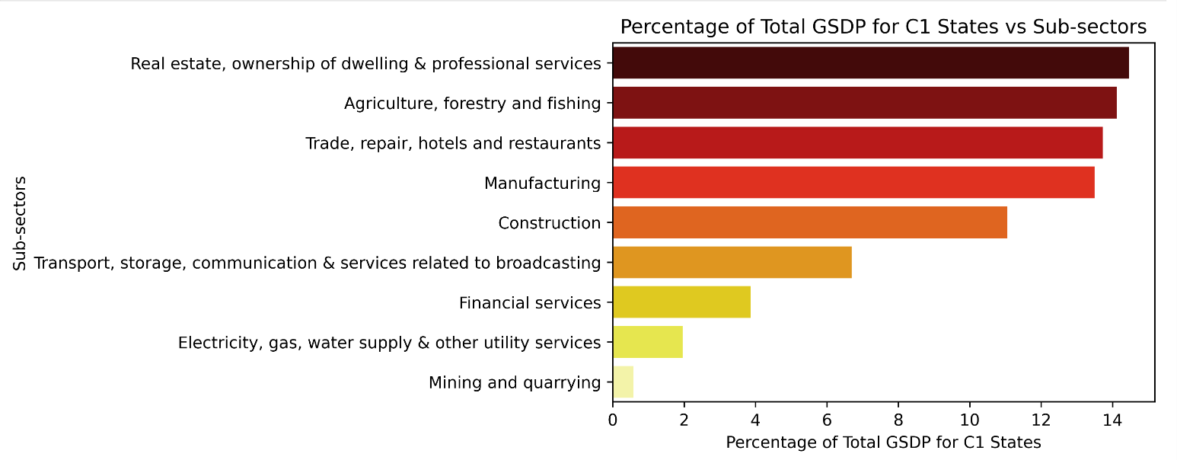
C1 States - Sub-Sectors contributing towards GDP
Top 5 Sub category
Real estate, ownership of dwelling & professional services
Agriculture, forestry and fishing
Trade, repair , hotels and restaurants
Manufacturing
Construction

Slide 12
Findings / Recommendations
We can see that for C1 states sub-sectors like Real Estate, Agriculture, Trade and Hotels, Manufacturing contribute evenly with very high contribution for each category which leads to the overall increase in the GDP for C1 States.
Construction also contributes substantially to the total GDP for C1 states as these states have rapid urbanization taking place which leads to increase in overall GDP.

Slide 13
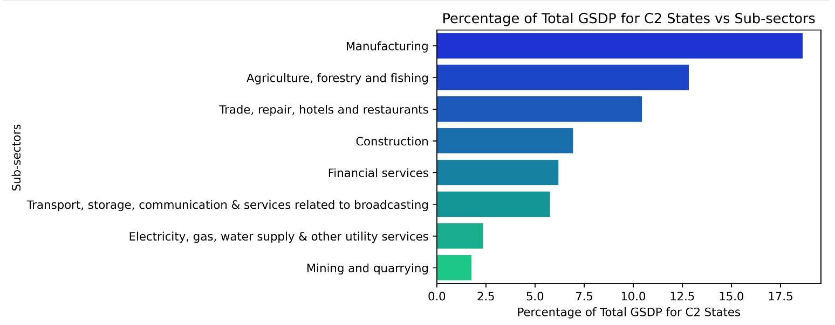
C2 States - Sub-Sectors contributing towards GDP
Top 5 Sub category
Manufacturing
Agriculture, forestry and fishing
Real estate, ownership of dwelling & professional services
Construction
Financial Services

Slide 14
Findings / Recommendations
For C2 states Manufacturing leads in terms of overall contribution to GDP. The states like Gujarat, Karnataka, Tamil Nadu and Maharashtra are considered to be manufacturing hubs of India.
Real Estate and Professional services also contribute substantially to the total GDP for C2 states.
Agriculture forms the backbone of India's GDP so it is obvious that it finds a place in the top 3 sub-sectors for C2 states.

Slide 15
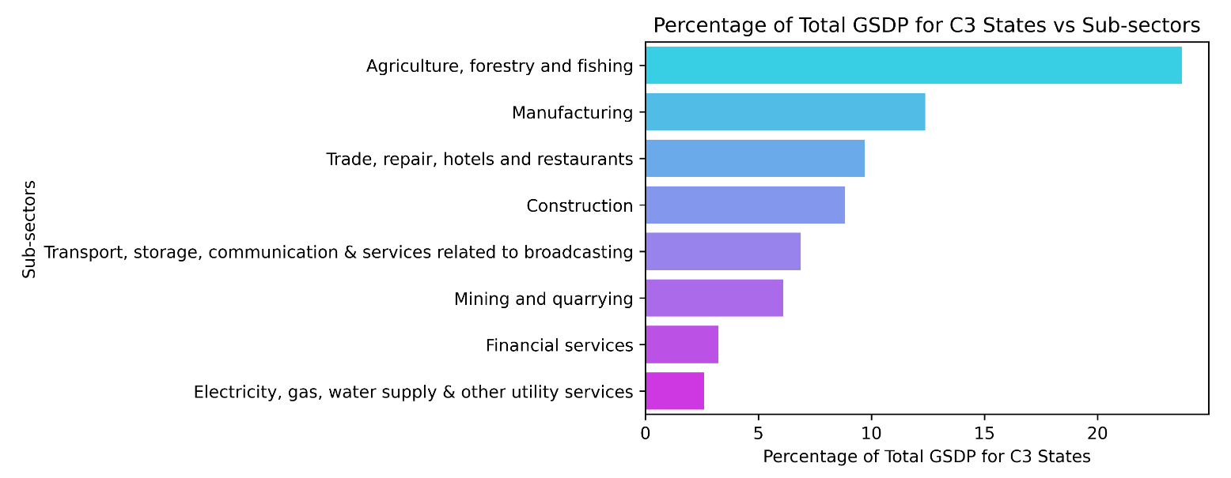
C3 States - Sub-Sectors contributing towards GDP
Top 5 Sub category
Agriculture, forestry and fishing
Manufacturing
Trade, repair, hotels and restaurants
Construction
Transport, storage, communication and service related to broadcasting

Slide 16
Findings / Recommendations
C3 states like Andhra Pradesh, Odisha, Meghalaya, Chhattisgarh, Mizoram have highly arable land and receive good amount of rain every year during the monsoon so it is obvious that Agriculture is the sub-sector that contributes more than 23% to these states.
Manufacturing is at second place contributing about 12% to the overall GDP.

Slide 17
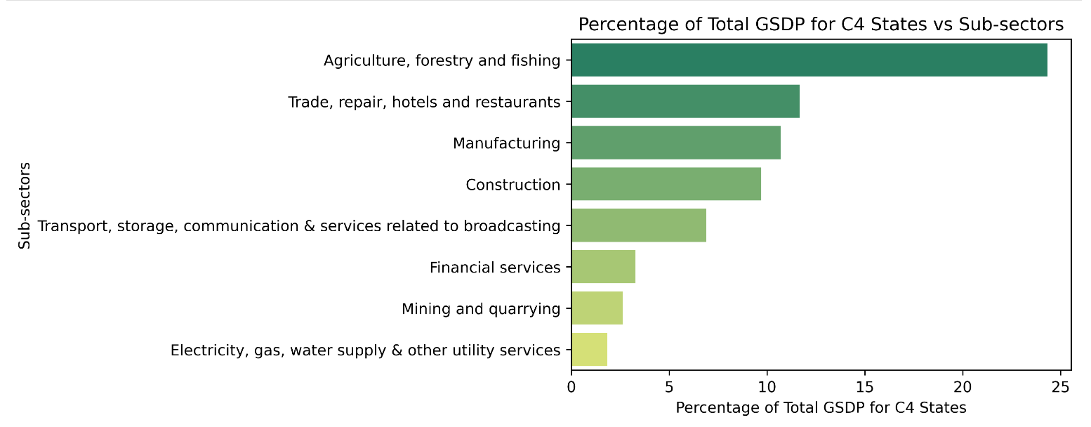
C4 States - Sub-Sectors contributing towards GDP
Top 5 Sub category
Agriculture, forestry and fishing
Trade, repair , hotels and restaurants
Manufacturing
Construction
Transport, storage, communication and service related to broadcasting
Top 5 State

Slide 18
Findings / Recommendations
C4 states like Bihar, Jharkhand, Uttar Pradesh agriculture sector features at top because of majority people involved in farming activities and also area under farming is more in these states.
UP is one of the top tourist attracting states as it is home to some of the most amazing places like Agra which has the Taj Mahal, Varansi, Kashi Vishwanath, Jim Corbett National Park.

Slide 19
Section V - GDP and Education Dropout Rates
The correlation matrix indicates that 2014-15 has a strong negative correlation with Upper Primary (-0.651) and Secondary (-0.581), suggesting an inverse relationship. Primary has a moderate positive correlation with Upper Primary (0.541), while Upper Primary and Secondary show a moderate association (0.509). These relationships hint at contrasting trends across different categories.

