Slide 1
Attribute Based Storage Supporting Secure Deduplication of Encrypted Data in Cloud
K.Yashaswini 2451-16-737-029
Manohar Reddy 2451-16-737-040
V.Nikhileshwar Reddy 2451-16-737-043
Guide: Mr.K.Chandra Sekhar

Slide 2
Contents
Abstract
Introduction
a)Statement of Problem
b)Requirement Specifications
Literature Survey
System Architecture
Modules
Results
Conclusion
Scope for Future Work
References

Slide 3
Abstract
Attribute-based encryption (ABE) has been widely used in cloud computing where a data provider outsources his/her encrypted data to a cloud service provider, and can share the data with users possessing specific credentials (or attributes).
However,the standard ABE system does not support secure deduplication, which is crucial for eliminating duplicate copies of identical data in order to save storage space and network bandwidth.
In our project, we present an attribute-based storage system with secure deduplication in a hybrid cloud setting, where a private cloud is responsible for duplicate detection and a public cloud manages the storage.
It can be used to confidentially share data with users by specifying access policies.
In addition, we put forth a methodology to modify a ciphertext over one access policy into ciphertext
of the same plaintext but under other access policies without revealing the underlying plaintext.

Slide 4
Introduction
Cloud computing greatly facilitates data providers who want to outsource their data to the cloud without disclosing their sensitive data to external parties and would like users with certain credentials to be able to access the data.
This requires data to be stored in encrypted forms with access control policies such that no one except users with attributes (or credentials) of specific forms can decrypt the encrypted data.
An encryption technique that meets this requirement is called attribute-based encryption (ABE), where a user’s private key is associated with an attribute set, a message is encrypted under an access policy (or access structure) over a set of attributes, and a user can decrypt a ciphertext with his/her private key if his/her set of attributes satisfies the access policy associated with this ciphertext.
However, the standard ABE system fails to achieve secure deduplication, which is a technique to save storage space and network bandwidth by eliminating redundant copies of the encrypted data stored in the cloud.
So, It would be desirable to design a cloud storage system possessing both properties-ABE and deduplication.
/*On the other hand, to the best of our knowledge, existing constructions for secure deduplication are not built on attribute-based encryption.
Nevertheless, since ABE and secure deduplication have been widely applied in cloud computing, it would be desirable to design a cloud storage system possessing both properties.*/

Slide 5
Statement of Problem
In a typical storage system, to store a file in the cloud, a data provider generates a tag and a cipher text. The data provider uploads the tag and the cipher text to the cloud.
Upon receiving an outsourcing request from a data provider for uploading a cipher text and an associated tag, the cloud runs a so-called equality checking algorithm, which checks if the tag in the incoming request is identical to any tags in the storage system.
If there is a match, then the underlying plaintext of this incoming cipher text has already been stored and the new cipher text is discarded.
It is apparent that such a system with a tag appended to the ciphertext does not provide the standard notion of semantic security for data confidentiality.

Slide 6
Requirements Specifications
HARDWARE REQUIREMENTS:
System : Pentium IV 2.4 GHz.
Hard Disk : 40 GB.
Monitor :15 VGA Colour
RAM : 1 GB.
SOFTWARE REQUIREMENTS:
Operating system : Windows 10
Coding Language : JAVA/J2ME
Technology : JSP
Platform :Netbeans IDE
Data Base : MYSQL

Slide 7
LITERATURE SURVEY
Cipher text-policy Attribute-based encryption
In several distributed systems a user should only be able to access data if a user possess a certain set of credentials or attributes. Currently, the only method for enforcing such policies is to employ a trusted server to store the data and mediate access control. However, if any server storing the data is compromised, then the confidentiality of the data will be compromised.
In this project we present a system for realizing complex access control on encrypted data that we call ciphertext-policy attribute-based encryption.
By using our techniques encrypted data can be kept confidential even if the storage server is untrusted; moreover, our methods are secure against collusion attacks.
Previous attribute-based encryption systems used attributes to describe the encrypted data and built policies into user's keys; while in our system attributes are used to describe a user's credentials, and a party encrypting data determines a policy for who can decrypt.

Slide 8
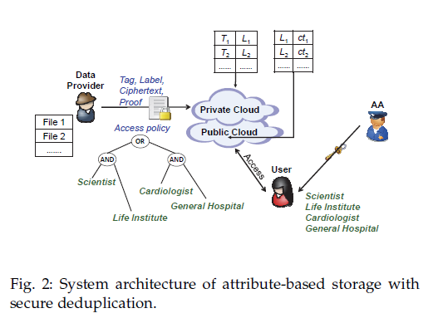
System Architecture

Slide 9
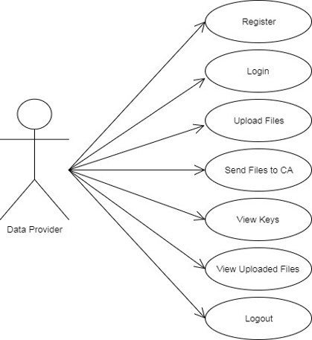
Use Case Diagram(Data Provider)

Slide 10
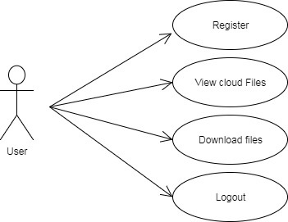
Use Case Diagram(User)

Slide 11
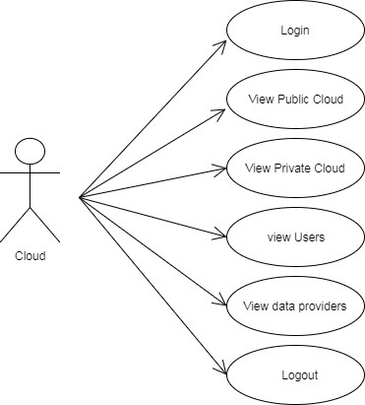
Use Case Diagram(Cloud)

Slide 12
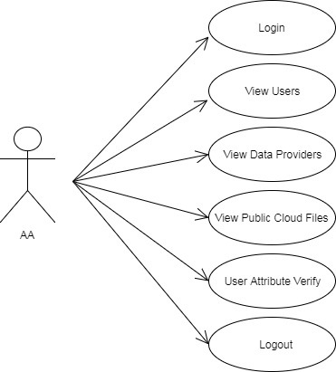
Use Case Diagram(Attribute Authority)

Slide 13
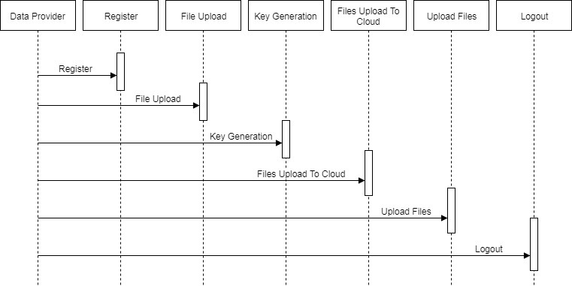
Sequence Diagram(Data Provider)

Slide 14
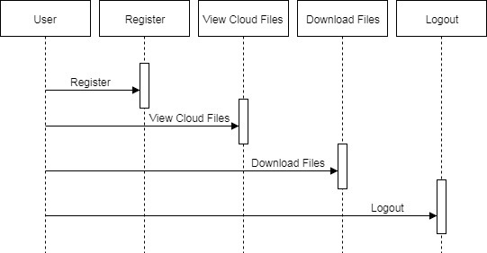
Sequence Diagram(User)

Slide 15
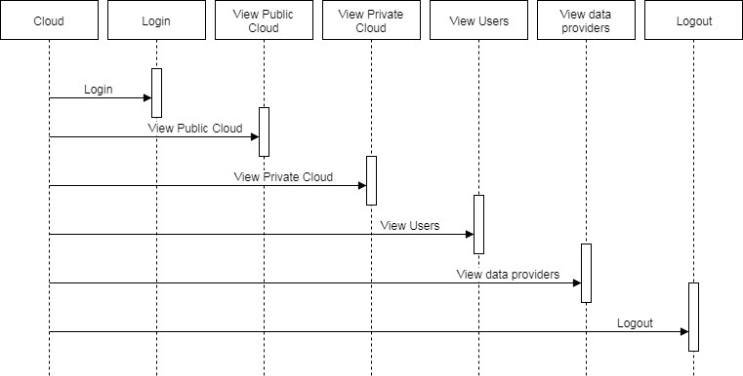
Sequence Diagram(Cloud)

Slide 16
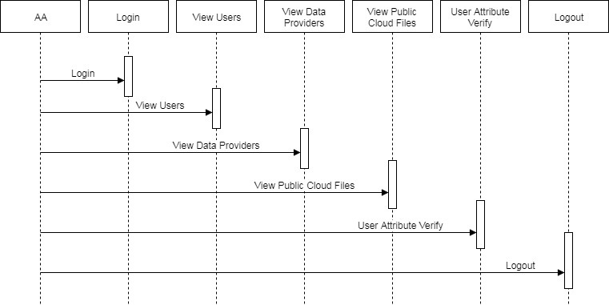
Sequence Diagram(Attribute Authority)

Slide 17
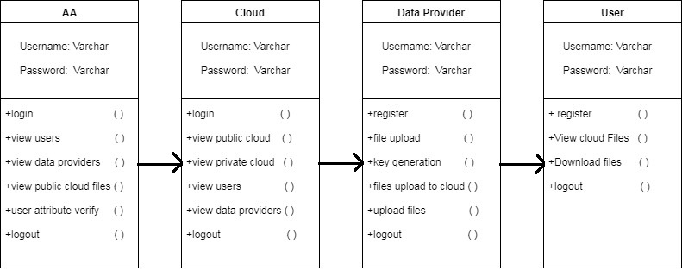
Class Diagram:

Slide 18
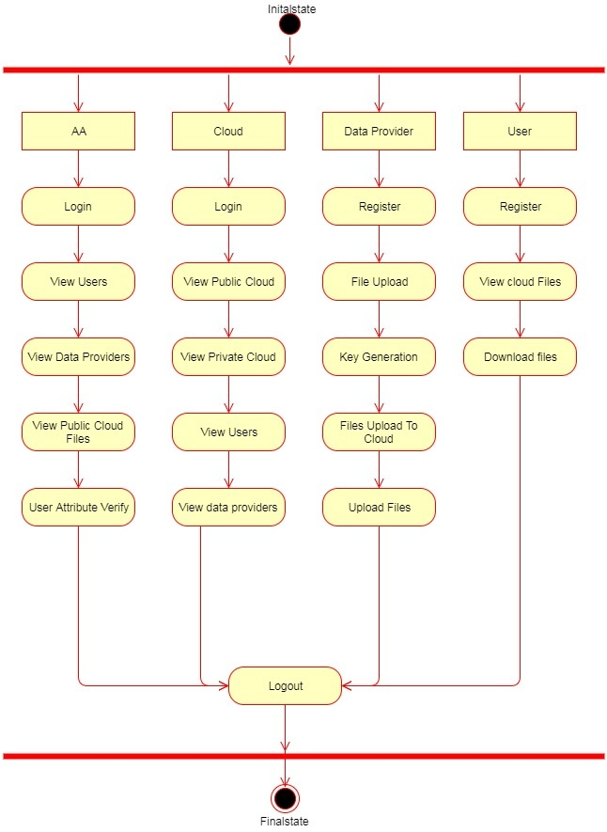
Activity Diagram:

Slide 19
Modules
Data Provider:
A data provider wants to outsource his/her data to the cloud and share it with users possessing certain credentials.
When sending a file storage request, each data provider firstly creates a tag T and a label L associated with the data, and then encrypts the data under an access structure over a set of attributes. Also, each data provider generates a proof pf on the relationship of the tag T, the label L and the encrypted message ct3, but this proof will not be stored anywhere in the cloud and is only used during the checking phase for any newly generated storage request.
User Module:
At the user side, each user can download an item, and decrypt the ciphertext with the attribute-based private key generated by the AA if this user’s attribute set satisfies the access structure. Each user checks the correctness of the decrypted message using the label, and accepts the message if it is consistent with the label.

Slide 20
Modules
Private Cloud:
It stores the private key which is used to encrypt the plain text to cipher text .
The private cloud performs certain computation such as tag checking.
After receiving the storage request the private cloud checks the validity and tests the equality of the new tag with existing tags in the system.
If there is no match for this new tag then the encrypted data is added to the public cloud for storage.
Public Cloud:
The cloud consists of a public cloud which is in charge of data storage.
Attribute Authority:
The AA issues every user a decryption key associated with his/her set of attributes.

Slide 21
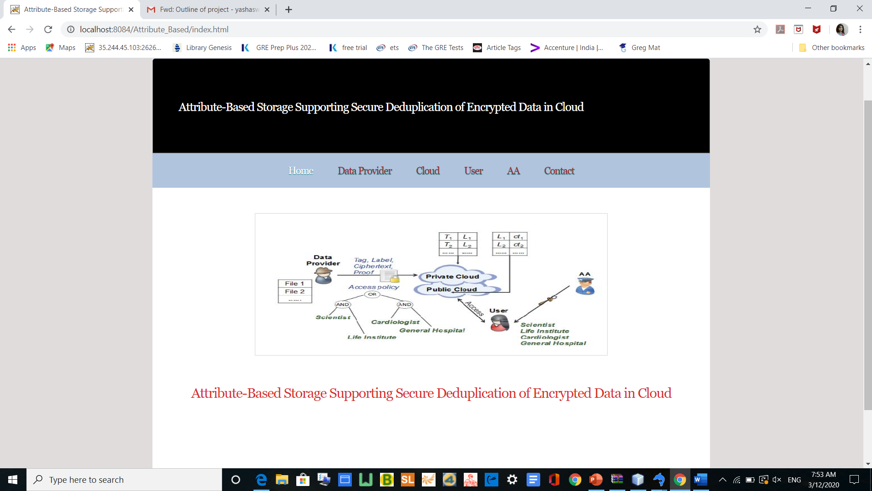
Results

Slide 22
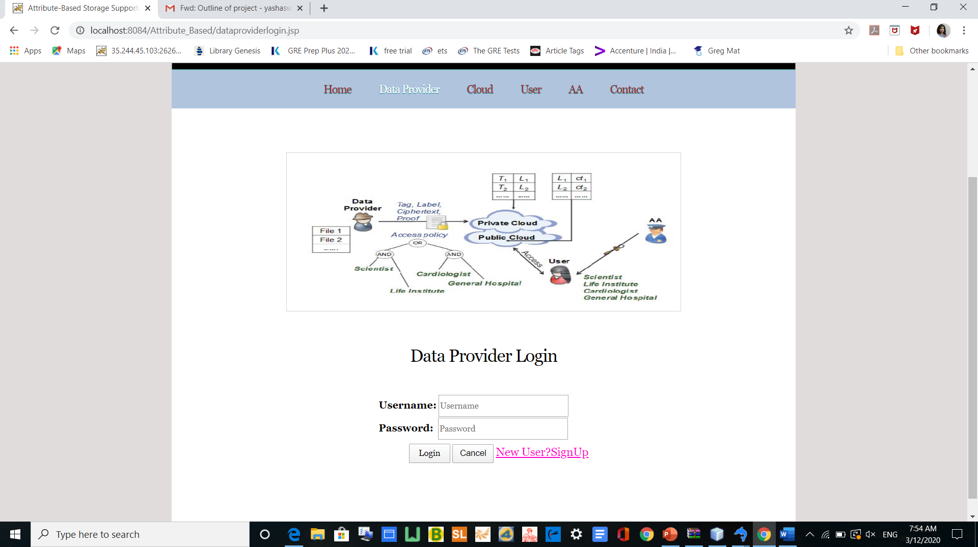
Data Provider Module

Slide 23
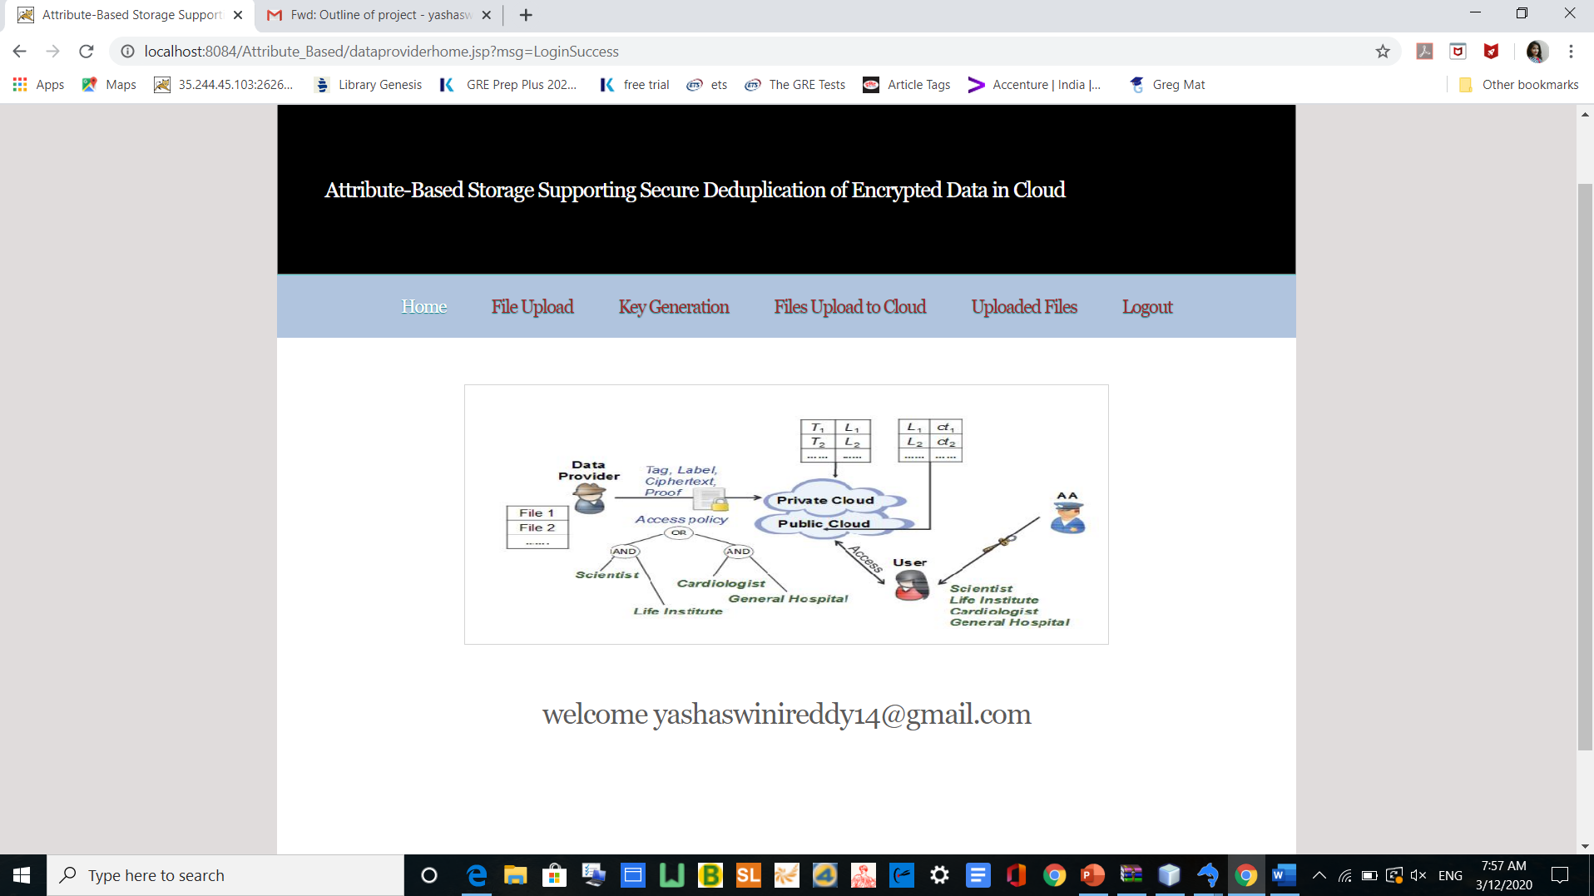
Data Provider

Slide 24
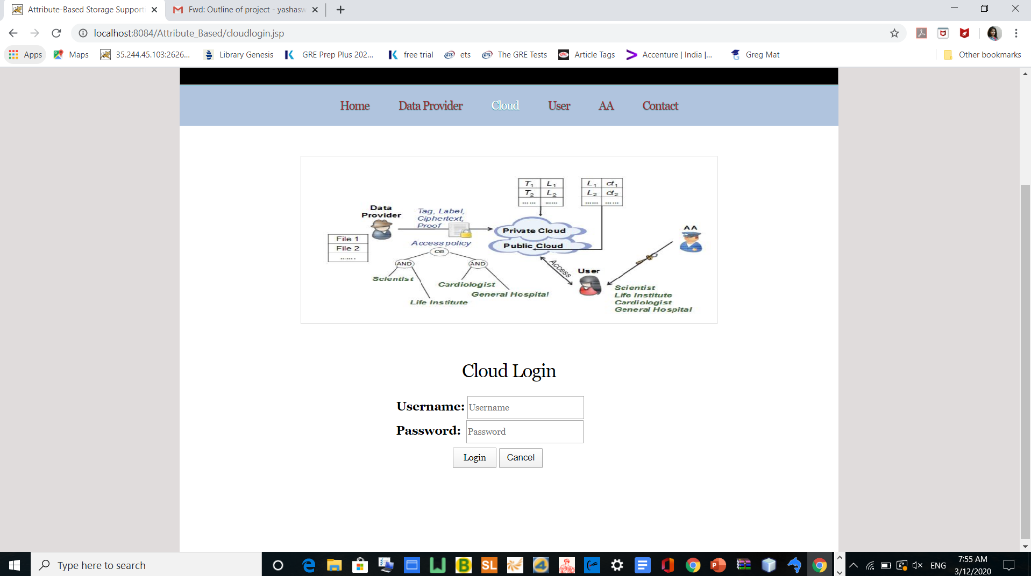
Cloud Module

Slide 25
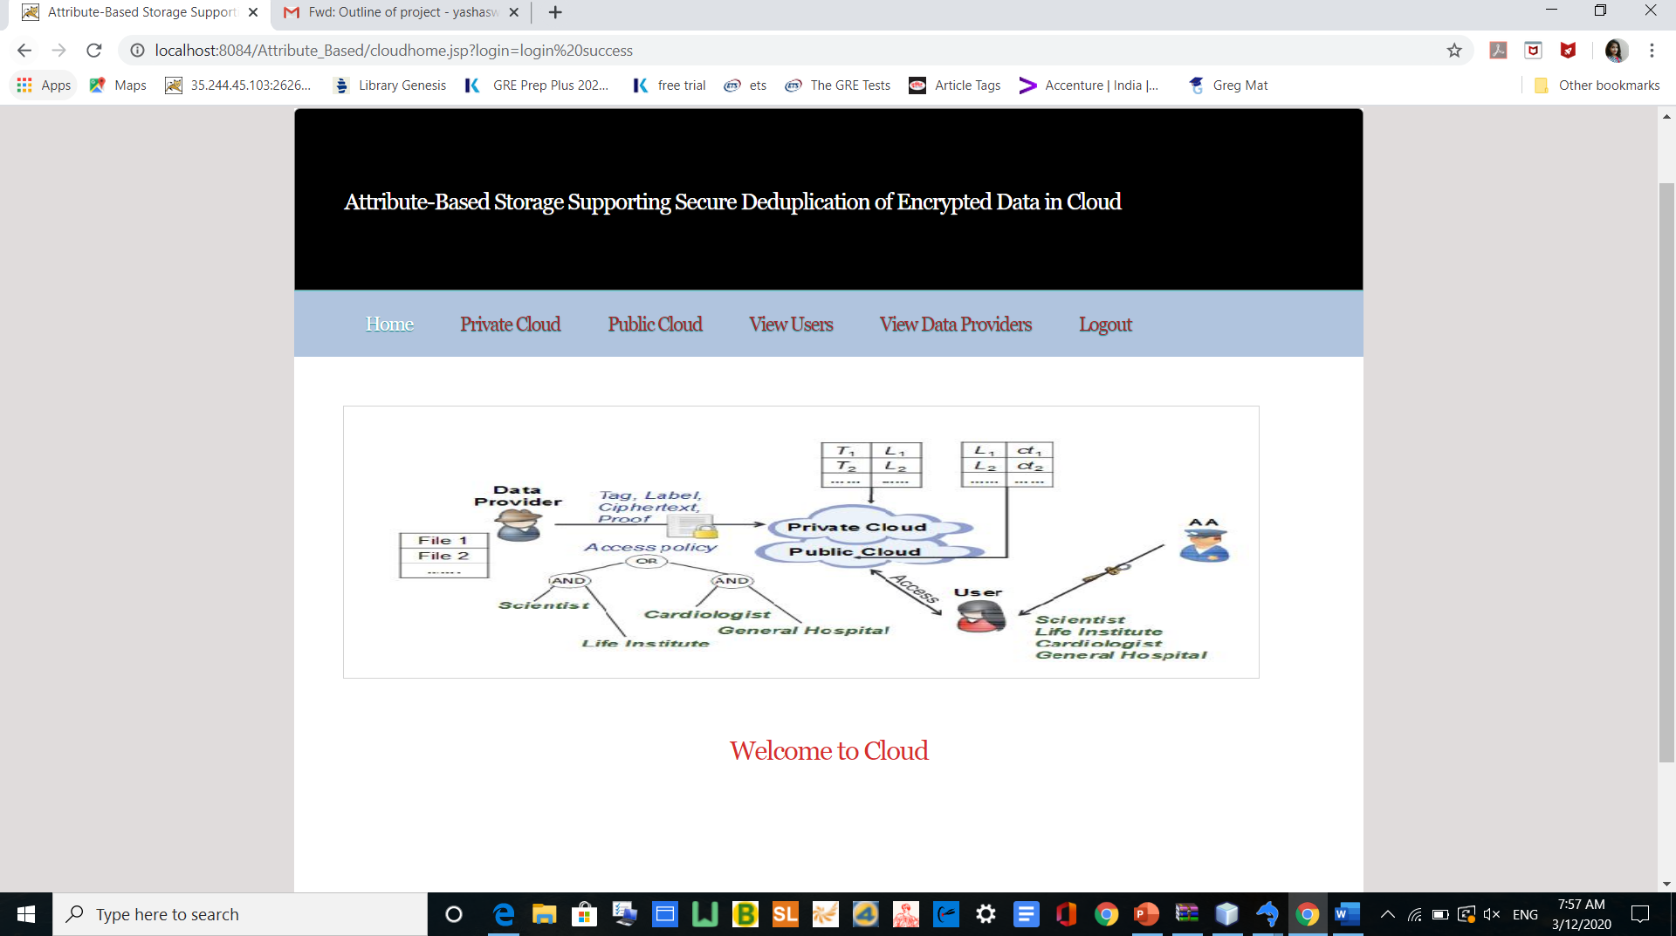
Cloud

Slide 26
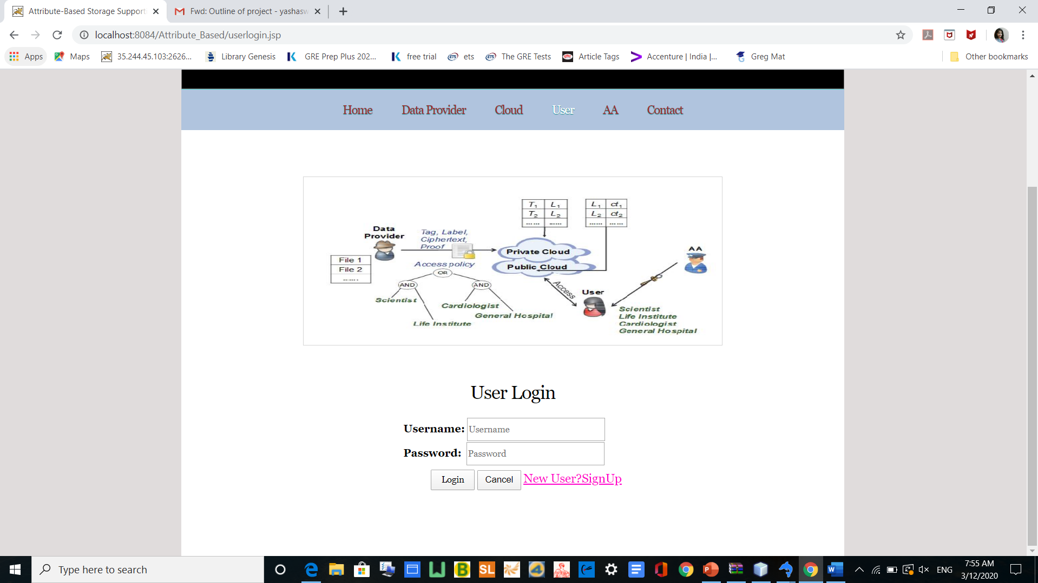
User Module

Slide 27
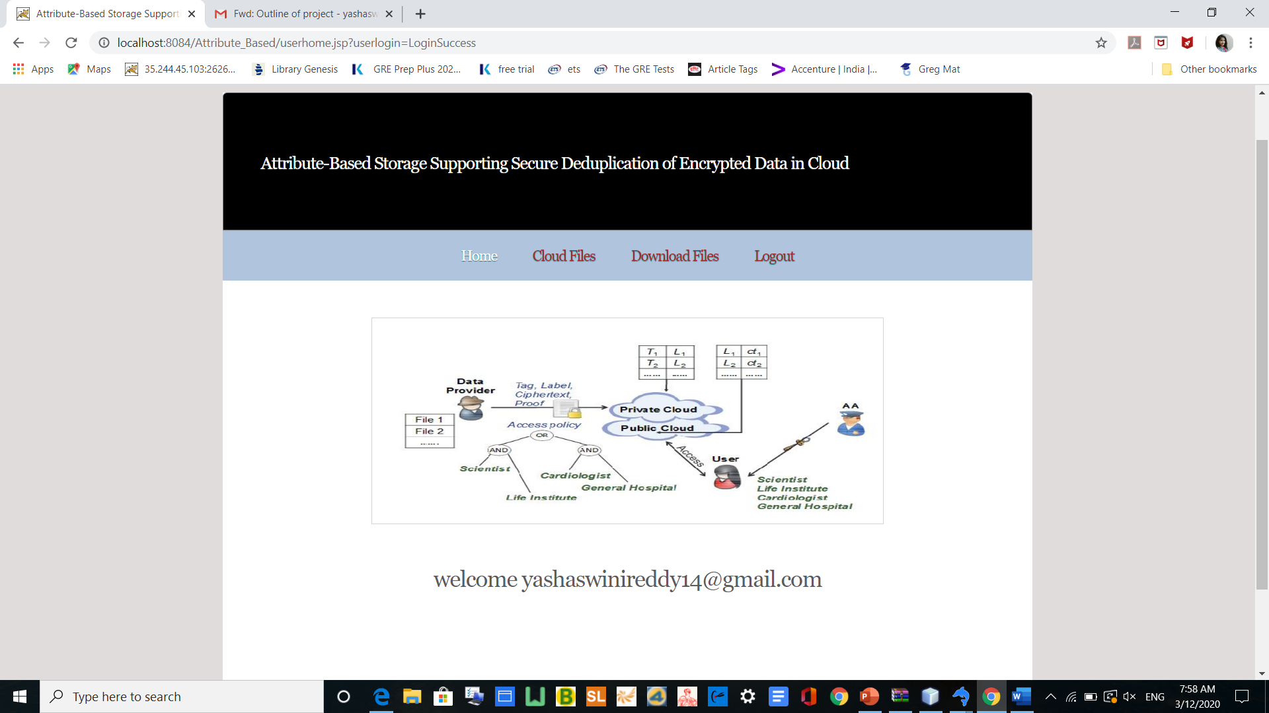
User

Slide 28
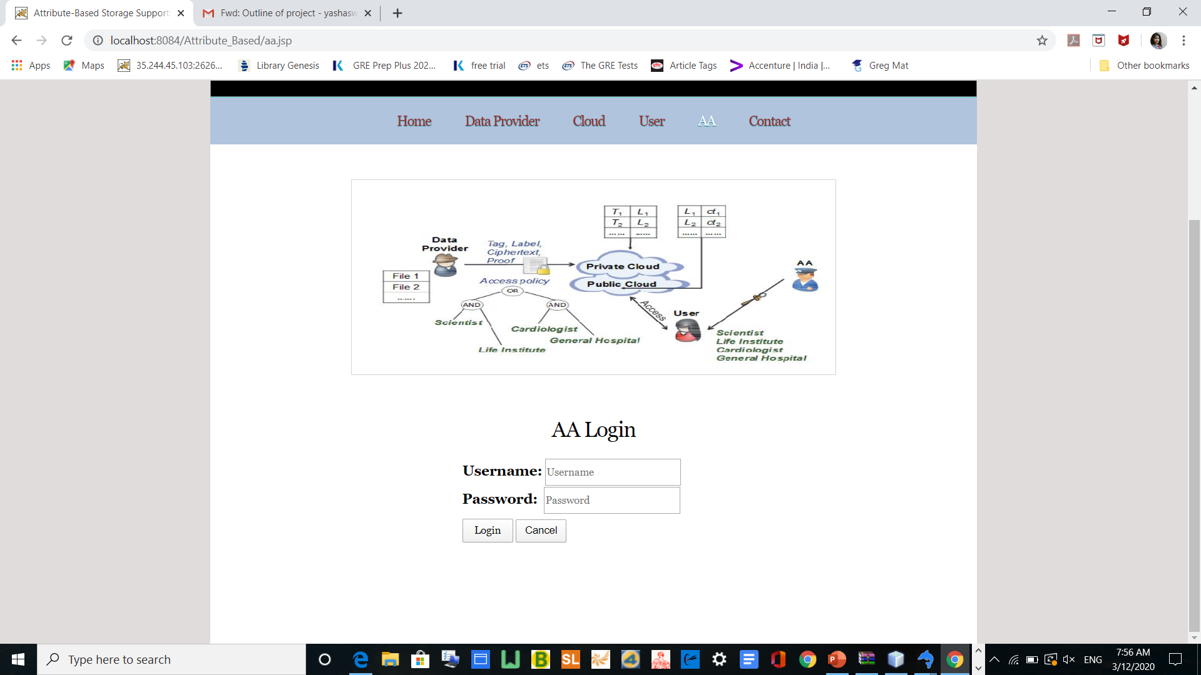
Attribute Authority Module

Slide 29
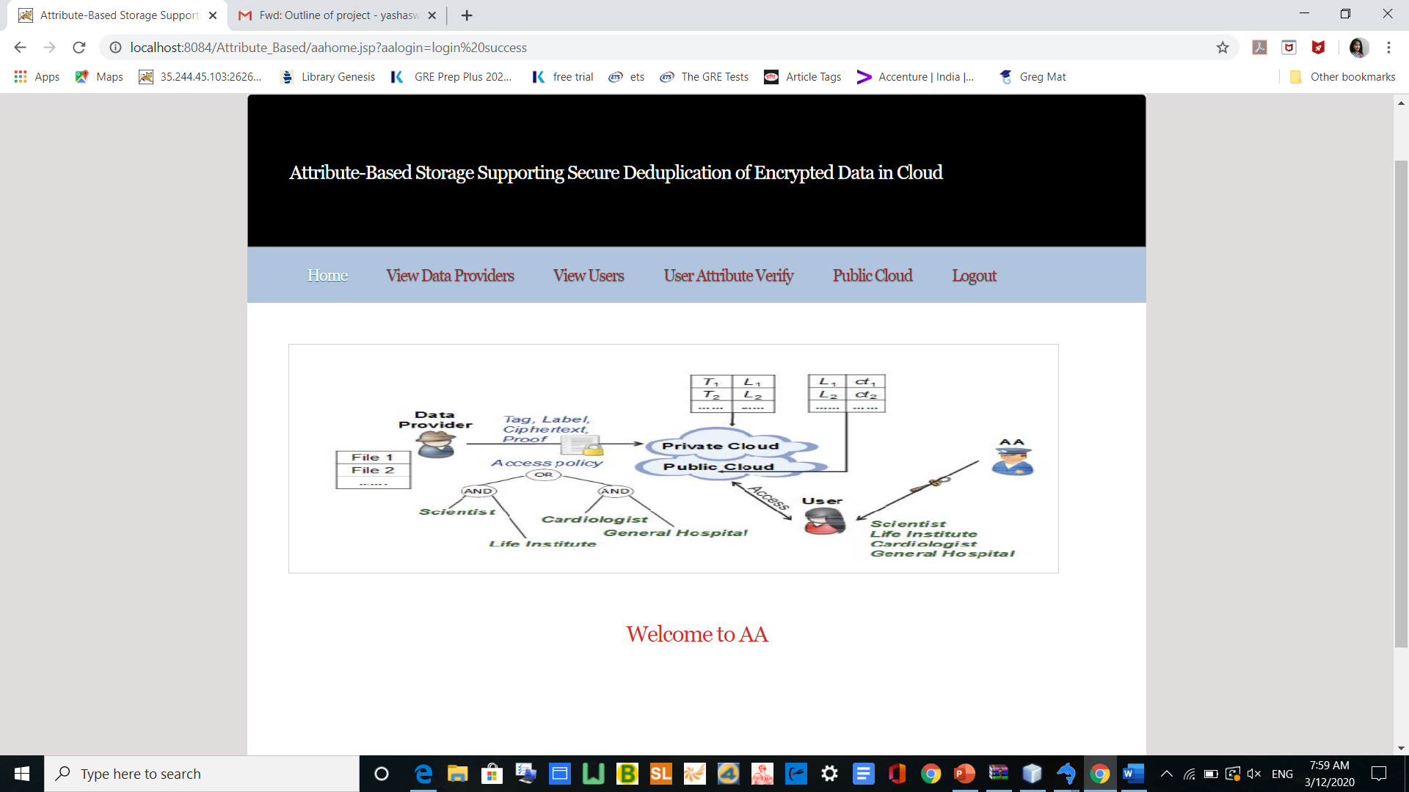
AA

Slide 30
Conclusion
Our storage system is built under a hybrid cloud architecture.
Firstly, it can be used to confidentially share data with other users by specifying an access policy .
Secondly, it achieves the standard notion of semantic security while existing deduplication schemes only achieve it under a weaker security notion.

Slide 31
Scope for Future Work
It is not possible to develop a system that makes all the requirements of the user. User requirements keep changing as the system is being used. Some of the future enhancements that can be done to this system are:
As the technology emerges, it is possible to upgrade the system and can be adaptable to desired environment.
Based on the future security issues, security can be improved using emerging technologies.

Slide 32
References
Hui Cui, Robert H. Deng, Yingjiu Li, and Guowei Wu,”Attribute-Based Storage Supporting Secure Deduplication of Encrypted Data in Cloud”
J. Lai, R. H. Deng, Y. Yang, and J. Weng, “Adaptable ciphertextpolicy attribute-based encryption,” in Pairing-Based Cryptography -Pairing 2013 - 6th International Conference, Beijing, China, November 22-24, 2013, Revised Selected Papers, ser. Lecture Notes in Computer Science, vol. 8365. Springer, 2013, pp. 199–214.
B. Waters, “Ciphertext-policy attribute-based encryption: An expressive, efficient, and provably secure realization,” in Public KeyCryptography - PKC 2011 - 14th International Conference on Practice and Theory in Public Key Cryptography, Taormina, Italy, March 6-9, 2011. Proceedings, ser. Lecture Notes in Computer Science, vol. 6571. Springer, 2011, pp. 53–70.
B. Lewko and B. Waters, “Decentralizing attribute-based encryption,” in Advances in Cryptology - EUROCRYPT 2011 - 30thAnnual International Conference on the Theory and Applications of Cryptographic Techniques, Tallinn, Estonia, May 15-19, 2011. Proceedings, ser. Lecture Notes in Computer Science, vol. 6632. Springer, 2011, pp. 568–588.

Slide 33
THANK YOU

