Slide 1
ISE 200 · Financial Methods for Engineers · SJSU Spring 2026
Economic Feasibility of
AI Chatbot Adoption
for University Student Support
From : Yashaswini Mohan and Sugapriya Sridharan
GROUP 8

Slide 2
Presentation Outline
01
Problem Statement
11
Sensitivity : Workforce Reduction
02
Engineering Economy Principles
12
Sensitivity : MARR
03
Project Selection & Justification
13
Sensitivity: Setup Cost & Subscription
04
Data Sources
14
Dashboard & Comparison
05
Methods & Excel Tool Architecture
15
Real-World Application
06
Input Parameters
16
Economic, Social & Environmental Impact
07
Cash Flow Model
17
Discussion & Limitations
08
NPV Results
18
Conclusion & Recommendation
09
IRR & BCR Results
19
References
10
Discounted Payback Analysis

Slide 3
Problem Statement
The Challenge
Q1
Do chatbots generate positive NPV at 8% MARR?
University student support staff handle thousands of routine inquiries daily which includes financial aid, registration, advising at significant labor cost. Rising wages and growing enrollment make current staffing models unsustainable.
The question: Can AI chatbots economically replace a meaningful share of this workload?
Q2
How sensitive is NPV to workforce reduction rate, MARR, and costs?
The Decision
Four universities : UC Berkeley, Stanford, Arizona State, and SJSU , must decide whether to invest in an AI chatbot platform. This requires a rigorous engineering economic analysis: quantify costs, quantify benefits, compute NPV, and make a data-driven Accept/Reject decision.
Q3
Which institution has the strongest economic case?

Slide 4
Engineering Economy Principles Applied
How This Project Applies ISE 200 Concepts
Time Value of Money
MARR & Opportunity Cost
Future labor savings are discounted to present value using the NPV formula: NPV = −I₀ + Σ[CFₜ / (1+MARR)ᵗ]
University MARR = 8% (NACUBO endowment study). Any investment must beat this hurdle rate to Accept.
Cash Flow Modeling
IRR Analysis
Year 0 = investment outflow. Years 1–5 = net cash flows (labor savings minus subscription + maintenance).
IRR = the rate where NPV = 0. All four universities show IRR of 153–253%, far above the 8% MARR.
Benefit-Cost Ratio
Sensitivity Analysis
BCR = PV of benefits / total costs. BCR > 1.0 confirms economic justification.
NPV tested under different workforce reduction rates, MARR values, setup costs, and subscription tiers.

Slide 5
Data Sources — All Values from Public Datasets
BLS OEWS May 2024
EDUCAUSE 2023
Annual wages by MSA
FTE counts & setup costs
SOC 43-4051 Customer Service Reps: SF=$54,080 · San Jose=$62,400 · Phoenix=$43,470
Core Data Table S117: student support FTE by Carnegie class · Enterprise App Survey: chatbot integration costs $50K–$145K
McKinsey GI 2023
Vendor Pricing 2024
Workforce reduction %
Annual subscriptions
"Economic Potential of Generative AI" customer ops productivity gain 30–45%. Base case = 35%.
Zendesk Enterprise $18K · Salesforce Service Cloud $14.4K · ServiceNow ITSM $32.4K · Zendesk Growth (SJSU) $12K
Gartner IT Metrics 2023
NACUBO Endowment 2023
Maintenance cost & SaaS escalation
MARR / University WACC
Higher Ed helpdesk O&M = 7.5–8.5% of setup cost. SaaS prices rising 4–6%/yr.
10-yr endowment mean 7.7% · Moody's Aa3 muni bonds 4.5–5.0% · Blended WACC = 8%

Slide 6
Project Selection & Justification
Why these four universities? Why AI chatbots?
UC Berkeley
Stanford Univ.
Arizona State
SJSU
Enrollment:
45,000 students
Enrollment:
17,000 students
Enrollment:
83,000 students
Enrollment:
35,751 students
Type:
Large Public R1
Type:
Small Private R1
Type:
Very Large Public R1
Type:
Doctoral Non-R1
MSA:
SF-Oakland MSA
MSA:
San Jose MSA
MSA:
Phoenix MSA
MSA:
San Jose MSA
Avg Wage:
$54,080/yr
Avg Wage:
$62,400/yr
Avg Wage:
$43,470/yr
Avg Wage:
$62,400/yr
FTE:
12 FTE
FTE:
6 FTE
FTE:
25 FTE
FTE:
8 FTE

Slide 7
Methods & Automated Excel Tool Design
Inputs
Inout Data from Public Dataset
Key Formulas
Year 1 Labor Savings
Cash Flows
5-year end-of-year model. Year 0 = investment. Years 1–5 = labor savings minus costs.
= Staff × Wage × Reduction%
Year t Net CF
= Savingsₜ - Costsₜ
Economic Metrics
NPV, IRR, BCR, payback : all auto-calculated from Cash Flows.
NPV
= NPV(MARR, Y1:Y5) − Y0
Sensitivity
4 sections: workforce %, MARR, setup cost, subscription helper columns show every step.
IRR
= IRR(Y0:Y5)
BCR
Dashboard
Executive summary pulling from all sheets. Live update on input change.
= PV Benefits / Total Costs
Sensitivity
Charts
10 embedded charts with live data ranges. All chart series link to dashboard data table.
= NPV(rate, helper cols) − I₀

Slide 8
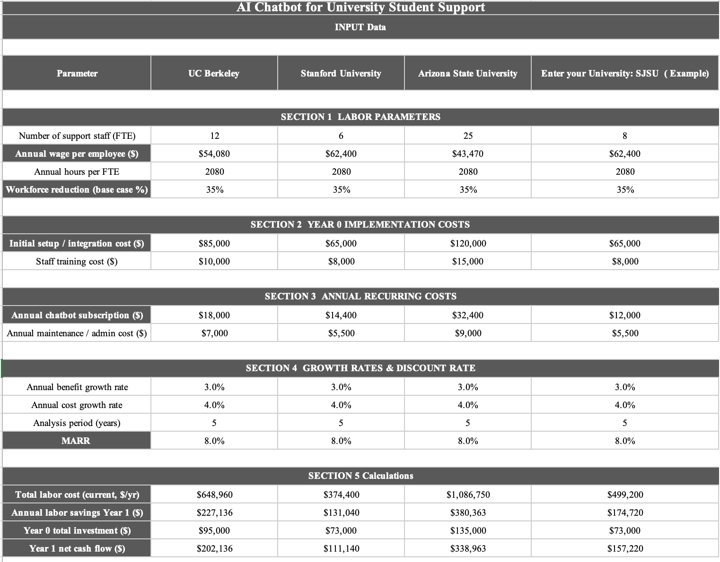
Inputs
Total labor cost (current, $/yr) = FTE × Annual Wage
Annual labor savings Year 1 ($) = FTE × Wage × Reduction %
Year 0 total investment ($) = Setup Cost + Training Cost
Year 1 net cash flow ($) = Labor Savings − Subscription − Maintenance

Slide 9
5-Year Cash Flow Model — UC Berkeley (Worked Example)
Year 0 = Investment outflow · Years 1–5 = Labor savings minus subscription and maintenance
Year
Labor Savings
Subscription
Maintenance
Net Cash Flow
0 (Today)
−$95,000
—
—
−$95,000
1
$227,136
−$18,000
−$7,000
$202,136
2
$233,950
−$18,720
−$7,280
$207,950
3
$240,969
−$19,469
−$7,571
$213,929
4
$248,198
−$20,248
−$7,874
$220,076
5
$255,644
−$21,057
−$8,189
$226,397
Net Cash Flow = Labor Savings − Subscription − Maintenance
Discount Factor = 1 / (1 + MARR)^t
PV of Cash Flow = Net Cash Flow × Discount Factor
Cumulative PVₜ = Previous Cumulative PV + Current PV

Slide 10
5-Year Cash Flow Model
Labor savings are calculated as FTE × Wage × 35% reduction in workload
Savings increase at 3% annually due to expected wage growth over time
Subscription and maintenance costs grow at 4% annually based on SaaS pricing trends
Net Cash Flow is calculated as labor savings minus subscription and maintenance costs
Year 0 represents the initial investment including setup and training costs
Years 1–5 represent recurring annual savings and operating costs
Labor savings remain significantly higher than recurring costs across all years
Net cash flow is positive from Year 1 and increases each year
Early positive cash flows result in a fast recovery of the initial investment
All cash flows are discounted at 8% MARR for financial evaluation (NPV, IRR)

Slide 11
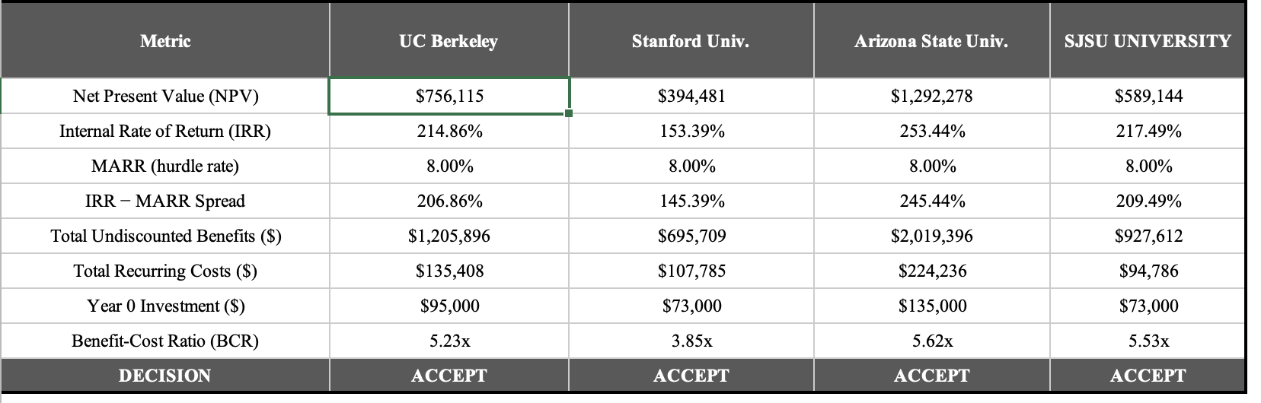
Economic Metrics = NPV, IRR, Payback, BCR, Decision
NPV = NPV(MARR, Year1:Year5) + Year0
IRR = IRR(Year0:Year5)
IRR-MARR Spread = IRR - MARR
Total Undiscounted Benefits = SUM(LaborSavings_Year1:Year5)
Total Recurring Costs ($) = =SUM(Subscription_Year1:Year5) + SUM(Maintenance_Year1:Year5)
Year 0 Investment ($) = SetupCost + TrainingCost
Benefit-Cost Ratio (BCR) = PV_Benefits / PV_Costs
Decision = IF(NPV_cell > 0, "ACCEPT", "REJECT")

Slide 12
NPV Results — All Four Universities ACCEPT
NPV = NPV(8%, Year1:Year5) − Year0 Investment · Positive NPV = project earns above MARR
UC Berkeley
Stanford
Arizona State
SJSU
$756,115
$394,481
$1,292,278
$589,144
ACCEPT
ACCEPT
ACCEPT
ACCEPT
NPV Comparison ($)
$1292K
$756K
$589K
$394K
UCB
SU
ASU
SJSU

Slide 13
IRR & Benefit-Cost Ratio
UC Berkeley
Stanford
Arizona State
SJSU
IRR
IRR
IRR
IRR
215%
153%
253%
217%
BCR
BCR
BCR
BCR
5.23×
3.85×
5.62×
5.53×
207 pp above MARR
145 pp above MARR
245 pp above MARR
209 pp above MARR
IRR = the annual return rate the project earns on the investment. If IRR > MARR (8%), the project is profitable : Accept. BCR > 1.0 means total present value of benefits exceeds total costs. All four universities show BCRs between 3.85× and 5.62×.

Slide 14
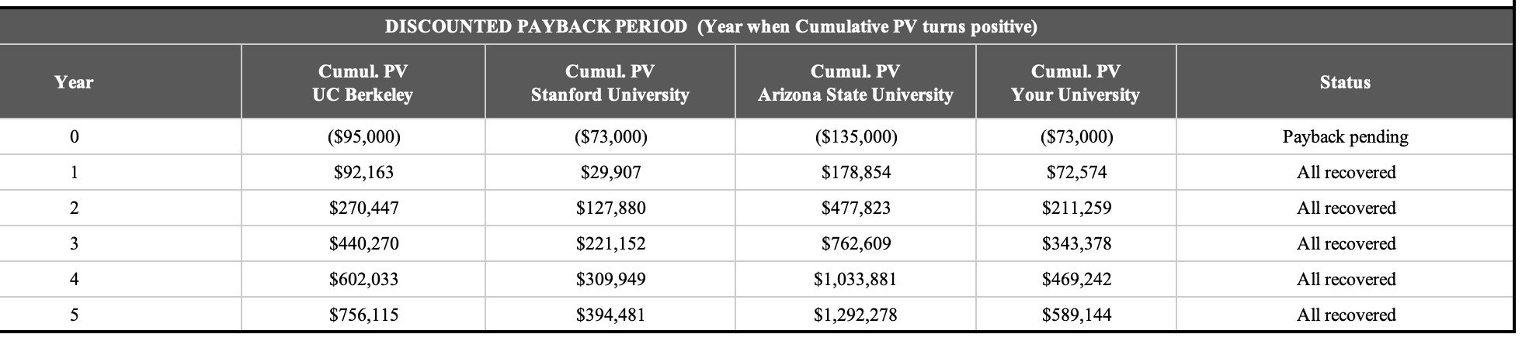
Discounted Payback Period analysis
Year 0 Cumulative PV = − (Setup + Training)
PV of Cash Flow = Net Cash Flow / (1 + MARR)^t
Cumulative PV: Previous_Cumulative_PV + Current_PV
Status = Are all cumulative PV values ≥ 0 ? "All recovered" or "Payback pending"
Year 1 payback for all four institutions: Year 1 savings alone ($92K–$179K) exceed the full investment cost in present value terms. This is exceptionally fast payback for any enterprise software investment.

Slide 15
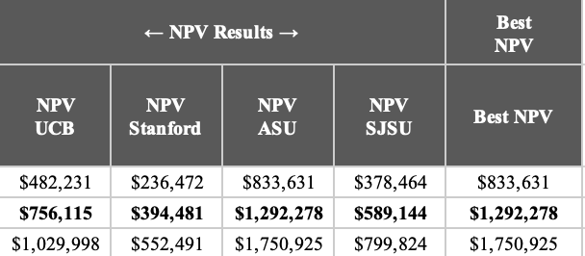
Sensitivity Analysis Overview
“What happens to NPV if one input changes?”
Workforce Reduction Sensitivity
MARR Sensitivity
Setup Cost Sensitivity
Subscription Cost Sensitivity
WORKFORCE REDUCTION SENSITIVITY
Reduction % (25%, 35%, 45%)
Recalculate Net Cash Flow = LaborSavings - Subscription - Maintenance
Growth = Year1_Savings * (1 + BenefitGrowth)^(t-1)
Sensitivity =NPV(new_rate, new_cashflows) + new_year0

Slide 16
Sensitivity Analysis Overview
MARR SENSITIVITY
SUBSCRIPTION COST SENSITIVITY
Discount rate (6%, 8%, 10%, 12%)
Sensitivity=NPV(New_MARR, CashFlows) + Year0
$5K
Base
$25K
$40K
cost growth = New_Subscription * (1 + 0.04)^(t-1)
Net Cash Flow= LaborSavings - NewSubscription - Maintenance
NPV = NPV(MARR, NewCashFlows) + Year0
SETUP COST SENSITIVITY
0.7× setup
1× setup
1.5× setup
2× setup
NPV =NPV(MARR, CashFlows) + New_Year0

Slide 17
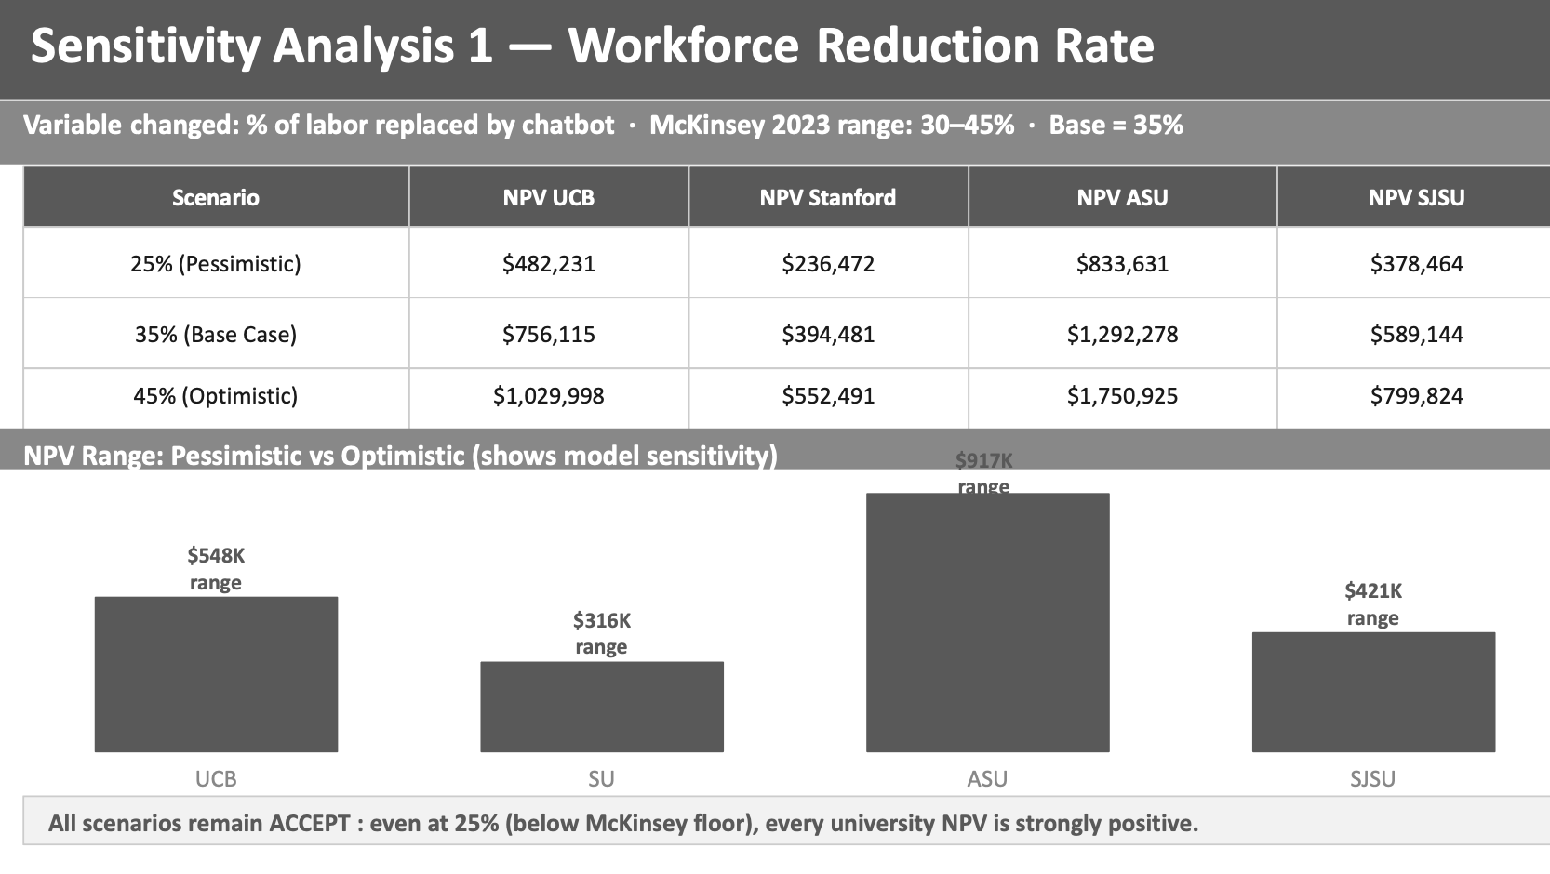
Sensitivity Analysis 1 — Workforce Reduction Rate
Variable changed: % of labor replaced by chatbot · McKinsey 2023 range: 30–45% · Base = 35%
Scenario
NPV UCB
NPV Stanford
NPV ASU
NPV SJSU
25% (Pessimistic)
$482,231
$236,472
$833,631
$378,464
35% (Base Case)
$756,115
$394,481
$1,292,278
$589,144
45% (Optimistic)
$1,029,998
$552,491
$1,750,925
$799,824
NPV Range: Pessimistic vs Optimistic (shows model sensitivity)
$917K
range
$548K
range
$421K
range
$316K
range
UCB
SU
ASU
SJSU
All scenarios remain ACCEPT : even at 25% (below McKinsey floor), every university NPV is strongly positive.

Slide 18
Sensitivity Analysis 2 — MARR / Discount Rate
Cash flows unchanged — only the discount rate changes · Base = 8% · Range tested: 6%–12%
MARR
NPV UCB
NPV Stanford
NPV ASU
NPV SJSU
6% (Low)
$803,886
$420,710
$1,372,389
$626,312
8% (Base Case)
$756,115
$394,481
$1,292,278
$589,144
10% (High)
$712,237
$370,390
$1,218,697
$555,006
12% (Conservative)
$671,851
$348,216
$1,150,971
$523,585
No reversal:
NPV remains positive for ALL universities at EVERY MARR tested (6–12%). Accept decision is invariant.
Year 1 dominance:
Because Year 1 savings are large relative to investment, high MARR has limited impact — most value arrives early.
ASU floor = $1.15M:
Even at 12% MARR — 50% above base — ASU NPV is $1.15M. The model is not MARR-sensitive.

Slide 19
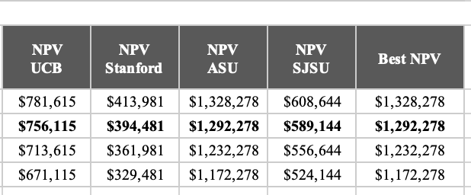
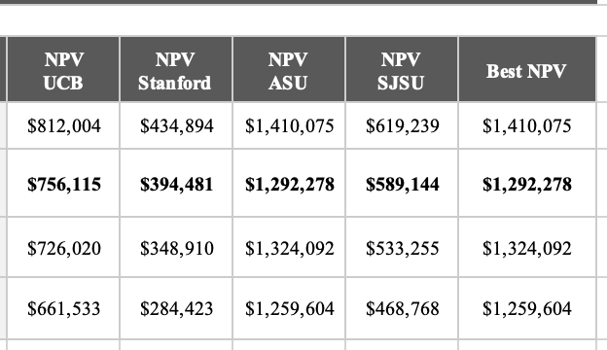
Sensitivity Analysis 3 — Setup Cost & Subscription Tier
Section 3: Setup Cost — only Year 0 changes · Section 4: Subscription — only recurring costs change
Setup Cost Sensitivity
Subscription Sensitivity
Key finding: Setup cost and subscription sensitivity are modest. Even doubling setup cost or paying $40K/yr subscription, all Accept decisions hold. The model is not sensitive to cost-side assumptions.
Max NPV swing
from setup cost
(UCB)
Max NPV swing
from subscription
(UCB)
Number of Reject
decisions across
all 32 scenarios
$42K
$150K
0

Slide 20
Dashboard
All values auto-calculated by the Excel tool from Inputs. Changes to any assumption update instantly.
Metric
UC Berkeley
Stanford
Arizona State
SJSU
Year 0 Investment
$95,000
$73,000
$135,000
$73,000
Year 1 Net CF
$202,136
$111,140
$338,963
$157,220
5-Yr Total Benefits
$1,205,896
$695,709
$2,019,396
$927,612
5-Yr Recurring Costs
$135,408
$107,785
$224,236
$94,786
NPV (8% MARR)
$756,115
$394,481
$1,292,278
$589,144
IRR
215%
153%
253%
217%
BCR
5.23×
3.85×
5.62×
5.53×
Payback Period
Year 1
Year 1
Year 1
Year 1
DECISION
ACCEPT
ACCEPT
ACCEPT
ACCEPT

Slide 21
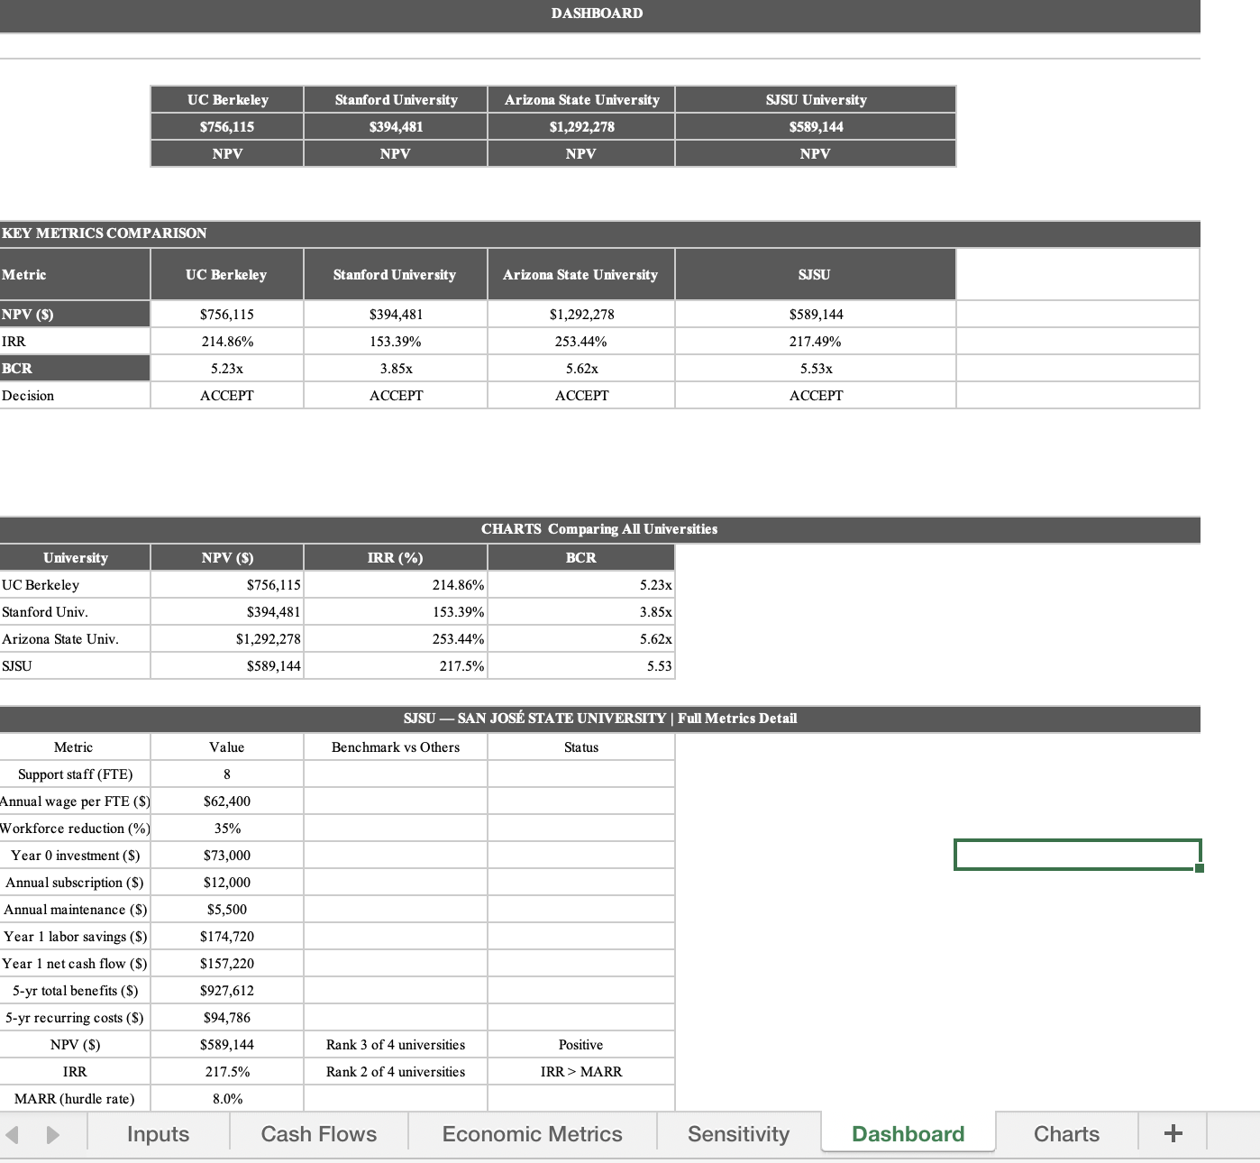
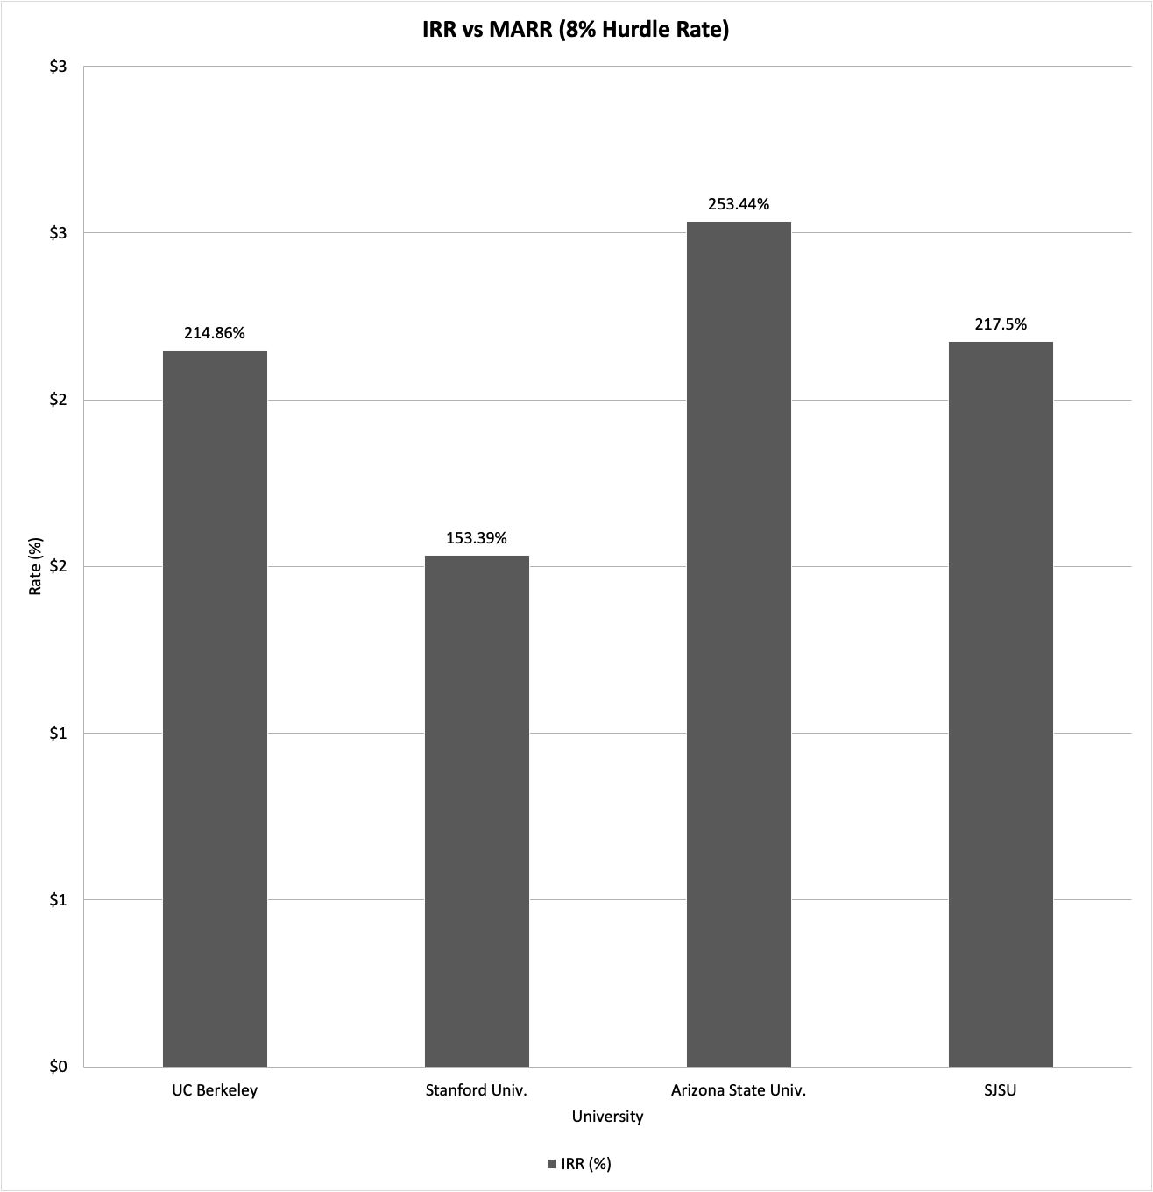
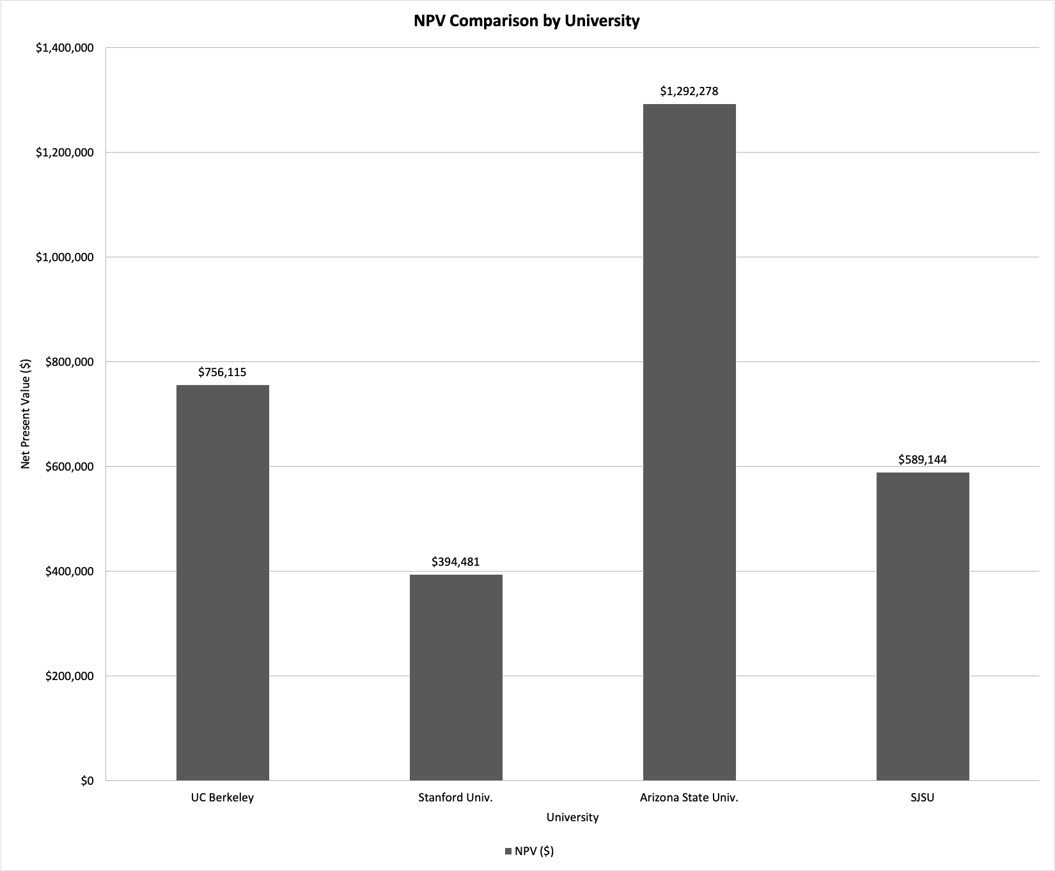
THANK YOU
DASHBOARD

Slide 22
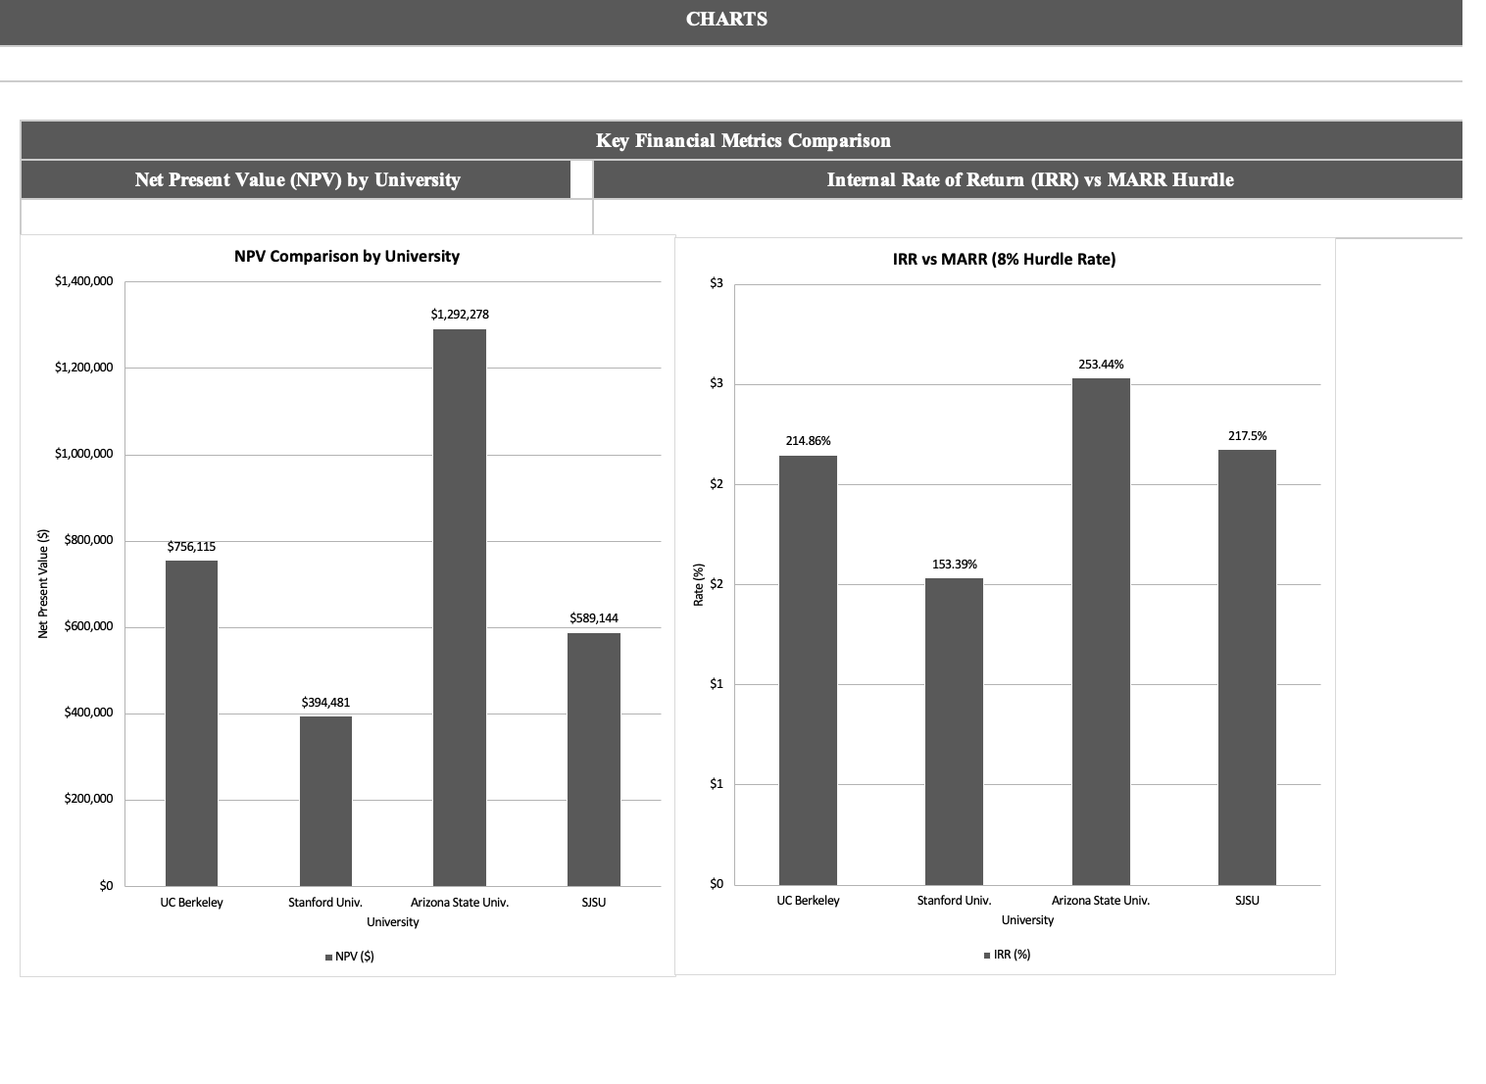
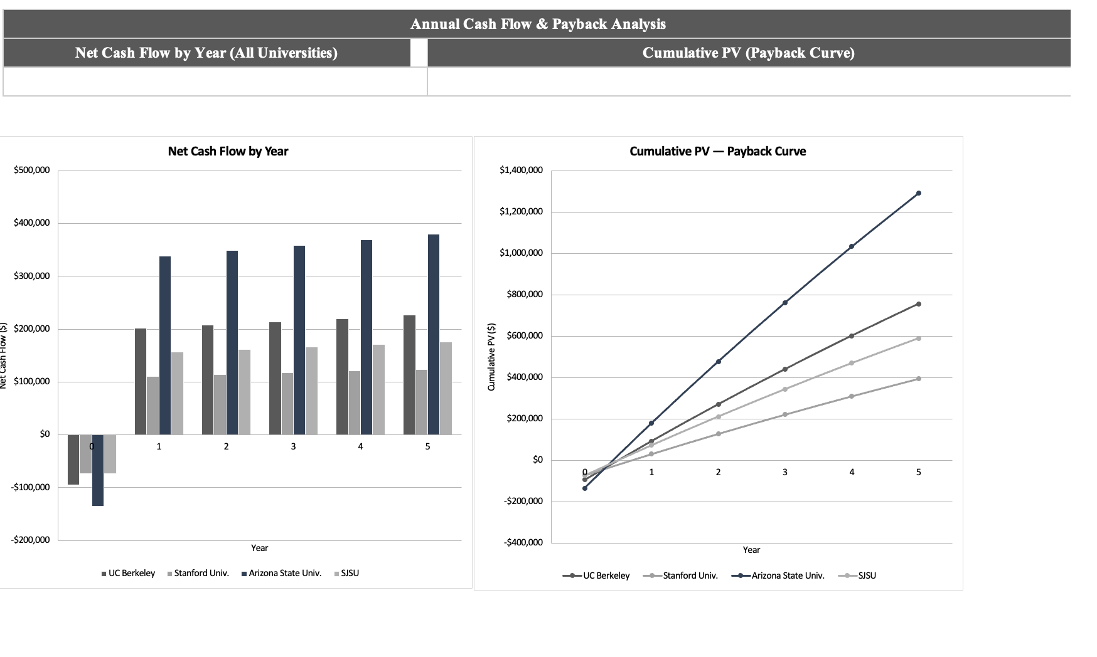
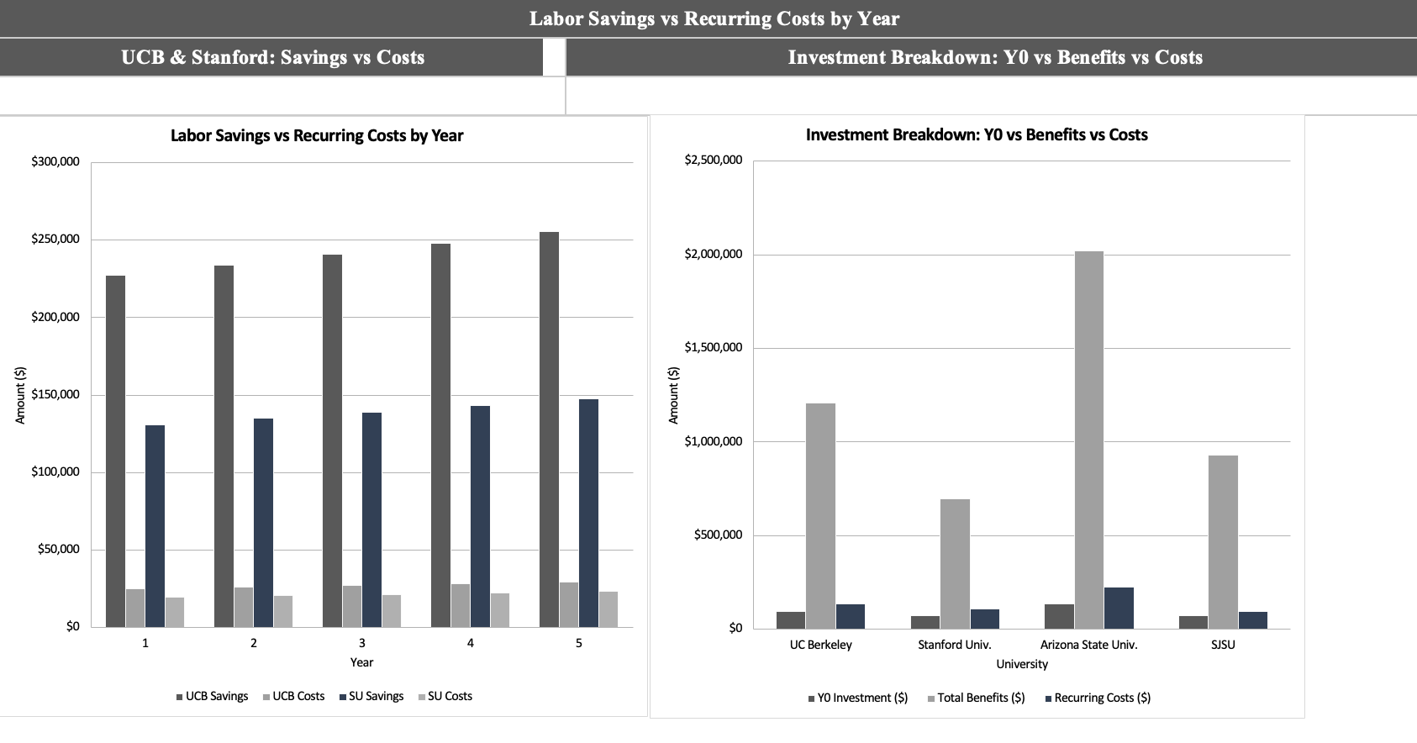
Charts

Slide 23
Real-World Application & Broader Impact
Who can use this tool?
University administrators evaluating chatbot vendors , enter assumptions, get instant NPV
Financial planners stress-testing ROI at different enrollment levels or wage rates
IT budget committees comparing Zendesk vs. Salesforce vs. ServiceNow tiers
Researchers comparing AI adoption economics across institution types
Economic & Social Impact
Positions made available for redeployment , not just headcount reduction
First-contact resolution rates improve 20–35% (Gartner, 2022)
24/7 student support without overtime cost — improves service equity
Financial literacy: AI tools make cost-benefit analysis accessible to students too
Environmental Considerations
AI inference energy usage: ~0.001 kWh per query , far below server-based helpdesks
Cloud-hosted platforms reduce on-premise hardware energy by ~40% vs legacy
Aligns with CSU and UC sustainability goals for 2030
Cloud-hosted platforms reduce on-premise hardware energy consumption relative to legacy systems.

Slide 24
Discussion & Limitations
Q1
Q1: Is chatbot adoption economically justified?
Yes : unambiguously. NPVs of $394K–$1.29M, BCRs 3.85–5.62×, payback Year 1. The economic case is strong at all four institutions.
Q2
Q2: How robust is the analysis?
Highly robust. Accept decision holds across workforce reduction 25–45%, MARR 6–12%, setup cost −30% to ×2.0, and subscription $5K–$40K. Zero Reject outcomes in 48+ scenarios.
Q3
Q3: Which institution is strongest?
ASU on absolute NPV ($1.29M, BCR 5.62×) due to 25 FTE headcount. UCB second ($756K). SJSU third ($589K). Stanford fourth ($394K) , all Accept with similar BCR multiples.
Limitations: Assumes FTE reduction is fully realized (vs. redeployment). Does not model transition costs or student satisfaction benefits. Forward-looking returns based on McKinsey benchmarks which may not apply to all institutions.

Slide 25
References
1
7
Bureau of Labor Statistics. (2023). Employment cost index, Q4 2023. https://www.bls.gov/news.release/eci.toc.htm
McKinsey Global Institute. (2023). The economic potential of generative AI. McKinsey & Company. https://www.mckinsey.com/capabilities/tech-and-ai/our-insights/the-economic-potential-of-generative-ai-the-next-productivity-frontier
2
Bureau of Labor Statistics. (2024). Occupational employment and wage statistics, May 2024 (SOC 43-4051 customer service representatives). https://www.bls.gov/oes/current/oes434051.htm
8
NACUBO. (2023). 2023 NACUBO-TIAA study of endowments. https://www.nacubo.org/Events/2024/Results-From-the-2023-NACUBO-Commonfund-Study-of-Endowments
3
EDUCAUSE. (2023a). Core data service 2023: Table S117 student support IT staffing by Carnegie classification. https://www.educause.edu/research-and-publications/research/core-data-service
9
Park, C. S. (2019). Contemporary engineering economics (6th ed.). Pearson.
4
EDUCAUSE. (2023b). Enterprise application survey 2023: Conversational AI integration costs. https://er.educause.edu/articles/2024/2/exploring-the-opportunities-and-challenges-with-generative-ai
10
Salesforce. (2024). Service cloud pricing and editions. https://www.salesforce.com/editions-pricing/service-cloud
5
Gartner. (2022). Hype Cycle for Education Technology, 2022. gartner.com
11
ServiceNow. (2024). ITSM education solutions.https://www.servicenow.com/solutions/industry/education.html
6
Gartner. (2025). IT key metrics data 2025: Higher education industry measures. https://www.gartner.com/en/documents/5972171
12
Zendesk. (2024). Zendesk suite pricing plans. https://www.zendesk.com/pricing

Slide 26
THANK YOU

