Slide 1
Sustainability analysis of data centers operations using Lean Principles

Slide 2
Introduction

Slide 3
Literature Survey

Slide 4
1.1 Process Improvement Techniques
1.Lean Techniques
2.Statistical Data Analysis Tools
3.Simulation Techniques
4.Industry 4.0 Technology-based techniques

Slide 5
1.1.1 Lean Techniques
Fishbone Analysis
MUDA Waste
PDCA

Slide 6
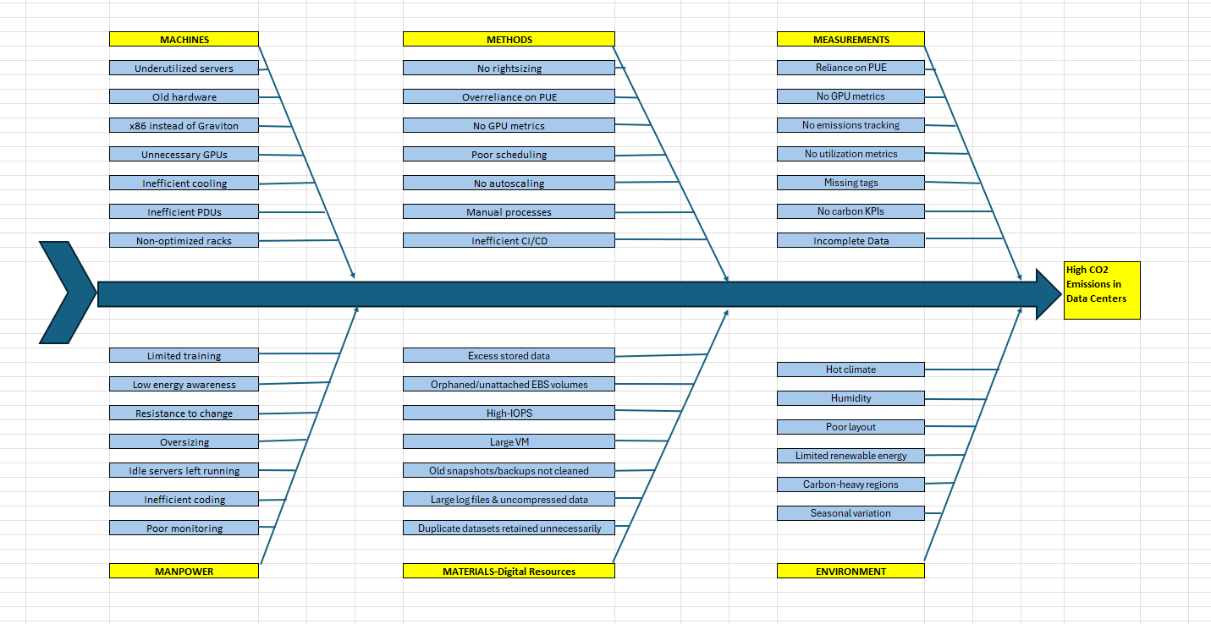
Fishbone Analysis

Slide 7
MUDA & PDCA

Slide 8
VSM
Use VSM to Map end-to-end carbon and energy flow for AWS compute resources.
Why VSM
We chose a power load to compute IT Power - 50%
Then we answer how many kWh does 1 vCPU-hour consume at 50% load

Slide 9
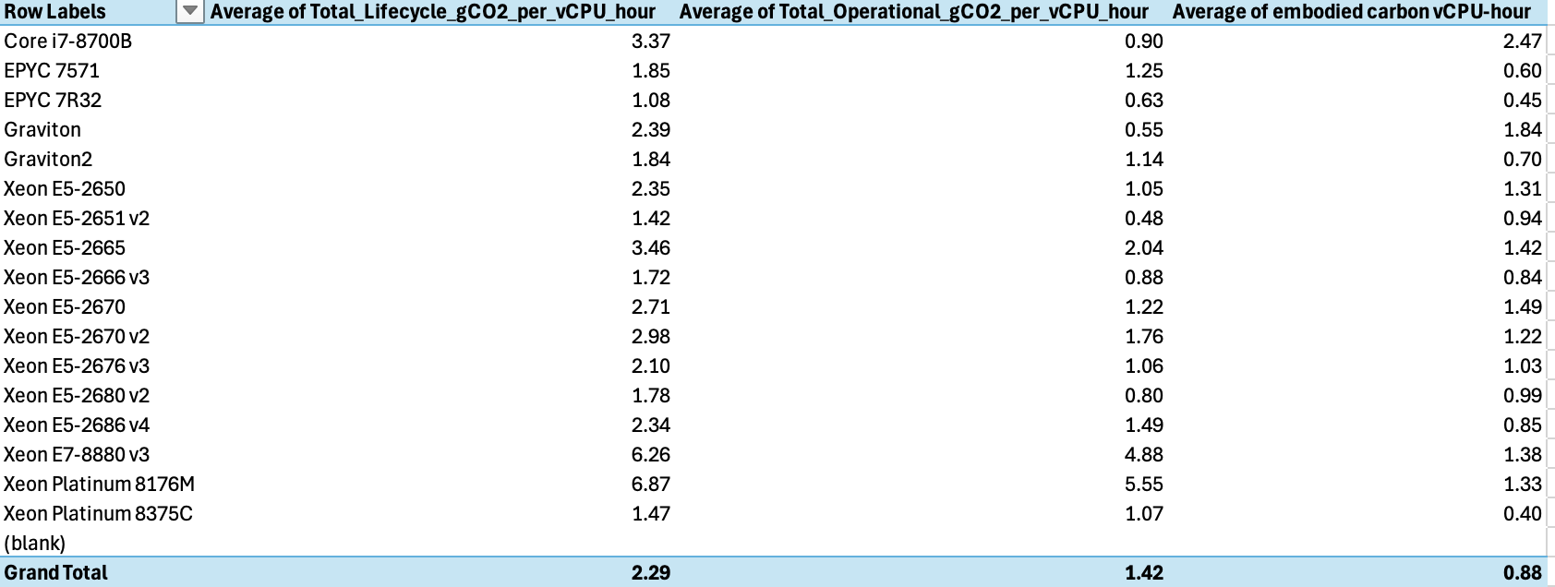

Slide 10
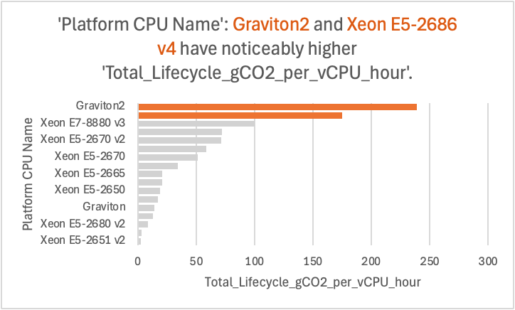

Slide 11
Boundary values using Excel

Slide 12
MINITAB

Slide 13
Python Code Analysis : Dataset
DATASET: ~402 rows, ~20 columns – each row represents one EC2 instance type / platform combination (e.g., m5.large on a specific CPU family).
Key instance-level fields: instance_type, instance_vcpu, instance_memory_in_gb → size of the VM., platform_cpu_name, platform_memory_in_gb, storage_type → underlying physical server family.
Power & energy profile ramwatt__idle, ramwatt__10, ramwatt__50, ramwatt__100, delta_full_machine → estimated server power at different loads.From these, we computed average power (W) and yearly IT energy (kWh).
Lifecycle / Scope-3 emissions Total Platform Scope 3 Emissions (kgCO2eq) → manufacturing + supply-chain CO₂ for each platform. We annualized this over 4 years to get Embodied_CO2e_kg_per_year.
Derived CO₂ metrics (in Python) Operational_CO2e_kg_per_year = Total_kWh × 0.4 kg CO₂/kWh (assuming PUE = 1.4). Total_CO2e_kg_per_year = Operational + Embodied. CO2e_kg_per_vCPU_per_year → efficiency metric used for comparing CPU platforms.

Slide 14
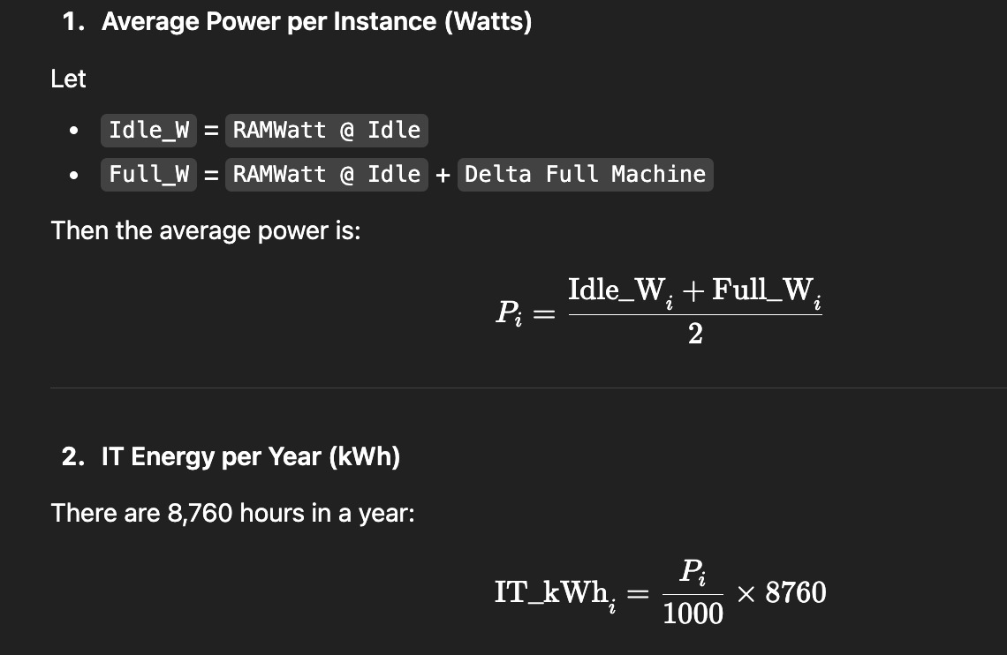
Energy Calculations

Slide 15
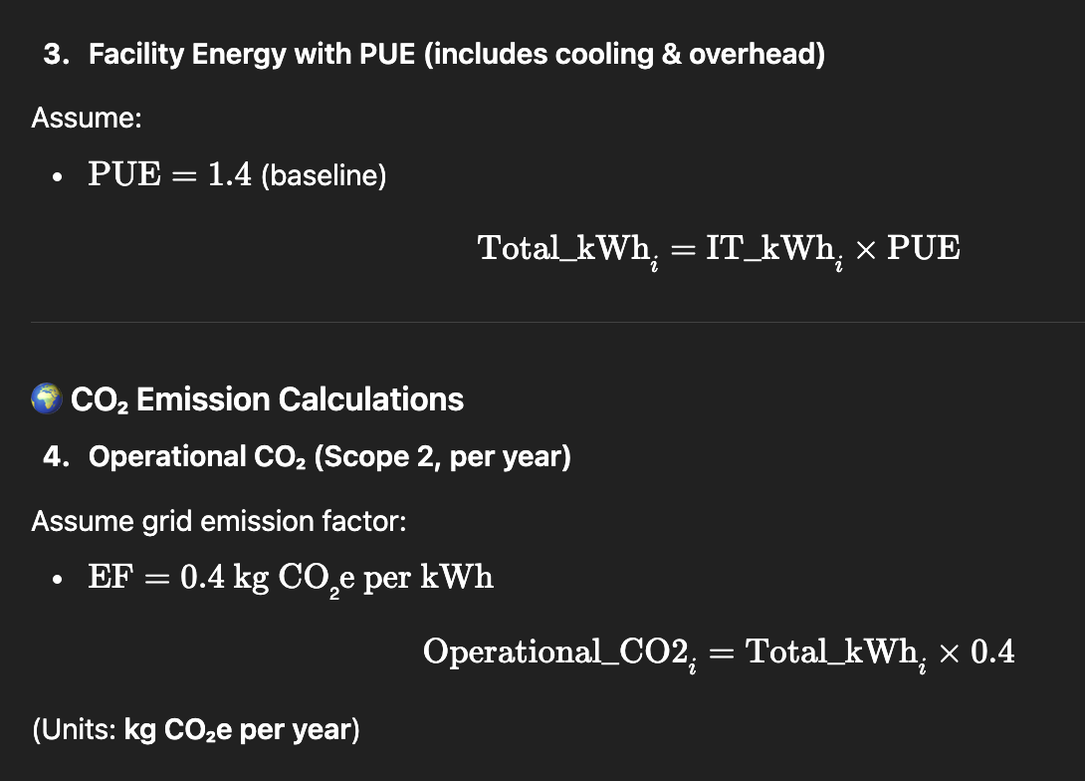
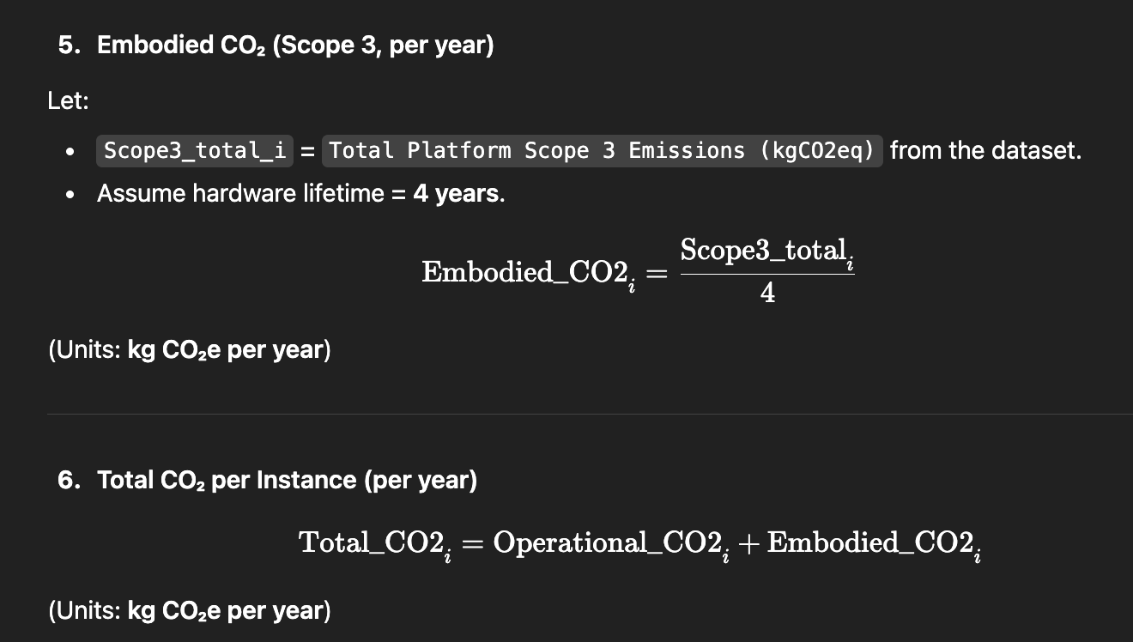

Slide 16
Top 10 carbon footprint CPU Platforms

Slide 17
Before VS after optimization CO2 emissions

Slide 18
Future Research

Slide 19
Selected References

