Slide 1
DOCTOR APPOINTMENT SYSTEM
Team members:
CHINMAY CS 4AI22CD013
K SHIVADARSHAN 4AI22CD028
SUNILKUMAR A B 4AI22CD056
YASHAS XAVIER 4AI22CD062
Under the guidance of
Mrs.SHALINI I S B.E,M.TECH
ASSISTANT PROFESSOR

Slide 2
PROBLEM STATEMENT
To design and develop an Doctor Appointment System that allows patients to book, reschedule, and cancel appointments with doctors online, reducing no-show rates, improving patient experience, and enhancing healthcare efficiency.

Slide 3
SCOPE OF THE PROJECT
Patient Features:
Online booking of appointments
View doctor profiles (specialization, experience, availability)
Reschedule or cancel appointments
Doctor Features:
Manage appointment schedule
View patient history and notes
Set available time slots
Admin Features:
User management (patients, doctors, staff)
Appointment management (approval, cancellations)
Reporting tools (appointments, doctor performance, etc.)

Slide 4
Expected benefits
Convenience and Accessibility: Patients can schedule appointments anytime, anywhere through the system, reducing the need for phone calls or in-person visits.
Reduced Wait Times: Pre-booked appointments and real-time scheduling minimize long wait times in clinics and hospitals.
Optimized Scheduling: Doctors can manage their time efficiently by setting available slots, reducing the chances of overbooking or under-booking.
Data Accuracy: Digital records of appointments reduce the chances of human error, ensuring that patients’ appointments are accurately tracked.
Accessibility for Diverse Patients: The system can cater to patients with different needs ( specialzation) and allow for flexible appointment options.

Slide 5
Project design
Hardware:
Web server, database server, client devices, network infrastructure.
Software:
Backend: PHP (with optional PHP framework), APIs.
Frontend: HTML, CSS (and optionally JavaScript).
Database: MySQL (for data storage).
Web Server: Apache.

Slide 6
Methodology
Identified the exact requirements and goals of the Doctor Appointment System.
Design the architecture, database, and interfaces for the system.
Choose the right tools and technologies for the system development.
Build the system based on the design and selected technologies.
Ensure that the system is working as expected and is free of bugs.
Deploy the system to a live environment where users can access it
Ensure users (patients, doctors, admins) can use the system effectively

Slide 7
Tools and technologies used
Components | Technologies & Tools
Backend | PHP
Frontend | CSS,HTML
Database | MYSQL
Web server | Apache
Development Environment | XAAMP

Slide 8
Implementation
Core Features:
User Roles: Admin, Doctor, Patient (Role-based Access Control)
Appointment Logic: Slot booking, conflict resolution, status updates.
Database Design:
Users Table: Stores user data (ID, name, email, role)
Appointments Table: Tracks appointments (patient ID, doctor ID, date, status)
Doctor Availability Table: Stores working hours (doctor ID, available slots)

Slide 9
RESULT
Improved Accessibility:
Patients can book appointments anytime, from anywhere.
Enhanced Efficiency:
Reduced manual work for doctors and administrative staff with automated scheduling.
Real-Time Availability:
Real-time doctor availability management reduces booking conflicts and errors.
Better Patient Management:
Centralized patient data for doctors to access medical history and track appointments.

Slide 10

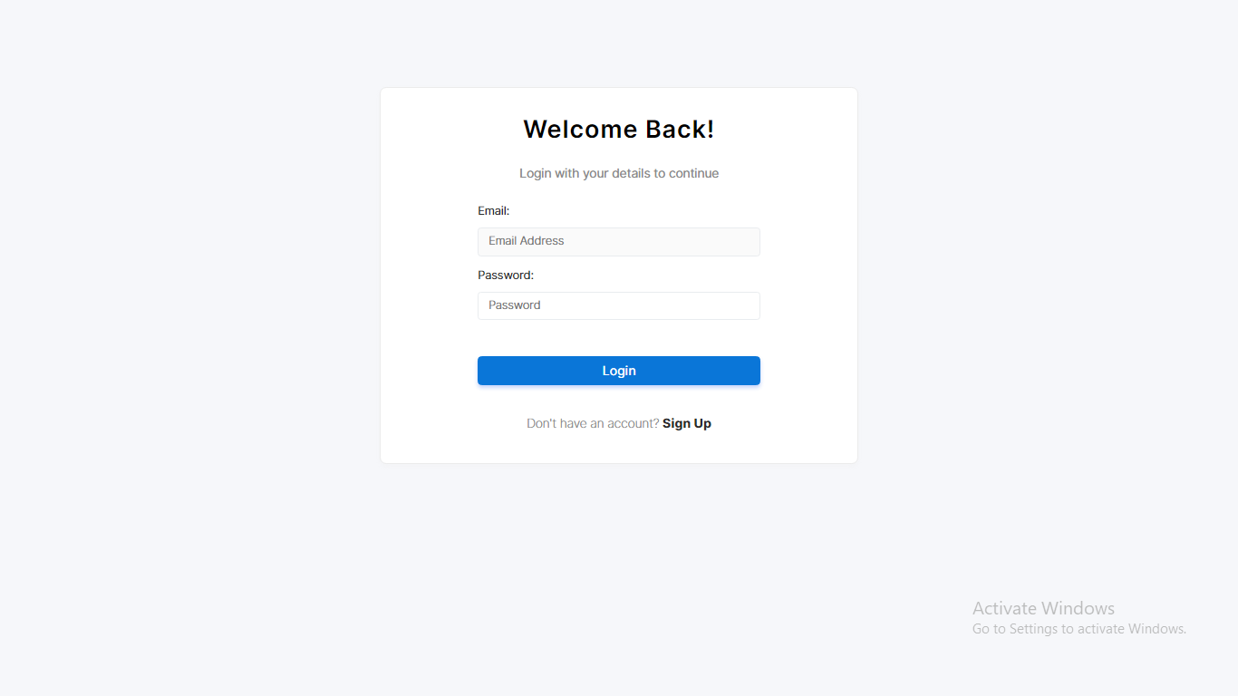
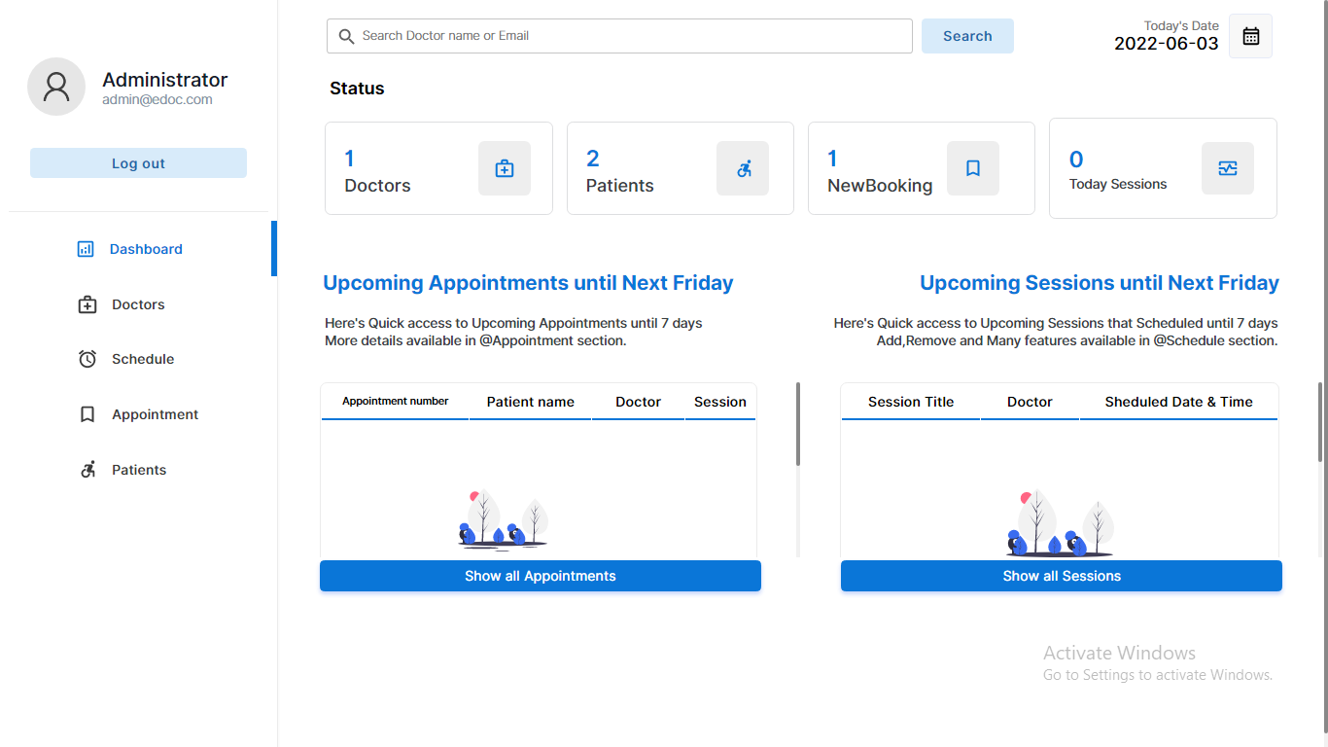
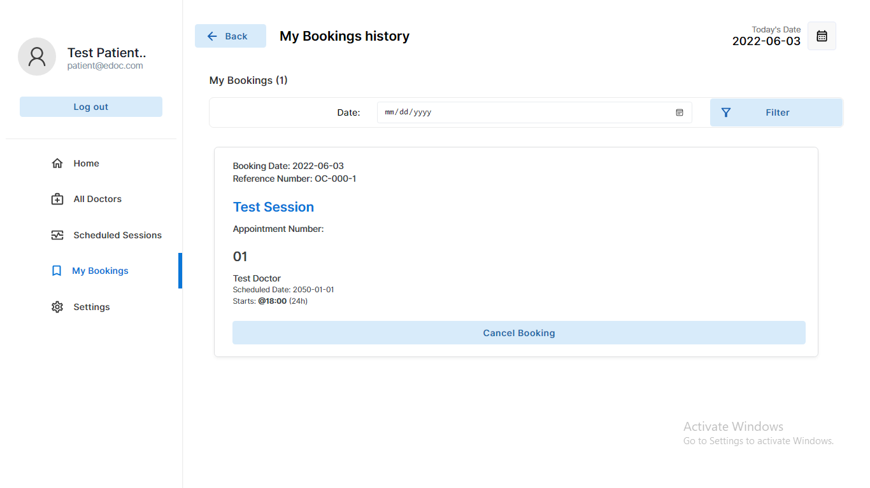
Fig1.1 Welcome page
Fig 1.2 Login page
Fig 1.3 Admin dashboard
Fig 1.4 Bookings

Slide 11
Future work
AI-Powered Appointment Scheduling and Recommendations
Telemedicine and Video Consultations
Payment Integration
Advanced Analytics and Reporting

Slide 12
Issues Encountered During Development
Connection to the server.
Difficulty in managing overlapping bookings, requiring real-time slot updates.
Ensuring accurate synchronization between user data, appointments, and doctor availability.
Addressing data privacy laws and ensuring secure storage of patient information.

Slide 13
Resolution of Issues
Implemented real-time slot availability checks and automatic updates to avoid double bookings.
Applied database constraints (foreign keys) and transactional logic to ensure data accuracy across appointments and user records.
Integrated load balancing, optimized database queries, and used caching (Redis) to handle peak traffic efficiently.

Slide 14
Conclusion
The Doctor Appointment System is a transformative solution designed to streamline the appointment scheduling process for both patients and healthcare providers. By leveraging modern web technologies and a user-friendly interface, the system significantly enhances the efficiency, accessibility, and convenience of managing healthcare appointments.
Time Slot Management: Efficiently handles appointment bookings, reducing scheduling conflicts and improving doctor availability.
User Accessibility: Provides an intuitive platform for patients to easily book, reschedule, or cancel appointments online.

Slide 15
THANK YOU

