Slide 1


Go, Change the world
Experiential Learning - ODD 2025-26
Phase-I Review
on
Theme: SDG 11- Sustainable Cities and Communities
Title of the Presentation
SnapFix:Democratizing Urban Maintenance through AI-Driven Citizen Reporting

Slide 2
Go, Change the world
Team Details
NAME OF STUDENT | Yashas M N | Saharsha | Samartha K B | Avyay Bhat
USN | 1RV23CY062 | 1RV23CY036 | 1RV23CD036 | 1RV23CS058
EMAIL ID | yashasmn.cy23@rvce.edu.in | saharsha.cy23@rvce.edu.in | samarthakb.cd23@rvce.edu.in | avyaybhat.cs23@rvce.edu.in
MENTOR
Dr. Rajeswara Rao K V S
Designation
Department of IEM
RV College of Engineering
Bengaluru-59

Slide 3
Go, Change the world
Table of Contents
Introduction
Problem Statement
Existing System
Our Solution
Objectives
Methodology
System Architecture
AI Models Used
Results % Metrics
Governance Impact
Future Work
Literature Survey
Conclusion

Slide 4
Go, Change the world
Introduction
Rapid urbanization has placed increasing strain on civic infrastructure and municipal maintenance systems, exposing limitations in traditional grievance mechanisms such as helplines, paper-based forms, and static web portals. These systems often lack visual and geospatial context, resulting in delayed responses, inefficient resource allocation, and declining citizen trust. With the widespread adoption of smartphones and messaging platforms, there is a growing opportunity to transform citizens into active participants in urban governance. SnapFix addresses this challenge by providing an AI-driven, conversational reporting platform that enables residents to submit geo-tagged images and brief descriptions of civic issues, facilitating faster identification, prioritization, and resolution of urban infrastructure problems.

Slide 5
Go, Change the world
Problem Statement
Delayed Response
Complaints face significant routing delays and processing bottlenecks
The Urban Governance Crisis
Urban citizens continue to face recurring civic issues yet the existing grievance-redressal systems remain slow, outdated, and highly manual. The current channels lack accessibility, transparency, and effective coordination between municipal departments, often resulting in misrouted complaints, missing evidence, and significant verification delays. These inefficiencies lead to delayed resolutions, low citizen engagement, and a growing loss of trust in civic governance.
Zero Transparency
Citizens receive no visibility into complaint status or resolution timelines
Data Overload
Municipal bodies drowning in unstructured data without prioritization tools

Slide 6
Go, Change the world
Why Current System Fails?
Traditional complaint channels—phone helplines, paper forms, municipal websites, and scattered social media posts—create a fragmented, inefficient ecosystem that fails both citizens and administrators.
Manual Processing
No Verification
Every complaint requires human categorization and routing, creating bottlenecks and inconsistencies
Without automated image analysis, false or duplicate reports consume valuable municipal resources
Poor Tracking
Reactive Governance
Weak feedback loops leave citizens in the dark and reduce trust in government responsiveness
Unstructured data prevents proactive maintenance and data-driven resource allocation

Slide 7

Go, Change the world
OUR SOLUTION
SnapFix is an AI-powered, citizen-centric reporting platform that transforms how municipalities handle infrastructure complaints. Citizens simply report issues through a conversational Telegram chatbot—no apps to download, no complex forms to fill.
The system intelligently processes every submission, automatically classifying issues, detecting urgency levels, and routing complaints to the appropriate departments. Real-time status tracking keeps citizens informed every step of the way.
01
02
Citizen Reports
AI Processes
Submit geo-tagged photos and brief descriptions via Telegram
Automated classification, urgency detection, and smart routing
03
04
Department Acts
Real-Time Updates
Officials receive prioritized, actionable complaints with full context
Citizens track resolution status and provide feedback

Slide 8
Objectives
Go, Change the world
1️⃣ To design and implement a multi-modal complaint intake framework
that enables the system to receive complaints through conversational interfaces (e.g., WhatsApp, Telegram, or Web UI), supporting structured (forms) and unstructured (text/image) inputs.
2️⃣ To develop an AI-based classification engine
using Natural Language Processing and optional Computer Vision to automatically interpret, categorize, and map incoming complaints to predefined civic domains.
3️⃣ To establish a backend service architecture
built on RESTful APIs and a persistent database (PostgreSQL/MongoDB) for secure storage, retrieval, geotagging, and status management of complaints.
4️⃣ To construct an administrative workflow and analytics layer
integrated with the backend to provide real-time dashboards, departmental segregation, complaint clustering by geography, and lifecycle tracking for efficient grievance resolution.

Slide 9
Design Methodology
Go, Change the world
1️⃣ To design and implement a multi-modal complaint intake framework
that enables the system to receive complaints through conversational interfaces (e.g., WhatsApp, Telegram, or Web UI), supporting structured (forms) and unstructured (text/image) inputs.
2️⃣ To develop an AI-based classification engine
using Natural Language Processing and optional Computer Vision to automatically interpret, categorize, and map incoming complaints to predefined civic domains.
3️⃣ To establish a backend service architecture
built on RESTful APIs and a persistent database (PostgreSQL/MongoDB) for secure storage, retrieval, geotagging, and status management of complaints.
4️⃣ To construct an administrative workflow and analytics layer
integrated with the backend to provide real-time dashboards, departmental segregation, complaint clustering by geography, and lifecycle tracking for efficient grievance resolution.

Slide 10
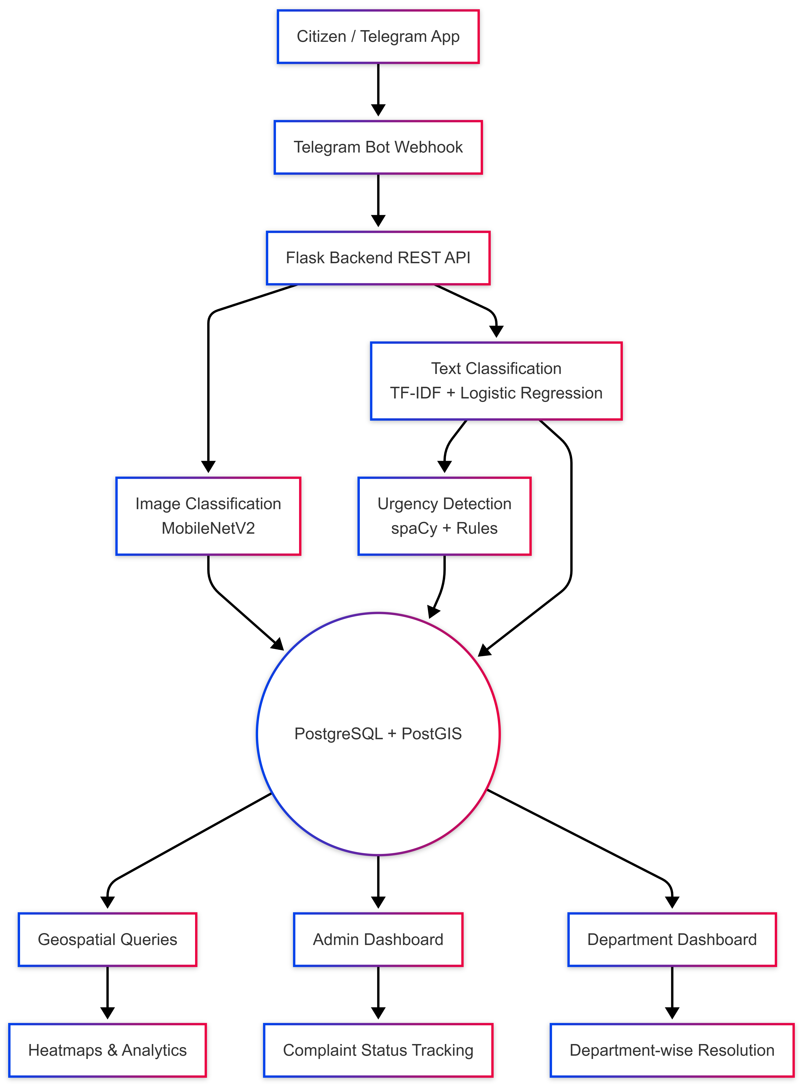





System Architecture
Go, Change the world
SnapFix combines accessible frontend interfaces with powerful backend processing
and intelligent AI layers to create a seamless complaint management ecosystem.
Telegram Bot
Conversational interface for intuitive citizen reporting
Flask API
RESTful backend for request processing and routing
AI Engine
Multi-model classification and urgency detection
PostGIS DB
Geospatial storage with location intelligence
Admin Portal
Analytics dashboard with heatmaps and insights

Slide 11
Go, Change the world
AI Models Used
SnapFix leverages three specialized AI models working in concert to transform raw citizen inputs into structured, actionable data for municipal departments.
1
2
3
Image Classification
Text Classification
Urgency Detection
Model: MobileNetV2
Model: TF-IDF + Logistic Regression
Tool: spaCy + Rule-Based Heuristics
Classifies infrastructure issues from citizen-submitted photos with high accuracy. This lightweight architecture enables real-time inference while maintaining low computational costs—perfect for municipal-scale deployment.
Analyzes complaint descriptions to determine issue categories. This interpretable approach delivers fast inference and strong performance on short text, making it ideal for quick complaint routing.
Identifies high-priority complaints involving safety hazards, power outages, or emergencies. This ensures critical issues receive immediate attention from the appropriate response teams.

Slide 12

Results And Metrics
Go, Change the world
The system has achieved remarkable precision in both image and text classification, while dramatically reducing the manual workload for municipal staff.
93%
Image Model Performance
Overall Accuracy: 93.36%
High precision and recall across all classes
Consistent performance despite class diversity
Image Accuracy
Overall classification accuracy with consistent performance across all infrastructure categories
85%
Operational Impact
~85% complaints routed automatically
Significant reduction in manual triage
Faster complaint acknowledgment and resolution
Auto-Routing
Complaints routed automatically without human intervention, reducing triage time
SnapFix delivers exceptional accuracy across all AI components, translating directly into operational efficiency and faster complaint resolution for municipalities.
99.8%
Text Model Performance
Precision: 0.9984
Recall: 0.9983
F1-Score: 0.9983
Text Precision
Near-perfect precision, recall, and F1-score for complaint text analysis

Slide 13




Governance Impact
Go, Change the world
SnapFix enables a fundamental shift from reactive complaint handling to proactive, data-driven municipal management aligned with UN Sustainable Development Goal 11.
Participatory Governance
Radical Transparency
Citizens become active sensors in their communities, contributing real-time infrastructure intelligence
Real-time tracking builds accountability and restores citizen trust in municipal responsiveness
Data-Driven Decisions
Equity Focus
Heatmaps, workload analytics, and frequency analysis guide strategic resource allocation
Identify and prioritize underserved neighborhoods using comprehensive complaint data

Slide 14
Go, Change the world
Mapping SnapFix to SDG 11 Targets
SDG 11 Goal:
Make cities inclusive, safe, resilient, and sustainable.
How SnapFix Contributes
Inclusive Participation
  Enables citizens to report issues using a familiar messaging platform (Telegram).
  Lowers barriers for participation across age, literacy, and socio-economic groups.
Safe & Resilient Infrastructure
  Early detection of hazards such as fallen trees, damaged poles, and potholes.
  Urgency detection ensures faster response to safety-critical complaints.
Sustainable Urban Management
  Data-driven prioritization reduces resource wastage.
  Heatmaps support preventive maintenance and long-term planning.
Transparent Governance
  Real-time complaint tracking builds public trust.
  Accountability through measurable resolution workflows.

Slide 15
Literature Survey
Go, Change the world
SL NO | PAPER TITLE, AUTHOR,YEAR | OBSERVATIONS
1 | AI-Driven Complaint Management System IJFMR, 2025 | This paper validates the architecture and features required for a modern complaint system, including geo-tagging, multimedia support, and real-time tracking, which directly relates to our proposed system's functionality.
2 | Proactive Complaint Management in Public Sector Informatics Using AI: A Semantic Pattern Recognition Framework MDPI, 2025 | This is highly relevant for selecting our classification model. It demonstrates the superior performance of Deep Learning models (BERT) over traditional classifiers for nuanced language understanding, which is critical for handling informal chat inputs.

Slide 16
Literature Survey
Go, Change the world
Sl No | Paper Title, Journal Name, Year | Major findings / observations
3 | Smart Civic Complaint Analyzer Using Natural Language Processing IJIRT, 2025 | This paper provides a blueprint for the specific NLP tasks our system needs to perform: classification and prioritization. It justifies the use of common Machine Learning models (like Naive Bayes) before scaling up to Deep Learning models.
4 | A Technological Survey on Citizen Complaint Management Systems and Future Advances (IEEE Xplore, 2025) | This provides the Literature Review foundation by detailing the shortcomings of existing manual systems (delays, lack of transparency) and justifies the move towards AI/digital transformation in e-governance for better efficiency and citizen trust.

Slide 17
Go, Change the world
Future Work
Our vision extends beyond single-city deployment to create a comprehensive, nationwide platform for intelligent civic infrastructure management.
Multi-City Deployment
1
Scale deployment across multiple cities.
2
Multilingual Support
Enable complaint submission in regional languages to ensure inclusive access for all citizens
Explainable AI
3
Provide transparent explanations of AI decisions to build administrative confidence
4
Edge Computing
Deploy edge inference capabilities for reliable operation in low-connectivity regions
Predictive Analytics
5
Shift from reactive repairs to preventive maintenance using historical pattern analysis

Slide 18
Go, Change the world
Conclusion
SnapFix demonstrates how artificial intelligence and citizen participation can be effectively combined to enhance urban infrastructure governance. By integrating computer vision for image-based issue classification, natural language processing for urgency detection, and geospatial analytics for decision support, the platform streamlines complaint handling while improving transparency and accountability. The system reduces manual intervention, accelerates response times, and empowers municipalities with data-driven insights for sustainable maintenance planning. Overall, SnapFix offers a scalable and inclusive framework for modern urban management, contributing toward safer, more resilient, and participatory cities in alignment with Sustainable Development Goal 11.

Slide 19
Go, Change the world
Thank You

