Slide 1
Knowledge Management
UE17CS342
Political History of Karnatak
Guide : Dr. Jayashree
Team : Chandrashekhara , Sudhakar , Yashwant , Nagaraja , Swathi

Slide 2
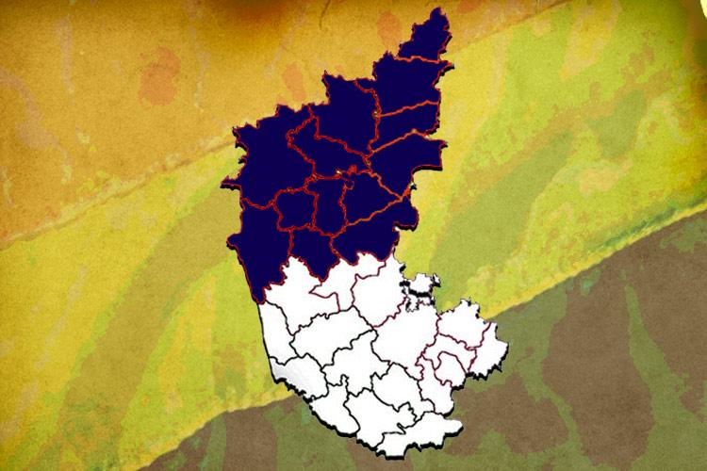
Introduction

Slide 3
Project Abstract and Scope
This paper analyses Knowledge Management (KM) as a political activity, We try to examine if at the macro political level KM is made, and how. The research is interesting because given that we live in a Knowledge Society, in the Information Era, it is more or less obvious that the political leaders should also do KM.
We divide the analysis in two main parts: theoretical ideas, and results. In the theoretical part we aim at distinguishing KM as made by law makers and results are the election results which are given by the election commision.

Slide 4
Design and Implementation
We firstly collect the data from the official resourses like indian constitution and election commision.
The website consists of results of many constituencies
The website basically help you to know the history of karnatak and its politics .
And gives the information about vidhana sabha , lok sabha and its respective houses .
And it also gives information about procedures and qualification etc .

Slide 5
About KM
Knowledge management is essentially about getting the right knowledge to the right person at the right time. This in itself may not seem so complex, but it implies a strong tie to corporate strategy, understanding of where and in what forms knowledge exists, creating processes that span organizational functions, and ensuring that initiatives are accepted and supported by organizational members. Knowledge management may also include new
knowledge creation, or it may solely focus on knowledge sharing, storage, and refinement. For a more comprehensive discussion and definition, see my knowledge management definition

Slide 6
User friendly aspect
The website also intends to be user-friendly in the sense that for some citizen who is very new to this system and is unaware of how to know about procedures .
Here the citizen can get a clear insight of the results .
It also shows the qualifications and sessions .
This feature thus is one of the most striking features which makes it possible for even an ordinary citizen can easily come to know about laws and procedures and can easily analyse the results of their respective constituency.
Notes:
<number>

Slide 7
Project Ananlysis
The analysis is done using css html js python.
The analysis shows that the previous year election results were annouced , with the last year analysis
Also the constitution laws were shown
Notes:
<number>

Slide 8
Conclusion
After the data is collected and analyzed in the form of explicit knowledge it is given to the politicians and peoples to make them aware.
Looking at the content they can come to know their strenth and failures .
Hence by doing this we are helping them to know what has happened and how it should happen.
Notes:
<number>

Slide 9
Thank You

