Slide 1
Cloud Cost Optimizer
Right-sizing cloud VMs with measured safety margins
Finds oversized VMs on real Azure data, recommends a cheaper size, explains why, and lets a person approve it.
Yashavantha P | Arthik Jain | Harshavardhan Naik
RV University | Advanced Cloud & Research Trends | November 2026
Notes:
Introduce the team. In one line: our project finds cloud VMs that are bigger than they need to be and recommends a cheaper size. A VM here is the same idea as an EC2 instance on AWS.

Slide 2
Cloud VMs are sized once and rarely revisited
1
2
3
The waste
The research gap
Our focus
Engineers size a VM for its expected peak, then rarely check it again. An on-demand EC2 instance bills every hour, used or not.
Our literature review found plenty of forecasting work. Far less work makes recommendations that non-engineers can trust and approve.
A measured safety margin on every recommendation
A plain-language explanation
Human approval, with risky changes reviewed one by one
Out of scope: reinforcement learning, GPU workloads, multi-cloud, and changing real cloud resources.
Notes:
The problem: engineers pick a size to be safe and rarely change it, and the bill keeps coming. Our review showed the field has many forecasting papers, but the gap is trust: can a finance reviewer understand and approve a recommendation? So we focused on a measured margin, a clear explanation and human approval. We left out reinforcement learning, GPUs and multi-cloud because we didn't have the data or infrastructure for them.

Slide 3
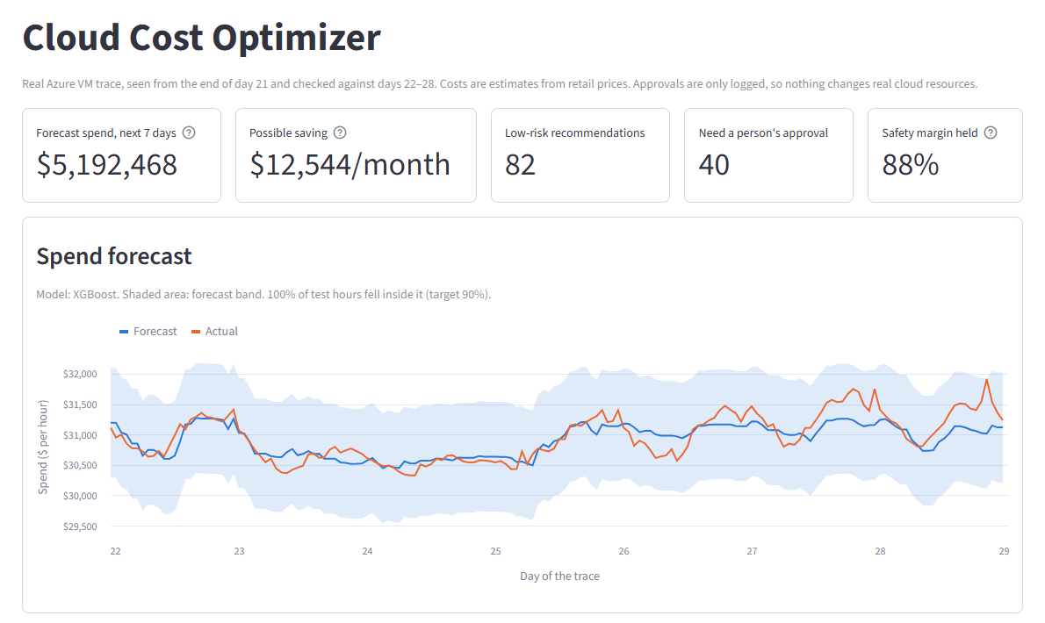
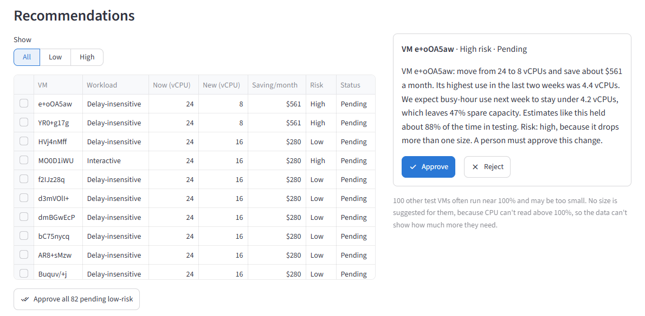
Demo: from forecast to approval
Top numbers
Bill forecast
Recommendation and explanation
Approve one, then all low-risk
Test results
1
2
3
4
5
Backup screenshots. Run the live dashboard for the real demo. Approvals are only logged, so no real VM changes.
Notes:
Switch to the live dashboard here. Command from the project folder: .venv\Scripts\streamlit run app.py. Show: the top numbers; the forecast chart; the first recommendation, 24 to 8 vCPUs saving $561 a month, which is high risk because it drops more than one size; click Approve, then Approve all 82 pending low-risk; then scroll to Did it work. Start the app before the talk because the first load can take about 10 seconds. The screenshots on this slide are a backup if the live demo fails.

Slide 4
One pipeline, from public data to approval
1
2
3
4
Collect
Prepare
Forecast the bill
Predict VM demand
VM list, CPU readings and prices
Hourly spend and hourly peak CPU
XGBoost, 7 days ahead
XGBoost, next week's busy-hour CPU
5
6
7
8
Add margin, pick size
Test
Explain
Approve
Conformal margin, then a 70% use target
Replay a week the model never saw
Plain-language sentence for each change
Streamlit dashboard logs each decision
Notes:
This is the whole system. Steps 1 and 2 collect and prepare the data. Step 3 forecasts the total bill. Step 4 predicts each VM's demand. Step 5 adds a safety margin and picks a size. Step 6 tests on a hidden week. Steps 7 and 8 explain each recommendation and let a person approve it. Each step is one Python script, run in order.

Slide 5
Real Azure data, sampled to fit our bandwidth
2.7M
20,000
$0.048
VMs in the 30-day trace
VMs sampled for right-sizing
per vCPU per hour, Dsv5 on-demand
Data | Columns we kept | AWS equivalent
VM table | vm_id, created, deleted, category, cores, memory | DescribeInstances, DescribeInstanceTypes
CPU readings | vm_id, hour, max_cpu | CloudWatch CPUUtilization
Prices | cores, hourly_price | AWS Price List API
Source: Azure Public Dataset V2 and the Azure Retail Prices API (East US, Linux). We removed the month-long CPU summary columns because they would leak the test week.
Notes:
We used the Azure Public Dataset V2 because it has real usage from millions of VMs and anyone can download it. The full data is about 156 GB and each connection was limited to about 0.6 MB per second, so we read one hour from each of 100 files. That gives 99 sampled hours spread across the month. We picked 20,000 VMs at random from 179,924 that ran from the start through day 28. We removed the month-long CPU summary columns because they include the hidden test week, which would be data leakage.

Slide 6
The bill forecast was only 0.51% off
Forecast $5.19M for the week; actual $5.20M
Our band was too wide: it held 100% of hours against a 90% target
Notes:
We forecast hourly spend one week ahead. The inputs are the hour, the day of week, spend at the same hour last week, and the 24-hour average ending one week ago. No input is newer than 168 hours, because a forecast made a week ahead wouldn't have newer data. XGBoost beat both baselines. Be honest that 59% better sounds bigger than it is, because total spend is very stable. The band was also wider than it needed to be.

Slide 7
The model predicts each VM's busy-hour CPU
Target: 95th percentile of hourly peak CPU over the next 7 days
Usage level
Group | VMs | Inputs | Predicts
Training | 13,995 | Days 1-14 | Days 15-21
Calibration | 2,998 | Days 1-14 | Days 15-21
Test | 2,996 | Days 8-21 | Days 22-28
mean, median, peak
Variation and pattern
std, share_above_80, weekend_weekday, day_night, week_change
9.2
9.19
VM type
CPU points of average error on test VMs
with Isolation Forest cleaning, against 9.21 raw: almost no gain
cores, memory, category
Notes:
For each VM we summarize the last 14 days into columns and predict its busy-hour CPU next week. Busy-hour CPU is the 95th percentile of hourly peaks: the level the VM stays at or below in about 95% of sampled hours. We split by VM, and test VMs also predict a later week, so they are new in both VM and time. The model is an XGBoost regressor with 300 trees. It is off by about 9.2 CPU points on average. We tested Isolation Forest cleaning, and it made almost no difference.

Slide 8
The safety margin comes from measured errors
1
Run the model on calibration VMs it never trained on
2
For each VM, calculate actual minus predicted CPU
3
Find the error level 90% of those VMs stayed under
4
Add that margin to each new prediction
87.8%
of test VMs stayed under the estimate, against a 90% target
Notes:
This method is split conformal prediction. Instead of guessing a margin, we measure how wrong the model was on VMs it didn't train on, and use that. Busy VMs are harder to predict, so one margin for everyone blocked too many quiet VMs. That's why each usage band gets its own margin. We hit 87.8% against a 90% target. It falls a little short because the test week is later than the calibration week. Disclose this if asked: the bands were added after a pilot run that overlapped the test week, so we report the single-margin version too.

Slide 9
A real VM: 8 vCPUs down to 4 saves $140 a month
12.19%
+6.13
18.32%
1.47
2.09
4
Model's prediction
Margin: 0-20% band
Upper estimate
vCPUs at that level, out of 8
vCPUs needed at 70% use
New size: next size up
Risk check
Saving
What really happened
Delay-insensitive, one size down, and its 3.47 vCPU peak fits in 4: low risk
($0.384 - $0.192) x 730 hours = $140 a month
Highest sampled use in the test week was 3.6 vCPUs, so 4 was enough
“VM MNSMtaJt: move from 8 to 4 vCPUs and save about $140 a month. We expect busy-hour use next week to stay under 1.5 vCPUs, which leaves 63% spare capacity. Risk: low.”
Notes:
Walk through one real VM from our results. The model predicts 12.19% CPU. Add the 6.13 margin for its band to get 18.32%. On 8 vCPUs that's 1.47 vCPUs. Dividing by 0.70 keeps it at or below 70% use, so it needs 2.09. The next available size is 4. The 70% target is our design choice. It passes all three risk rules, so it's low risk. The quote is shortened from the explanation shown on the dashboard. In the hidden week, its highest sampled use was 3.6 vCPUs, so 4 was enough.

Slide 10
On a hidden week, caution cost half the savings
ML vs simple rule
What the margin does
What it doesn't do
ML saved 0.31 points more, but the 95% interval (-0.10 to 0.71) includes zero
It changes fewer VMs (4.07% vs 8.38%), so savings and total overload both drop
Among downsized VMs, overload is about the same: 0.94% vs 0.87%
122 recommendations from 2,996 test VMs, worth an estimated $12,544 a month. Intervals come from 2,000 resamples of the test VMs.
Notes:
This is the main result. Overload means a VM's peak in a sampled hour was above its new size. We always show savings and overload together, because the most reckless policy would always save the most. Be honest: ML alone didn't clearly beat the simple rule, because recent usage already predicts next week well. The margin makes the system more cautious by changing fewer VMs, but among the VMs it changes, it isn't demonstrably safer. Savings interval: simple rule 7.12 to 9.34, ML only 7.44 to 9.65, our policy 3.47 to 5.28.

Slide 11
What worked
Full pipeline on real data, from download to dashboard
Accurate bill forecast on a stable fleet
Low overload: 0.04% of VM-hours
Margin close to target: 87.8% against 90%
Limits to keep in mind
99 of 672 hours sampled, so peaks may be underestimated | CPU only, so savings are optimistic | CPU caps at 100%, so only downsizing is evaluated | Retail prices on a 2019 trace from one region | 78% of test VMs are already at the smallest size
Notes:
Say this directly: it worked as an honestly tested system, but it didn't show that ML saves more than a simple rule. Risk levels mostly show how costly a mistake would be, since 26 of the 40 high-risk items are interactive workloads. Savings are limited because 78.3% of test VMs, making up 56.7% of test spend, are already at the smallest size. The explanations haven't been tested with real users yet, so don't claim that.

Slide 12
On AWS, it would read CloudWatch metrics
The project needs | AWS source
VM list and sizes | DescribeInstances, DescribeInstanceTypes
CPU usage | CloudWatch CPUUtilization (Maximum)
Memory usage (missing in our data) | CloudWatch Agent, mem_used_percent
Workload category | EC2 tags
Prices and actual bill | Price List API, Cost Explorer
Not built yet
It only reads the Azure dataset today. It needs an AWS connector and EC2 instance types, and it hasn't been tested on AWS.
AWS Compute Optimizer
It already recommends EC2 sizes in production. Ours is a research prototype that openly measures its margin against a simple baseline.
No logs get uploaded: it would run in the company's own account with a read-only IAM role.
Notes:
Our test used Azure data, but the method isn't tied to one provider. On AWS, the data would come from these APIs. It covers EC2 only for now; RDS and ECS or EKS are the natural next targets. Rollout would be: build the connector, create a read-only IAM role, install the CloudWatch Agent for memory, run in recommendation-only mode for 2 to 4 weeks, then apply approved changes starting with non-production. As a rough calculation, on $100,000 a month of on-demand EC2 spend, our test rate of 4.33% would be about $4,330 a month, but that isn't guaranteed.

Slide 13
Where the project stands
Done
Paper submitted
Next
Working pipeline and dashboard on real data
Tested on a hidden week
Full project explanation document
Confluence 2027, Paper ID 1175
Acceptance notice due 25 December 2026
Conference on 21-22 January 2027
Process the full CPU readings
Add memory usage data
Build the AWS connector
Test explanations with real users
Thank you.
Notes:
Close with the main message: our system works and reduces cost carefully, but a simple rule saved about as much as ML alone. Our real contribution is a measured margin, clear explanations and human approval, tested honestly. Section 17 of the project explanation document has short answers to likely questions.

