Slide 1
BAPI BADI Smart Forms

Slide 2
Agenda
BAPI
BADI
Smartforms

Slide 3
BAPI
What is BAPI?
BAPIs is Business Application Programming Interface.
How is it made available in SAP ?
Business Object Repository (BOR) of the SAP system and are used for carrying out
particular business tasks.
In the SAP system, BAPIs are stored as RFC-capable function modules in the ABAP Workbench Function Builder(SE37).
BAPIs have standard business interfaces that enable external applications (with the help of SAP business objects) to access SAP processes, functions and data.
Client programs that use BAPIs to access SAP business objects can be part of the same SAP system, part of an external system (for example, a .Net application), part of an HTTP Gateway, or part of another SAP system.
If you want to use a BAPI to trigger a business process in another system, you usually use the synchronous communication method sRFC , because in most cases, you want the data to be returned to the sending system.
For asynchronous communication using BAPIs, ALE is used, with additional IDoc interfaces being generated for the BAPIs.

Slide 4
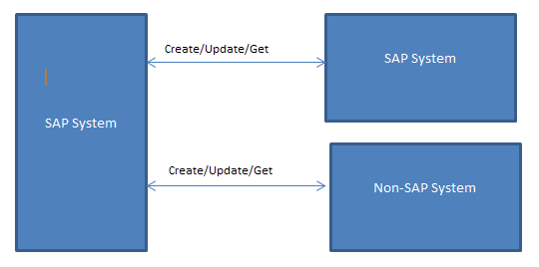
BAPI
Transaction Code
BAPI
Types Of Operations
Create
Change/Update
GetList
GetDetails
Delete

Slide 5
Demo

Slide 6
BADI
What is Badi?
BADI is a Business Add-ins and Alternative for customer exits
BADI's are ABAP object oriented based.
Types of Badi
Kernel Badi
Classical Badi
How to Find:
Class CL_EXITHANDLER method: Get Instance
Transaction Code
SE18/SE19

Slide 7
Demo

Slide 8
SmartForms
Use
Business documents - Order Confirmation, Invoice, Delivery Note.
Transaction Code
SMARTFORMS is the transaction to design the smart form layout
SMARTSTYLES transaction allows to define paragraph and character formats (fonts, barcodes, etc.)
Smart form will generate a function module after activation and This Function is used to call smart form in report. This function module may be change in each system after import.
Form Painter
Design output layout-Add Pages Windows, Logo etc.
Form Attribute
Created By/Changed By, Pages format, style, Character & Line per Inch
Form Interface
Importing parameters have to be defined so that an ABAP program can send the data to be printed.
Global Definitions
Declare Global Variables, Work Area, Internal tables, Types, Code etc.

Slide 9
Smart Forms
Smart forms Components
Windows, Logo, Table ,Template, Alternative, Loop, Program Line, Command and Text Element
How to Debug smart form
How to call smart forms from report

Slide 10
Demo

