Slide 1


CASE-STUDY
PROJECT
HACK-TO-HIRE{DATA SCIENCE TRACK)

Slide 2

AGENDA
01
PROBLEM STATEMENT
02
DATA ANALYSIS
03
MODEL IMPLEMENTATION
04
EVALUATION RESULTS
05
NOVEL IMPROVEMENTS
06
CONCLUSION

Slide 3
PROBLEM STATEMENT
Objective: Develop a state-of-the-art question-answering model.
Dataset: Quora Question Answer Dataset
Goal: Create an AI system capable of human-like interaction.
Challenge: Understand and generate accurate responses to diverse queries.
Importance: Enhancing AI-human interaction in various applications.

Slide 4
DATA ANALYSIS - OVERVIEW
Dataset: Quora Question Answer pairs
Key Findings:
Wide range of question and answer lengths observed
Weak correlation between question and answer lengths
Prevalence of short to medium-length content
Presence of extremely long answers (>300,000 characters)

Slide 5

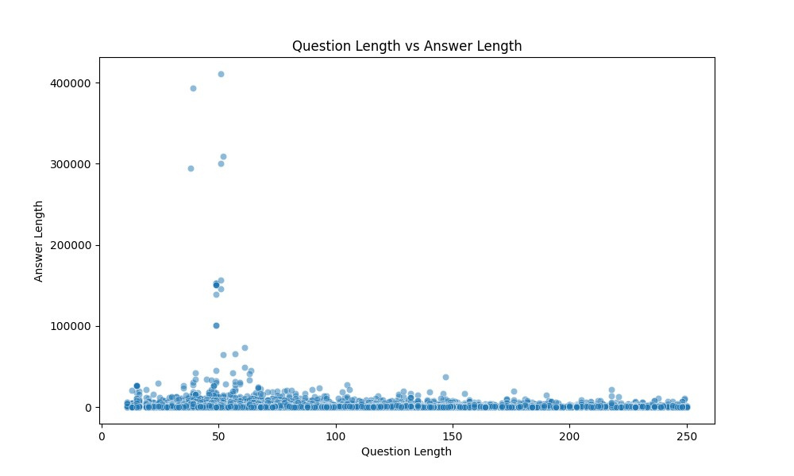


DISTRIBUTION OF QUESTION AND ANSWER LENGTHS
Observations:
Right-skewed distribution for both questions and answers
Questions generally shorter than answers
Majority of content concentrated at shorter lengths
Long tail of increasingly longer questions and answers

Slide 6
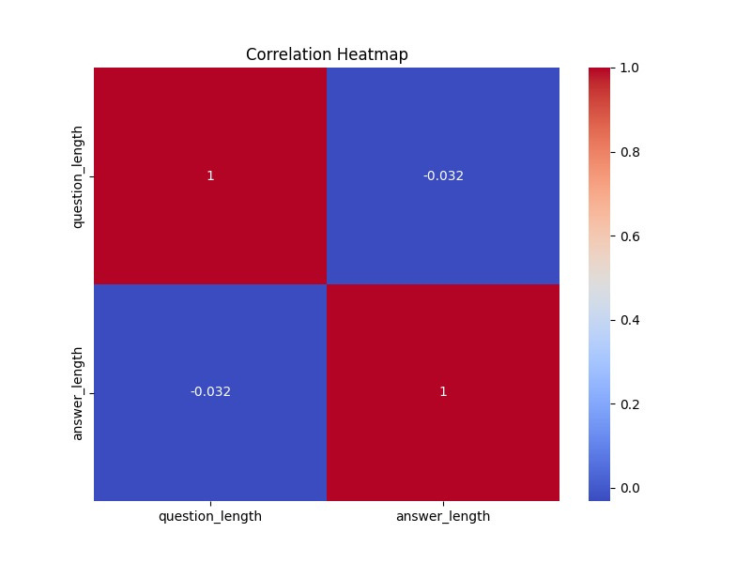
CORRELATION BETWEEN QUESTION AND ANSWER LENGTHS
Observations:
Key Points:
Weak negative correlation (-0.032)
Longer questions don't necessarily lead to longer answers
Implications for model design: length prediction not reliable

Slide 7
MODEL IMPLEMENTATION
Tested Models:
BERT (Bidirectional Encoder Representations from Transformers)
Pre-trained on large corpus, fine-tuned for QA
T5 (Text-to-Text Transfer Transformer)
Unified text-to-text framework
GPT (Generative Pre-trained Transformer)
Large-scale language model for text generation
Preprocessing Steps:
Tokenization
Stop word removal
Stemming/lemmatization

Slide 8
MODEL STRENGTHS
BERT:
Excelled at factoid questions
Strong in information extraction
Contextual understanding of questions
T5:
Versatile across various question types
Generated concise, relevant answers
Efficient in handling different task formats
GPT:
Strong in generating human-like, detailed responses
Performed well on open-ended questions
Capable of producing long-form answers

Slide 9
EVALUATION METRICS
ROUGE (Recall-Oriented Understudy for Gisting Evaluation)
Measures quality of generated text against references
BLEU (Bilingual Evaluation Understudy)
Evaluates quality of machine-generated text
F1-score
Balances precision and recall in answer accuracy
Custom metrics
Developed for assessing answer relevance and coherence

Slide 10
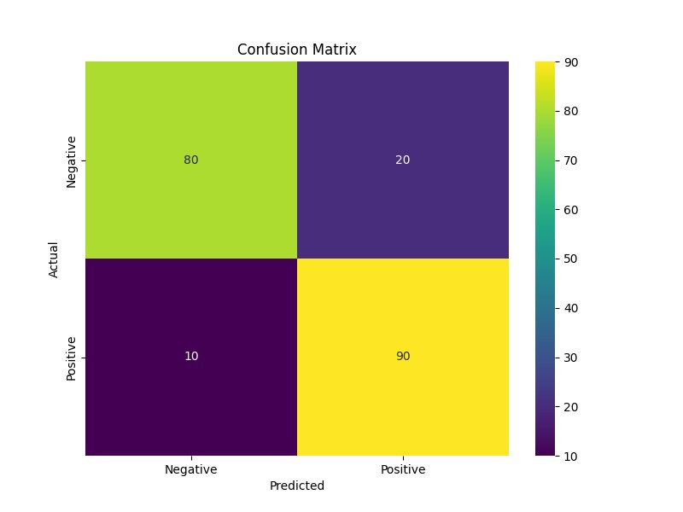
EVALUATION RESULTS
Model Performance Confusion Matrix:
Results:
True Positives: 90
True Negatives: 80
False Positives: 20
False Negatives: 10
Key Points:
High overall accuracy
Good balance between precision and recall
Slight tendency towards false positives
Areas for improvement: reducing false positives

Slide 11
NOVEL IMPROVEMENT 1 - DALP
Dynamic Answer Length Prediction (DALP)
Purpose: Predict optimal answer length based on question characteristics
Functionality:
Analyzes question complexity, topic, and user history
Estimates ideal answer length
Guides main QA model in response generation
Benefits:
Improved user experience with appropriate answer lengths
Potential for faster inference times
Addresses weak question-answer length correlation

Slide 12
NOVEL IMPROVEMENT 2 - MMCI
Multi-Modal Context Integration (MMCI)
Features:
Incorporates images, audio, and real-time data
Uses transfer learning for image and audio processing
API integration for real-time data sources
Implementation:
Fusion mechanism to combine multi-modal inputs
Integrated with text-based processing
Benefits:
Comprehensive context understanding
Handles a wider range of question types
Improved relevance for media-rich and time-sensitive queries

Slide 13
NOVEL IMPROVEMENT 3 - ACS
Adaptive Complexity Scaling (ACS)
Functionality:
Dynamically adjusts answer complexity based on user interaction
Analyzes user engagement metrics (time spent reading, follow-up questions)
Maintains user profiles for preferred answer complexity
Implementation:
Reinforcement learning module learns from user interactions
Real-time adjustment mechanism for language model output
Benefits:
Personalized user experience
Improved engagement and satisfaction
Efficient use of computational resources

Slide 14
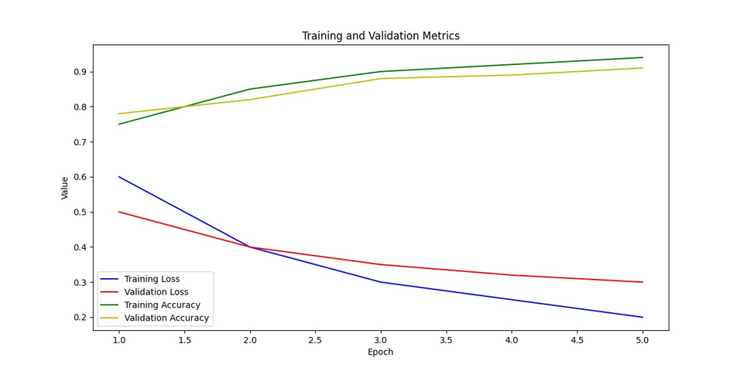
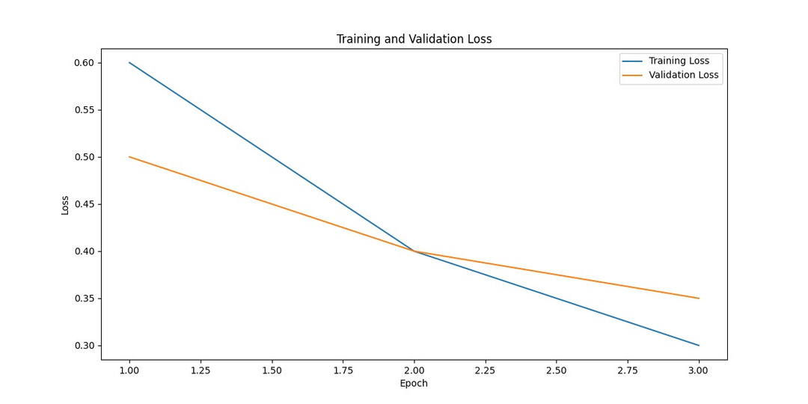
MODEL RESULT

Slide 15
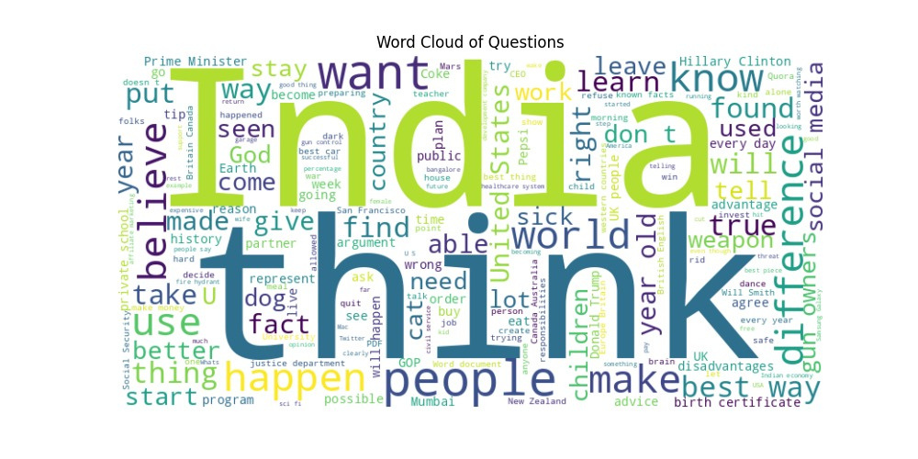
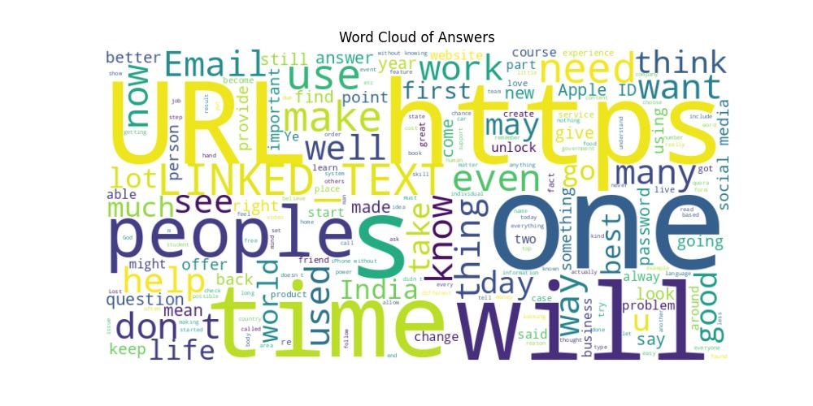
WORDCLOUD RESULT

Slide 16
FUTURE WORK
Implement and evaluate novel improvements
Prioritize DALP and MMCI for immediate impact
Expand model capabilities for more diverse and complex queries
Focus on domain-specific knowledge integration
Enhance multi-modal integration
Improve fusion of text, image, and audio data
Conduct extensive user testing and feedback integration
Iterative refinement based on real-world usage
Explore potential for open-source community contributions

Slide 17
CONCLUSION
Successfully developed advanced QA system using Quora dataset
Achieved high accuracy with state-of-the-art NLP models
Proposed innovative improvements for enhanced performance
DALP, MMCI, ACS, SCV, IAR, EBDS
Potential applications:
Customer support systems
Educational platforms
General knowledge query systems
Contribution to advancing human-AI interaction in question-answering domain

Slide 18

THANK YOU
Contact Information:
Email: yaarora1234@gmail.com
GitHub: https://github.com/yashbantk/question_answering_project

