Slide 1
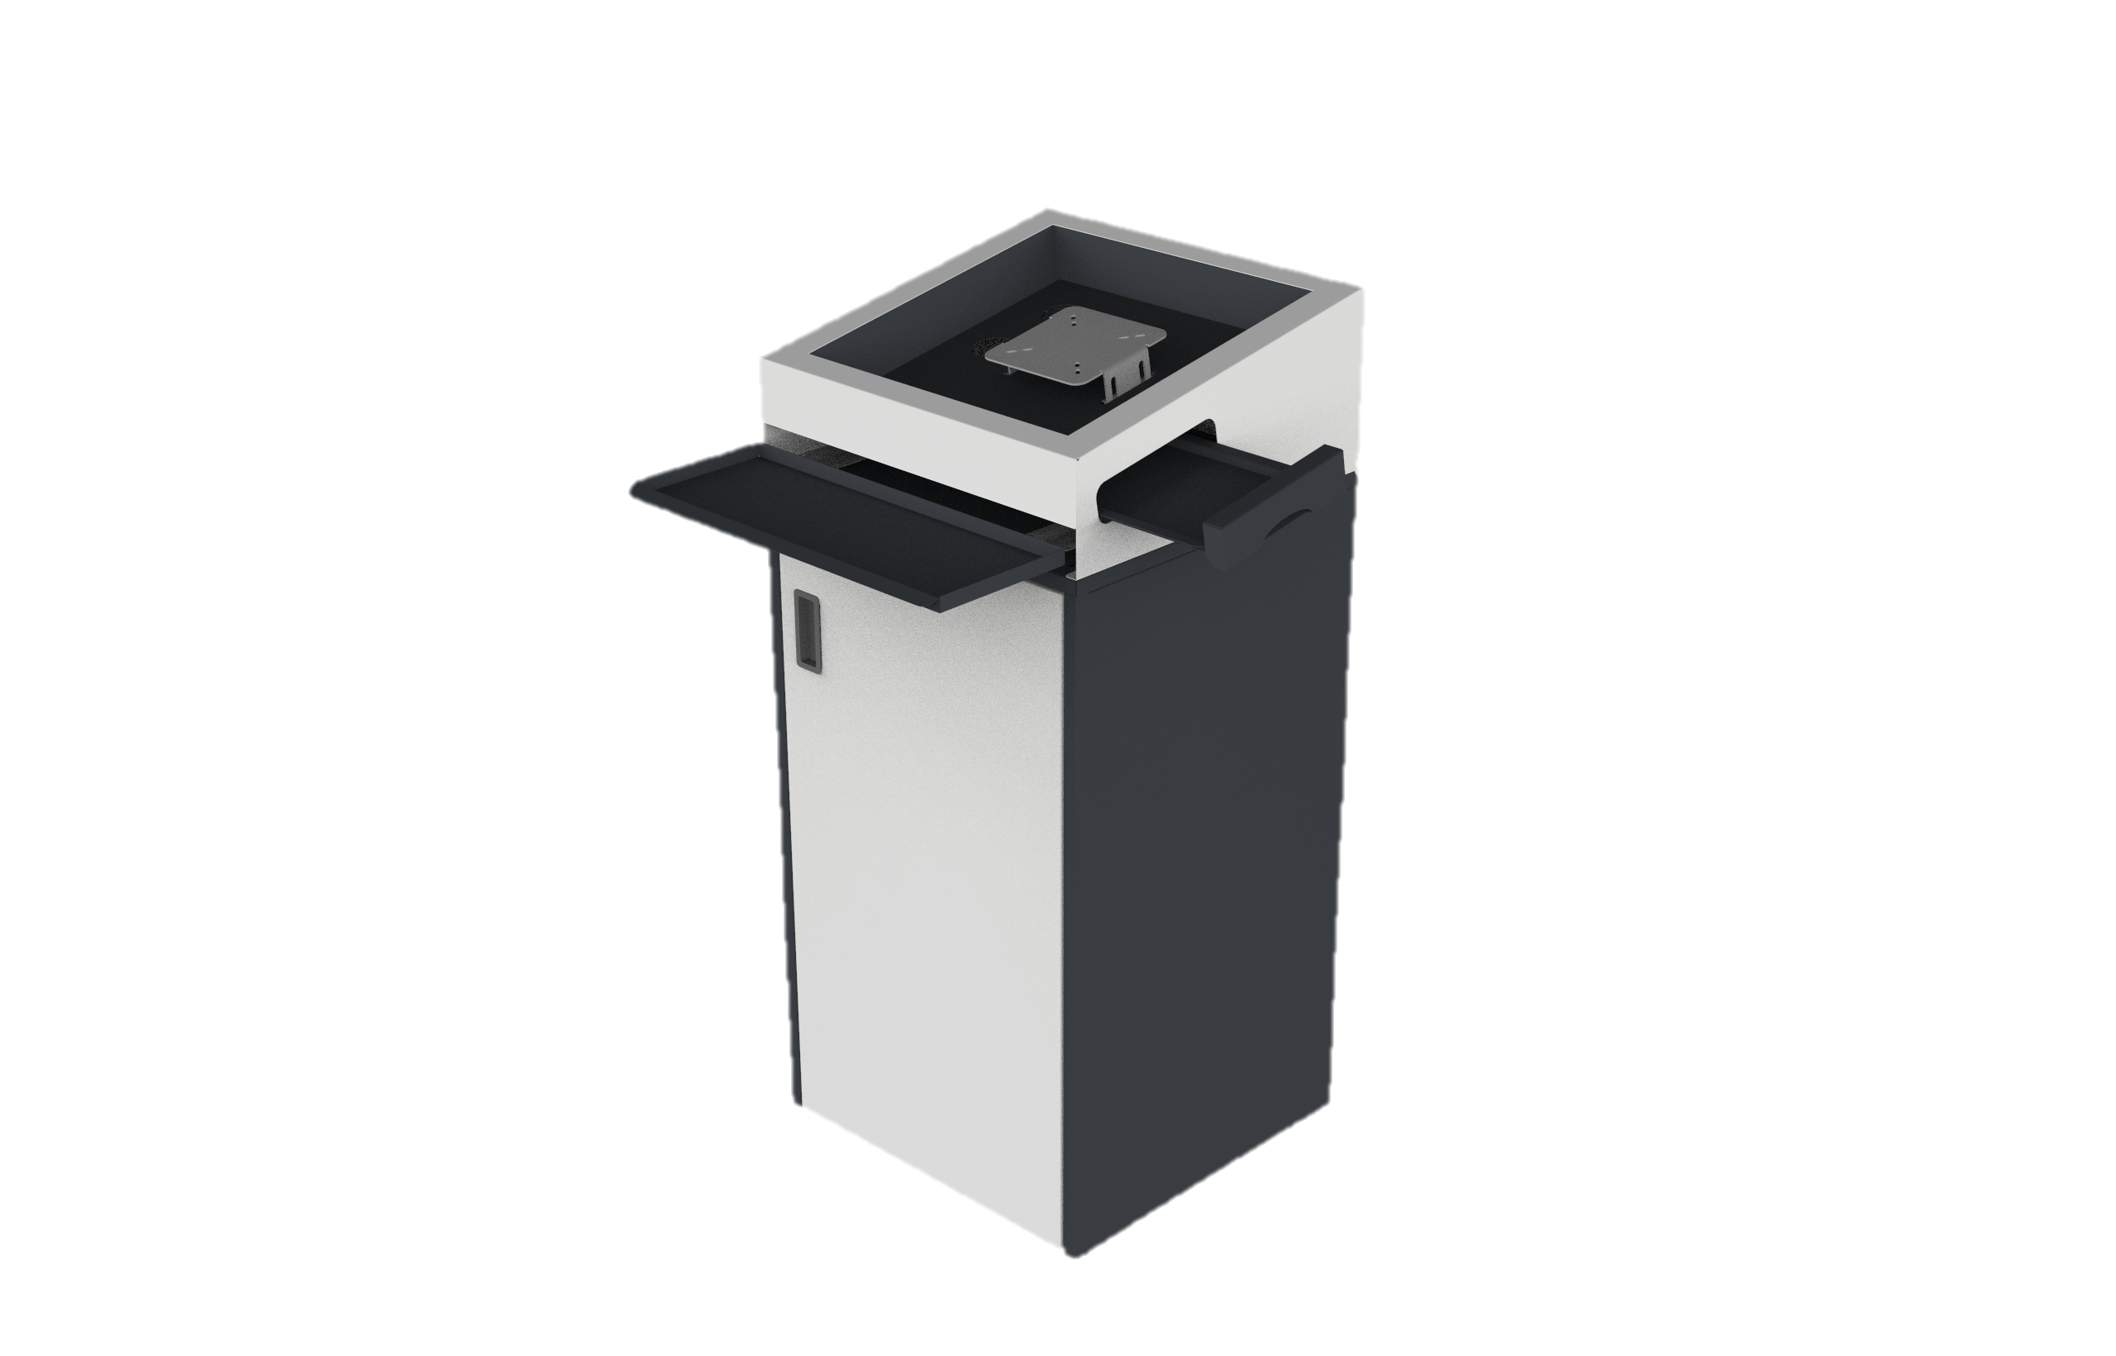
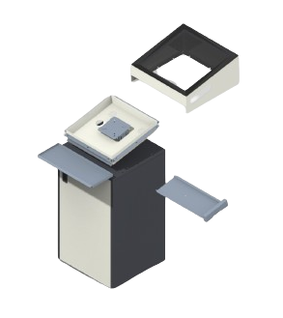
GO TO MY PROJECT
Digital Podium
An ultimate tool for seamless lectures and presentations - the Digital Podium! Elevate your speaking engagements with its convenient monitor mounting, effortlessly sliding keyboard tray, and a dedicated mouse tray on the side. Impress your audience with a sleek and organized setup that enhances your delivery and professionalism.

Slide 2
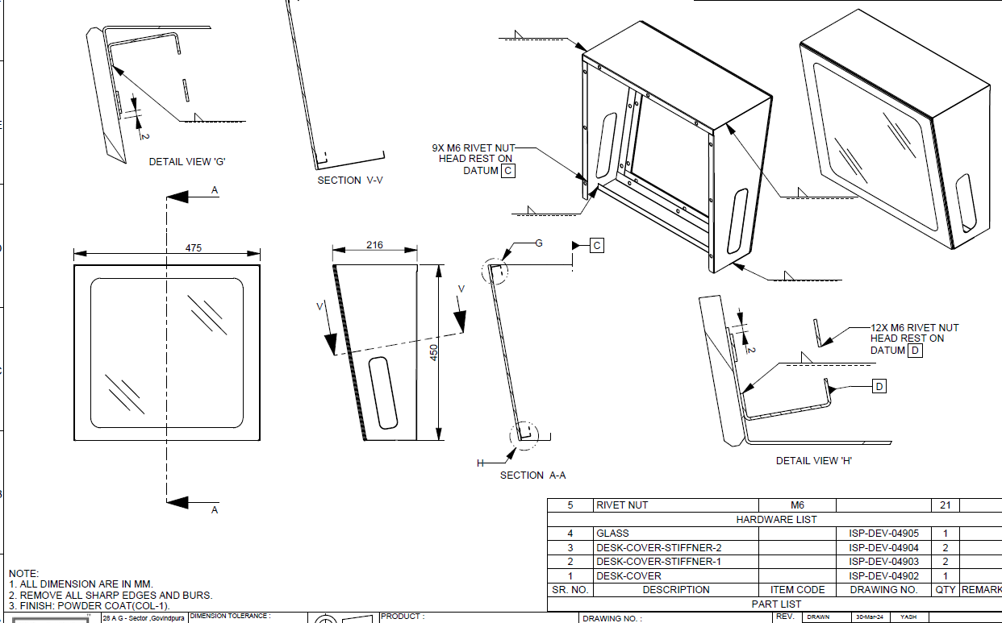
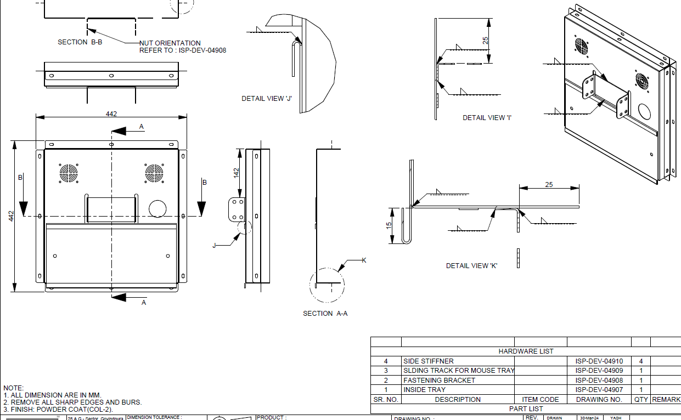
Features: Crafted with a soft, yet durable sheet metal construction, delivering an elegant design that's easy to maintain. Simple assembly process ensures quick setup without any hassle. Designed to be production-friendly for seamless integration into any environment. Features a smooth sliding mechanism for the mouse tray, ensuring convenience and efficiency.

