Slide 1
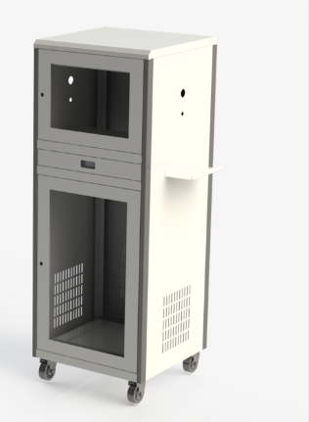
GO TO MY PROJECT
Control Desk Panel
Specially design and developed for VOLVO-EICHER COMMERCIAL VEHICLE-BAGRODA the panel design to consider as modular joinery and their operating system and production line. this panel can assemble and dismantle easily.

