Slide 1

Springboard Internship Program
SENTIMENT ANALYSIS OF SOCIAL MEDIA CONTENT
FOLLOWED BY
TEXT CLASSIFICATION
By :
Yash Bedagkar
yashb440@gmail.com

Slide 2
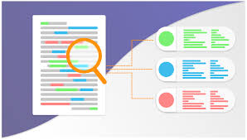
Table of Contents
Problem Statement and Business Use case | 3
Sentiment Analysis for Text Data Understanding | 4
Data Overview and Preprocessing | 5
Vectorization and Data Splitting | 7
Handling Class Imbalance | 8
Modeling Approach | 9
Models Used | 10
Performing Hyperparameter Tuning | 11
Choosing the best model | 12
Evaluating the best chosen model on validation data | 13
Project Achievements | 14

Slide 3
To identify and classify emotions in customer comments to understand customer sentiment.
Problem
Statement
Problem - Businesses face overwhelming volumes of customer feedback, leading to slow issue resolution and missed insights.
Solution - Build a model to classify emotions in social media comments, enabling real-time sentiment analysis.
ANALYZING SOCIAL MEDIA REACTIONS TO UNDERSTAND USER SENTIMENT ON PRODUCT LAUNCHES
Business Use Case
Real-Time Insights
Issue Identification
Product Improvement
Targeted Marketing

Slide 4
Business Use Cases
Competitor Analysis
Demographic Insights
Compare the sentiment and reactions towards the company with competitors' products.
Segment sentiment analysis by demographics such as age, location, and user expertise.
Crisis Management
Pre-Launch vs Post-Launch Sentiment:
Identify emerging negative sentiments related to the product and implement strategies to mitigate potential damage to the brand
Evaluate how initial expectations align with actual user satisfaction and address any gaps.

Slide 5
Sentiment Analysis for Text Data Understanding
Purpose
To familiarize with text data processing and sentiment extraction.
Approach
Lexicon-based sentiment analysis.
Outcome
Gained insights into handling text data for further analysis.

Slide 6
Data Overview and Preprocessing
Dataset -
The dataset consists of 16,000+ text records, each labeled with one of six emotions: sadness, joy, love, anger, fear, and surprise. This labeled data provides a rich source for training and evaluating models to accurately classify the emotional tone of customer comments.
Data Preprocessing Steps -
1
Convert text to lowercase
2
Remove links
3
Remove next lines
4
Remove text containing numbers

Slide 7
5
Remove extra spaces
6
Remove special characters
Remove stop words - Eliminate common words such as "and," "the," and "is" that do not contribute to the text's meaning,
For e.g. "the product is great" becomes "product great."
7
Stemming - Stemming in NLP is the process of reducing words to their base or root form by removing suffixes and prefixes without considering the context.
For e.g. changing -----> chang
8
Lemmatization - Lemmatization in NLP is the process of reducing words to their base or dictionary form, known as the lemma, by considering the context and morphological analysis.
For e.g. changing -----> change
9

Slide 8
Vectorization
Data Splitting
Vectorization is the process of converting text data into numerical representations using TF-IDF that can be used by machine learning algorithms.
TF (Term Frequency): Measures how often a word appears in a document.
IDF (Inverse Document Frequency): Measures how important a word is by evaluating how common or rare it is across all documents in the dataset.

Slide 9
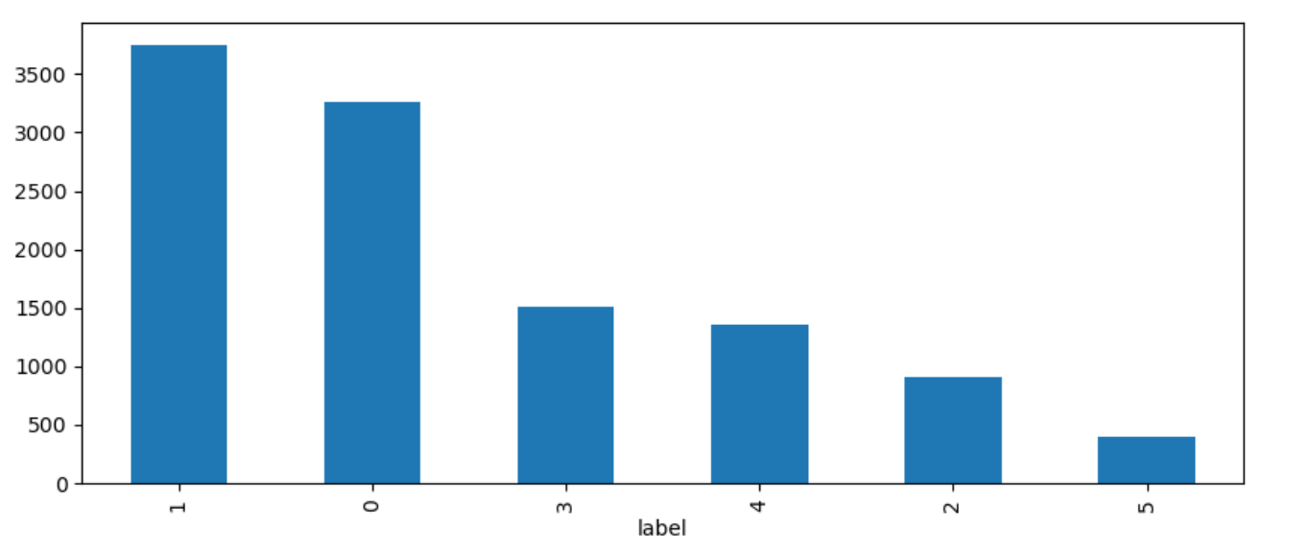
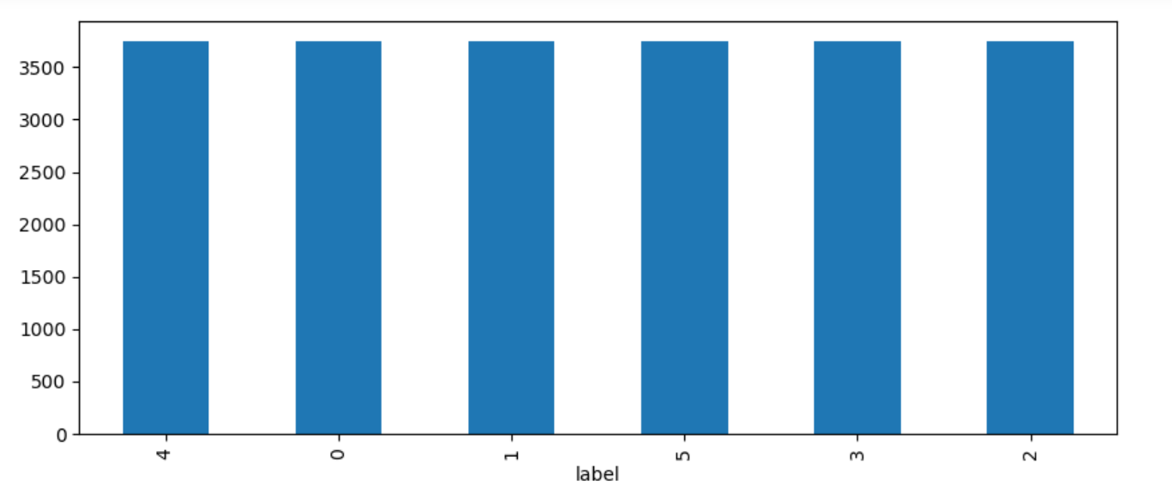
Handling Class Imbalance
Before
After
Applying SMOTE
SMOTE (Synthetic Minority Over-sampling Technique) generates synthetic samples in the training set to balance the class distribution.
SMOTE is to be applied only to the training data and not to the testing data.

Slide 10
Modeling Approach
Train the model on the training data.
Evaluate its performance on training and testing data.
Perform hyperparameter tuning.
Re-train with the best parameters and evaluate.
Choose the best model based on performance metrics.
Evaluate the best model on validation data.

Slide 11
Models Used
Logistic Regression
Naïve Bayes Classifier
XGBoost
A simple and interpretable model that estimates probabilities using a logistic function.
Effective for both binary and multiclass classification, providing clear insights into the influence of each feature.
Based on Bayes’ theorem, it calculates the probability of each class given the feature values.
Assumes independence between predictors, making it highly efficient for large datasets.
An learning method that builds a series of decision trees, where each tree corrects errors of the previous one.
Known for its high performance in classification tasks due to its ability to handle complex relationships and interactions between features.

Slide 12
Performing Hyperparameter Tuning
The process of optimizing the hyperparameters that govern the training of a machine learning model to achieve the best possible performance.
Methods:
Grid Search: Evaluates all possible combinations.
Random Search: Samples random combinations.
Process:
Define search space.
Select the search method.
Evaluate combinations.
Identify best parameters.

Slide 13
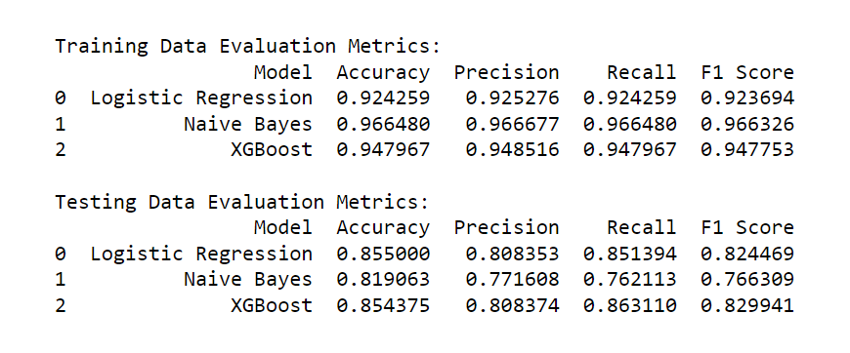
Choosing the best model
Based on the evaluation metrics, XGBoost is the best model for this problem. It's consistent across all metrics. It has the highest F1 Score and Recall, indicating a better balance between precision and recall, and its accuracy is very close to the Logistic Regression model.

Slide 14
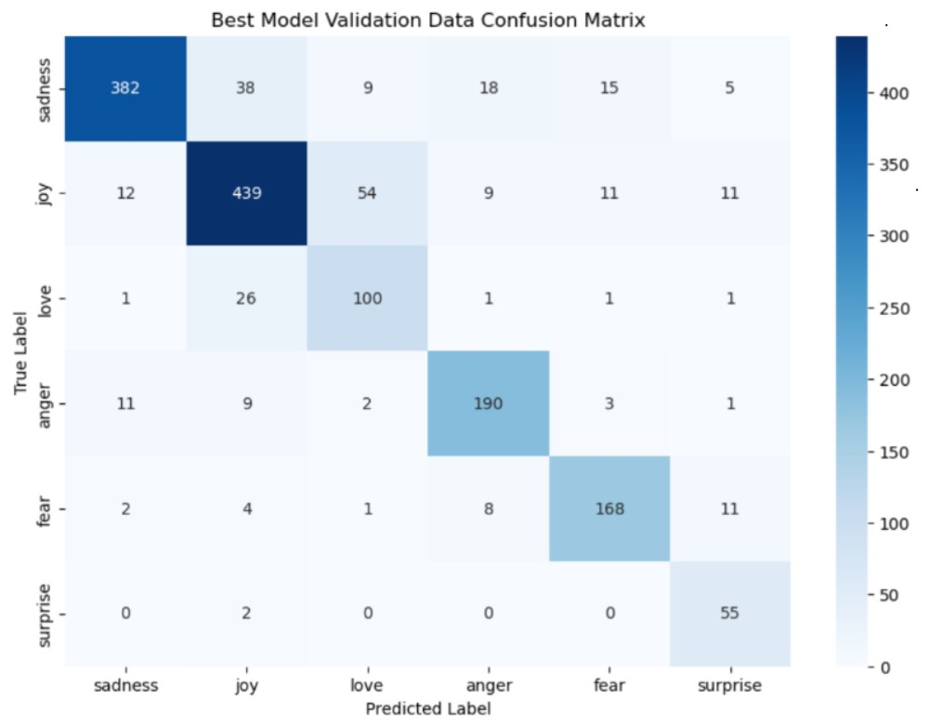
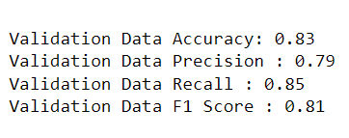
Evaluating the best chosen model on validation data

Slide 15
Project Achievements
Understanding User Sentiment
Product Improvement
Quickly gauges customer reactions to product launches.
Uses emotional insights to guide better product development.
Targeted Marketing
Brand Managment
Enhances marketing campaigns based on emotional data.
Continuously monitors sentiment to maintain a positive brand image.

Slide 16

Thank you!

