Slide 1

DA 120B · DATA ANALYTICS PROJECT
Air Quality Index Analysis
Six years of pollution data across 26 Indian cities, 2015–2020
Yash David Bedekar
Project Lead & Data Engineer
Surya Koushik Palla
Data Analyst & Visualisation Lead
Aryaman Negi
Statistical Analyst
Arda Onhun
Insights & Reporting Lead
Source: CPCB (Central Pollution Control Board) via Kaggle · 29,531 daily observations

Slide 2



EXECUTIVE SUMMARY
Six years of Indian air quality, at a glance
29,531
26
2015–20
35.5%
~26%
r = 0.80
Daily city-level observations
Indian cities covered
Period analysed (Jan '15–Jul '20)
Of city-days rated "Moderate"
Of city-days are unhealthy (AQI>200)
PM10 correlation with AQI (strongest)
RQ1 — Temporal
RQ2 — Pollutants
RQ3 — Exposure
How does AQI change daily, monthly, seasonally and year-on-year?
Which pollutants most strongly drive the overall AQI score?
How often is air unhealthy, and which cities suffer most?
AQI Analysis · India 2015–2020
2

Slide 3
METHODOLOGY
About the dataset
CPCB AQI SCALE
Good
0–50
Source
Central Pollution Control Board (CPCB), via Kaggle (curated by Rohan Rao)
Satisfactory
51–100
File
city_day.csv — one row per city per day
Moderate
101–200
Records
29,531 daily observations
Coverage
26 major Indian cities, 1 Jan 2015 – 1 July 2020
Poor
201–300
Pollutants
PM2.5, PM10, NO2, SO2, CO, O3 (µg/m³ or mg/m³)
Very Poor
301–400
License
CC0 — Public Domain
Severe
401–500
This project defines “unhealthy” as AQI > 200 (Poor, Very Poor, Severe).
AQI Analysis · India 2015–2020
3

Slide 4



DATA PREPARATION
Data cleaning & quality notes
Missing-value profiling
Top Missing-Value Columns
Quantified gaps per column; pollutant NaNs kept as-is using pairwise-complete stats.
Xylene
61.3%
PM10
37.7%
Outlier capping
Ahmedabad AQI values reached 2,049 (sensor faults). AQI_capped clips all aggregates at 500.
NH3
35.0%
Toluene
27.2%
Feature engineering
Benzene
19.0%
Derived Year, Month, Season, DayOfWeek, and an Unhealthy (AQI>200) flag.
AQI
15.9%
2020 data covers Jan–Jul only, so year-on-year 2020 figures blend a partial year with the COVID-19 lockdown effect.
AQI Analysis · India 2015–2020
4

Slide 5
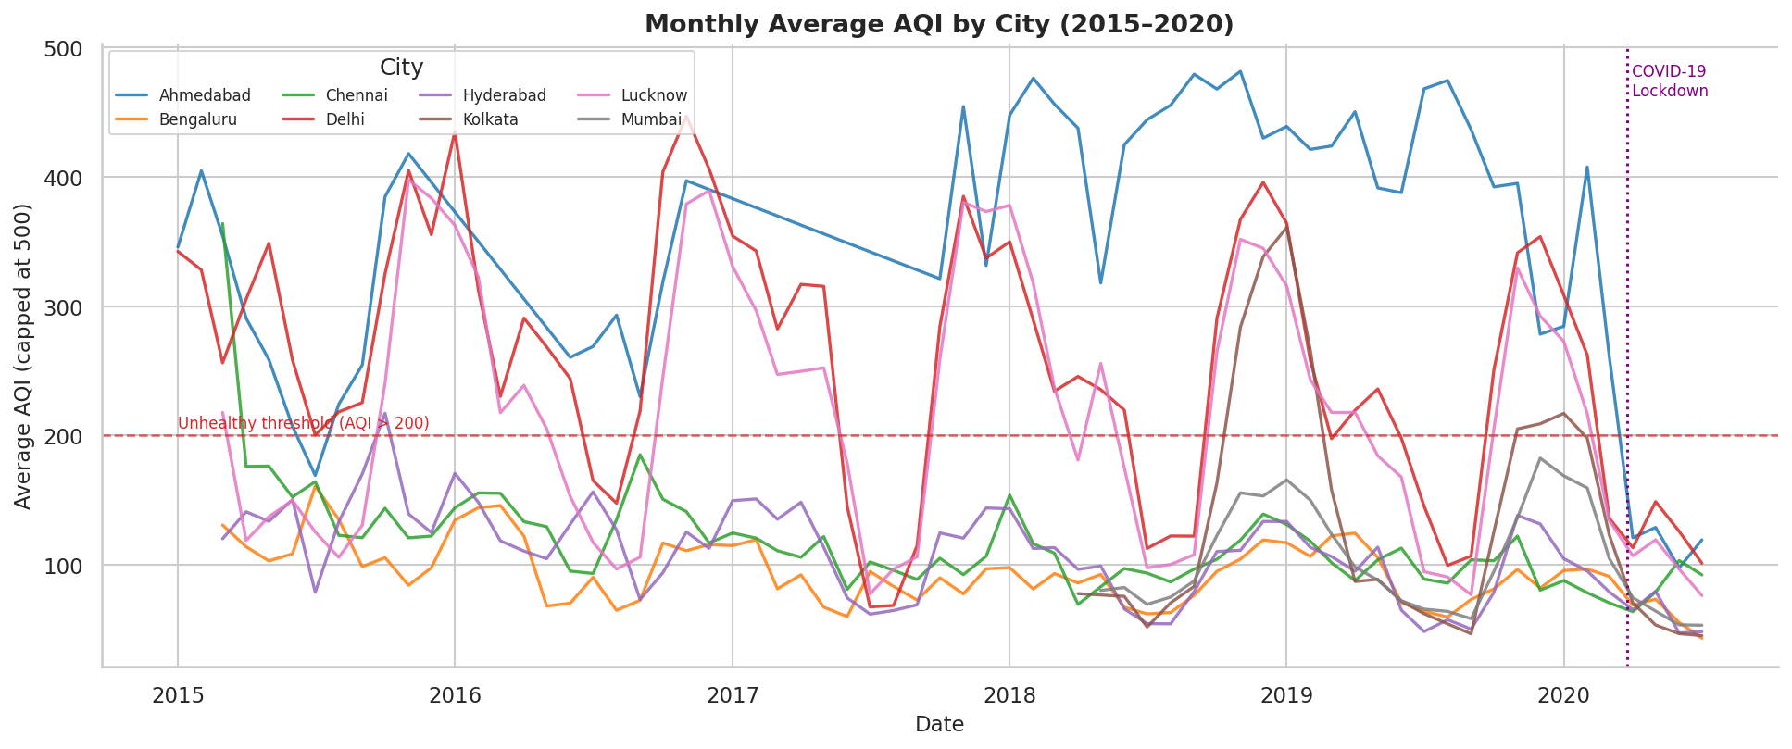
RQ1 · TEMPORAL PATTERNS
Monthly AQI trend across cities (2015–2020)
Every city shows a clear winter (Dec–Jan) peak; the March–June 2020 COVID-19 dip is visible across all series.
AQI Analysis · India 2015–2020
5

Slide 6
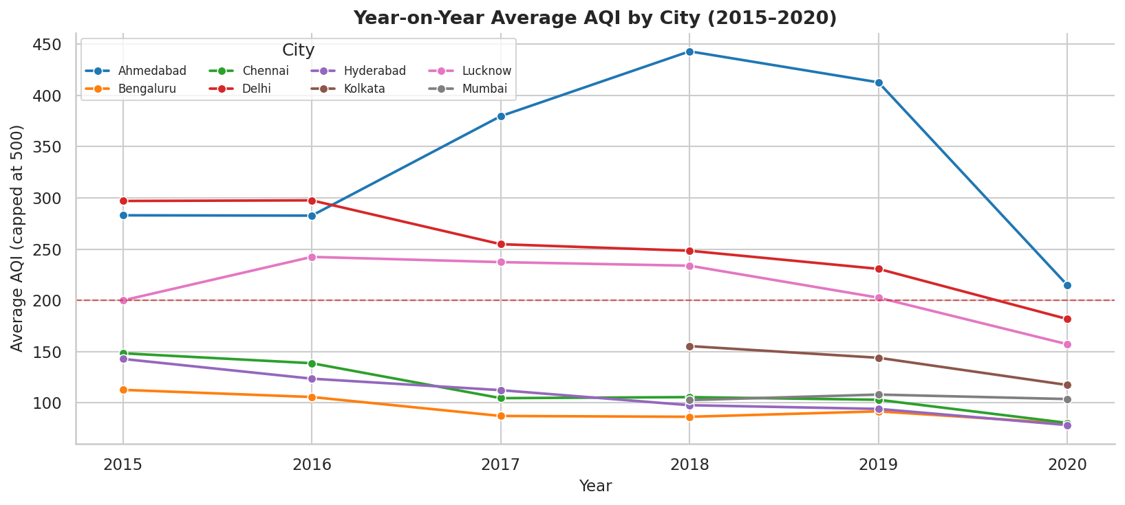
RQ1 · TEMPORAL PATTERNS
Year-on-year average AQI by city
Selected Cities — Mean AQI by Year
City | 2015 | 2018 | 2020
Ahmedabad | 283 | 443 | 215
Delhi | 297 | 248 | 182
Lucknow | 200 | 234 | 157
Bengaluru | 113 | 86 | 80
Ahmedabad & Lucknow
rose sharply through 2018 before the 2020 lockdown pulled every city down — the clearest year-level signal of human influence on air quality.
AQI Analysis · India 2015–2020
6

Slide 7
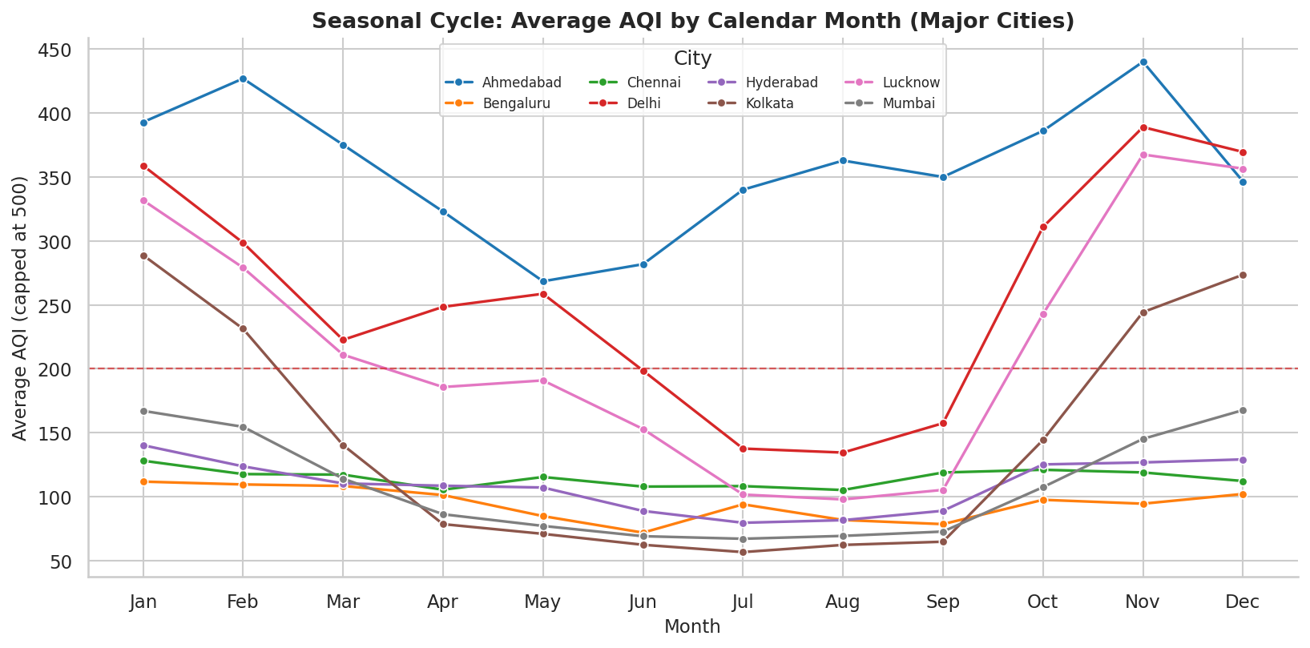
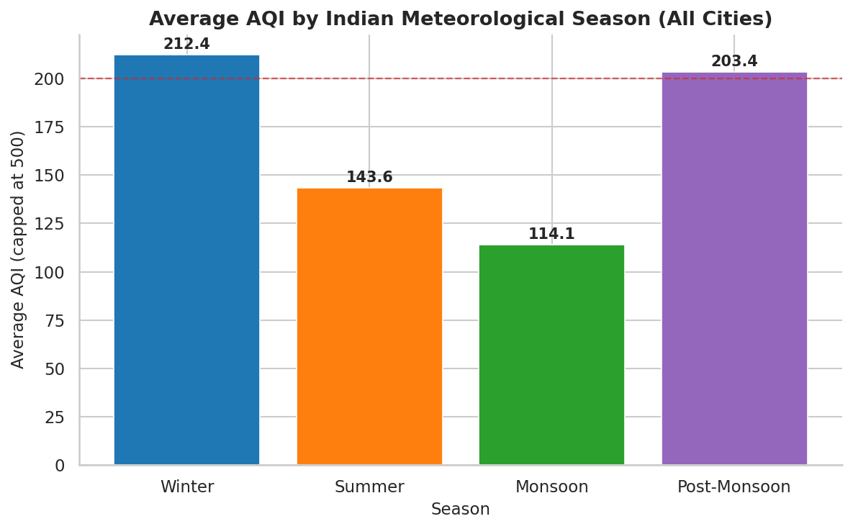
RQ1 · TEMPORAL PATTERNS
Air quality follows a strong seasonal cycle
Winter (Dec–Jan) temperature inversions trap pollutants; monsoon rains (Jul–Aug) wash them out — Winter averages 212.4 AQI vs. 114.1 in Monsoon.
AQI Analysis · India 2015–2020
7

Slide 8
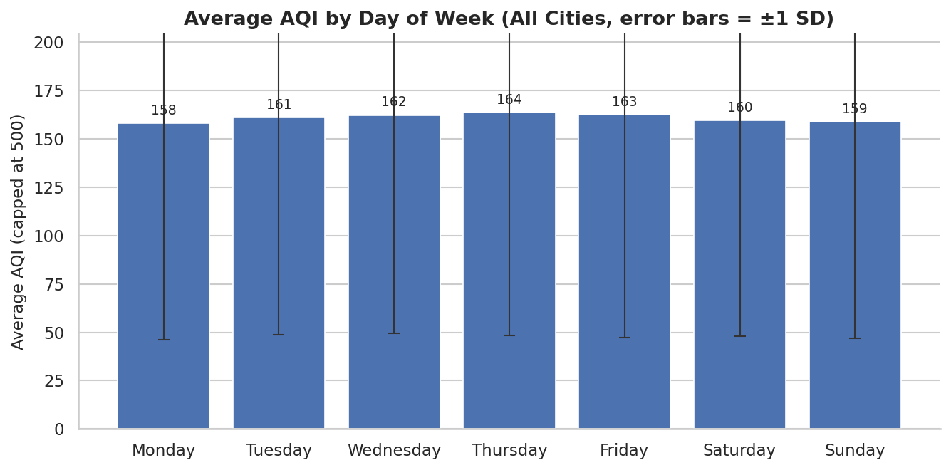
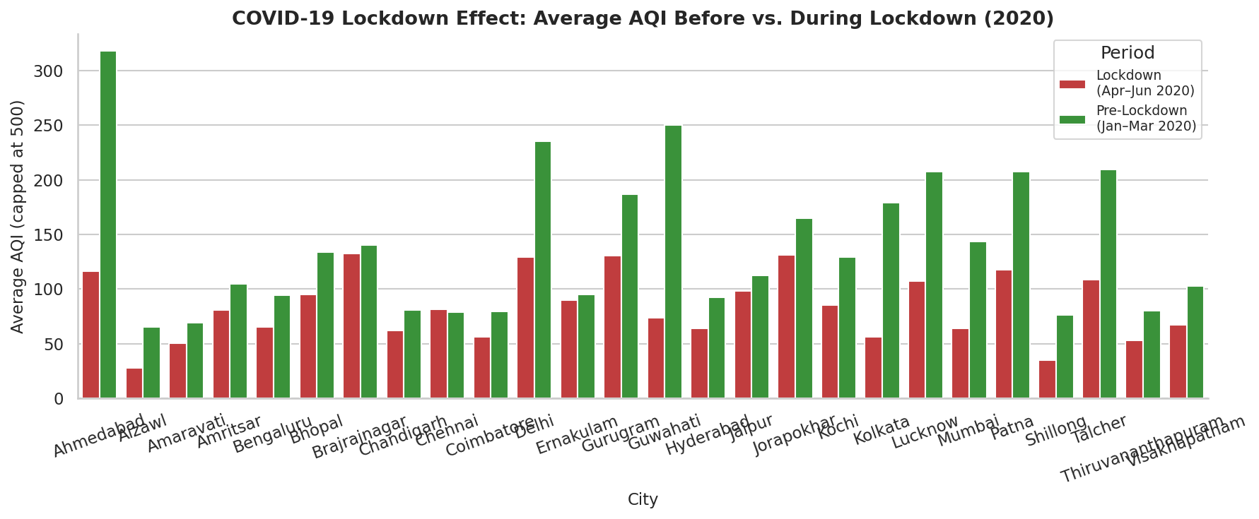
RQ1 · TEMPORAL PATTERNS
Weekday effects are negligible — human activity shocks are not
Mon–Sun averages sit within a narrow 158–164 AQI band: weather, not weekday traffic, drives pollution.
Every one of the 26 cities improved during the Apr–Jun 2020 lockdown vs. Jan–Mar 2020 — Guwahati fell 237.8%, Ahmedabad 173.7%, confirming direct human contribution to urban air pollution.
AQI Analysis · India 2015–2020
8

Slide 9
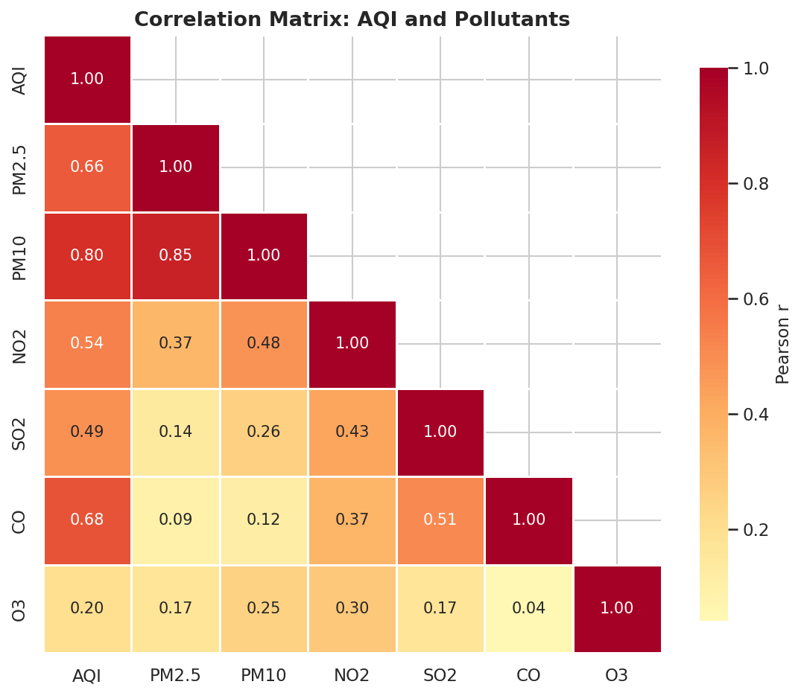
RQ2 · POLLUTANT RELATIONSHIPS
Which pollutants drive the AQI score?
Correlation with AQI (Pearson r)
PM10
0.80
CO
0.68
PM2.5
0.66
NO2
0.54
SO2
0.49
O3
0.20
PM10 is the strongest driver of AQI (r=0.80); ozone is weakly correlated (r≈0.20) and not a dominant driver in India.
AQI Analysis · India 2015–2020
9

Slide 10
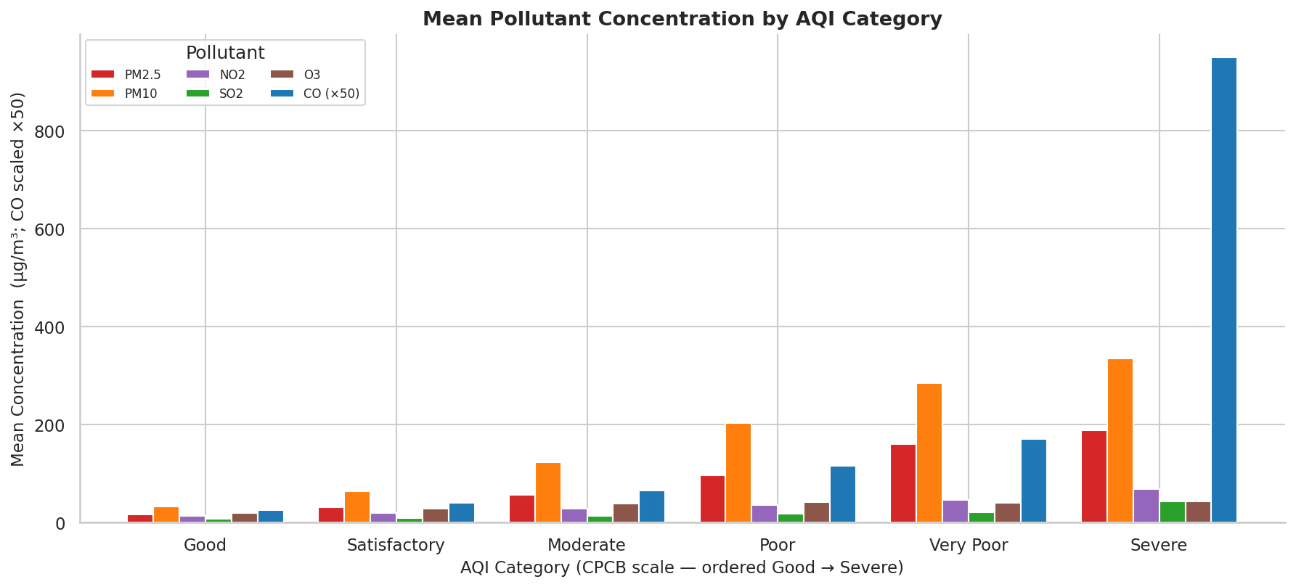
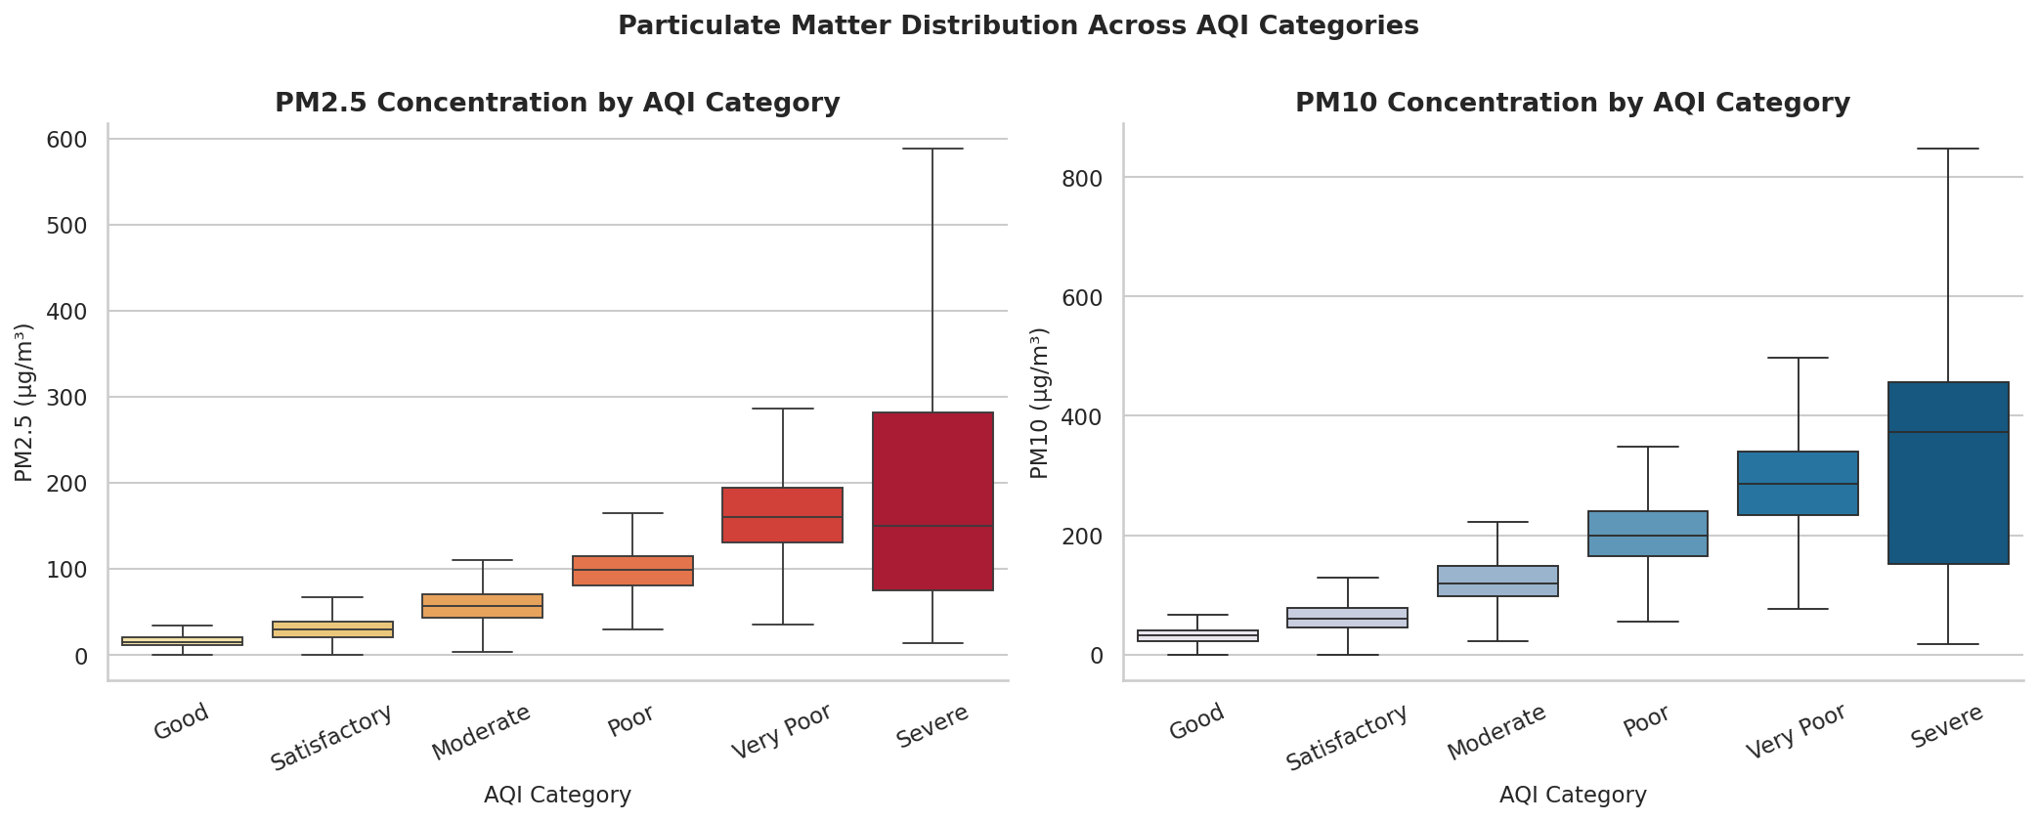
RQ2 · POLLUTANT RELATIONSHIPS
Pollutant concentrations rise with AQI severity
PM2.5 and PM10 climb steeply from Good to Severe; CO spikes sharply in Severe days, validating the CPCB category scheme.
AQI Analysis · India 2015–2020
10

Slide 11
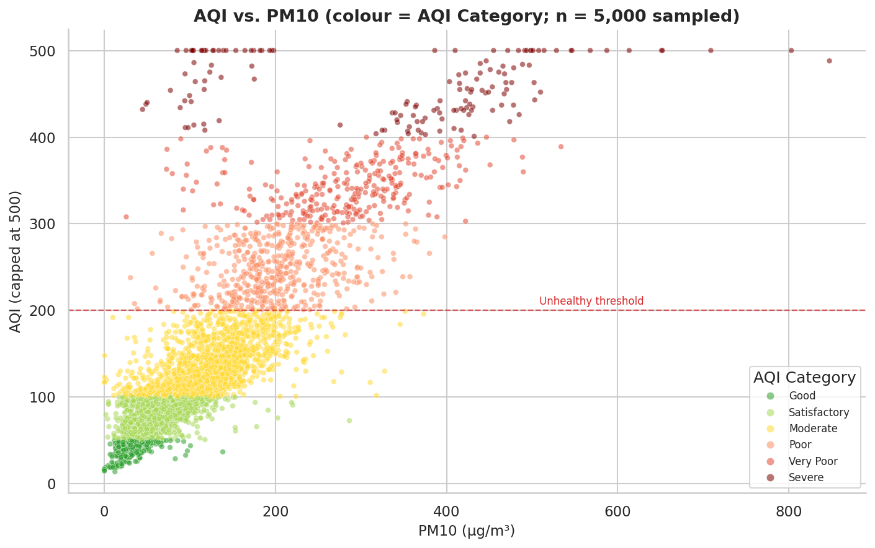
RQ2 · POLLUTANT RELATIONSHIPS
AQI vs. PM10 — a strong positive relationship
n = 5,000 days randomly sampled for plotting clarity
Severe days cluster above PM10 ~200 µg/m³
Colour scale matches the 6-category CPCB scheme
Takeaway:
coarse particulate matter (PM10) is the single best predictor of India's overall AQI, reinforcing dust and construction/road-dust control as high-leverage interventions.
AQI Analysis · India 2015–2020
11

Slide 12
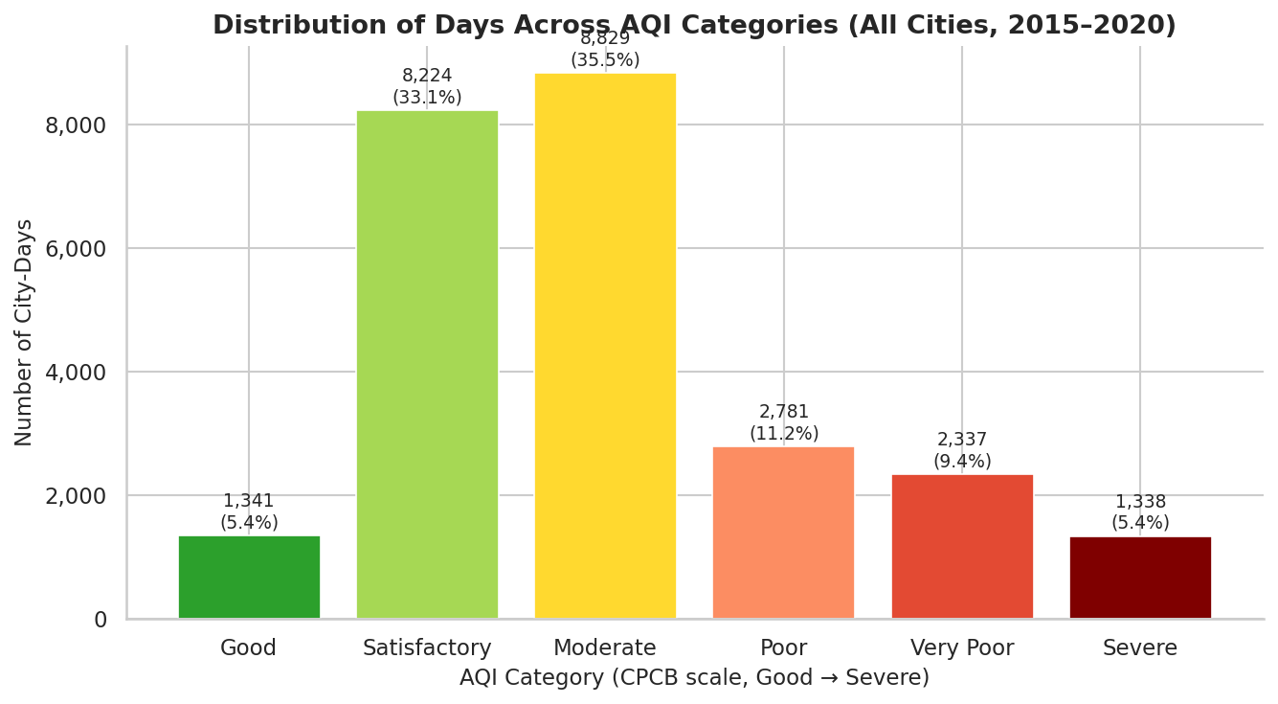
RQ3 · CITY EXPOSURE
How is exposure distributed across AQI categories?
35.5%
"Moderate" is the single largest bucket — everyday baseline pollution, not an outlier state
26.0%
Poor, Very Poor & Severe combined — one in four city-days breaches the unhealthy threshold
38.5%
Good & Satisfactory combined — clean-air days are still the minority nationwide
AQI Analysis · India 2015–2020
12

Slide 13
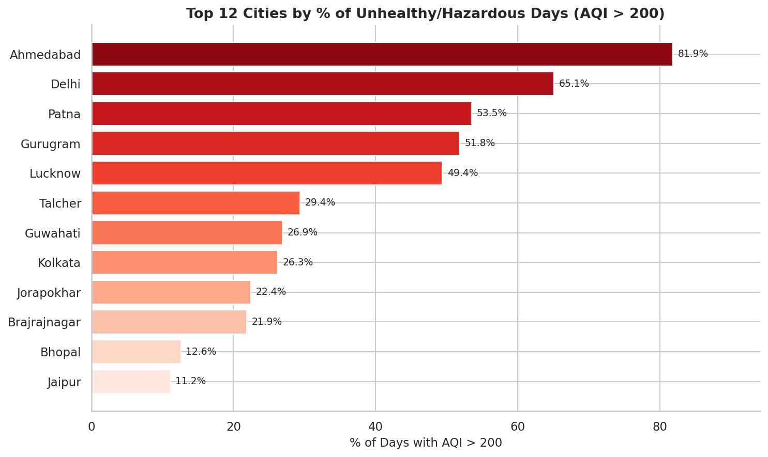
RQ3 · CITY EXPOSURE
Which cities suffer the most unhealthy days?
81.9%
Ahmedabad — highest share of unhealthy days (partly inflated by sensor outliers)
65.1%
Delhi — second worst, driven by winter inversions & stubble burning
~2%
Bengaluru, Hyderabad, Mumbai — cleanest major metros (<5%)
AQI Analysis · India 2015–2020
13

Slide 14
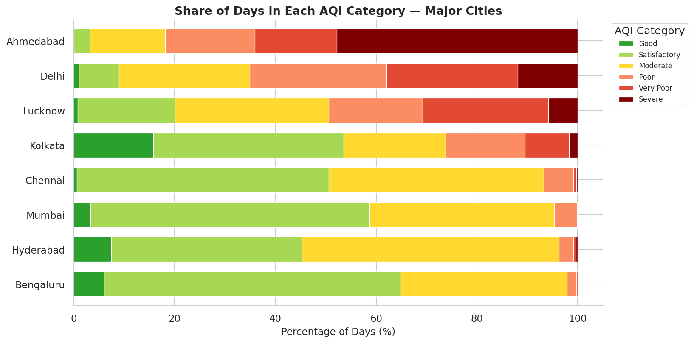
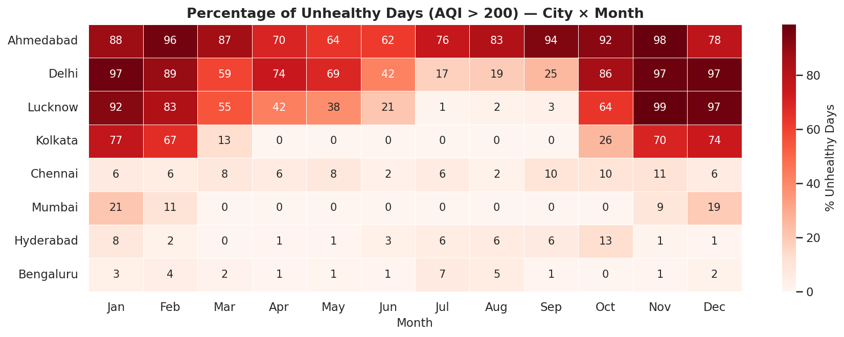
RQ3 · CITY EXPOSURE
A clear north–south divide in air quality
Northern cities (Ahmedabad, Delhi, Lucknow) spend most days in Poor–Severe territory; October–January is the worst exposure window nationwide.
AQI Analysis · India 2015–2020
14

Slide 15

SYNTHESIS
Key findings
RQ1 — Temporal
RQ2 — Pollutants
RQ3 — Exposure
Strongly seasonal: winter peaks, monsoon lows
North–south divide: Delhi/Lucknow vs. Bengaluru/Chennai
Weekday effect negligible — weather dominates
Lockdown cut AQI in every one of 26 cities
PM10 strongest AQI driver (r = 0.80)
CO (0.68) and PM2.5 (0.67) also major factors
Ozone weakly correlated (r ≈ 0.20)
PM2.5/PM10 rise monotonically Good → Severe
~26% of all city-days are unhealthy (AQI>200)
Ahmedabad (~82%) & Delhi (~65%) worst affected
South/coastal cities least affected (2–5%)
Oct–Jan: worst window (stubble burning, Diwali)
AQI Analysis · India 2015–2020
15

Slide 16




CONCLUSION
Air pollution in India is systemic, seasonal, and human-driven
Target PM10/PM2.5 sources
Focus on Oct–Jan
Prioritise dust suppression, construction controls, and vehicle emissions given PM's dominant AQI correlation.
Concentrate stubble-burning enforcement, firework restrictions and inversion-day advisories on this window.
Prioritise northern cities
Improve data quality
Ahmedabad, Delhi, Lucknow, Patna & Gurugram need the most urgent intervention and monitoring investment.
Fix sensor-outlier handling (Ahmedabad) and reduce PM10/NH3/Xylene missingness for more reliable tracking.
Data: CPCB via Kaggle (CC0) · Team: Yash David Bedekar · Surya Koushik Palla · Aryaman Negi · Arda Onhun · DA 120B, 2025–26

