Slide 1

DATA ANALYTICS PROJECT
Air Quality Index Analysis
Trends, pollutants and unhealthy-air conditions across major Indian cities
India · 2015–2020 · 26 cities · 29,531 daily records
Good
Satisfactory
Moderate
Poor
Very Poor
Severe
Source: Central Pollution Control Board (CPCB) — Kaggle: Air Quality Data in India

Slide 2
OVERVIEW
Introduction
This project analyses Air Quality Index (AQI) data to understand how air quality changes across selected locations and time periods.
It examines AQI categories and the major pollutants — PM2.5, PM10, NO2, SO2, CO and O3 — to identify meaningful patterns in the data.
The workflow covers data preparation, exploratory analysis, visual interpretation and clear findings on pollution trends, pollutant relationships and unhealthy-air conditions.
Six key pollutants
PM2.5
PM10
Fine particles
Coarse particles
NO₂
SO₂
Nitrogen dioxide
Sulphur dioxide
CO
O₃
Carbon monoxide
Ground ozone

Slide 3
DATA
The Dataset
26
29,531
2015–20
6
Cities monitored
Daily records
Years covered
Core pollutants
Structure of city_day.csv
About the data
Column | Description
City | City name — 26 Indian cities
Date | Calendar date (daily, 2015–2020)
PM2.5 / PM10 | Particulate matter (µg/m³)
NO2 / SO2 / O3 | Gaseous pollutants (µg/m³)
CO | Carbon monoxide (mg/m³)
AQI | Air Quality Index value
AQI_Bucket | CPCB category: Good → Severe
Compiled by India's Central Pollution Control Board (CPCB).
Real monitoring data — pollutant columns contain missing values that are handled during cleaning.
Rows without an AQI value are dropped; trace columns (NH3, Benzene, etc.) are set aside.
Six CPCB AQI categories range from Good (0–50) to Severe (401–500).

Slide 4



OBJECTIVES
Problem Statement & Research Questions
How does air quality vary over time and place, what drives it, and how often does it become unhealthy?
RQ1 · Temporal Trends
RQ2 · Pollutant Links
RQ3 · Unhealthy Air
How does AQI change over time? Are there clear daily, monthly or seasonal patterns?
Is there a relationship between PM2.5, PM10, NO2, SO2, CO, O3 and the overall AQI category?
How often does air reach unhealthy or hazardous levels, and which cities are most affected?

Slide 5
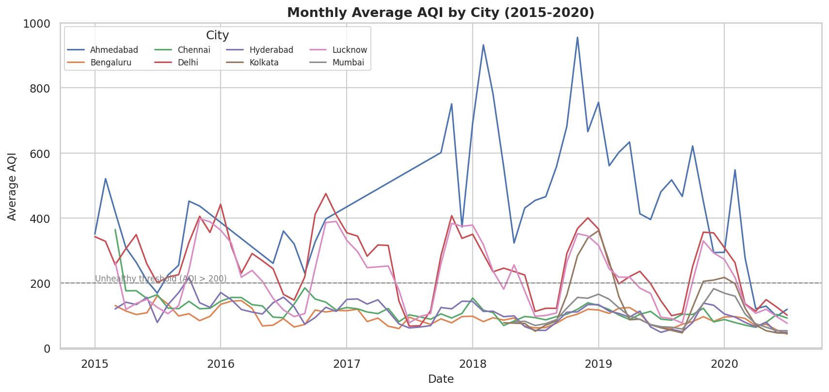
RQ1 · TEMPORAL TRENDS
AQI climbs every winter and clears in the monsoon
Insights
A strong, repeating seasonal cycle: AQI peaks in winter (Dec–Jan) and post-monsoon.
Lowest readings come in the monsoon (Jul–Aug) when rain washes out particulates.
Northern cities — Delhi and Lucknow — sit far above the rest all year.
The dip in early 2020 lines up with the COVID-19 lockdown.

Slide 6
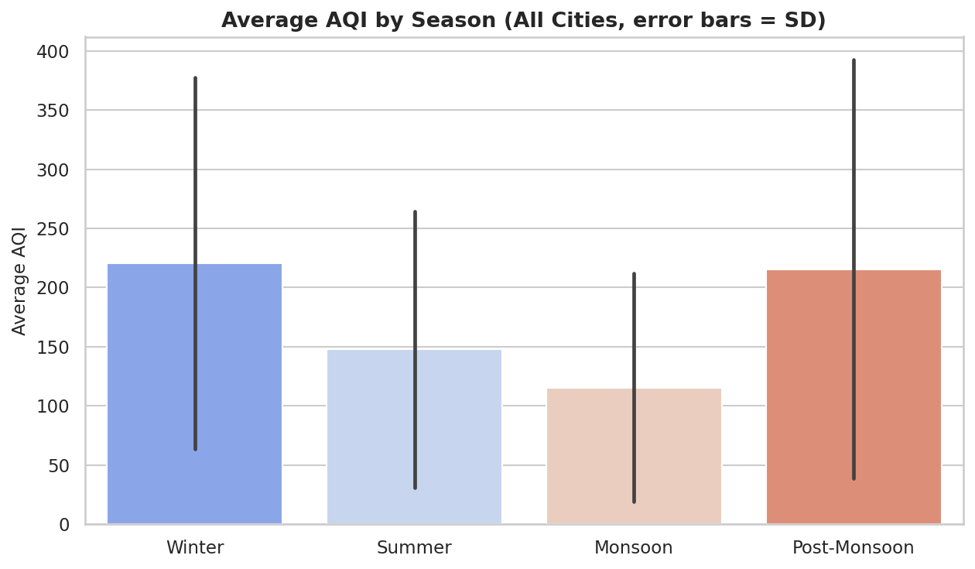
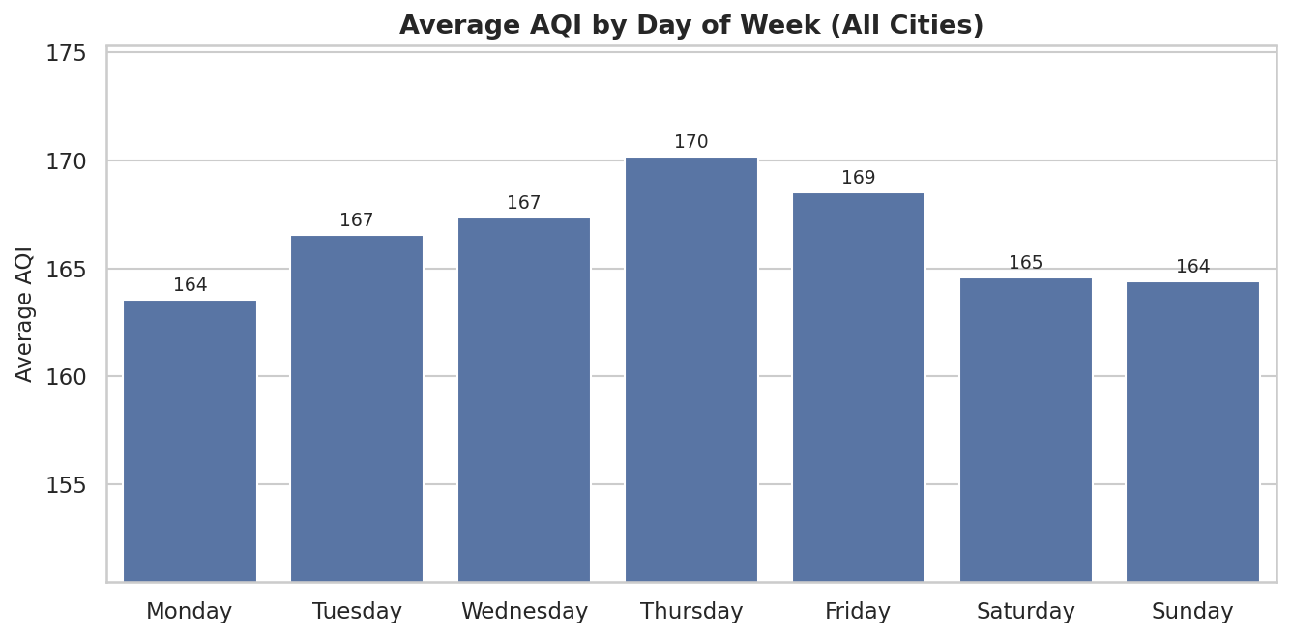
RQ1 · TEMPORAL TRENDS
Season drives AQI; the day of week barely matters
221
215
148
116
avg AQI · Winter
avg AQI · Post-Mon.
avg AQI · Summer
avg AQI · Monsoon

Slide 7
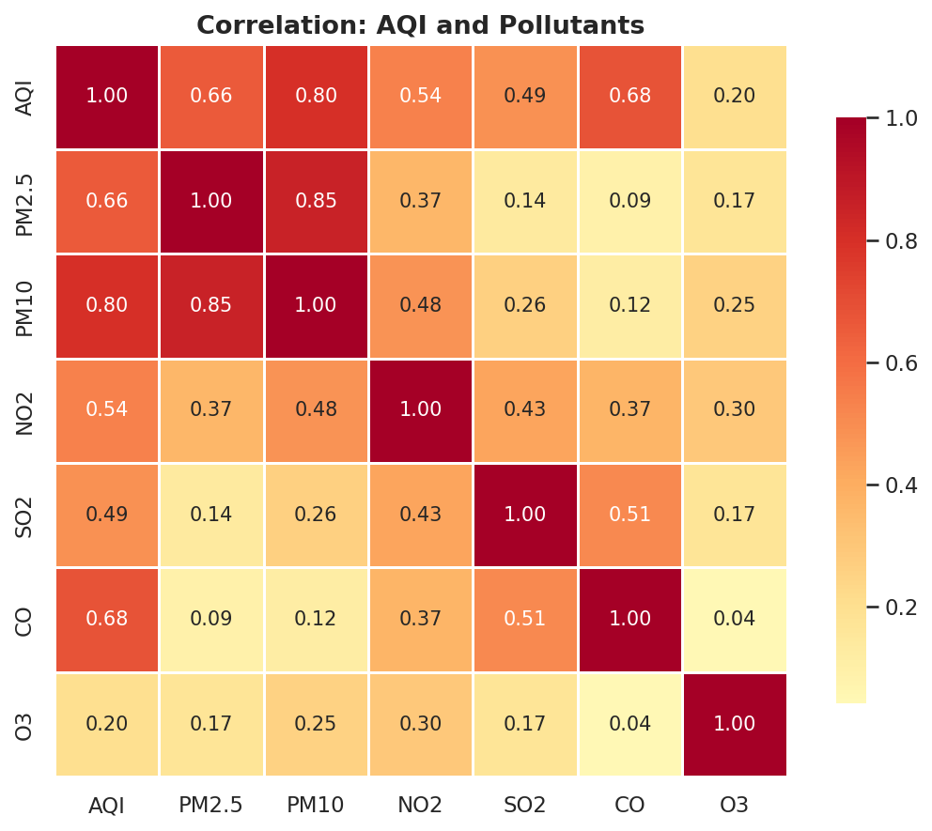
RQ2 · POLLUTANT RELATIONSHIPS
Particulate matter drives the Air Quality Index
Correlation of each pollutant with AQI
PM10 (0.80), CO and PM2.5 (~0.67) track AQI most closely, while O3 (0.20) is only weakly related — AQI is largely a particulate-matter story.

Slide 8
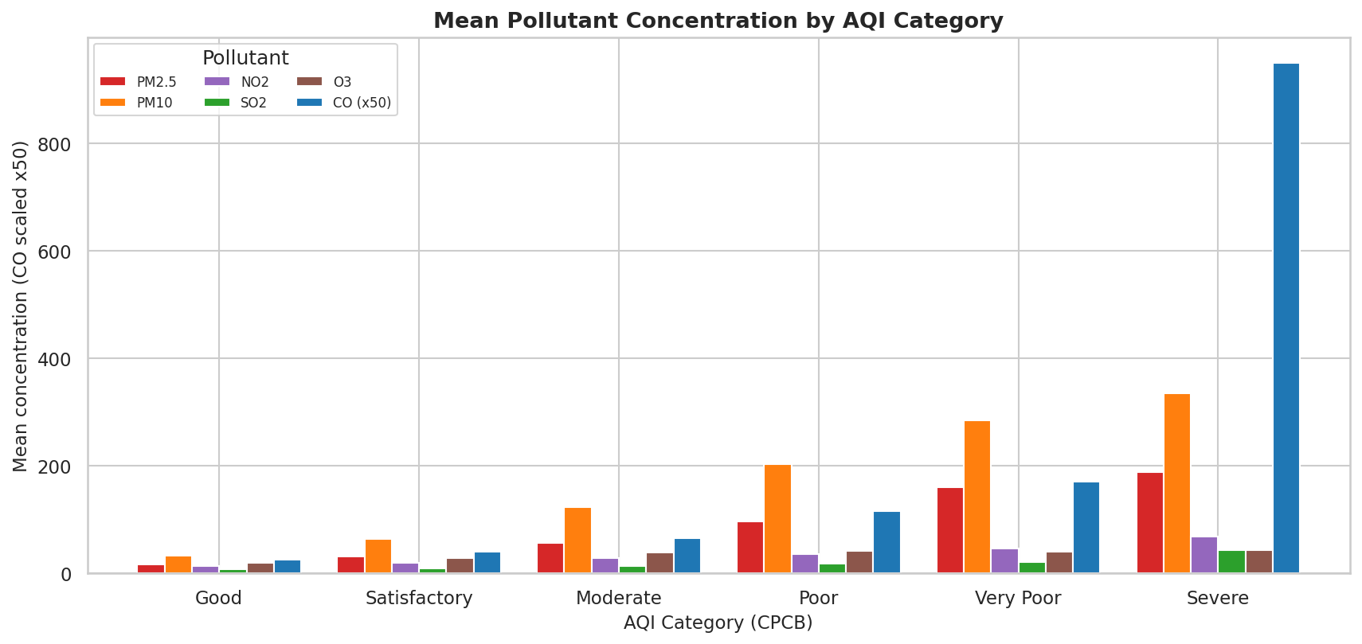
RQ2 · POLLUTANT RELATIONSHIPS
Pollutant levels rise step-by-step with each AQI category
What the bars show
Mean concentrations of every pollutant increase from Good to Severe.
PM2.5 and PM10 show the steepest climb across categories.
This confirms the CPCB categories meaningfully separate real pollution levels.
(CO scaled ×50 so it is visible next to the particulates.)

Slide 9
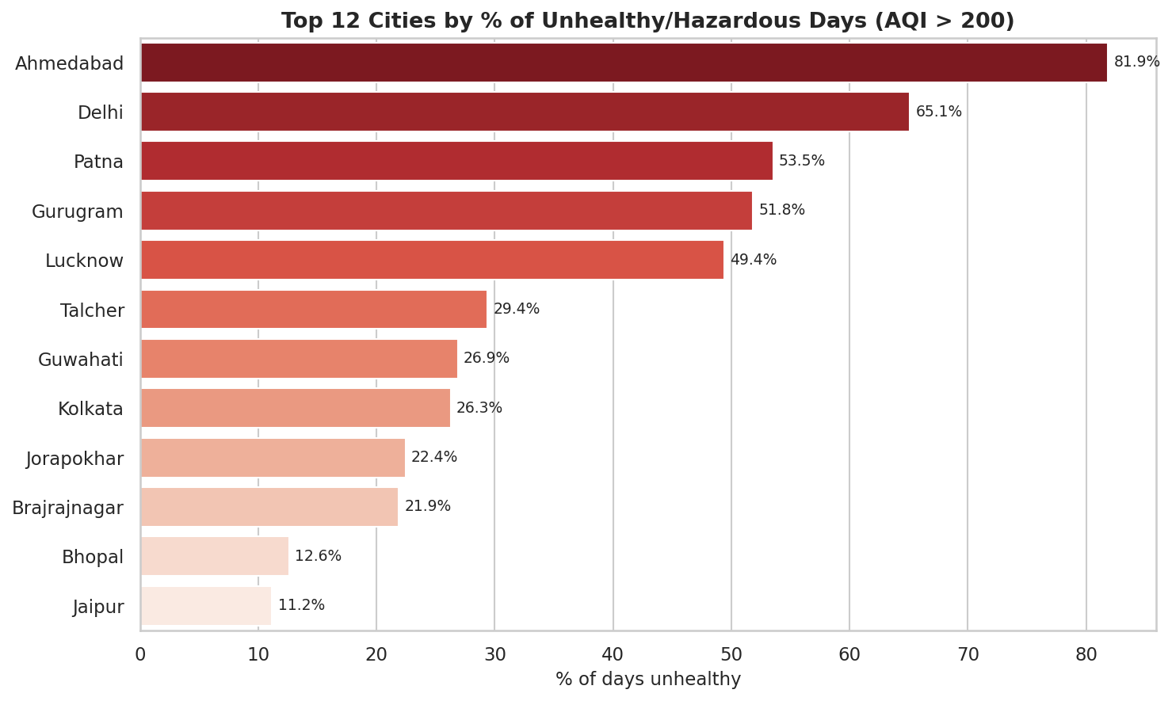
RQ3 · UNHEALTHY CONDITIONS
One in four city-days is unhealthy — the north bears the brunt
82%
Ahmedabad days unhealthy
65%
Delhi days unhealthy
26%
All cities overall
Note: Ahmedabad shows some implausible AQI values (max ≈ 2049 vs the 500 ceiling), hinting at sensor issues.

Slide 10
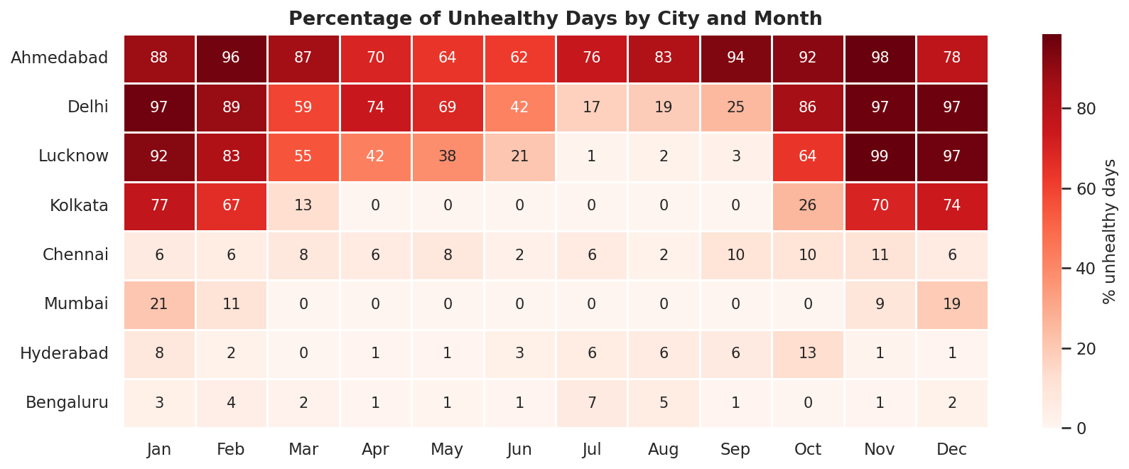
RQ3 · UNHEALTHY CONDITIONS
Worst exposure: northern cities through Oct–Jan
Unhealthy-day summary (major cities)
When & where
City | Mean AQI | Unhealthy %
Ahmedabad | 452 | 81.9%
Delhi | 260 | 65.1%
Lucknow | 218 | 49.4%
Kolkata | 141 | 26.3%
Hyderabad | 109 | 3.8%
Chennai | 114 | 6.7%
Mumbai | 105 | 4.6%
Bengaluru | 94 | 2.1%
Unhealthy days concentrate in the cooler months (Oct–Jan) when air is stagnant.
Southern & coastal cities stay below ~7% of days unhealthy all year.

Slide 11


SUMMARY
Key Findings
Time
Pollutants
Locations
AQI follows a strong seasonal cycle — high in winter, low in the monsoon. Weekday effects are negligible; a 2020 lockdown dip is visible.
Particulate matter (PM10, PM2.5) and CO correlate most with AQI; O3 least. Pollutant levels rise stepwise across AQI categories.
~26% of city-days are unhealthy. Ahmedabad, Delhi and other northern cities are worst hit; coastal/southern cities stay cleaner.

Slide 12

Conclusion
Air quality across Indian cities is driven mainly by season and particulate matter. The clearest lever for cleaner air is reducing PM2.5/PM10 in northern cities during the winter months, when unhealthy and hazardous days are concentrated.
Good
Satisfactory
Moderate
Poor
Very Poor
Severe
Analysis: Python (pandas, matplotlib, seaborn) · Data: CPCB / Kaggle — Air Quality Data in India (2015–2020)

