Slide 1
ANDROID APPLICATION DEVELOPMENT

Slide 2
CONTENTS
What is Android?
History of Android
Android Architecture
Components of Android App
Android Studio
System Requirements
Developing Your First App
Programming Language Use
Conclusion
Reference

Slide 3
What is Android?
Android is an open-source operating system developed by Google for smartphones, tablets, smart TVs, wearables, and other devices. It is based on the Linux kernel and is the most widely used mobile operating system in the world.
Key Features of Android:
Open-source: Developers can modify and customize it.
Google Services Integration: Comes with apps like Gmail, Google Maps, and Play Store.
App Support: Millions of apps available on the Google Play Store.
Customization: Allows users to change themes, icons, and widgets.
Multi-device Compatibility: Runs on phones, tablets, smartwatches (Wear OS), TVs (Android TV), and cars (Android Auto).

Slide 4
History Of Android
The story of Android dates back to 2003 when Andy Rubin, Rich Miner, Nick Sears, and Chris White co-founded a start-up Android Inc. in Palo Alto, California. However, the company was later faced with the insufficiency of funds which brought Google into the picture. Google could sense the potential the product carried within and sealed a deal worth $50 Million to acquire Android in 2005. All the four Co-founders soon moved to the Googleplex to continue to develop the OS further under their new owners. The first public Android Beta Version 1.0 was
finally published on 5th November 2007.

Slide 5
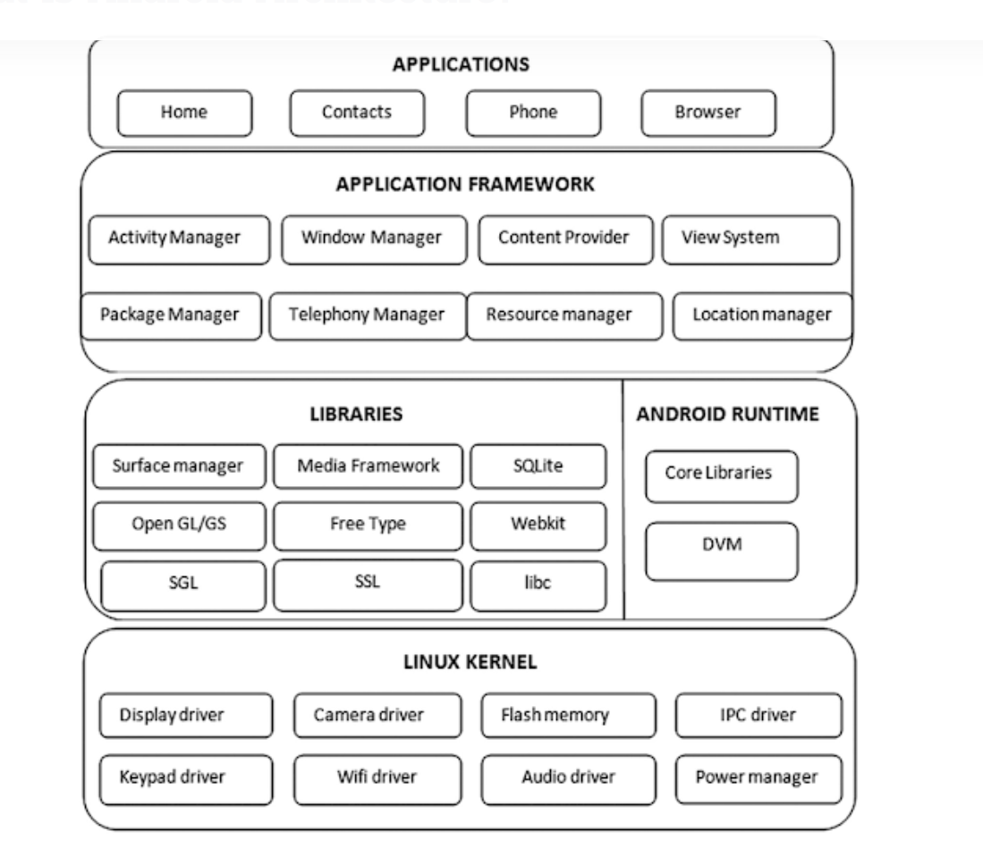
Android Architecture

Slide 6
Components of Android App
An android component is simply a piece of code that has a well defined life cycle e.g. Activity, Receiver, Service etc. The core building blocks or fundamental components of android are activities, views, intents, services, content providers, fragments and AndroidManifest.xml.
Activity:
An activity is a class that represents a single screen. It is like a Frame in AWT.
View:
A view is the Ul element such as button, label, text field etc. Anything that you see is a view.

Slide 7
Intent
In Android development, an Intent is a messaging object used to request an action from another component (such as an activity, service, or broadcast receiver). It enables communication between different parts of an app or between multiple apps.
Types of Intents in Android
Explicit Intent
Used to start a specific component (Activity, Service, or BroadcastReceiver) within the same app.
Example: Navigating from one activity to another.

Slide 8
Implicit Intent
Used to request an action that can be handled by any available app.
Example: Opening a webpage in a browser.
Intent intent = new Intent(Intent.ACTION_VIEW);
intent.setData(Uri.parse("https://www.google.com"));
startActivity(intent);

Slide 9
Services A Service in Android is a component that runs in the background to perform long-running operations without a user interface. Services are used when an app needs to perform tasks such as playing music, downloading files, or syncing data in the background.
Types of Services in Android
1️⃣ Foreground Service
Runs in the background but shows a notification to the user.
Used for ongoing tasks like music playback or location tracking.
Example:
2️⃣ Background Service
Runs in the background without a user interface.
Used for short-lived tasks like fetching data or storing logs.
Since Android 8 (Oreo), background execution is restricted, and WorkManager or Foreground Services should be used instead.

Slide 10
Content Provider: Content Providers are used to share data between the applications. Fragment: Fragments are like parts of activity. An activity can display one or more fragments on the screen at the same time.

Slide 11
Android Studio Android Studio is the official Integrated Development Environment (IDE) for developing Android apps. It is based on IntelliJ IDEA and is developed by Google. It provides tools and features to help developers build, test, and debug Android applications efficiently.
Key Features of Android Studio:
Intelligent Code Editor:
Offers code completion, refactoring, and real-time error checking.
Layout Editor:
Drag-and-drop UI design using XML and ConstraintLayout for responsive designs.
Android Virtual Device (AVD):
Built-in emulator to test apps on different Android devices without needing a physical phone.
Gradle-Based Build System:
Automates dependency management, compilation, and APK packaging.
Debugger & Performance Profiler:
Helps analyze CPU, memory, and network usage.

Slide 12
System Requirements for Android Studio (2025 Edition) For Windows OS: Windows 10 or later (64-bit) Processor: Intel Core i5 or AMD Ryzen 5 (Recommended: i7/Ryzen 7) RAM: 8 GB minimum (Recommended: 16 GB or more) Storage: At least 8 GB free space (SSD recommended for better performance) Graphics: OpenGL 2.0+ support Screen Resolution: 1280 x 800 minimum
Additional Requirements
Java Development Kit (JDK) 17+ (bundled with Android Studio)
Fast Internet Connection (for SDK & Emulator updates)
Android Emulator: Requires at least 4 GB RAM (8 GB recommended)

Slide 13
Android Emulator
The Android Emulator is a built-in tool in Android Studio that lets you test Android apps on a virtual device without needing a physical phone. It mimics real Android hardware and software, allowing developers to check their app’s functionality, UI, and performance on different devices.
Features of Android Emulator
✅ Multiple Device Profiles: Test apps on different screen sizes, resolutions, and hardware configurations. ✅ Different Android Versions: Run apps on various Android versions (e.g., Android 11, 12, 13, etc.). ✅ Hardware Emulation: Simulates sensors like GPS, accelerometer, camera, and fingerprint scanner. ✅ Fast Deployment: Instant Run allows quick code testing without restarting the app. ✅ Connectivity Simulation: Emulates WiFi, cellular networks, and airplane mode.

Slide 14
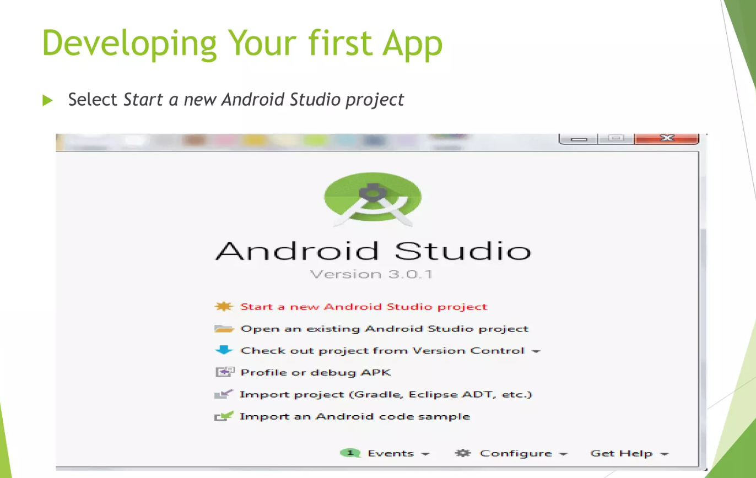

Slide 15
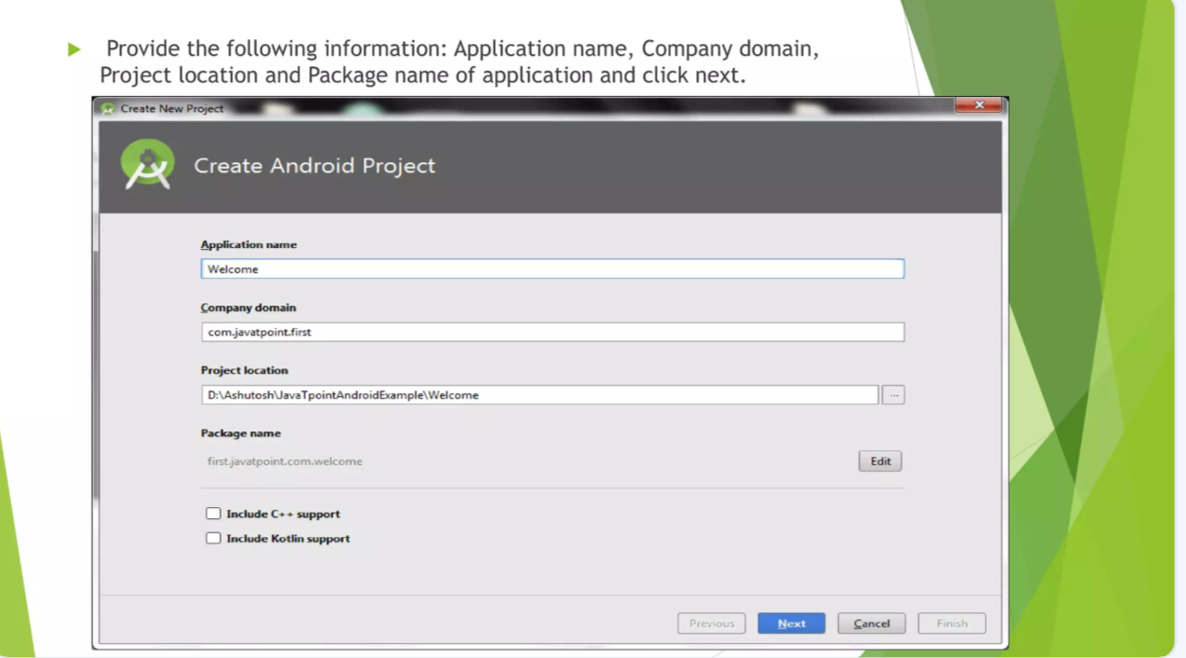

Slide 16
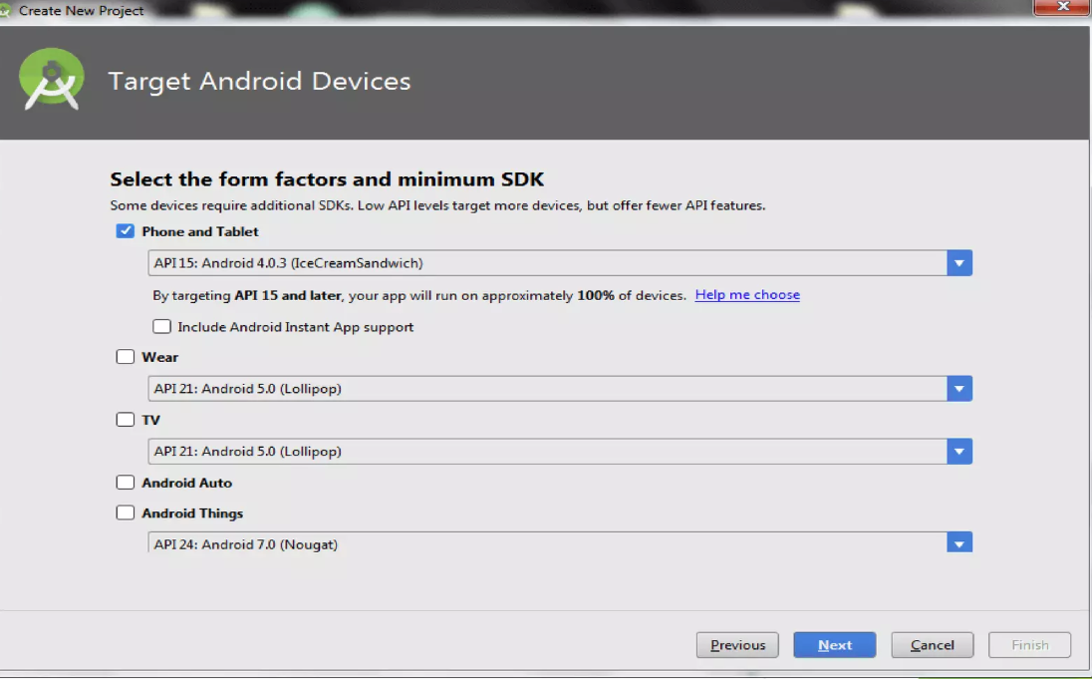

Slide 17
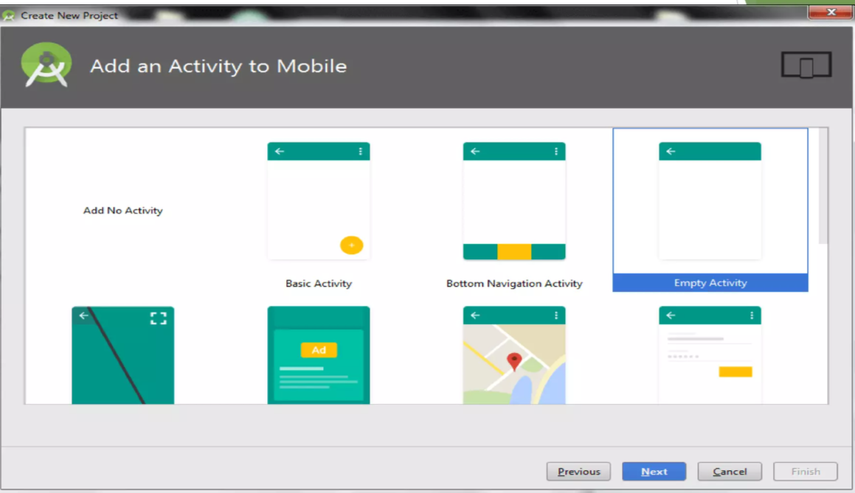

Slide 18
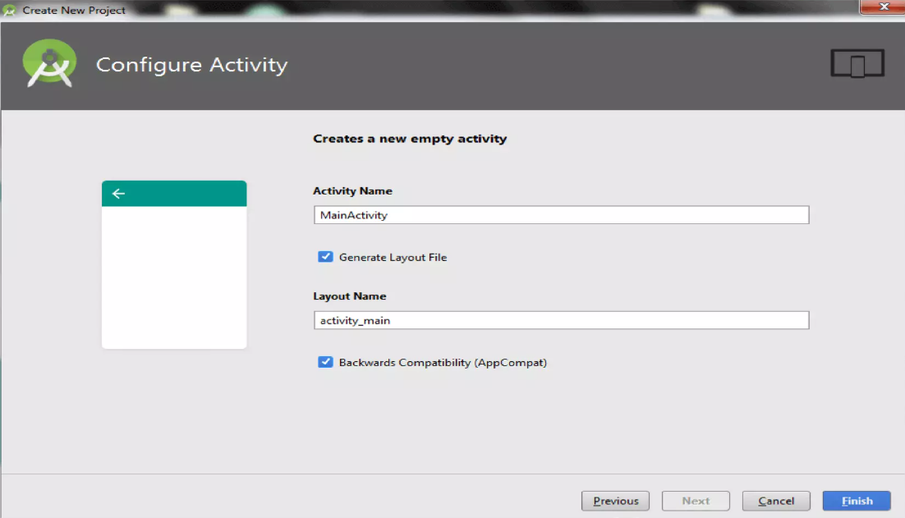

Slide 19
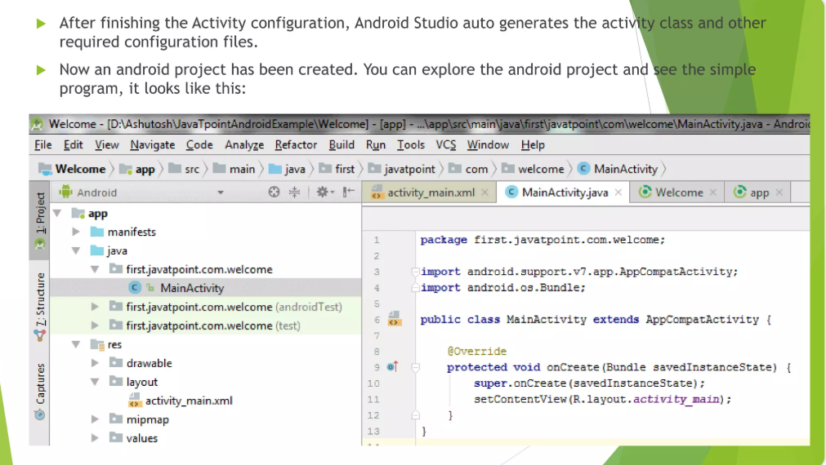

Slide 20
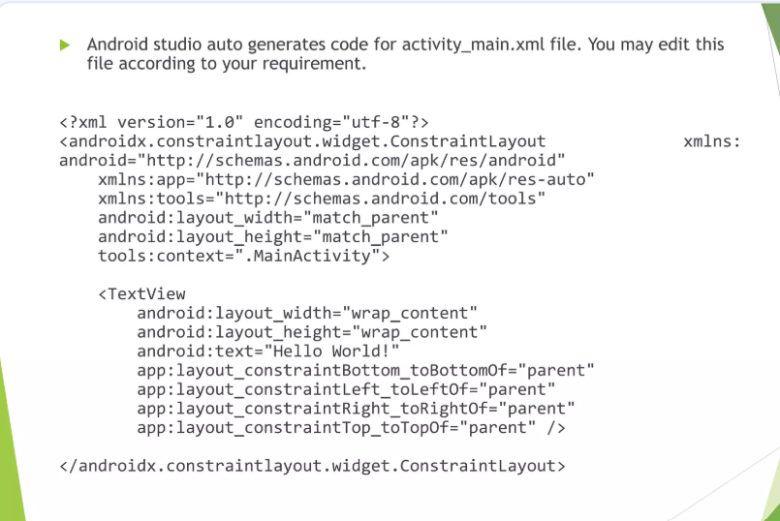

Slide 21
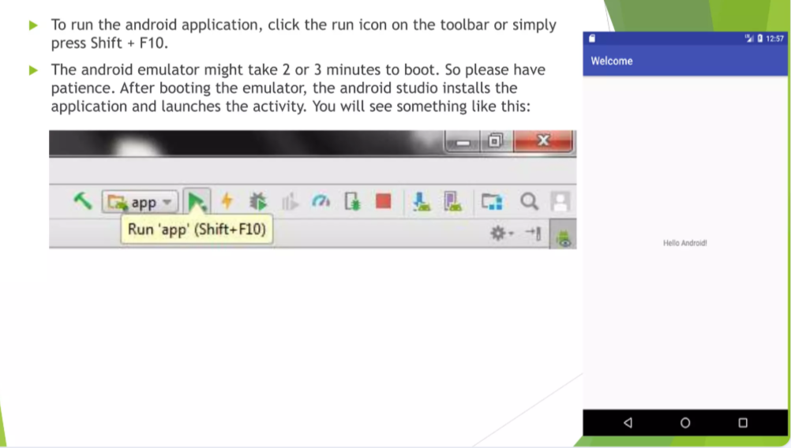

Slide 22
Programming languages
1️⃣ Kotlin (Recommended by Google)
🔹 Best for: Native Android apps 🔹 Why? ✅ Officially recommended by Google for Android development ✅ Concise & expressive syntax (less boilerplate code than Java) ✅ Fully interoperable with Java ✅ Safer (reduces NullPointerException errors) ✅ Works with Jetpack Compose (modern UI toolkit)

Slide 23
Java (Traditional Language for Android)
🔹 Best for: Legacy Android apps, enterprise applications 🔹 Why? ✅ Long-time official language for Android ✅ Huge community support ✅ Compatible with most Android libraries ✅ Runs on the JVM (Java Virtual Machine)

Slide 24
conclusion
Android programming is a powerful and versatile skill that allows developers to create innovative mobile applications for millions of users worldwide. With languages like Kotlin (recommended by Google), Java (legacy support), and frameworks like Flutter (Dart) and React Native (JavaScript), developers have multiple options to build apps efficiently.
Mastering Android Studio, Jetpack libraries, and modern UI tools like Jetpack Compose is essential for creating high-performance and user-friendly apps. Additionally, leveraging APIs, databases, and cloud services enhances app functionality and scalability.
With a vast community, extensive documentation, and numerous learning resources available, anyone can start and excel in Android development—whether as a beginner or an experienced programmer. The future of Android development continues to evolve with AI, AR/VR, and cross-platform technologies, making it an exciting field to explore.

Slide 25
References
Official Documentation & Guides
Books & eBooks

Slide 26
Thank You

