Slide 1

Khed Taluka Shikshan Prasarak Mandal’s
Hutatma Rajguru Mahavidyalaya, Rajgurunagar, Pune- 410505
TYBBA(CA)
A
Presentation
On
“Cloud Computing”
Presented By:Patil Dnyaneshwar Subhash
ROLL NO:45
GUIDE: R.S.Jadhav

Slide 2
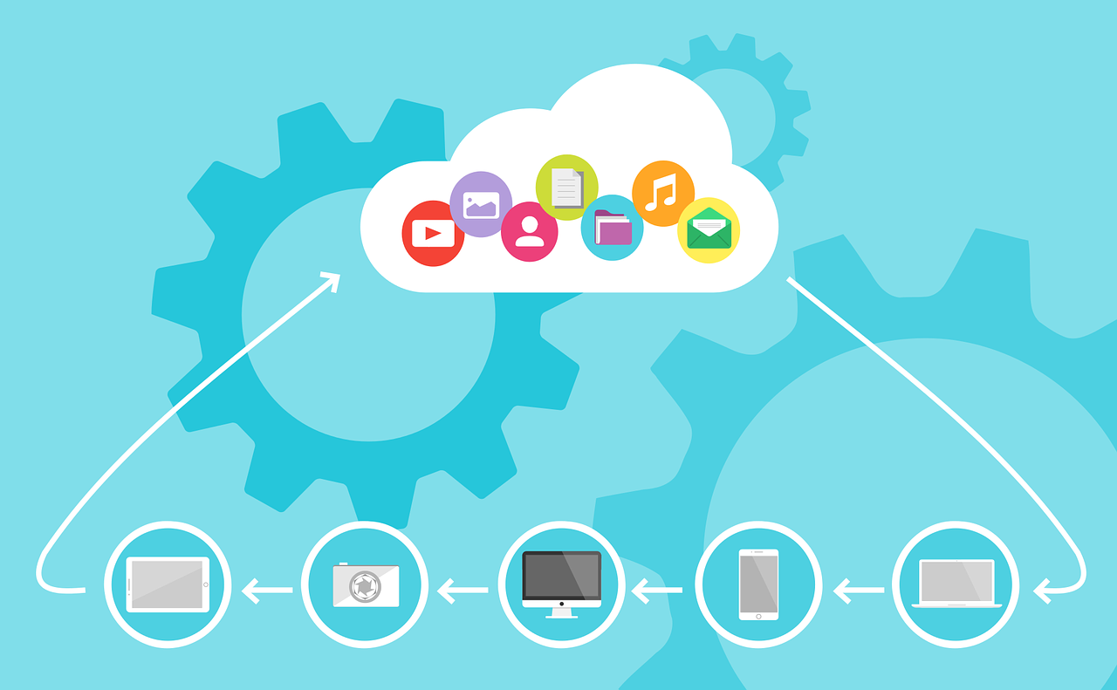
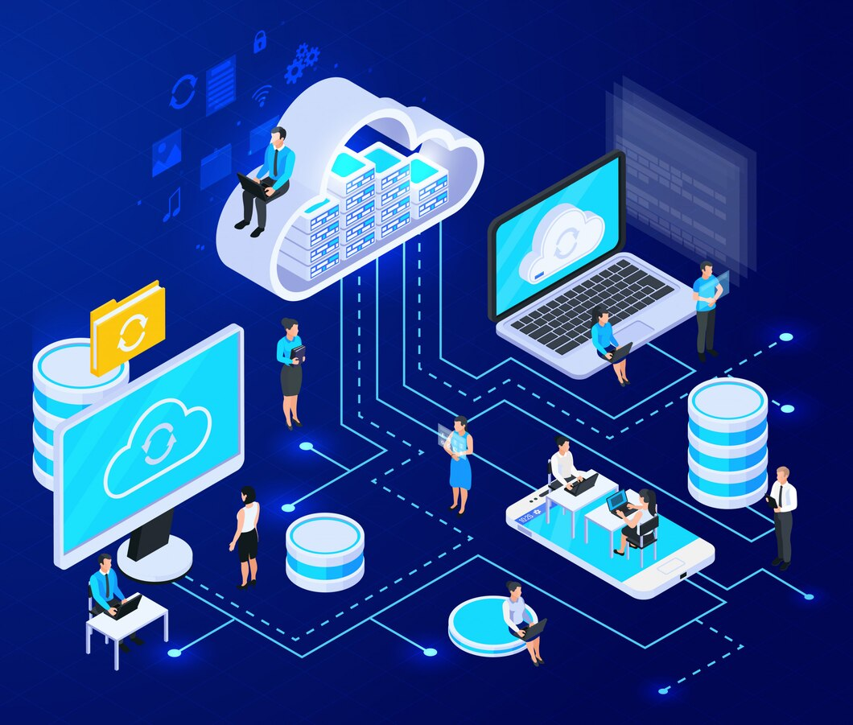
Cloud Computing

Slide 3
Introduction
What is Cloud Computing?
- Cloud computing is the delivering computing services—like storage, processing power, and software over the internet. Instead of using your own computer or local server, you use remote servers (the "cloud").
Examples: Google Drive, AWS, Azure.

Slide 4
Characteristics of Cloud Computing
On-Demand Self-Service – You can use cloud services whenever you need them, without waiting for approval.
Broad Network Access – You can access cloud services from anywhere using the internet.
Resource Pooling – The cloud shares its resources with many users, giving everyone what they need.
Rapid Elasticity – You can quickly add or remove resources based on demand.
Measured Service – You only pay for what you use, just like electricity or water.

Slide 5
Types of Cloud Computing
1. Private Cloud – Used by one company for security (e.g., a bank’s cloud).
2. Hybrid Cloud – Mix of public and private clouds (e.g., storing sensitive data privately but using public apps).
3. Community Cloud – Shared by similar groups (e.g., government or universities).
4. Public Cloud – Open for everyone on the internet (e.g., Google Drive, AWS).

Slide 6
Cloud Computing Service Models
1. IaaS (Infrastructure as a Service) – Rent computers and storage online.
Example: Google Compute Engine.
2. PaaS (Platform as a Service) – Get a platform to build apps.
Example: Google App Engine.
3. SaaS (Software as a Service) – Use ready-made apps online.
Example: Gmail, Google Drive.

Slide 7
Advantages of Cloud Computing
1. Cost-effective – You only pay for what you use, saving money on hardware and maintenance.
2. Scalability & Flexibility – You can easily increase or decrease resources based on your needs.
3. Disaster Recovery – Your data is backed up and can be restored if something goes wrong.
4. Security & Compliance – Cloud providers offer strong security and follow rules to protect your

Slide 8
Challenges in Cloud Computing
1. Security Risks – Data stored online can be targeted by hackers.
2. Internet Dependency – You need a stable internet connection to access cloud services.
3. Compliance & Legal Issues – Companies must follow data protection laws, which can be complex.
4. Vendor Lock-in – Moving from one cloud provider to another can be difficult and expensive.

Slide 9
Popular Cloud Service Providers
Amazon Web Services (AWS)
Microsoft Azure
Google Cloud Platform (GCP)
IBM Cloud

Slide 10
Use Cases of Cloud Computing
Cloud storage (Google Drive, Dropbox)
Web hosting (AWS, Azure)
Big data processing (Hadoop, Spark)
Machine learning and AI

Slide 11
Future of Cloud Computing
Edge computing
Serverless computing
Quantum computing integration
Enhanced AI capabilities

Slide 12
Conclusion
✅ Summary:
Cloud computing delivers services over the internet.
It offers different models: IaaS, PaaS, SaaS.
Benefits include cost savings, scalability, and security.
Challenges include security risks and vendor lock-in.
Major providers: AWS, Azure, GCP, IBM Cloud.

