Slide 1

Welcome

Slide 2

Khed Taluka Shikshan Prasarak Mandal’s Hutatma Rajguru Mahavidyalaya, Rajgurunagar, Pune- 410505
TYBBA(CA)
A
PPT Presentation On :
“Blockchain-Based Secure Electronic Voting System”
Presented By-
Rakshe Sahil Haribhau
Roll No : 51
Under Guidance :
Prof R.S. Jadhav Mam

Slide 3
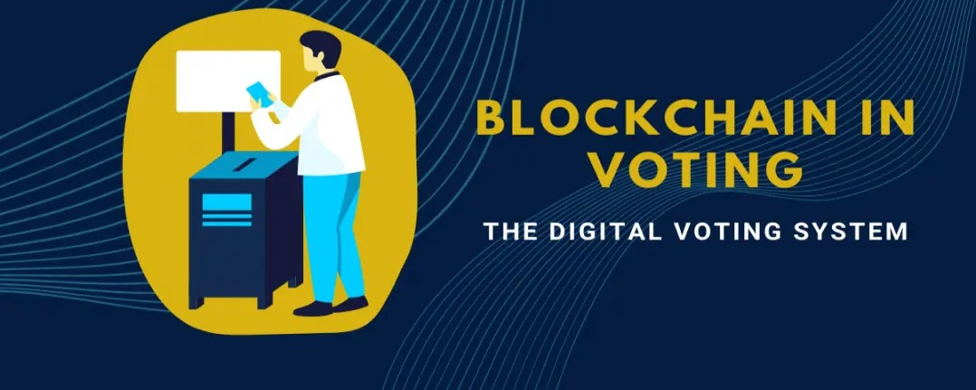


Slide 4
Introduction to Blockchain in Voting
What is Blockchain?
A decentralized, tamper-proof digital ledger
Why Use Blockchain in Voting?
Eliminates fraud, enhances security, and ensures transparency
Current Challenges in E-Voting Systems
Hacking risks, lack of voter trust, vote tampering

Slide 5

Study objectives

Slide 6




How Blockchain Enhances Security & Transparency
Decentralization – No single point of failure
Cryptographic Security – Encryption ensures data integrity
Smart Contracts – Automates and verifies election rules
Immutable Records – Prevents vote tampering and ensures transparency

Slide 7



Benefits of a Blockchain-Based Voting System
✅ Transparency: Publicly verifiable results
✅ Security: Protection from cyber threats ✅ Anonymity & Privacy: Ensures voter identity protection ✅ Accessibility: Enables remote voting for all

Slide 8
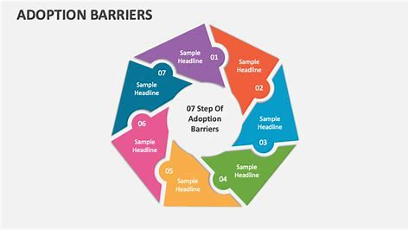



Conclusion & Future Prospects
Potential Challenges: Scalability, regulatory hurdles, adoption barriers
Future Trends: AI integration, biometric authentication, wider adoption
Final Thought: Blockchain voting can revolutionize democracy by ensuring free and fair elections

Slide 9

Thank You!!

