Slide 1
SQL DATA ANALYTICS
Mobility
Analytics
A business-focused analysis of a mobility platform using MySQL and SQL
MySQL • SQL • Business Insights
Yash Bhola
Data Analyst Portfolio Project
MOBILITY ANALYTICS | SQL PROJECT
1

Slide 2
01 / OVERVIEW
02
Project Overview
What the project solves and why the analysis matters
BUSINESS OBJECTIVE
PROJECT HIGHLIGHTS
Turn mobility transaction data into clear business insights.
• 8 relational tables
• 8 CSV data sources
• Easy, Moderate & Advanced analysis
• Business questions answered with SQL
• Results interpreted as operational insights
The analysis evaluates customers, drivers, rides, revenue, vehicles, payments and promotions.
30 SQL QUESTIONS
MOBILITY ANALYTICS | SQL PROJECT
2

Slide 3
02 / DATA
03
Data Sources
Eight CSV files loaded into the mobility_analytics MySQL database
cities.csv
City master data
users.csv
Customer profiles & activity
drivers.csv
Driver performance
vehicles.csv
Vehicle details
rides.csv
Ride transactions
payments.csv
Payment transactions
ratings_feedback.csv
Ratings & comments
promotions.csv
Campaigns & discounts
CSV → MySQL tables → SQL queries → Business insights
MOBILITY ANALYTICS | SQL PROJECT
3

Slide 4
03 / DATABASE
04
Detailed Table Structure — Core Tables
Key fields from the three most important operational tables
USERS
DRIVERS
RIDES
FIELD
TYPE
PURPOSE
FIELD
TYPE
PURPOSE
FIELD
TYPE
PURPOSE
user_id
VARCHAR
Primary key
driver_id
VARCHAR
Primary key
ride_id
VARCHAR
Primary key
name
VARCHAR
Customer name
name
VARCHAR
Driver name
user_id
VARCHAR
User FK
signup_date
DATE
Signup date
city_id
VARCHAR
City FK
driver_id
VARCHAR
Driver FK
city_id
VARCHAR
City FK
vehicle_id
VARCHAR
Vehicle link
vehicle_id
VARCHAR
Vehicle FK
device_type
VARCHAR
Device
rating
DEC
Driver rating
city_id
VARCHAR
City FK
wallet_balance
DEC
Wallet
total_rides_completed
INT
Completed
pickup_time
DATETIME
Pickup
rating
DEC
User rating
is_active
TINY
Active flag
distance_km
DEC
Distance
is_active
TINY
Active flag
acceptance_rate
DEC
Acceptance %
total_fare
DEC
Fare
total_rides
INT
Ride count
cancellation_rate
DEC
Cancel %
payment_mode
VARCHAR
Payment
ride_status
VARCHAR
Status
MOBILITY ANALYTICS | SQL PROJECT
4

Slide 5
03 / DATABASE
05
Detailed Table Structure — Supporting Tables
Reference, transaction and engagement tables
CITIES
VEHICLES
PAYMENTS
FIELD
TYPE
PURPOSE
FIELD
TYPE
PURPOSE
FIELD
TYPE
PURPOSE
city_id
VARCHAR
Primary key
vehicle_id
VARCHAR
Primary key
payment_id
VARCHAR
Primary key
city_name
VARCHAR
City name
driver_id
VARCHAR
Driver FK
ride_id
VARCHAR
Ride FK
state
VARCHAR
State
vehicle_type
VARCHAR
Type
amount
DEC
Amount
tier
VARCHAR
City tier
make / model
VARCHAR
Vehicle
payment_mode
VARCHAR
Mode
year
INT
Model year
payment_status
VARCHAR
Status
RATINGS_FEEDBACK
PROMOTIONS
fuel_type
VARCHAR
Fuel
cashback_applied
DEC
Cashback
FIELD
TYPE
PURPOSE
FIELD
TYPE
PURPOSE
feedback_id
VARCHAR
Primary key
coupon_id
VARCHAR
Primary key
ride_id
VARCHAR
Ride FK
ride_id
VARCHAR
Ride FK
user_rating
DEC
User rating
coupon_code
VARCHAR
Coupon
driver_rating
DEC
Driver rating
campaign_name
VARCHAR
Campaign
user_comment
VARCHAR
Comment
discount_type
VARCHAR
Type
feedback_tags
VARCHAR
Tags
discount_amt
DEC
Discount
5
MOBILITY ANALYTICS | SQL PROJECT

Slide 6
04 / PREPARATION
06
Data Preparation
Steps used to build a clean and connected SQL dataset
01
IMPORT
LOAD DATA LOCAL INFILE
Load CSV records into MySQL
02
CLEAN
NULLIF()
Convert blank values into NULL
03
STRUCTURE
PRIMARY KEYS
Uniquely identify each record
04
RELATE
FOREIGN KEYS
Connect related tables
05
ANALYZE
SQL QUERIES
Answer business questions
MOBILITY ANALYTICS | SQL PROJECT
6

Slide 7
05 / ANALYSIS
07
SQL Analysis Framework
30 questions organized by increasing analytical complexity
EASY
10 questions
Counts • averages • revenue • payment modes
MODERATE
10 questions
City comparisons • ratings • distance • top users
ADVANCED
10 questions
Revenue thresholds • peak hour • spending • promotions
Core SQL concepts: SELECT • WHERE • JOIN • GROUP BY • HAVING • ORDER BY • LIMIT • Aggregate functions
MOBILITY ANALYTICS | SQL PROJECT
7

Slide 8
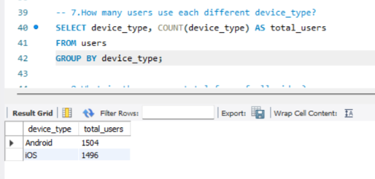
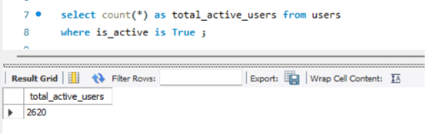
06 / RESULTS
08
Basic & Moderate Results
Actual MySQL Workbench screenshots
Active users = 2,620
Device distribution: Android 1,504 | iOS 1,496
MOBILITY ANALYTICS | SQL PROJECT
8

Slide 9
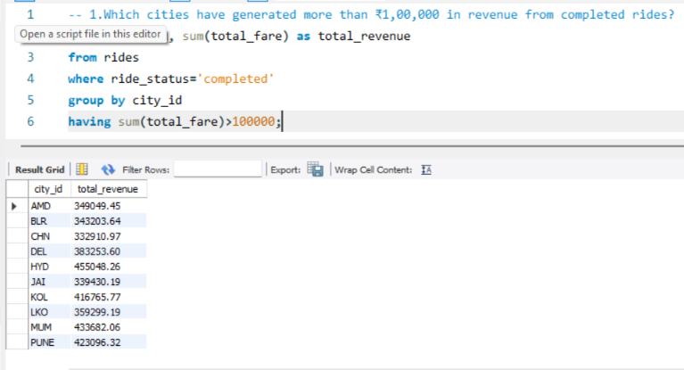
07 / ADVANCED
09
Advanced Result — City Revenue
Actual query output for cities above the ₹1,00,000 revenue threshold
KEY FINDING
HYD
₹455,048.26
Highest completed-ride revenue visible in the result set.
Uses WHERE + GROUP BY + HAVING + SUM()
Advanced Query #1
MOBILITY ANALYTICS | SQL PROJECT
9

Slide 10
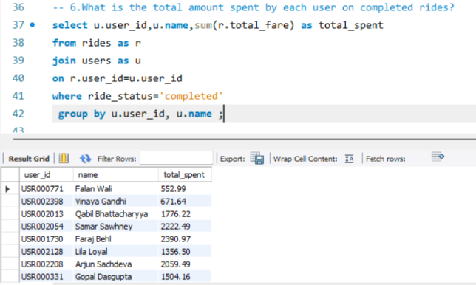
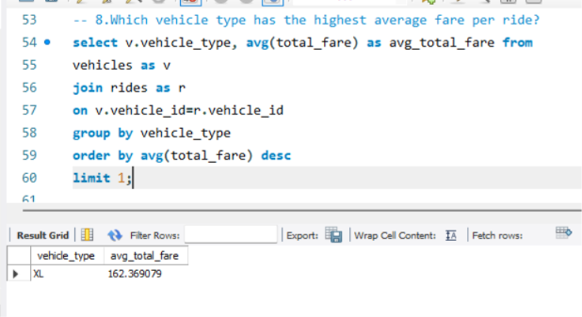
08 / ADVANCED
10
Advanced Results — Customer & Vehicle Analysis
Actual query outputs showing spending and fare performance
Advanced Query #6 — User spending on completed rides
Advanced Query #8 — XL highest average fare: ₹162.37
MOBILITY ANALYTICS | SQL PROJECT
10

Slide 11
09 / CONCLUSION
11
Conclusion & Future Scope
What the project demonstrates
PROJECT OUTCOME
FUTURE SCOPE
• Designed an 8-table relational mobility database
• Loaded and prepared eight CSV datasets
• Created 30 business-oriented SQL queries
• Analyzed users, drivers, rides, revenue, vehicles, payments and promotions
• Converted SQL outputs into business-focused findings
Power BI dashboard
Python EDA
Demand forecasting
Customer segmentation
THANK YOU
MOBILITY ANALYTICS | SQL PROJECT
11

