Slide 1
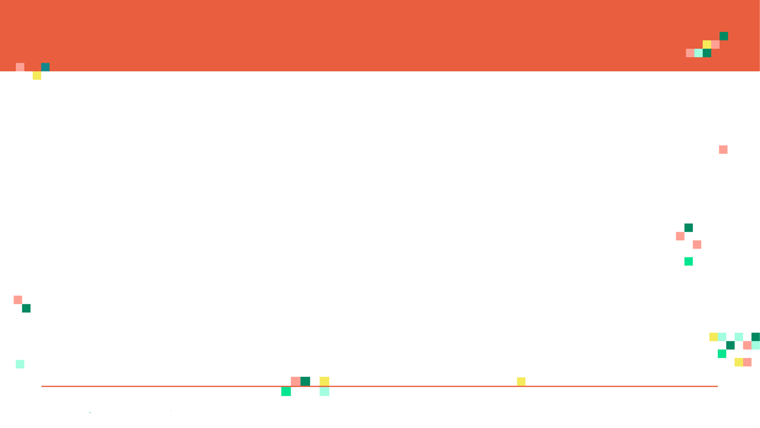
Faculty Focus Areas
Celebal Innovation Lab
A PRESENTATION ON “Big Data and Hadoop”
S. No | Faculty Name | Designation | Current Focus Areas | Sub Areas/ Problems Statements
10 | Ajit Noonia | Asst. Professor | VANET(Vehicular Ad-Hoc Network) | Handover Mechanism & Security issues
11 | Lal Babu Purbey | Asst. Professor | Cloud Computing | Cloud Security
12 | Manish Bhardwaj | Asst. Professor | Big Data | Big Data
13 | Manish Kumar Sharma | Asst. Professor | Wearable Computing, Machine Learning and Cloud Computing | Fatigue Detection System, MultiLayer Multiflex Classifier
14 | Manish Sharma | Asst. Professor | Data Security & Privacy | Big Data Security Challenges
15 | Mukesh Chand (ECE) | Asst. Professor | Antenna & Robotics
16 | Nimish Arvind | Asst. Professor | Cloud Computing | Improving Security on PAAS Level
Submitted By:
Kuldeep Tailor
Akshay Joshi

Slide 2


Slide 3
INTRODUCTION
Big Data burst upon the scene in the first decade of the 21st century.
The first organizations to embrace it were startup firms like ebay, google, linkedin and facebook which were built around big data from the beginning.

Slide 4



What is big data ?

Slide 5
Huge data right?
Facebook collects about 500 TBs of data per day.
Instagram stores TBs of data in form of images, text, and other formats.
Google was handling roughly 100 billion searches per month as of August 2012.

Slide 6
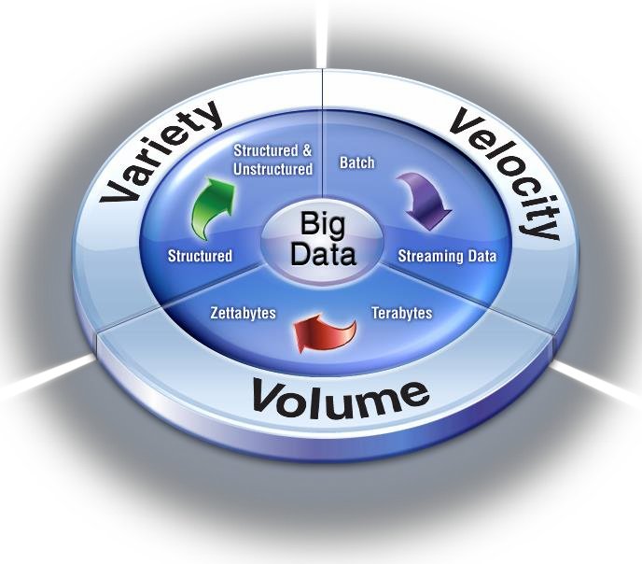
The 3 V’s of Bigdata

Slide 7
How Big is Big data?
These is no exact number by which we can classify any data as big data.
It is a constantly moving target.
It refers to volume of data that is so large that it is difficult to process it using traditional database and software techniques.

Slide 8
Large Dataset Challenges
Storing large VOLUMES (TB/PB/ZB)
Processing In Timely Manner
Processing Variety of DATA
Costly High End Infrastructure

Slide 9

Need of...

Slide 10
What is Hadoop?
Hadoop is a software framework for distributed processing of
large datasets across large clusters of computers
-Large datasets → Terabytes or petabytes of data
-Large clusters → hundreds or thousands of nodes
Hadoop is based on a simple data model, any data will fit.

Slide 11
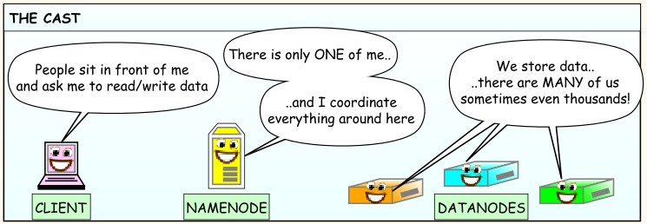
HDFS

Slide 12
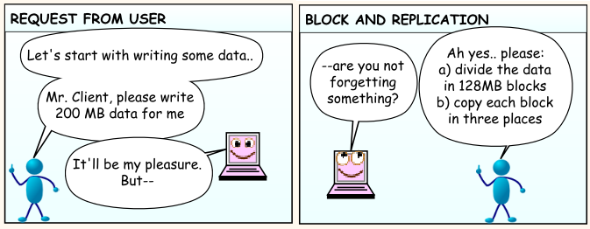
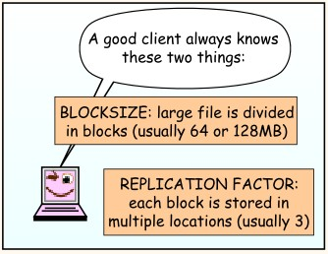
Storing a file in hdfs...

Slide 13
Map Reduce
Map Reduce was proposed by Google
- A programming paradigm to process huge data sets in small chunks parallely.
- MR allows complex data analysis in realtime.
- Follows simple strategy:
“Divide & Conquer”

Slide 14
Principles of Hadoop
- Need to process big data
- Need to parallelize computation across thousands of nodes
- Commodity hardware
~ Large number of low-end cheap machines working in parallel to solve a computing problem
- Automatic parallelization & distribution
~Hidden from the end-user
- Fault tolerance and automatic recovery
~Nodes/tasks will fail and will recover automatically

