Slide 1

Customer Shopping Behavior Analysis
3,900 purchases • 18 columns • goal: uncover patterns to guide strategy

Slide 2

Dataset Summary
Rows & Columns
Key Features
3,900 rows • 18 columns
Age, Gender, Location, Item, Category, Amount, Season, Rating, Subscription
Missing Data
37 missing values in Review Rating

Slide 3

Exploratory Data Analysis (Python)
01
Load & Inspect
pandas: df.info(), .describe()
02
Missing Handling
Imputed Review Rating by category median
03
Standardize & Engineer
snake_case columns; age_group; purchase_frequency_days
04
DB Integration
Loaded cleaned DataFrame into PostgreSQL

Slide 4
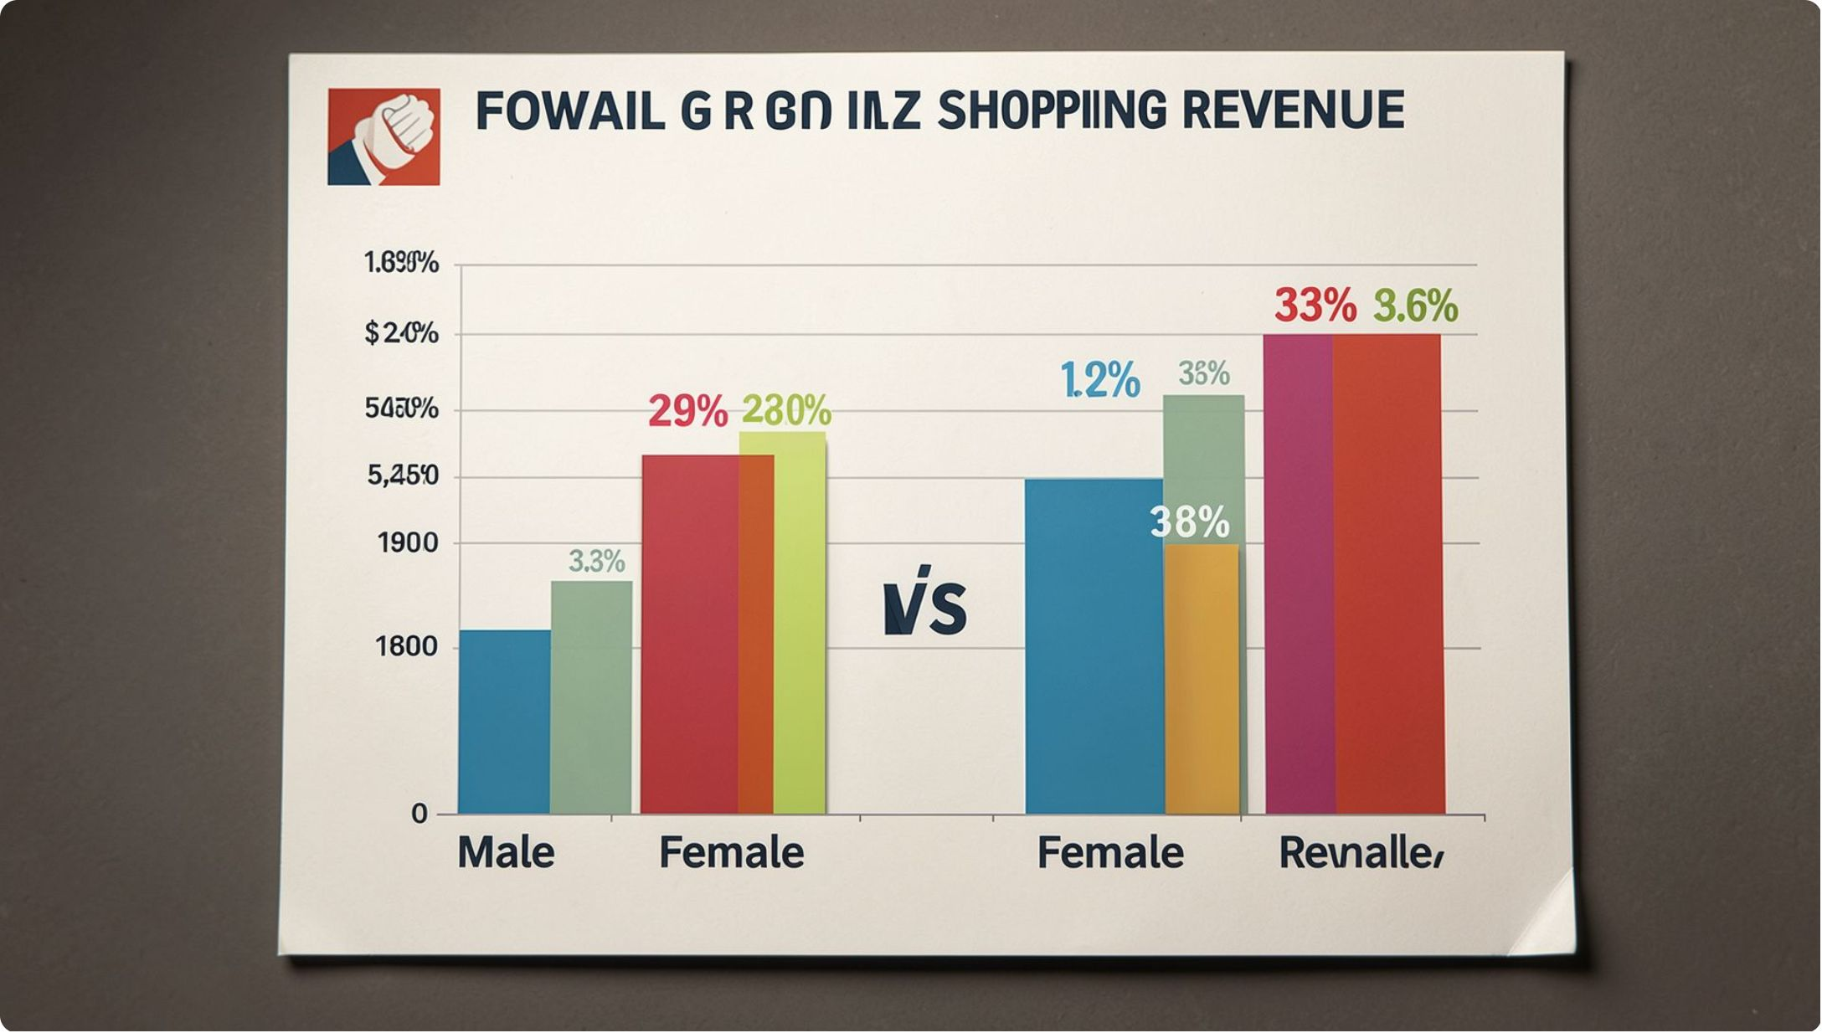

Revenue by Gender
Male: 157,890 • Female: 75,191
Male-driven revenue larger; explore targeting opportunities

Slide 5

Discounts & High Spenders
839 rows flagged: used discount yet spent above average
Top examples
customers with purchase_amounts: 64, 73, 90, 85, 97...

Slide 6






Top Products by Rating
Gloves
Avg rating 3.86
Sandals
Avg rating 3.84
Boots
Avg rating 3.82
Hat
Avg rating 3.80
Skirt
Avg rating 3.78

Slide 7
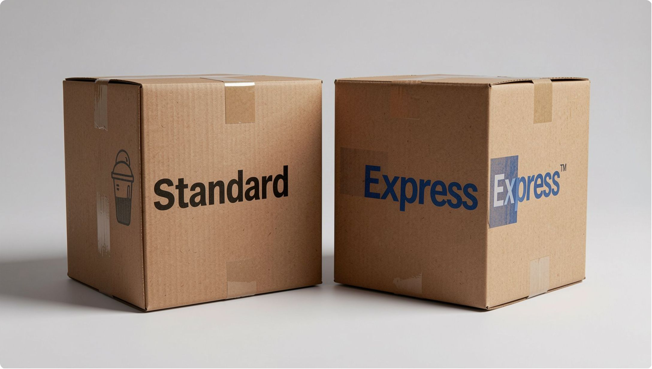
Shipping & Subscriptions
Avg purchase: Standard $58.46 • Express $60.48
Subscribers: 1,053 — avg spend $59.49 • Total rev $62,645
Non-subscribers: 2,847 — avg spend $59.87 • Total rev $170,436

Slide 8
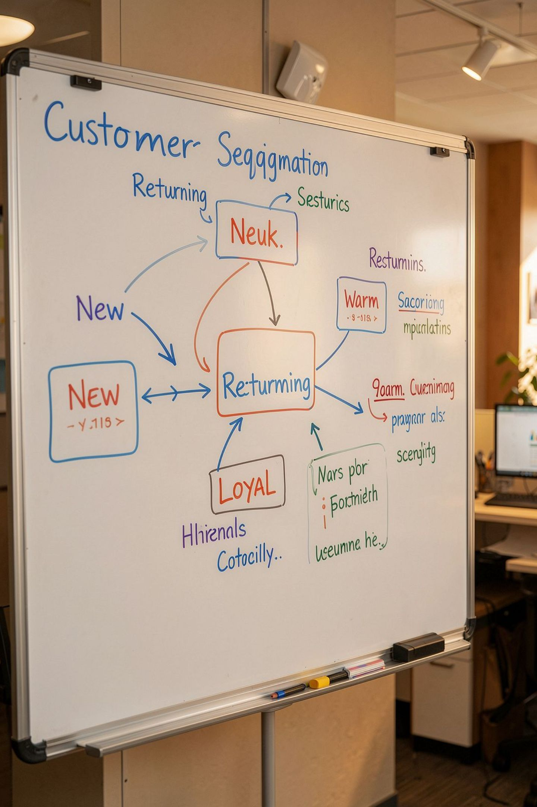
Customer Segmentation
Loyal: 3,116 • Returning: 701 • New: 83
Recommendation: reward repeat buyers to grow Loyal segment

Slide 9
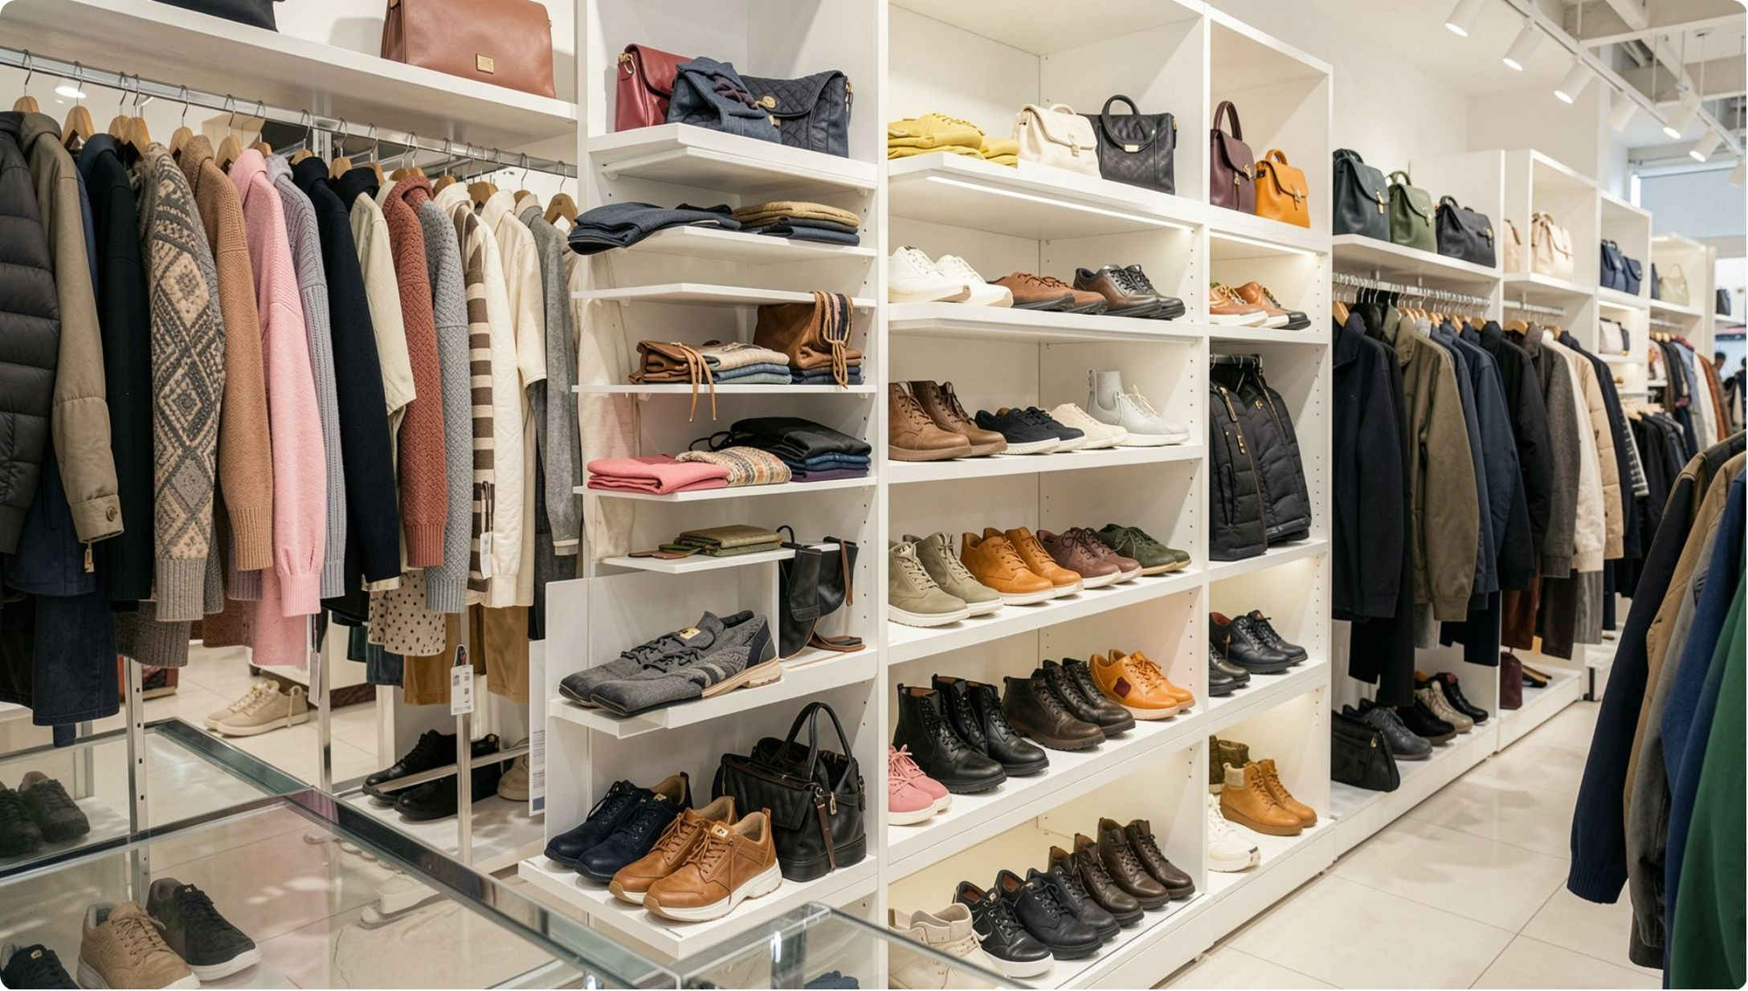
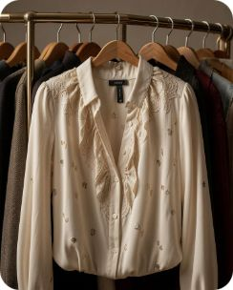

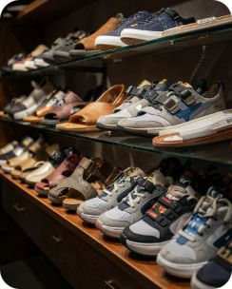
Top Categories & Products
Clothing
Revenue ≈ 100K • Top: Blouse, Pants, Shirt
Accessories
Revenue ≈ 75K • Top: Jewelry, Sunglasses, Belt
Footwear
Revenue ≈ 30K • Top: Sandals, Shoes, Sneakers

Slide 10

Business Recommendations
Boost Subscriptions
Promote exclusive subscriber benefits
Loyalty Programs
Reward repeat buyers to increase loyalty
Review Discounts
Balance promotions with margin control
Product Positioning
Feature top-rated and best-selling items
Targeted Marketing
Focus on high-revenue age groups & express-shipping users

