Slide 1
PS-4 · LOCAL SERVICE MANAGEMENT · 5TH SEMESTER
FoodBridge
A smart platform to coordinate the collection and distribution of surplus food
🍱
Team CodeBlooded (Team 5)
Yash Chopade · BTE24FSD100019
Priyambada Chouhan · BTE24FSD000011
Mohammad Ayan Manihar
Mentor: Verman Kumar, IIT (BHU) Varanasi
Notes:
Introduce the team and the problem statement PS-4: coordinating collection and distribution of usable surplus food.

Slide 2
The problem
Restaurants, hostels, events and households often have good food left over — while people nearby go hungry.
📵
⏱
🤝
No central channel
Food is time-critical
No tracking or trust
Donors don’t know who needs food; NGOs don’t know who has it. It depends on phone calls and luck.
Cooked food is safe only for a few hours. Slow coordination means it gets thrown away.
Nobody knows if food was picked up, by whom, or whether it reached people.
Notes:
Explain the three gaps: discovery, speed, and accountability.

Slide 3
Our solution: FoodBridge
A full-stack web platform that matches surplus food to the right receiver nearby, alerts them instantly and tracks it until it is served.
🍱
Donor
🤲
Receiver
🛡
Admin
Restaurants, hostels, events, households
NGOs, shelters, community kitchens, volunteers
Platform operator
Post food with photo, quantity, location & safe-until time
See ranked matches on a map, claim, pick up, distribute
Monitor all users, donations, statistics and live map

Slide 4
How it works
📸
🧠
🔔
🚚
→
→
→
1. Post
2. Match
3. Notify
4. Track
Donor adds food details, photo and pickup point. AI suggests category & safe shelf life.
Engine scores every receiver on distance, urgency, quantity, preference & fairness.
Top matches get an instant real-time alert and claim with one tap.
Claimed → Picked up → Delivered. Donor sees how many people were fed.

Slide 5
Key features (focus areas covered)
🔐
Middleware
🗄
Database
🖼
Image upload
JWT auth, role-based access, validation, rate limiting, logging, error handler
SQLite: users, donations, notifications with keys, constraints & indexes
Multer upload with type & 5 MB size checks; photos shown on cards
⚡
Real-time alerts
🗺
Maps
🧠
AI matching
Socket.io push for new match, claim, pickup, delivery, expiry
Leaflet + OpenStreetMap live map, GPS location picker, directions
Explainable match score + AI food check (Gemini or rule-based)

Slide 6
AI-based smart matching
How the score works
Haversine distance, 0 at 15 km radius
Food expiring within 2 h gets top priority
Servings compared with receiver capacity
Veg-only receivers never get non-veg
Fewer pending pickups → fairer share
Top 5 matches (≥35%) notified instantly
Every match shows its reasons, e.g. “Very close (1.5 km)” · “Expires within 2 hours”.

Slide 7
System architecture
⚙ Express API (Node.js)
🗄 SQLite
🖥 React client
⇄
Middleware: JWT auth · roles · validation · rate limit · logger · errors
Routes: auth · donations · notifications · stats · admin · ai
Services: matching engine · food analyzer · notifier
Job: auto-expire every minute
users · donations · notifications
Vite + React Router
Donor / Receiver / Admin dashboards
Leaflet maps
Socket.io client
Notification bell & toasts
REST
⇄
Socket.io
🖼 Uploads
⇄
Multer · /uploads
🤖 Gemini (optional)
⇄
AI food check; rule fallback

Slide 8
Database design & donation lifecycle
users
Status flow
id, name, email, password_hash, role, phone, org_name, org_type, lat, lng, food_preference, capacity
available
unclaim → back to available
cancel → cancelled
safe time passed → expired (auto job)
Claim is one atomic SQL UPDATE — two receivers can never claim the same food
↓ claim
claimed
donations
id, donor_id → users, title, category, food_type, quantity, image, lat, lng, expires_at, status, claimed_by → users, timestamps
↓ pickup
picked_up
↓ deliver
notifications
delivered
id, user_id → users, message, type, donation_id, is_read, created_at

Slide 9
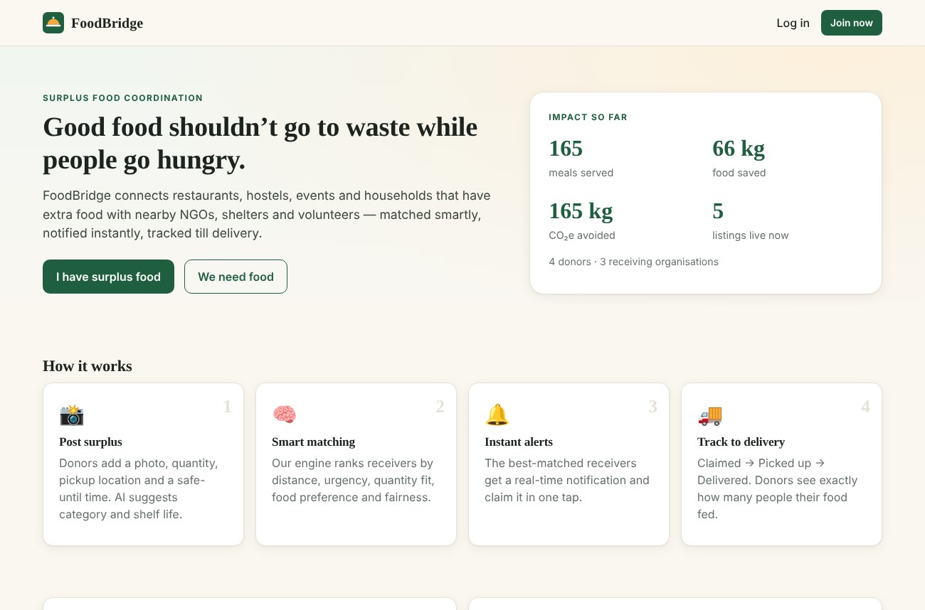
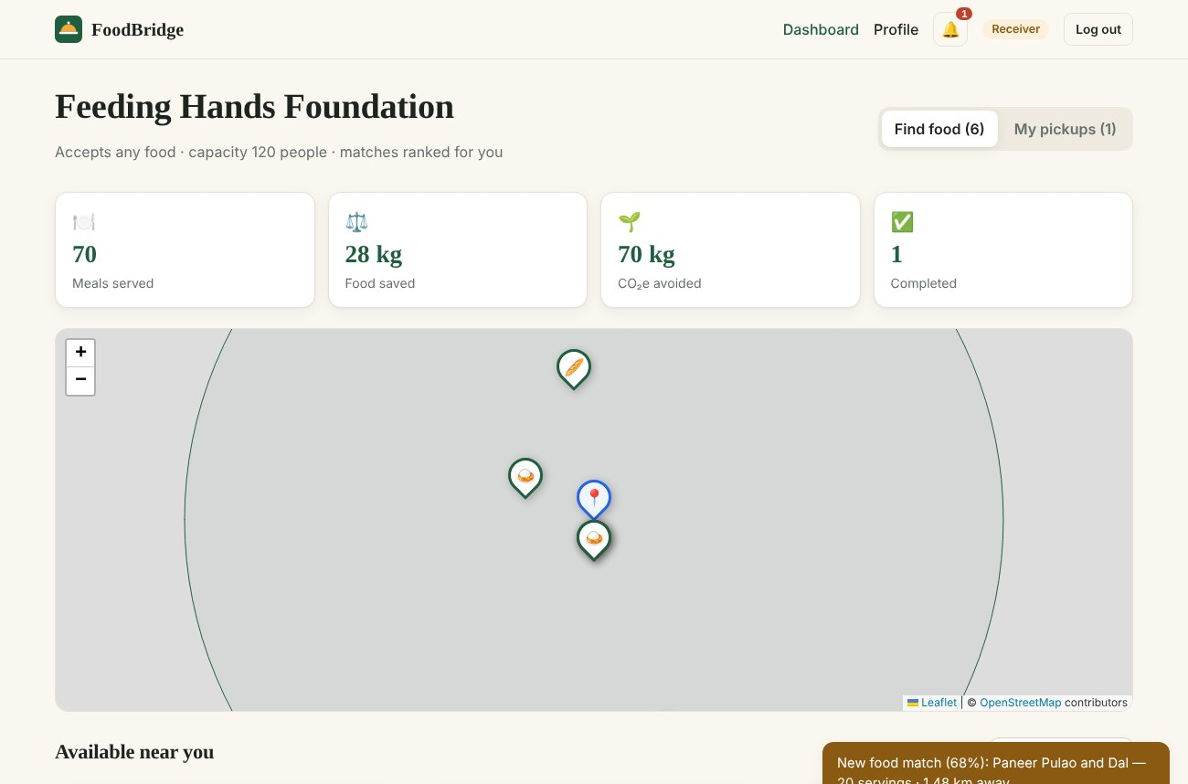
Screens: landing & receiver matches
Landing page with live impact stats (meals, food saved, CO₂ avoided).
Receiver dashboard: live map + real-time “new food match” notification.

Slide 10
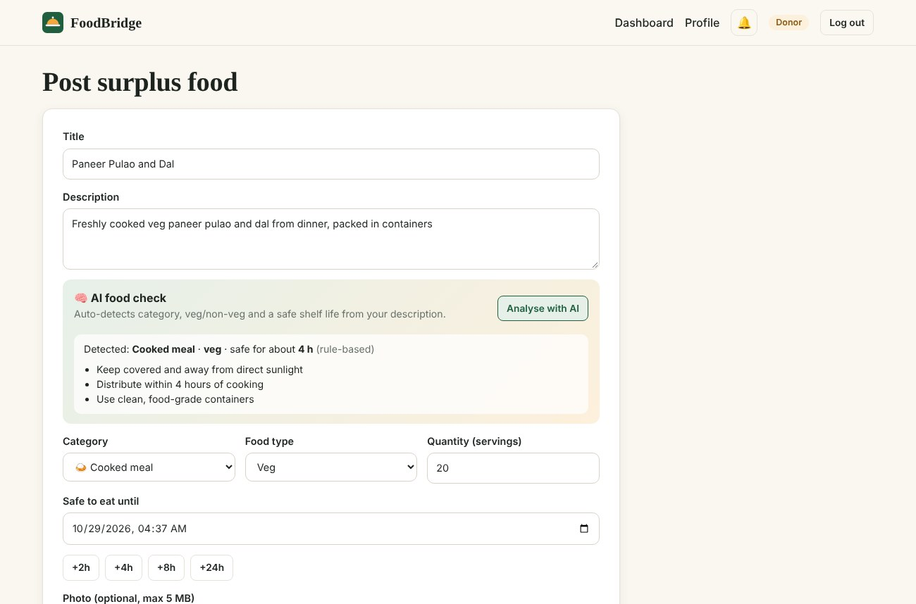
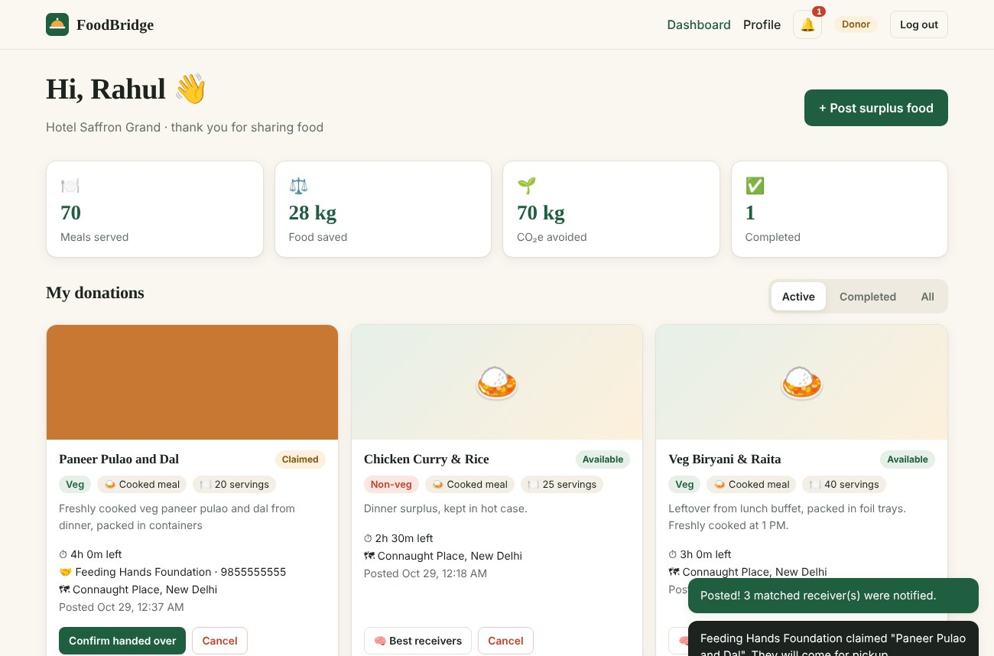
Screens: posting food & donor tracking
Post food form with AI food check, photo upload and map picker.
Donor gets an instant alert when food is claimed, with receiver contact.

Slide 11
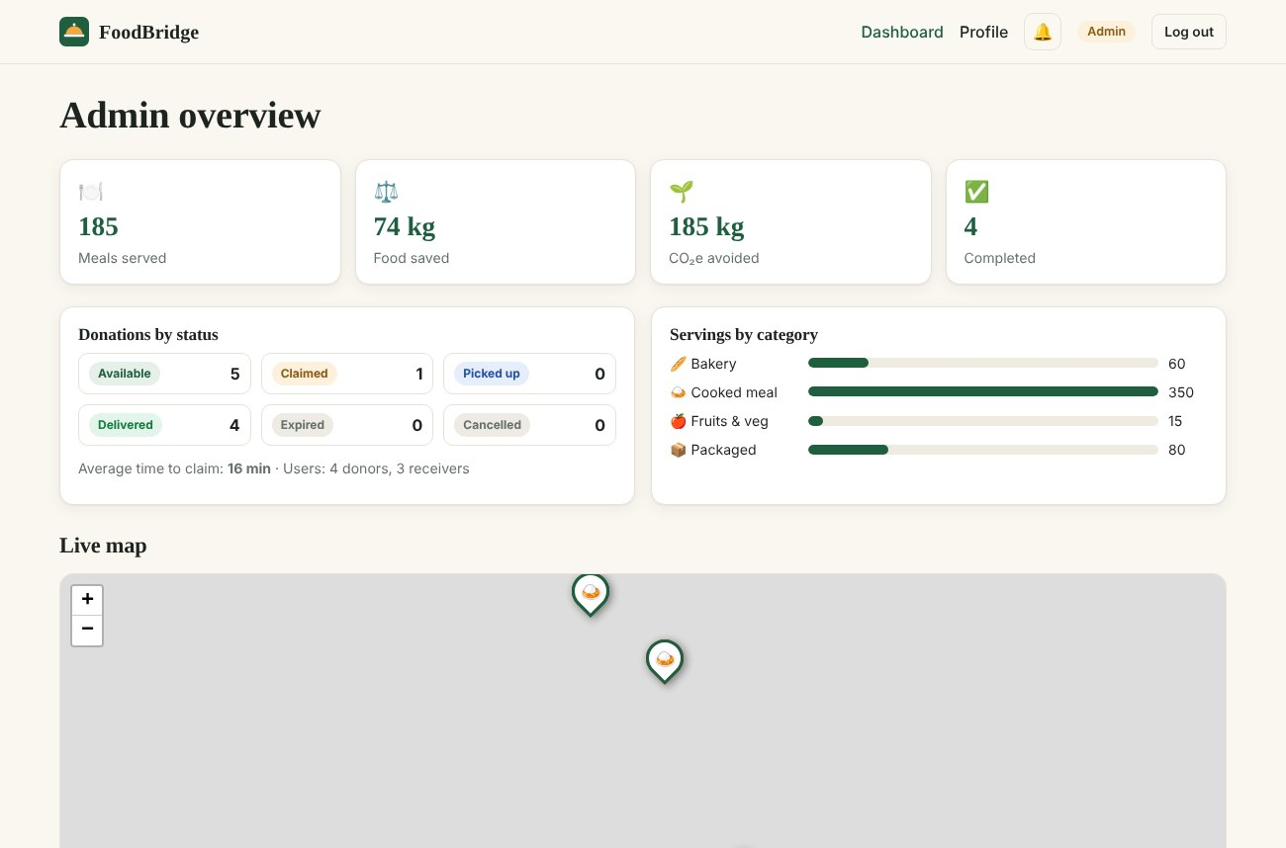
Screens: admin panel
Admin can see
Total meals, food saved, CO₂ avoided
Donations by status & category
Average time to claim
Live map of active food
All users & donations; cancel any listing

Slide 12
Tech stack & testing
Frontend
React 19 · Vite · React Router · Leaflet · Socket.io client
✅ Tested end-to-end
Register & login for every role
Post with photo → matches notified live
Double-claim blocked (409 Conflict)
Wrong-order status changes rejected
Role checks (donor can’t claim, etc.)
Past expiry & bad input rejected
Veg-only filter respected
Backend
Node.js · Express 5 · Socket.io · Multer · JWT · bcrypt
Database
SQLite (sql.js) — zero setup, file based
AI
Weighted matching engine · Google Gemini (optional)

Slide 13
Future scope
📱
Mobile app with push notifications
🛵
Volunteer delivery with live tracking
Thank you!
📷
Image-based freshness detection
Questions?
Team CodeBlooded
✔
Verified NGO badges & food-safety ratings
🗣
Hindi & regional language support

