Slide 1

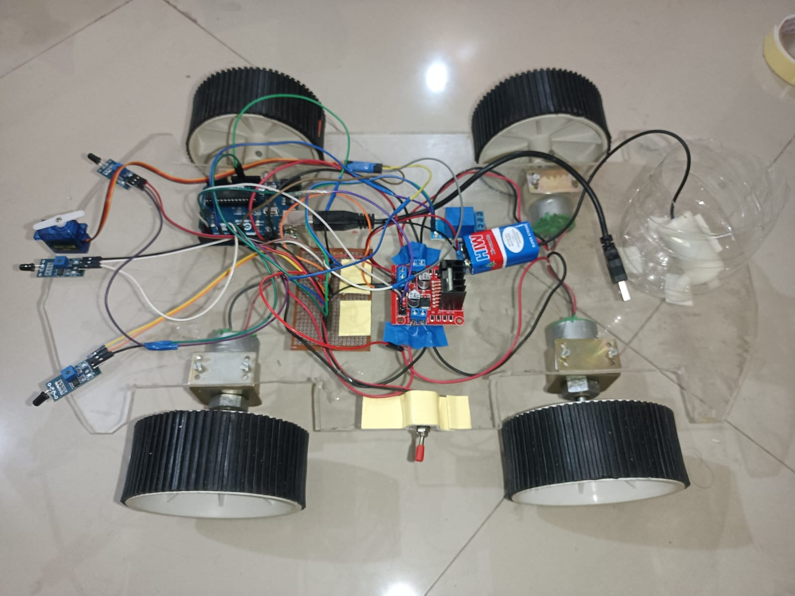
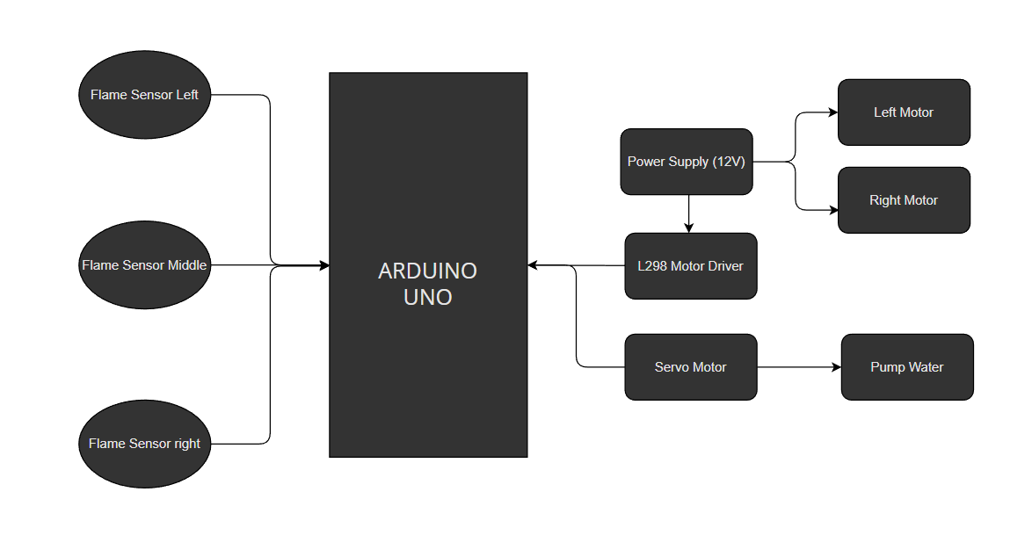
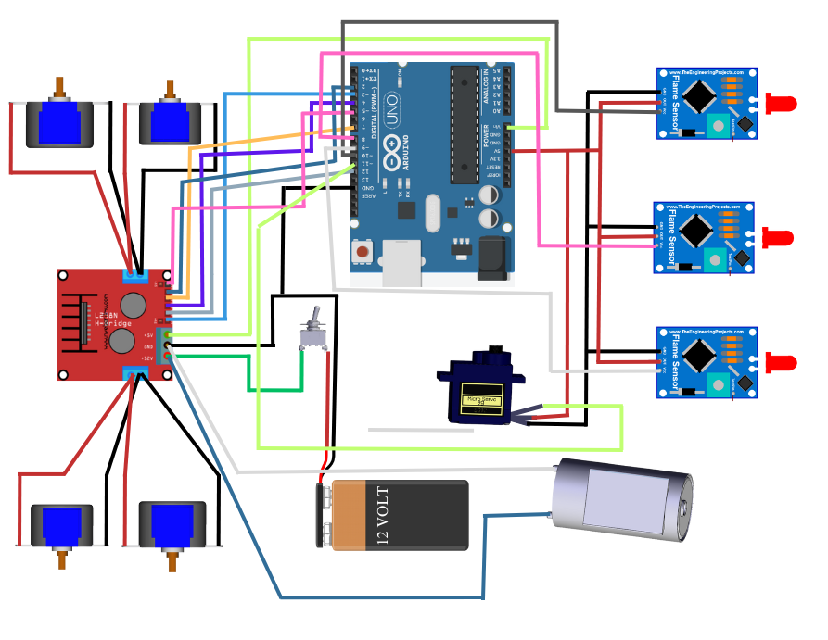
Dr. D. Y. Patil Institute of Technology, Pimpri, Pune Department of Electronics & Telecommunication Engineering TE Mini Project Poster and Project Exhibition Fire Fighting Robot 1. TETC26 Shruti Awate 2. TETC59 Yash Anap 3. TETC69 Yash Chandane
INTRODUCTION
The Fire Fighting Robot (FFR) mini project aims to address the critical challenge of firefighting in hazardous and life-threatening situations by leveraging the capabilities of robotics and automation. Fires pose significant risks to both human life and property, and the need for efficient and effective firefighting techniques is paramount.
HARDWARE SETUP PHOTO:
AIM & OBJECTIVES:
The objective of this mini project is to design and build a robotic system capable of autonomously detecting and extinguishing fires in indoor environments.
The robot should be able to operate in various scenarios, including residential buildings, offices, and industrial facilities.
Design and development of low-cost firefighting robot.
Run automatically firefighting robot.
Extinguish fire.
RESULT:
Fire Detection and Localization: The robot successfully detects the presence of fire using sensors such as flame detectors, temperature sensors, or smoke detectors. It can accurately determine the location of the fire within its operational range.
Fire Suppression: The robot effectively suppresses or extinguishes the fire using its fire suppression system. It could be equipped with mechanisms like water cannons, fire extinguishers, or foam generators that are capable of effectively combating the fire.
BLOCK DIAGRAM:
CONCLUSION:
In conclusion, the fire-fighting robot mini project aimed to design and develop a robot capable of detecting and suppressing fires It showcased effective fire detection, suppression mechanisms, mobility, safety features, and control capabilities. The project documentation, including design specifications and code, provided a comprehensive overview of the robot's architecture and functionality.
Fire fighter robot can be used in the Area where a can’t go.
Capability of sensing accurately with increased flexibility.
Reliable and economical.
Extinguishes fire where probability of explosion is high.
Disaster area monitoring and rescues.
Fire fighter robot can be used it Restaurants.
CIRCUIT DIAGRAM:
APPLICATIONS:

