Slide 1



Dr. D. Y. Patil Unitech Society
Dr. D. Y. Patil Institute of Technology, Pimpri
Department of Electronics & Telecommunication Engineering
BE Final Year Project Presentation Exam
A.Y. 2023-24
“Prediction of pathloss model for millimeter wave communication using Deep Learning”
Group:
Yash Chandane (B190243001)
Shruti A. Awate (B190243208)
Yash P. Anap (B190243239)
Advisor/Guide: Mrs. Sheetal Pawar
Electronics and Telecommunication
Dr. D Y Patil Institute of Technology, Pimpri , Pune

Slide 2

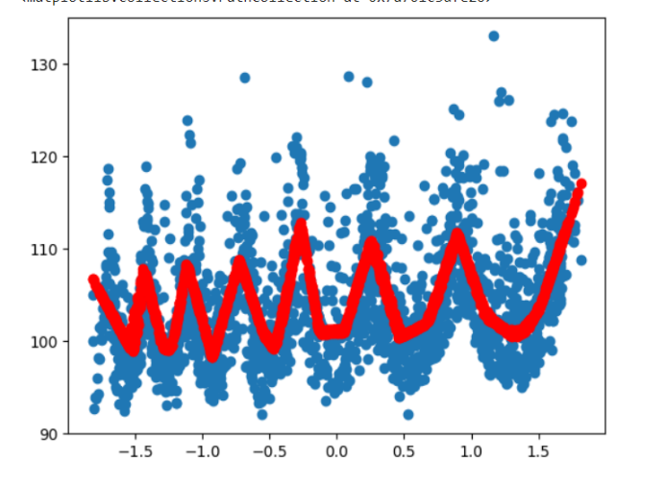
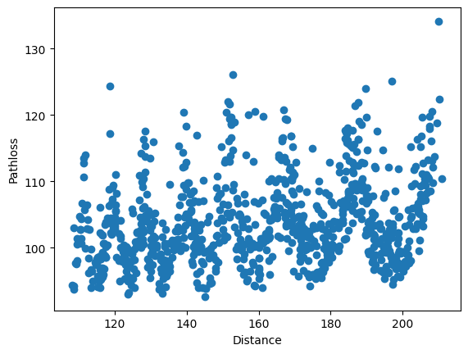
Outline
Introduction
Literature Survey
Research Gap
Aim and Objective
Block Diagram / Methodology
Circuit Diagram & System Specification
Results and Discussion
Conclusion
Future Scope
References
Electronics and Telecommunication
Dr. D Y Patil Institute of Technology, Pimpri , Pune

Slide 3
Introduction
As wireless communication technology rapidly advances, the millimeter-wave (mmWave) spectrum has become essential for meeting the growing demand for high-speed and high-capacity networks.
The mmWave frequency band, ranging from 30 GHz to 300 GHz, offers substantial bandwidth, which is crucial for achieving higher data rates and improved network performance.
Path loss is the reduction in signal strength as it travels through space, is a critical factor that impacts the performance and reliability of mmWave communications. Unlike lower frequency bands, mmWave signals are more susceptible to obstacles like buildings, trees, and even weather conditions like rain and humidity.
These factors lead to higher path loss and signal degradation, making accurate prediction models essential for effective network design and optimization.
The rapid evolution of wireless communication technologies has ushered in a new era of connectivity, with millimeter-wave communication emerging as a cornerstone for the realization of high-speed, low-latency applications in the era of 5G and beyond.
Electronics and Telecommunication
Dr. D Y Patil Institute of Technology, Pimpri , Pune

Slide 4
The primary objective is to develop a path loss model that surpasses the limitations of conventional empirical models and adapts to the dynamic and complex nature of millimeter-wave propagation.
Deep learning algorithms used in project are trained on DeepMIMO dataset, allowing them to learn and discern complex relationships between various parameters that influence path loss in millimeter-wave communication. Through this training process, the model can generalize and predict path loss with a level of precision that traditional models struggle to achieve.
As millimeter-wave communication becomes increasingly integral to deploying advanced wireless networks, the accuracy of path loss prediction becomes paramount. A more precise path loss model, facilitated by Deep Learning, enhances our theoretical understanding of millimeter-wave propagation and offers practical benefits in optimizing network coverage, planning deployments, and ensuring reliable communication in diverse environments.
Electronics and Telecommunication
Dr. D Y Patil Institute of Technology, Pimpri , Pune

Slide 5

Literature Survey
Paper | Year | Methodology/Technique used | Findings
1. Modelling by Optimal ANN the Prediction of Propagation Path Loss in Urban Environments | 2013 | Algorithm used in paper is Levenberg– Marquardt backpropagation algorithm, DE-LM. Model Used is Artificial Neural Network(ANN). | The optimum ANN training method for a given problem.
2. Determination of Neural Network Parameters for Path Loss Prediction in Very High Frequency Wireless Channel | 2019 | Algorithm used in paper is Levenberg– Marquardt(LM), Differential Evolution(DE) and Scale Conjugate Gradient(SCG). Model Used is Artificial Neural Network(ANN). | ANN models have proven to be easier to deploy than deterministic models and they are also more accurate than empirical models. In addition, ANN can be adapted for path loss predictions in rural, suburban and urban propagation environments.
3. Path loss Predictions from Microcell to Macro cell | 2016 | Algorithm used in paper is Levenberg– Marquardt(LM). The Lee Microcell Model --base for this multiple breakpoint microcell propagation prediction model | The Model is validated in both 900 and 1800 MHz frequency bands based on the collected measurement data.
4.CNN-Based mmWave Path Loss Modelling for Fixed Wireless Access in Suburban Scenarios | 2020 | Algorithm used in paper is Enhanced Local Area Multi-Scanning Algorithm (E-LAMS) Model used is Convolutional Neural Network(CNN). | Presented a CNN-based mmWave path loss modeling method based on the field measurement data in suburban scenarios.
5.Pathloss prediction using DL with appl. to cellular optimization and efficient d2d link scheduling | 2020 | Algorithm used in paper is Data-Driven Interpolation, Model-based Interpolation, and Model-based Prediction Model used is Convolutional Neural Network(CNN). | WinProp completes a simulation in roughly an order of 1sec on a Intel Core i7-8750H CPU, and RadioUNet roughly an order of 10−3 sec on an Nvidia Quadro GR100.
Electronics and Telecommunication
Dr. D Y Patil Institute of Technology, Pimpri , Pune

Slide 6

Research Gap
Our project is based on 28Hz frequency which is not used by any of the researchers till the date.
With 0-18 BS, 1,632,261 active users, and path loss ranging from 100 to 110, these visuals highlight key parameters influencing signal attenuation are used in project.
CNN Model for Tabular Dataset.
MSE :- 26.72031989132215
Normalization of Dataset using Gradient Decent Algorithm
Electronics and Telecommunication
Dr. D Y Patil Institute of Technology, Pimpri , Pune

Slide 7

Aim and Objectives
Aim
To make predictions about signal strength loss more precise to ensure better network performance and service quality.
To create a model that works well in various settings, like cities, suburbs, and rural areas, for reliable signal predictions everywhere.
To use an advanced deep learning techniques to continually improve the accuracy and efficiency of signal loss predictions.
To move beyond the simplifications of older models by learning directly from data, capturing the true complexity of how signals behave in the real world.
Objectives
To understand the basics of milli - meter wave communication in 5G.
To Gain insights into path loss models used in mm-Wave communication.
To gain understanding of deep learning concepts.
To design a deep learning model for pathloss prediction.
Electronics and Telecommunication
Dr. D Y Patil Institute of Technology, Pimpri , Pune

Slide 8

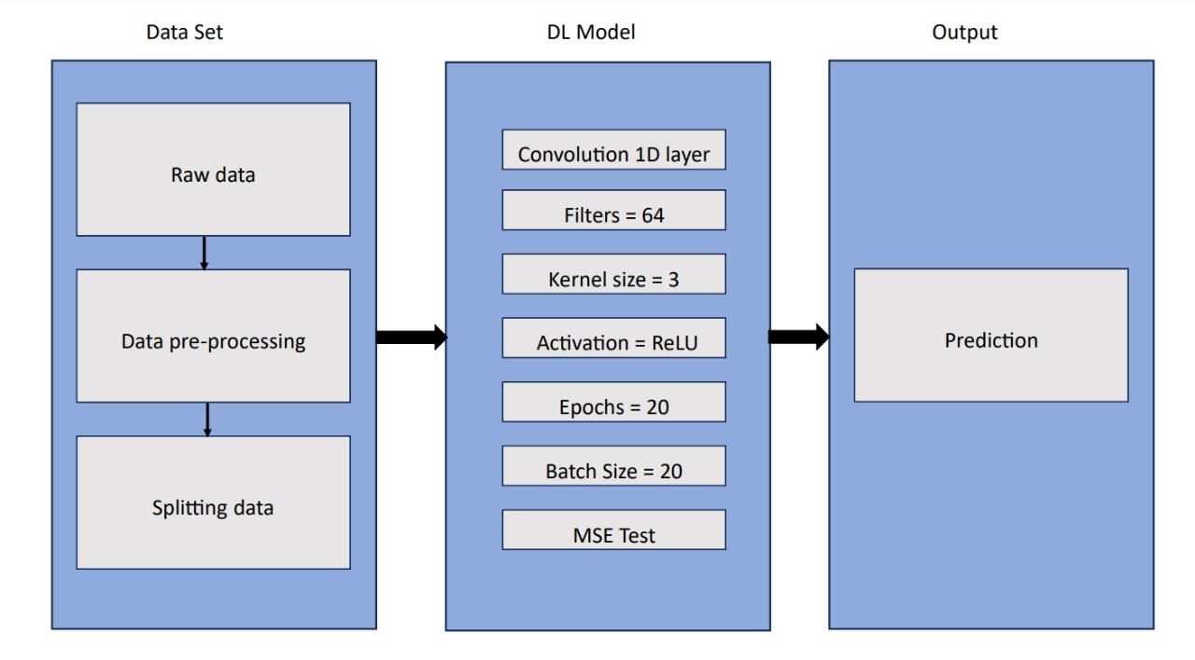
Block Diagram / Methodology
Electronics and Telecommunication
Fig. Purpose System for Path Loss Prediction
Dr. D Y Patil Institute of Technology, Pimpri , Pune

Slide 9
Raw Data: This is the initial dataset that you will use for training and testing your model
Data Pre-processing: Before feeding the raw data into the model, it needs to be pre-processed. This step may involve normalizing or standardizing the data, handling missing values, and possibly transforming the data into a suitable format. The goal is to make the data suitable for the model to learn effectively.
Splitting Data: The pre-processed data is then split into training and testing sets. The training set is used to train the model, while the testing set is used to evaluate its performance.
DL Model: This represents the structure of the deep learning model. In this case, it includes:
Activation: The activation function applied to the output of the Scattering Plot of Distance.
Electronics and Telecommunication
Dr. D Y Patil Institute of Technology, Pimpri , Pune

Slide 10
Convolution layer: ReLU introduces non-linearity into the model, helps to learn complex patterns.
Prediction: This layer (or layers) generates the final predictions from the model. Depending on the problem, this could be a dense (fully connected) layer followed by an activation function suited to the task.
5. Training: The training process involves feeding the training data into the model, allowing it to learn the patterns in the data. This step includes:
6. MSE Test: After training, the model's performance is evaluated on the test set. The Mean Squared Error (MSE) is a common metric for regression tasks, measuring the average squared difference between the predicted and actual values. Lower MSE indicates better performance.
Electronics and Telecommunication
Dr. D Y Patil Institute of Technology, Pimpri , Pune

Slide 11

System Specifications
1. Convolution layer used is 1D layer
A Convolution 1D layer applies a one-dimensional convolution operation to input data, commonly used in sequence processing tasks like time series analysis and natural language processing.
2. Filter = 64
This parameter specifies the number of filters (or kernels) used in the convolution layer. Each filter will learn different features from the input data.
3. Kernel Size = 3
This defines the size of the filters, which in this case is 3. The filter will slide over the input data, considering 3 data points at a time.
4. Activation = ReLU
The activation function applied to the output of the convolution layer. ReLU (Rectified Linear Unit) introduces non-linearity into the model, helping it learn complex patterns.
5. Epochs size = 20
The number of times the entire training dataset is passed through the model.
6. Batch Size = 20
The number of training samples fed into the model at once. Training in batches can make the learning process more efficient and stabilize gradient descent.
Electronics and Telecommunication
Dr. D Y Patil Institute of Technology, Pimpri , Pune

Slide 12

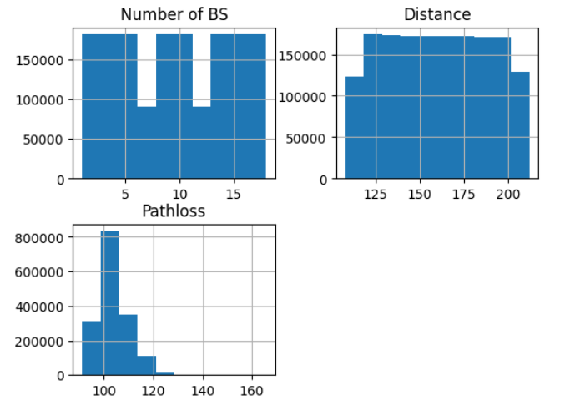
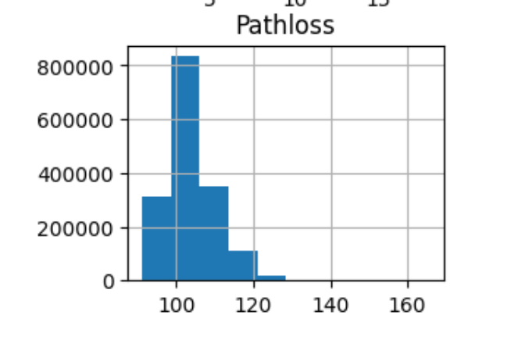
Results & Discussion
Graphical Representation of Raw Dataset
Figure 1
Figure 2
Figure 3
In Figure 1, the graphs represent the graphical representation of no. of Base Station used for the prediction of pathloss model. It shows that at base station around 7 and 13 we have less users.
In Figure 2, the graphs represent the distance used for the prediction of pathloss model.
In Figure 3, the graphs represent the graphical representation of the pathloss used for the prediction of pathloss model. It shows that the pathloss is high in the range between (100 -110).
Electronics and Telecommunication
Dr. D Y Patil Institute of Technology, Pimpri , Pune

Slide 13
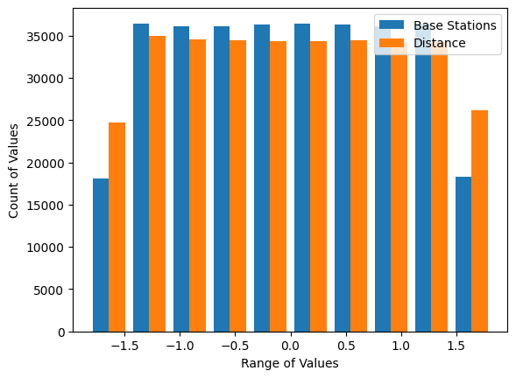
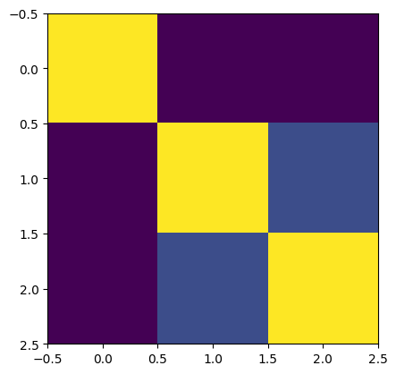
Results & Discussion Cont…
In Figure 4, the graphs represent the graphical representation of the Normalized Dataset. Negative value indicates the entire dataset is shifted so that it revolves around zero.
(i.e. Gradient Descent Algorithm).
Figure 4
In Figure 5, it represents a heat-map it is a data visualization tool that represents data values using color gradients, making it easier to identify patterns, correlations, and outliers. The correlational value between the No of BS to No. to BS, Distance to Distance and Pathloss to Pathloss is the best as the correlation between them is 0 and others are correlated to each other with a specific value based on the correlational value.
Electronics and Telecommunication
Figure 5
Dr. D Y Patil Institute of Technology, Pimpri , Pune

Slide 14
Results & Discussion Cont…
Graphical Representation of predicted output
Figure 6
In Figure 6, it represents a scatter plot which visualizes the connection between path loss and distance in millimeter wave communication.
Distance is typically on the horizontal axis (x-axis) in meters, while path loss, often measured in decibels (dB), sits on the vertical axis (y-axis). The diagonal trend line depicts as distance rises, so does path loss. This signifies a weakening signal with increasing travel distance.
However, the data points around the trend line aren't perfectly aligned. This indicates that other factors influence path loss besides distance. These can be environmental obstacles (buildings, trees), or even the frequency of the signal itself, with higher frequencies experiencing greater path loss. By analyzing such scatter plots, researchers gain valuable insights into how various factors affect signal strength, ultimately allowing them to create more accurate models for predicting path loss in millimeter wave communication systems.
Electronics and Telecommunication
Dr. D Y Patil Institute of Technology, Pimpri , Pune

Slide 15

System Advantages and Applications
Advantages
Improved Accuracy: The deep learning model can make more precise predictions about how much signal strength is lost as it travels through the air.
Real-Time Prediction Capabilities: Once trained, the deep learning model can make predictions quickly. This is important because we need to know how strong the signal will be right away, especially in situations where the network has to adapt quickly to changes.
Strong Generalization to Unseen Data: Even if the deep learning model hasn't seen a particular situation before, it can still make good predictions based on what it has learned from similar situations.
Reduced Dependency on Simplifying Assumptions: Instead of relying on simple ideas about how signals travel, the deep learning model learns directly from the data.
Adaptability to Complex Environments: Whether the signal is traveling through a city, suburb, or countryside, the deep learning model can handle it. It learns from lots of different situations during its training, so it's good at understanding how the signal behaves in different places.
Electronics and Telecommunication
Dr. D Y Patil Institute of Technology, Pimpri , Pune

Slide 16
Applications
Network Planning and Optimization: Telecom companies can use the model to plan and optimize mmWave networks better. It helps them decide where to place antennas and how to adjust signals for the best coverage and performance.
Next-Gen Networks (like 5G): The model contributes to the development of advanced wireless networks like 5G by ensuring better connectivity and faster speeds, especially in crowded urban areas.
Autonomous Vehicles and Traffic Systems: It helps vehicles communicate with each other and with infrastructure (like traffic lights) more reliably, improving safety and traffic management.
Wireless Internet Connections: The model helps optimize wireless connections, providing faster and more reliable internet access, even in remote areas.
Military Communication: For defense purposes, the model ensures secure and efficient communication in challenging environments, aiding military operations.
Smart Cities and IoT Devices: In smart cities, the model ensures better connectivity for devices like smart meters and sensors, making urban infrastructure more efficient and responsive.
Electronics and Telecommunication
Dr. D Y Patil Institute of Technology, Pimpri , Pune

Slide 17
Conclusion
In conclusion, our project focused on predicting path loss in 5G millimeter-wave (mmWave) communication using deep learning. This is an important step forward for wireless communication technology. We used advanced deep learning techniques, particularly Convolutional Neural Networks (CNNs), to improve how we predict signal loss in mmWave environments.The accuracy and flexibility of our deep learning model are promising for better network planning and deployment in 5G networks. This means we can potentially create more efficient and reliable communication systems. Additionally, the model's ability to handle large amounts of data suggests it will continue to improve as it processes more information, meeting the evolving demands of future communication networks.Moving ahead, further research and development will be crucial to refine the model's structure, boost its performance, and test its real-world applications. By continuously innovating at the intersection of deep learning and mmWave communication, we can develop faster, more reliable, and more efficient wireless networks. These advancements will be vital for the connectivity needs of the future, ensuring that our communication infrastructure keeps pace with technological advancements and growing user demands.
Electronics and Telecommunication
Dr. D Y Patil Institute of Technology, Pimpri , Pune

Slide 18

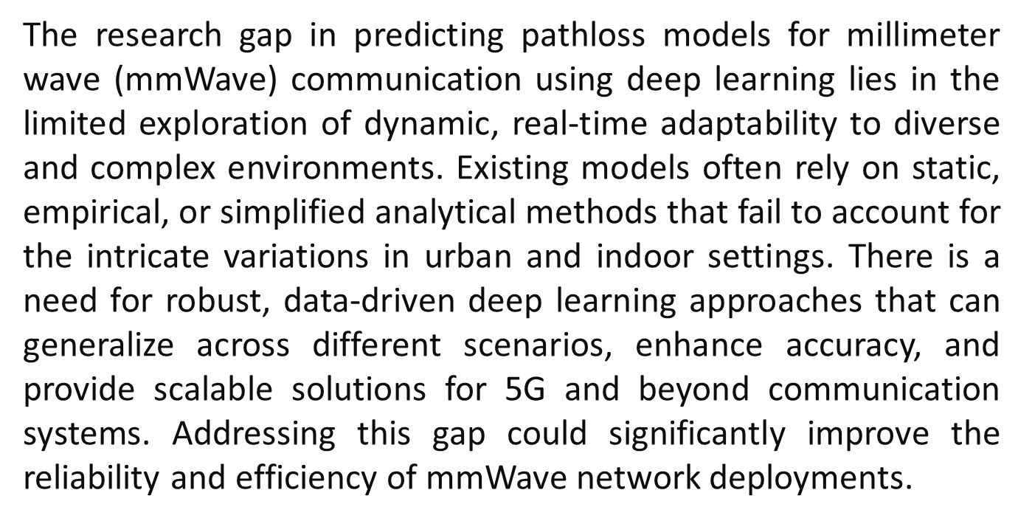
Graphical Summary
Electronics and Telecommunication
Dr. D Y Patil Institute of Technology, Pimpri , Pune

Slide 19

Future Scope
The model can be continuously improved by incorporating more data from diverse locations and conditions to ensure accuracy and reliability in real-world scenarios.
As wireless communication evolves, the model can be adapted for future technologies like 6G, ensuring its continued relevance.
Expanding the model to work well in various environments—such as cities, suburbs, rural areas, indoors, and outdoors—will make it versatile for different network planning needs.
By focusing on these areas, the project will significantly advance wireless communication technologies, leading to faster, more reliable, and adaptive networks that meet future demands.
Electronics and Telecommunication
Dr. D Y Patil Institute of Technology, Pimpri , Pune

Slide 20
References
Al-Samman, A. M., Rahman, T. A., Azmi, M. H., Sharaf, A., Yamada, Y., & Alhammadi, A. (2018, March). "Path loss model in indoor environment at 40 GHz for 5G wireless network". In 2018 IEEE 14th International Colloquium on Signal Processing & Its Applications (CSPA) (pp. 7-12). IEEE.
Adachi, F. (2002, October). "Evolution towards broadband wireless systems". In The 5th International Symposium on Wireless Personal Multimedia Communications (Vol. 1, pp. 19-26). IEEE.
G.R. McCartney, J. Zhang, S. Nie, T.S. Rappaport, "Path loss models for 5G millimeter wave propagation channels in urban microcells", in 2013 IEEE Global Communications Conference (GLOBECOM), 2013, pp. 3948–3953.
B. Nin, Z. Chen, W. Chen, Y. Du, J. Fang, "Channel Estimation and Hybrid Beam Forming for Reconfigurable Intelligent Surfaces Assisted THz Communications", in ICC 2020 IEEE International Conference on Communications (ICC), 2020, pp. 1–7.
Z. Xiao, T. He, P. Xia, X. Xia, "Hierarchical codebook design for beamforming training in millimeter-wave communication", IEEE Trans. Wireless Common. 16 (1)(2017) 141–153.
S. Sun, T.S. Rappaport, S. Rangan, T.A. Thomas, A. Ghosh, I.Z. Kovacs, I. Rodriguez, O. Komen, A. Partyka, J. Jarvelainen, "Propagation path loss models for 5G urban micro and macro-cellular scenarios", in 2016 IEEE 83rd Vehicular Technology Conference (VTC2016-Spring), 2016.
Electronics and Telecommunication
Dr. D Y Patil Institute of Technology, Pimpri , Pune

Slide 21

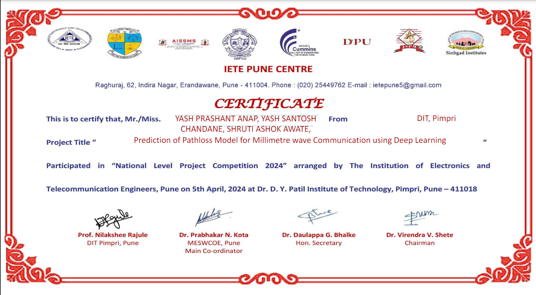
Participation in Project Competition Details
Electronics and Telecommunication
Dr. D Y Patil Institute of Technology, Pimpri , Pune

Slide 22

Thank You
Electronics and Telecommunication
Dr. D Y Patil Institute of Technology, Pimpri , Pune

Slide 23

Any Questions?
Electronics and Telecommunication
Dr. D Y Patil Institute of Technology, Pimpri , Pune

