Slide 1


Slide 2
6
Chapter
Legal Issues For
The Entrepreneur

Slide 3
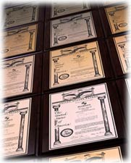
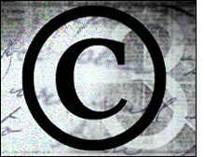

Intellectual Property
Patents
Copyrights
Trademarks

Slide 4


Lawyer
Why Have One?
  Determine What Is Needed
  Search For Lawyer With Special Expertise
How to Select Lawyer
  One-Time Service or On-Going?
  Set-Up Comfortable Working Relationship
  Determine Costs Up-Front

Slide 5
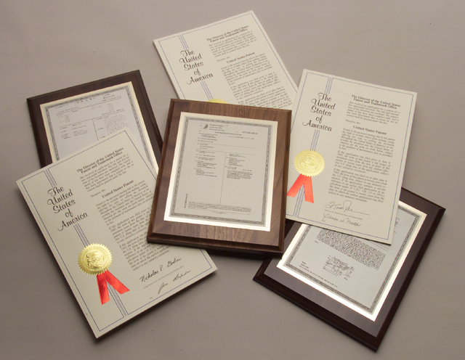
Patents
Contract Between Government & Inventor- 17 Year Protection
Grants Holder Protection Of Idea
Types
  Utility
  Design
  Plant
  Business Method
International- WTO
Infringement

Slide 6

Patent Documentation
U.S. Patent & Trademark Office
Disclosure Document- Date Of Conception
Application
  Introduction
  Description
  Claims

Slide 7



Trademarks
Distinguishing Word/Name/Symbol
Benefits
  Notice Of Exclusive Rights
  Entitlement To Sue
  Incontestable Rights
  Prevent Importation Of Goods With Similar Mark
  Entitled To Use Of Notice Of Registration®
  Basis For Foreign Filing

Slide 8

Trademark
Filing Requirements
Completion of Written Form
Drawing of Mark
Five Specimens Showing Use Of Mark
Fee

Slide 9

Copyrights
Prevents Others From Copying Original Works Of Authorship
Software Added To Law In 1980
Registered With Library Of Congress
Requirements
  Form From PTO
  Two Copies Of Work
  Fee- Register of Copyrights
Protection
  Author - Life + 50 Years
  Institution - Publication + 75 Years

Slide 10
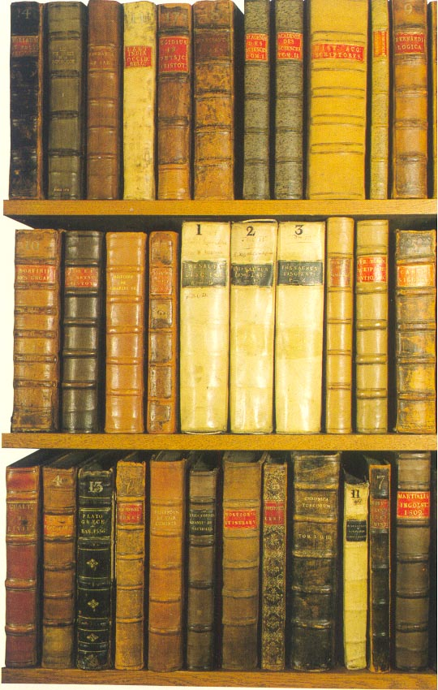


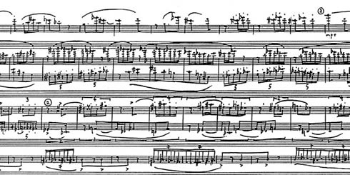
Copyright Protection
Books
Scripts
Articles
Poems
Songs
Sculptures
Models
Maps
Blueprints
Collages
Printed Material On Board Games
Data
Music

Slide 11
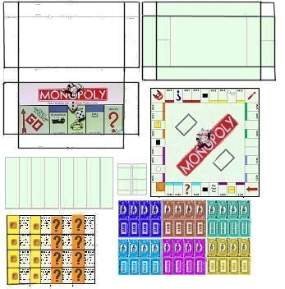
Monopoly Protections
Copyright
Instructions
Utility
Patent
Trademark
Design
Patent

Slide 12

Trade Secrets
Protection Against Revealing Information
Not Covered By Federal Law
Confidentiality Agreement

Slide 13

Licensing
Contract For Rights To Intellectual Property Of Others
Property Owner Receives Royalty/Fee
Value = Marketing Strategy To Holder Of Patent, Copyright, Trademark

Slide 14

Licensing Factors
Recognizable Property?
Complement Product/Service
Experience With Property
Long-Term Outlook
Kind Of Protection
Commitment?
Renewal Options/Terms

Slide 15

Product Safety/Liability
Consumer Product Safety Act (1972)- Legal Specifications
Identify
  Standards
  Substantial Hazards
  Dangerous Defects
Amended (1990) – Stricter Guidelines

Slide 16

Product Liability Claims
Negligence
Warranty
Strict Liability
Misrepresentation

Slide 17

Types Of Insurance
Property
Casualty
Life
Workers’ Compensation
Bonding

Slide 18

Contracts
Legally Binding Agreement Between Two Parties
Requirements
  Offer
  Acceptance
  Consideration
  Competency
  Legal
  $500+ Must Be In Writing

Slide 19
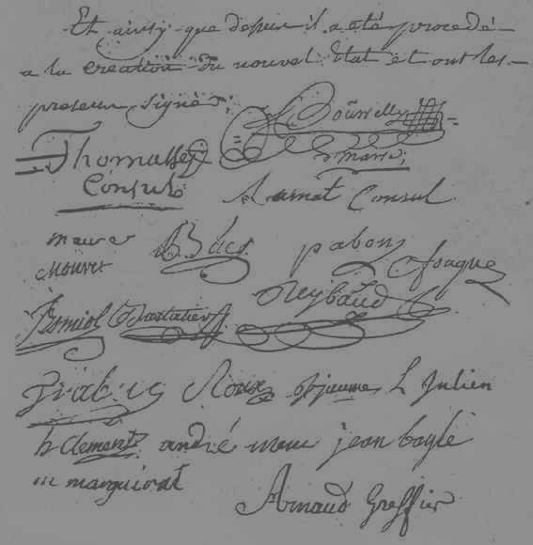
Contract Ingredients
Parties Named & Roles Specified
Detailed Description Of Transaction
Exact Value Of Transaction
Signatures of All Parties Involved

Slide 20

Remedies For Breach
Fulfill Agreement Or Pay Damages
Both Parties Agree To Drop Matter

