Slide 1
OOPs
Authored by: Harshad Korade
Presented by: Harshad Korade
This document and all its contents contain information from Cybage Software Private Limited which may be privileged, confidential, or otherwise protected from disclosure. The information is intended to be for the addressee(s) only. Any unauthorized disclosure, copy, distribution, or use of the contents of this message is strictly prohibited.

Slide 2
Course Structure
Target audience | Open for All
Level | Level 1
Pre-requisites | Basic knowledge of any programming language such as c or c++.
Training methods | PPT and Interaction with audience.
Evaluation | After completion of Training program,.

Slide 3
Agenda
What’s Object Oriented prog..ing?
OOPs Vs. Procedural prog..ing
Object Oriented Concepts
Classes & Objects
Static, Final, Const
Class Abstraction
Interfaces
Magic Methods
Object Serialization
Exception Handling

Slide 4
What is Object Oriented Programming ?
“A programming paradigm that treats program elements as objects that have data fields and functions operates on them”
“Grouping of functionality and data”
“Hierarchical partitioning of functionality ”
“Separation of interface and implementation”
Procedural Programming:
Step by step logic to solve a problem.

Slide 5
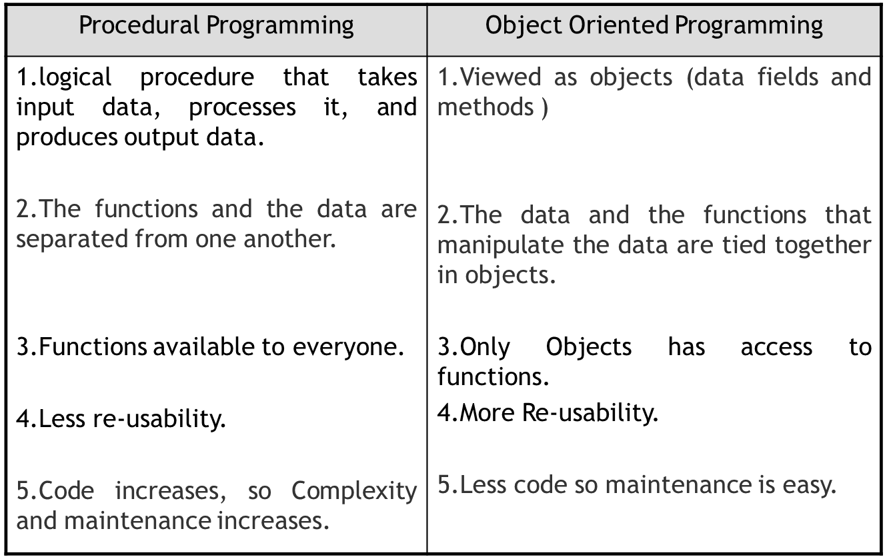
OOPs Vs. Procedural programming

Slide 6
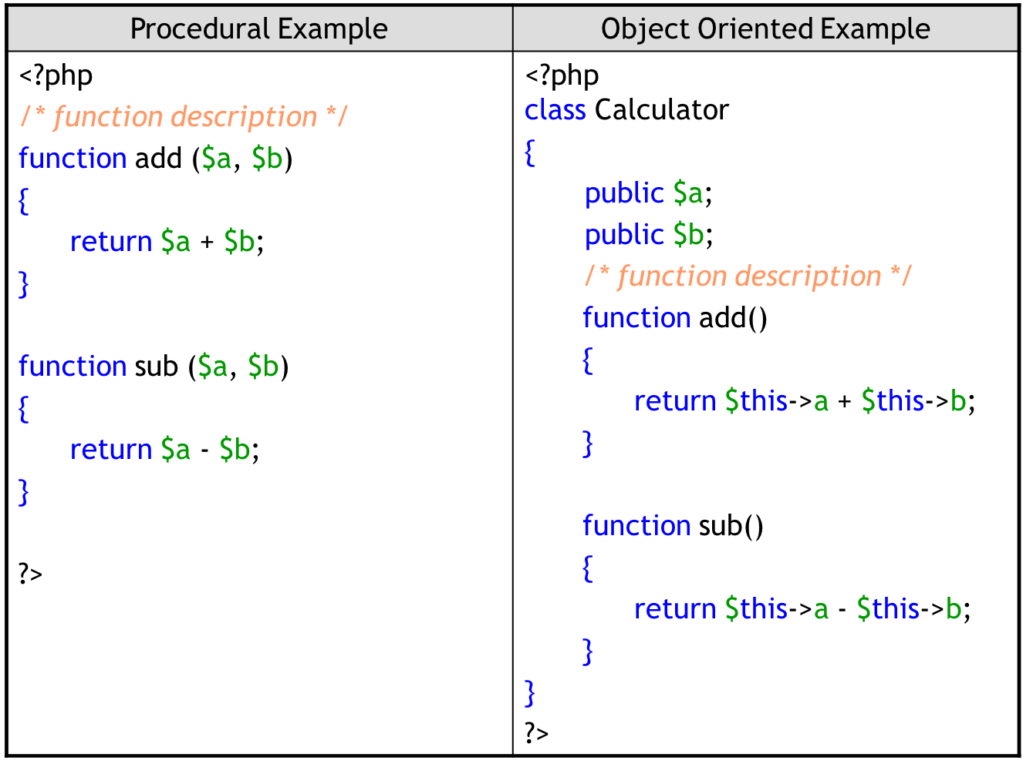
OOPs Vs. Procedural programming….

Slide 7
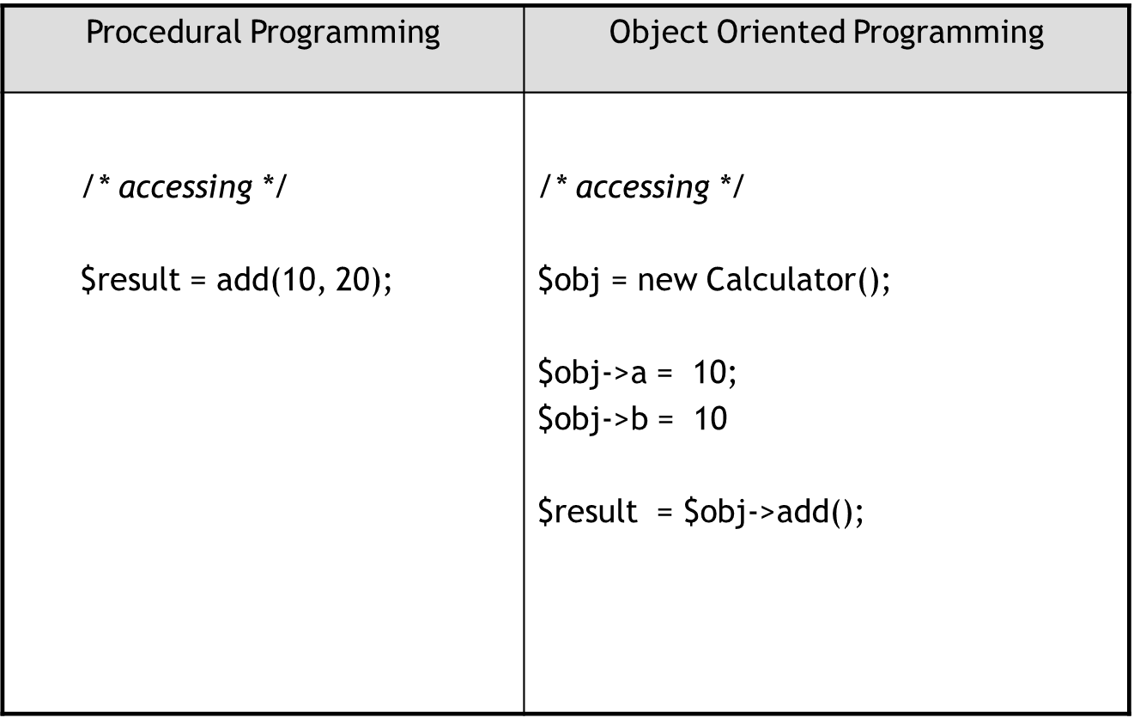
OOPs Vs. Procedural programming….

Slide 8
Object Oriented Concepts
OOP’s 4 Pillars
Encapsulation
Inheritance
Abstraction
Polymorphism
Overloading
Overriding
PHP doesn’t support
1. Multiple inheritance (supports with Interfaces)
2. Method Overloading
3. Operator Overloading

Slide 9
Classes & Objects
Class is a Template of code which contains set of methods and variables.
class MyClass {
//define variables here
//define methods here
}
Every class definition should begin with the keyword “class”, followed by a class name.
Name of class should not be a reserved word in PHP.
$instance = new MyClass();
“new” keyword is used to create an instance of class.

Slide 10
Constructors and Destructors
class MyClass {
function __construct() {
print "In constructor\n";
}
function __destruct() {
print "Destroying\n";
}
}
The constructor method will be called whenever you create a new object of that class.
The destructor method will be called as soon as all references to a particular object are removed.

Slide 11
$this Reference
class MyClass {
private $amount;
function __construct($newamount) {
$this->amount = $newamount;
}
function getAmount() {
return $this->amount;
}
function test() {
return $amount; //Here $amount is just a local variable
}
} /* Class ENDS */
$obj = new MyClass(200);
print $obj->getAmount();
print $obj->test();
All Instance variables should be accessed by $this pseudo-variable in all instance methods of that class.
"->" is the symbol used to access any instance variables or methods.
When Accessing variables with an object or $this, we will not use $ in front of variable.

Slide 12
Visibility
There are 3 Visibility operators in PHP
1. Public
2. Protected
3. Private
Public variables/methods can be accessed everywhere.
Protected can be accessed in that class, inherited class and parent classes.
Private limits visibility only to the class that defines the item.

Slide 13
Visibility…..
class MyClass {
public $a = 'Public';
protected $b = 'Protected';
private $c = 'Private';
function printHello() {
print $this->a;
print $this->b;
print $this->c;
}
}
$obj = new MyClass();
print $obj->a; // Works
print $obj->b; // Fatal Error
print $obj->c; // Fatal Error
$obj->printHello(); // Shows Public, Protected and Private

Slide 14
Method Visibility
Class methods must be defined with public, private, or protected.
Methods without any declaration are defined as public.
class MyClass {
public function myPublic() {
…..
}
protected function myProtected() {
….
}
private function myPrivate() {
….
}
function foo() {
…..
}
}

Slide 15
Inheritance
Animal
Birds
Mammals
..etc..
Elephant
Multiple, Multi-level
PHP doesn't Support Multiple inheritance (supports with Interfaces)

Slide 16
Inheritance…..
class MyClass {
public $hello = “Hello”;
function sayHello() {
print $this->hello;
}
}
class DerivedClass extends MyClass {
}
$d = new DerivedClass();
print $d->hello;
$d->sayHello();
All properties (except private) of Base class will be available in Derived class.

Slide 17
Parent Keyword
Class DerivedClass extends MyClass {
//overridden
function sayHello() {
parent::sayHello();
print “ Rama”;
}
}
In the same way you can access parent constructor by parent::__construct()
:: is called scope resolution operator, we‘ll discuss it later in this session.

Slide 18
Polymorphism
Overloading
Method Overloading
Operator Overloading
“Method overloading" means, the ability to declare multiple functions with the same name, which get called based on the number/type of parameters.
This does not exist in PHP.
In PHP, "overloading" is just a mechanism for providing handlers for access to missing methods/variables.
PHP doesn’t support Operator Overloading
Method Overriding – Using same method name in derived class

Slide 19
PHP Overloading …..
class MethodTest {
public function __call($name, $arguments) {
echo "Calling object method $name " . join(', ', $arguments). "\n";
}
public static function __callStatic($name, $arguments) {
echo "Calling static method $name " . join(', ', $arguments) . "\n";
}
}
$obj = new MethodTest();
$obj->runTest('in object context');
MethodTest::runTest('in static context'); // As of PHP 5.3.0

Slide 20
PHP Method Overloading ….
function __call ( string $name , array $arguments )
is triggered when invoking inaccessible methods in an object context.
function __callStatic ( string $name , array $arguments )
is triggered when invoking inaccessible methods in a static context.
The $name argument is the name of the method being called.
The $arguments argument is an enumerated array containing the parameters passed to the $name'ed method.
Food for thought : func_num_args() and func_get_args()

Slide 21
Comparing Objects…..
If you are comparing two objects with ==
They are equal if and only if
1. They have the same properties and values
2. And they are instances of the same class
If you are comparing two objects with ===
They are equal if and only if
1. They refer to the same instance of the same class.
$obj1 = new MyClass();
$obj2 = new MyClass();
$obj3 = $obj1;
If( $obj1 == $obj2 ) { print “true”; }
If( $obj1 === $obj2 ) { print “false”; }
If( $obj1 === $obj3 ) { print “true”; }

Slide 22
Keywords: Static, Final, Const
In PHP you can define class members or methods as static.
Static members (Variables)
1. can be accessed through ‘Scope Resolution Operator ::’
2. cannot be accessed through an Object.
Static Methods can be accessed through
1. Scope Resolution Operator ::
2. with an Object of that class *

Slide 23
Static keyword
class MyClass {
public static $my_static = “I am Static”;
public static function staticMethod() {
echo ”I am Static Method”;
}
function getStaticValue() {
return self::$my_static; //Self is a Keyword to access static content of that class
}
}
print MyClass :: $my_static;
MyClass :: staticMethod();
$obj = new MyClass();
print $obj -> staticMethod();
print $obj -> my_static; // error, Undefined "Property" my_static

Slide 24
Final & Const Keyword
final has three uses
1) prevent class Inheritance
2) prevent method overriding
3) And to declare constants
PHP supports all features, but the 3rd with 'Const' keyword
Lets see an example

Slide 25
Final & Const Keyword
final class MyClass {
const PI = 3.142;
final public function moreTesting() {
print "PI value is :" . self::PI ;
}
}
class Child extends MyClass { //Error … can’t extend final classes
}

Slide 26
Class Abstraction
Abstract Methods
1) Methods defined as abstract simply declare the method's signature they cannot define the implementation.
2) All derived classes must implement parent class Abstract Methods
Abstract Classes
1) You cannot create an Object of an Abstract Class
2) Any class that contains at least one abstract method must also be abstract

Slide 27
Class Abstraction -- Example
abstract class MyClass {
abstract function sayHello();
}
class ChildClass extends MyClass {
function sayHello() {
print "Hello";
}
}

Slide 28
Interfaces
Interfaces are just like classes which define methods without Implementations.
Interfaces are defined using the interface keyword
All methods declared in an interface must be public, this is the nature of an interface.
To implement an interface, the implements operator is used.
You can implement two or more interfaces at the same time. (Multiple Inheritance )

Slide 29
Interface -- Example
interface ElectricalDevice {
public function power_on();
public function power_off();
}
interface FrequencyTuner {
public function get_frequencey();
public function set_frequency($f);
}
class Radio implements ElectricalDevice, FrequencyTuner {
// Implement ElectricalDevice methods here...
// Implement FrequencyTuner methods here...
}

Slide 30
Magic Methods
__construct
__destruct
__toString
__clone
__call,
__callStatic,
There are many more magic methods please go through PHP documentation

Slide 31
Object Serialization
There are two function available in PHP for Serialization
serialize(Object)
- Returns a string containing a byte-stream representation of Object.
unserialize(String)
- Creates a PHP Object from a stored representation

Slide 32
Object Serialization -- Example
class MyClass {
public $one = 1;
function show_one() {
echo $this->one;
}
}
$obj = new MyClass();
$str = serialize($obj);
$obj = unserialize($str);

Slide 33
Exception Handling
PHP's Exception Handling is similar to the other programming languages like Java
try
{
$connection = mysql_connect(...);
if ($connection === false)
throw new Exception('Cannot connect to mysql');
}
catch (Exception $e)
{
echo 'Caught exception: ‘ . $e->getMessage() . "\n";
}

Slide 34
The Built in Exception class
Class Exception { protected $message = 'Unknown exception'; // exception message protected $code = 0; // user defined exception code protected $file; // source filename of exception protected $line; // source line of exception function __construct($message = null, $code = 0); final function getMessage(); // message of exception final function getCode(); // code of exception final function getFile(); // source filename final function getLine(); // source line final function getTrace(); // an array of the backtrace() final function getTraceAsString(); // formatted string of trace /* Overrideable */ function __toString(); // formatted string for display }

Slide 35
Extending Exceptions
class FileNotFound extends Exception {
public function __construct() { parent::__construct(“File Not Found”, 123);
}
}

Slide 36
Namespaces
Namespaces are available in PHP as of PHP 5.3.0.
Please visit namespaces for more info

Slide 38
Thank You!!

