Slide 1
PHP Unit Testing
Authored by: Sunil Sharma
Presented by: Sunil Sharma
This document and all its contents contain information from Cybage Software Private Limited which may be privileged, confidential, or otherwise protected from disclosure. The information is intended to be for the addressee(s) only. Any unauthorized disclosure, copy, distribution, or use of the contents of this message is strictly prohibited.

Slide 2
Document History
Version No. | Authored/ Modified by | Remarks/ Change History | Date <dd- mon-yy >
1 | Sunil Sharma |  | 10-08-2017

Slide 3
Learning Objectives
PHPUnit understanding
Installation & Getting started
PHPUnit Options
Types of testing
What are unit tests
What is PHPUnit
Installation
PHPUnit Conventions
Writing PHPUnit test
Understand Assertions
Understand Annotations
Setup & Dependency management
Running PHPUnit test
Command line options
Understand command line options
Process Isolation
Debugging, etc.

Slide 4
Course Structure
Target audience
Level | Beginner
Pre-requisites | PHP, OOPs Concepts
Training methods | PPT, Demo
Evaluation | Online objective test

Slide 5
Agenda
Types of Test
What is unit test
What is PHPUnit
Installations
Conventions
First unit test
Mocking
Annotations
Assertions in PHPUnit
Understanding command line output
Command line options
Demo
Q&A

Slide 6
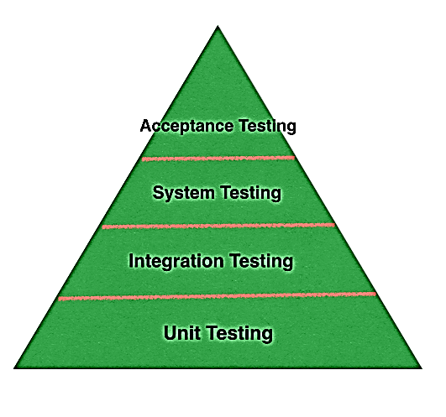
Types of tests
Unit testing
Test smallest unit of functionality
Integration Testing
Combine units of codes and test the combination works correctly
Built on top of unit testing.
Able to catch bugs we could not spot by unit testing
System testing
Created to simulate the real time scenarios in a simulated real life environment
Acceptance testing
Acceptance tests are actually done by the users of the software.
Users do not care about the internal details of the software.
They only care how the software works

Slide 7
What is unit test
Unit Testing is a level of software testing where individual units/ components of a software are tested. The purpose is to validate that each unit of the software performs as designed
Units are smallest testable part of an application
Functions
Classes
Methods

Slide 8
What is PHPUnit
PHPUnit is a programmer-oriented testing framework for PHP
It is an instance of the xUnit architecture (collective name) for unit testing frameworks
A framework that enables you to create your test suite.
Features
Mocking
Code coverage Analysis
Logging, etc.

Slide 9
Installation
On Linux machine. The process can be done in your terminal via commands below:
If you have done everything right, you should be able to see PHPUnit version by typing command below in your terminal.
Using Composer

Slide 10
Conventions
File structure and filenames
Your tests should mirror your codebase directly but within its own folder, and test files must match the file they are testing, with Test appended

Slide 11
Conventions (Continued..)
Class names
Class names are exactly the same as filenames. Whatever you have named your file should be the name of your class - which should be true for your non-test code anyway!
Method (test) names
Your test method names should start with test, in lower case
For example, if you are testing a method called verifyAccount(), name your test testVerifyAccount ()
Methods must be public
PHPUnit is unable to run tests that are either protected or private - they must be public
Extends PHPUnit
Your classes must extend the PHPUnit_Framework_TestCase class, or extend a class that does

Slide 12
First PHPUnit Test

Slide 13
Running your first unit test
Just use phpunit & test filename to run your first unit test.

Slide 14
Mocking (Stub)
When writing unit tests, the goal is to test the individual component, such as a service. Often, the service requires other parts of the system to function. When this is the case, it often makes sense to make mock versions of these dependencies so that we focus testing just on that service.
PHPUnit comes with a very powerful feature to help us handle outside dependencies. It basically involves replacing the actual object with a fake, or 'mock', object that we fully control, removing all dependencies on outside systems or code that we really have no need to test.
For ex. Currency Converter class depends on external service to get current currency rates for calculation, and development environment do not have access to external service.
Features of Mock
Disable original constructor
Abstract Classes
Mock Methods
Mock methods with callback returns

Slide 15
Annotations
An annotation is a special form of syntactic metadata that can be added to the source code of some programming languages
Applications such as PHPUnit use this information at runtime to configure their behavior.
Note that : A doc comment in PHP must start with /** and end with */. Annotations in any other style of comment will be ignored.

Slide 16
Annotations
There are varieties of annotations supported by PHPUnit. Some of the commonly used annotations:
@group A test can be tagged as belonging to one or more groups using the @group annotation
@author It is an alias for the @group annotation and allows to filter tests based on their authors.
@small The @small annotation is an alias for @group small. A small test must not depend on a test marked as @medium or @large (If the PHP_Invoker package is installed and strict mode is enabled, a small test will fail if it takes longer than 1 second to execute)
@medium The @medium annotation is an alias for @group medium. A medium test must not depend on a test marked as @large. (If the PHP_Invoker package is installed and strict mode is enabled, a medium test will fail if it takes longer than 10 )
@large The @large annotation is an alias for @group large. (If the PHP_Invoker package is installed and strict mode is enabled, a large test will fail if it takes longer than 60 seconds to execute)
@after It can be used to specify methods that should be called after each test method in a test case class.
@before It can be used to specify methods that should be called before each test method in a test case class.
@depends It can be used to express dependencies
A producer is a test method that yields its unit under test as return value.
A consumer is a test method that depends on one or more producers and their return values.
Demo :
- Express dependency
- Exploiting the dependencies between tests
- Real time DB Connection dependency

Slide 17
Assertions in PHPUnit
An assertion is a statement that a predicate (Boolean-valued function, a true–false expression) is expected to always be true at that point in the code. If an assertion evaluates to false at run time, an assertion failure results, which typically causes the program to crash, or to throw an assertion exception
The assertion methods are declared static and can be invoked from any context using
$this->assertTrue()
self::assertTrue()
Some commonly used assertions
assertTrue(bool $condition[, string $message = ''])
assertEquals(mixed $expected, mixed $actual[, string $message = ''])
assertArrayHasKey(mixed $key, array $array[, string $message = ''])
assertContains(string $needle, string $haystack[, string $message = '', boolean $ignoreCase = false])
assertCount($expectedCount, $haystack[, string $message = ''])
assertEmpty(mixed $actual[, string $message = ''])

Slide 18
Understanding command line output
For each test run, the PHPUnit command-line tool prints one character to indicate progress:
Character | Description
. | Printed when the test succeeds
F | Printed when an assertion fails while running the test method.
E | Printed when an error occurs while running the test method.
R | Printed when the test has been marked as risky
S | Printed when the test has been skipped
I | Printed when the test is marked as being incomplete or not yet implemented

Slide 19
Command line options
Command line option | Description
Test Selection Options
--filter <pattern> | Filter which tests to run.
--group ... | Only runs tests from the specified group(s).
--exclude-group ... | Exclude tests from the specified group(s).
Logging Options
--log-junit <file> | Log test execution in JUnit XML format to file
Test Execution Options:
--debug | Display debugging information.
--process-isolation | Run each test in a separate PHP process.

Slide 21
Test Your Knowledge Quotient for <Topic Name>…
Q1.
Q2.
Q3.
Q4.
Q5.
Q6.
Q7.
Q8.
Q9.
Q10.

Slide 22
Thank You!

