Slide 1
Strings and File Handling
Presented by: Rishikesh Khodke
Authored by: Rishikesh Khodke

Slide 2
Course Structure
Target audience | Open for All
Level | Level 1
Pre-requisites | Basic knowledge of any programming language such as c or c++.
Training methods | PPT and Interaction with audience.
Evaluation | After completion of Training program,.

Slide 3
String Handling
Copyright © 2019 Cybage Software Pvt. Ltd. All Rights Reserved. Cybage Confidential.
www.cybage.com

Slide 4
Agenda
Syntax (Various ways of Specifying Strings).
Variable Parsing.
Useful functions and operators.

Slide 5
Strings….
A string is series of characters.
In PHP, a character is the same as a byte.
i.e. There are exactly 256 different characters possible.
A string literal can be specified in 4 different ways
Single quoted
Double quoted
Heredoc syntax
Nowdoc syntax (since PHP 5.3.0)

Slide 6
Strings….Single Quoted
The simplest way to specify a string is to enclose it in single quotes (the character ')
echo ‘We have included string in quotes ’;
To specify a literal single quote, escape it with a backslash (\)
// Outputs: This is easy : "I'll do this for you.” echo ‘This is easy : "I\'ll do this for you.”’;
To specify a literal backslash, double it (\\).
Ex. echo “\\”;

Slide 7
Strings….Single Quoted
The simplest way to specify a string is to enclose it in single quotes (the character ')
echo ‘We have included string in quotes ’;
To specify a literal single quote, escape it with a backslash (\)
// Outputs: This is easy : "I'll do this for you.” echo ‘This is easy : "I\'ll do this for you.”’;
To specify a literal backslash, double it (\\).
Ex. echo “\\”;

Slide 8
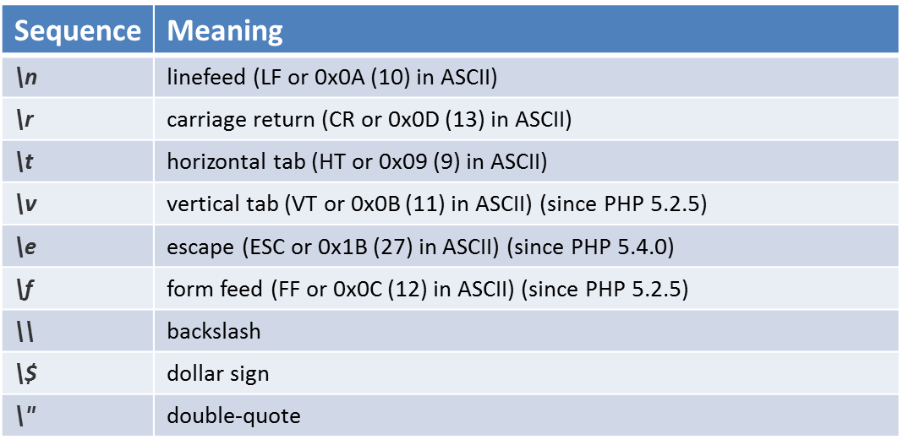
Strings…. Double Quoted
If the string is enclosed in double-quotes ("), PHP will interpret more escape sequences for special characters:

Slide 9
Strings…. Heredocs and nowdocs
Heredocs and nowdocs are the easiest and cleanest ways in php to use and format multiline strings. The only difference between a heredoc and a nowdoc is that a heredoc performs string interpolation, turning your variables into the string they represent, while a nowdoc does not.

Slide 10
Strings….Heredoc
Another way to delimit strings is by using heredoc syntax ("<<<").
Provide an identifier after <<<, then the string, and then the same identifier to close the quotation.
The closing identifier must begin in the first column of the line. The closing delimiter (possibly followed by a semicolon) must also be followed by a newline.
$str = <<<EOD
Example of string
spanning multiple lines
using heredoc syntax.
EOD;

Slide 11
Strings….Heredoc continued
The identifier must follow the same naming rules as any other label in PHP: it must contain only alphanumeric characters and underscores, and must start with a non-digit character or underscore.
Heredoc text behaves just like a double-quoted string, without the double-quotes.
In starting days It was used to construct SQL queries .
$sql = <<<SQL select * from $tablename
where id in [$order_ids_list]
and product_name = "widgets"
SQL;

Slide 12
Strings….Nowdoc
Nowdoc syntax is similar, only difference is that the delimiter is enclosed within single quotes.
No variable substitution or escaping takes place.
A nowdoc is identified with the same <<< sequence, but the identifier is enclosed in single quotes, e.g. <<<'EOT'.
A nowdoc is specified similarly to a heredoc, but no parsing is done inside a nowdoc.
<?php
echo <<<'EOD'
Example of string spanning multiple lines
using nowdoc syntax. Backslashes are always treated literally,
e.g. \\ and \'.
EOD;

Slide 13
Strings…. Heredoc and Nowdoc
<?php
echo <<<EOT
My name is "$name". I am printing some $foo->foo.
Now, I am printing some {$foo->bar[1]}.
This should print a capital 'A': \x41
EOT;
?>
My name is "MyName". I am printing some Foo.
Now, I am printing some Bar2.
This should print a capital 'A': A
<?php
echo <<<'EOT'
My name is "$name". I am printing some $foo->foo.
Now, I am printing some {$foo->bar[1]}.
This should not print a capital 'A': \x41
EOT;
?>
My name is "$name". I am printing some $foo->foo.
Now, I am printing some {$foo->bar[1]}.
This should not print a capital 'A': \x41

Slide 14
Strings….Variable Parsing
When a string is specified in double quotes or with heredoc, variables are parsed within it.
There are two types of syntax: a simple one and a complex one
The simple syntax provides a way to embed a variable, an array value, or an object property in a string with a minimum of effort.
The complex syntax can be recognized by the curly braces surrounding the expression.

Slide 15
Strings….Variable Parsing : Simple Syntax
If a dollar sign ($) is encountered, the parser will greedily take as many tokens as possible to form a valid variable name
Similarly, an array index or an object property can be parsed. With array indices, the closing square bracket (]) marks the end of the index.

Slide 16
Strings…. Variable Parsing : Complex Syntax
It allows for the use of complex expressions
Simply write the expression the same way as it would appear outside the string, and then wrap it in { and }
This syntax will only be recognized when the $ immediately follows the { or vice versa.
$great = 'fantastic';
echo "This is { $great}";
echo "This is {$great}";
echo "This works: {$arr['key']}“;
echo "This works: {$arr[4][3]}";

Slide 17
Strings….Operators
There are two string operators.
The concatenation operator ('.'), which returns the concatenation of its right and left arguments.
The concatenating assignment operator ('.='), which appends the argument on the right side to the argument on the left side.

Slide 18
Strings…. Functions
strlen() function: This function is used to find the length of a string.
echo strlen("Hello Cybage!");
strrev() function: This function is used to reverse a string.
echo strrev("Hello Cybage!");
str_replace() function: This function takes three strings as arguments. The third argument is the original string and the first argument is replaced by the second one.
echo str_replace(" World ", “Cybage", "Hello World!"), "\n";
strpos() function: This function takes two string arguments and if the second string is present in the first one, it will return the starting position of the string otherwise returns FALSE.
echo strpos("Hello Cybage!", “Cybage"), "\n"; => 6

Slide 19
Strings…. Functions
trim() function: This function allows us to remove whitespaces or strings from both sides of a string.
echo trim("Hello World!", "Hed!"); => llo Worl
str_word_count() function counts the number of words in a string
echo str_word_count("Hello world!"); // outputs 2
substr(string,start,length) function returns a part of a string.
echo substr("Hello world",6); => world
htmlspecialchars(string,flags,character-set,double_encode) function converts some predefined characters (&, “, ‘, <,>) to HTML entities.
$str = “String & ‘Files'";
echo htmlspecialchars($str, ENT_QUOTES);

Slide 20
Refrance
https://www.w3schools.com/php/php_ref_string.asp

Slide 21
File Handling
Copyright © 2019 Cybage Software Pvt. Ltd. All Rights Reserved. Cybage Confidential.
www.cybage.com

Slide 22
Agenda
File Handling
File open/close
File read/write
File functions
File upload

Slide 23
File Handling
File handling is an important part of any web application. You often need to open and process a file for different tasks.
File handling in PHP is similar as file handling is done by using any programming language like C. PHP has many functions to work with normal files.

Slide 24
File Opening Modes
Before we look how to open a file in PHP you need to know that a file can be opened in different modes. For example you can open a file in read only mode or in read and write modes.
Modes Description
r Read only. Starts at the beginning of the file
r+ Read/Write. Starts at the beginning of the file
w Write only. Opens and clears the contents of file; or creates a new file if it doesn’t exist
w+ Read/Write. Opens and clears the contents of file; or creates a new file if it doesn’t exist
a Append. Opens and writes to the end of the file or creates a new file if it doesn’t exist
a+ Read/Append. Preserves file content by writing to the end of the file
x Write only. Creates a new file. Returns FALSE and an error if file already exists
x+ Read/Write. Creates a new file. Returns FALSE and an error if file already exists

Slide 25
Open File - fopen()
The first parameter of fopen() contains the name of the file to be opened and the second parameter specifies in which mode the file should be opened.
<?php
$myfile = fopen("webdictionary.txt", "r") or die("Unable to open file!");
echo fread($myfile,filesize("webdictionary.txt"));
fclose($myfile);
?>

Slide 26
Write to File - fwrite()
The first parameter of fwrite() contains the name of the file to write to and the second parameter is the string to be written.
<?php
$myfile = fopen("newfile.txt", "w") or die("Unable to open file!");
$txt = “Cybage\n";
fwrite($myfile, $txt);
$txt = " Cybage\n ";
fwrite($myfile, $txt);
fclose($myfile);
?>

Slide 27
PHP file I/O functions
function name(s) | category
file, file_get_contents, file_put_contents | reading/writing entire files
basename, file_exists, filesize, fileperms, filemtime, is_dir, is_readable, is_writable, disk_free_space | asking for information
copy, rename, unlink, chmod, chgrp, chown, mkdir, rmdir | manipulating files and directories
glob, scandir | reading directories

Slide 28
Reading/writing files
contents of foo.txt | file("foo.txt") | file_get_contents("foo.txt")
Hello how are you? I'm fine | array( "Hello\n", #0 "how are\n", #1 "you?\n", #2 "\n", #3 "I'm fine\n" #4 ) | "Hello\n how are\n you?\n \n I'm fine\n"
file returns lines of a file as an array
file_get_contents returns entire contents of a file as a string

Slide 29
Reading/writing an entire file
# reverse a file
$text = file_get_contents("poem.txt");
$text = strrev($text);
file_put_contents("poem.txt", $text); PHP
file_get_contents returns entire contents of a file as a string
file_put_contents writes a string into a file, replacing any prior contents

Slide 30
Appending to a file
# add a line to a file
$new_text = “This is new text appended";
file_put_contents("poem.txt", $new_text, FILE_APPEND); PHP

Slide 31
The file function
# display lines of file as a bulleted list
$lines = file("todolist.txt");
foreach ($lines as $line) {
?>
<li> <?= $line ?> </li>
<?php
}
?>
file returns the lines of a file as an array of strings
each string ends with \n
to strip the \n off each line, use optional second parameter:

Slide 32
Fixed-length files, file and list
list($name, $phone, $pin) = file("personal.txt");
File :
Cybage Software Pvt. Ltd.
020 6604 170
411014
reads the file into an array of lines and unpacks the lines into variables
Need to know a file's exact length/format

Slide 33
Other file operations
Copy() — Copies file
unlink — Deletes a file
file_exists() - Checks whether a file or directory exists
Chmod() — Changes file mode
Mkdir() — Makes directory
Pathinfo() - Returns information about a file path

Slide 34
File Pointers
fseek ($handle, $offset , $where)
$where :
SEEK_SET - Set position equal to offset bytes.
SEEK_CUR - Set position to current location plus offset.
SEEK_END - Set position to end-of-file plus offset.
rewind($handle) :
Sets the file position indicator for handle to the beginning of the file stream.

Slide 35
File Upload
File input in Form
Enctype = "multipart/form-data" is used when a form requires binary data, like the contents of a file, to be uploaded
The type="file" attribute of the <input> tag.
$_FILES
By using the global PHP $_FILES array you can upload files from a client computer to the remote server.
$_FILES["file"]["name"] - the name of the uploaded file
$_FILES["file"]["size"] - the size in bytes of the uploaded file
$_FILES["file"]["tmp_name"] - the name of the temporary copy of the file stored on the server
move_uploaded_file (string $filename , string $destination)
move_uploaded_file($tmp_name, "$uploads_dir/$name");

Slide 36
Dealing With Directories
Open a directory
$handle = opendir('dirname');
$handle 'points' to the directory
Read contents of directory
readdir($handle)
Returns name of next file in directory
Files are sorted as on filesystem
Close a directory
closedir($handle)
Closes directory 'stream'

Slide 37


Copyright © 2019 Cybage Software Pvt. Ltd. All Rights Reserved. Cybage Confidential.
www.cybage.com

Slide 38

Thank You!
10/22/2019
www.cybage.com
Copyright © 2019 Cybage Software Pvt. Ltd. All Rights Reserved. Cybage Confidential.

