Slide 1
PBL PROJECT
TRIP BILL GENERATOR

Slide 2
project GUIDE – Reena kharat ma’am
GROUP MEMBERS:
YASH CHINCHOLE – SYCOA37
VIJAY CHAURE – SYCOA35
ATHARVA BOKADE – SYCOA25
SAHIL BOMBLE – SYCOA26

Slide 3
project dESCRIPTION
OUR PROJECTS HELPS IN PLANNING TRIP
PROVIDES YOU WITH OPTIONS TO CHOOSE SUCH AS DESTINATION, HOTELS & APPLICABLE DISCOUNTS
OPTIONS INCLUDES DEPARTURE POINT, ARRIVAL POINT ,TRAVEL MODE, HOTELS ETC
AT THE END YOU ARE PROVIDED WITH FINAL BILL WITH ALL INFORMATION REGARDING TO THE BOOKING OF TRIP

Slide 4
Concepts Used :
Class ObjeCTs
Constructor and destructor
Inheritance
File handling
Exception handling

Slide 5
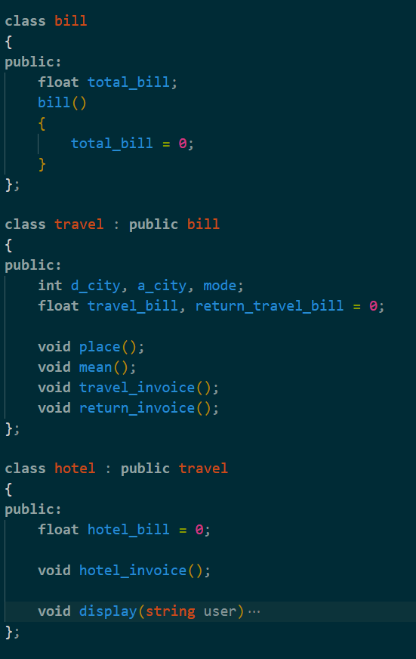
Class Objects
We used class to make three different classes :
Bill class
Hotel Class
Travel class
Containing attributes like total bill, Travel destination and package information

Slide 6
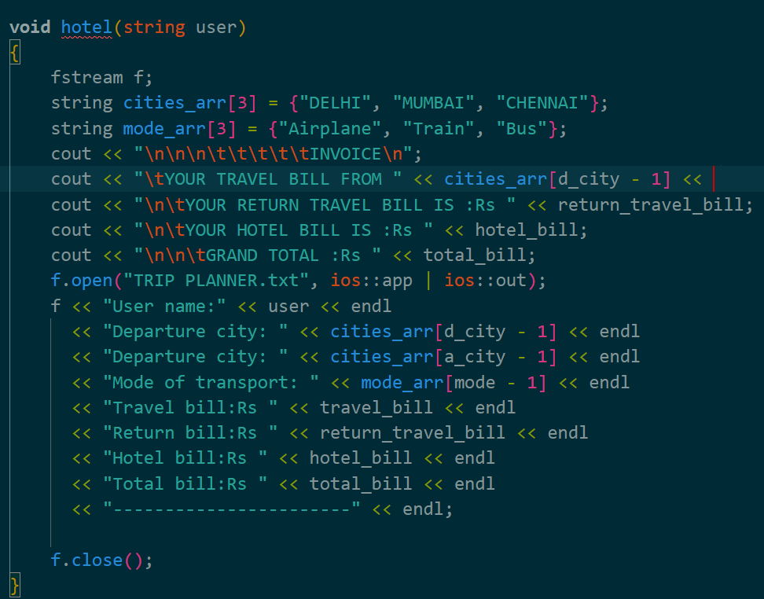
Contsructor
We have used constructor and destructor to initialise variables and function that needed to be called on object creation and set the values accordingly as required by our program

Slide 7
Inheritance
In this Program we have used a type of inheritance called multilevel inheritance
In this, we transfer the required class properties from one to another maintaining a “level” like structure
bill
travel
hotel

Slide 8
File handling
In our program we need to have a file for bill generation and this file will generate bill and travel generation.
For this purpose we used fstream (file handling) to open and generate a file.

Slide 9
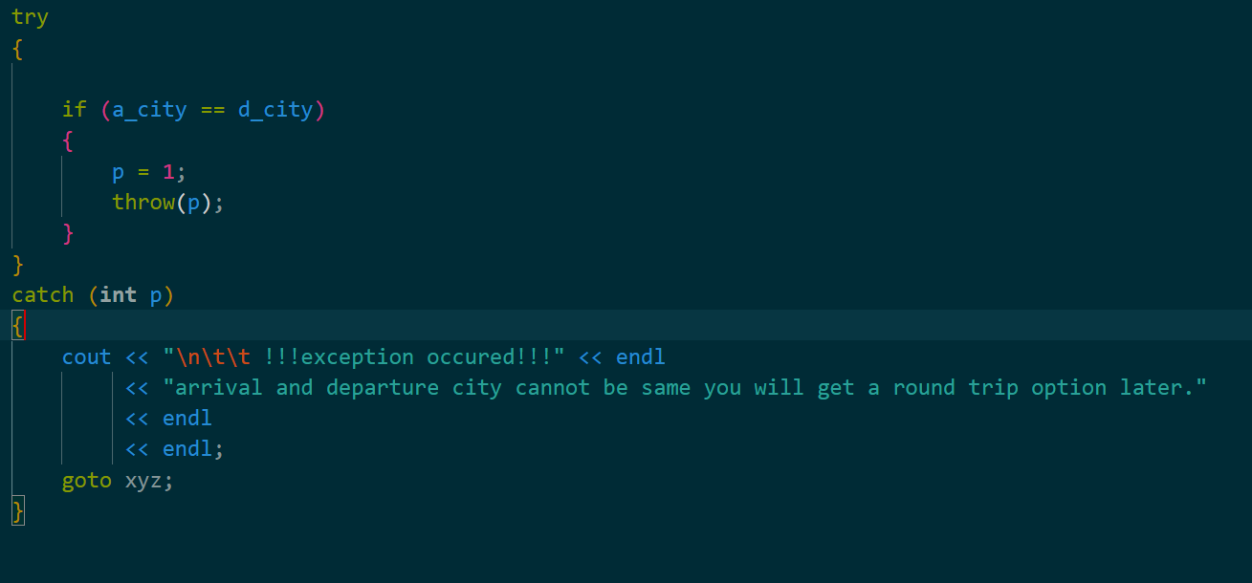
Exception handling
To avoid exceptions and unexpected errors that could have happened in our project we used “try” to find the exception
And then in “catch” statement we handled the error accordingly
Corresponding image shows try and catch demonstration in our project

Slide 10
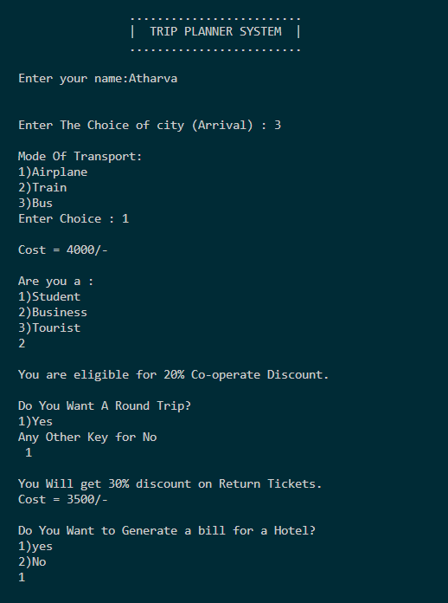
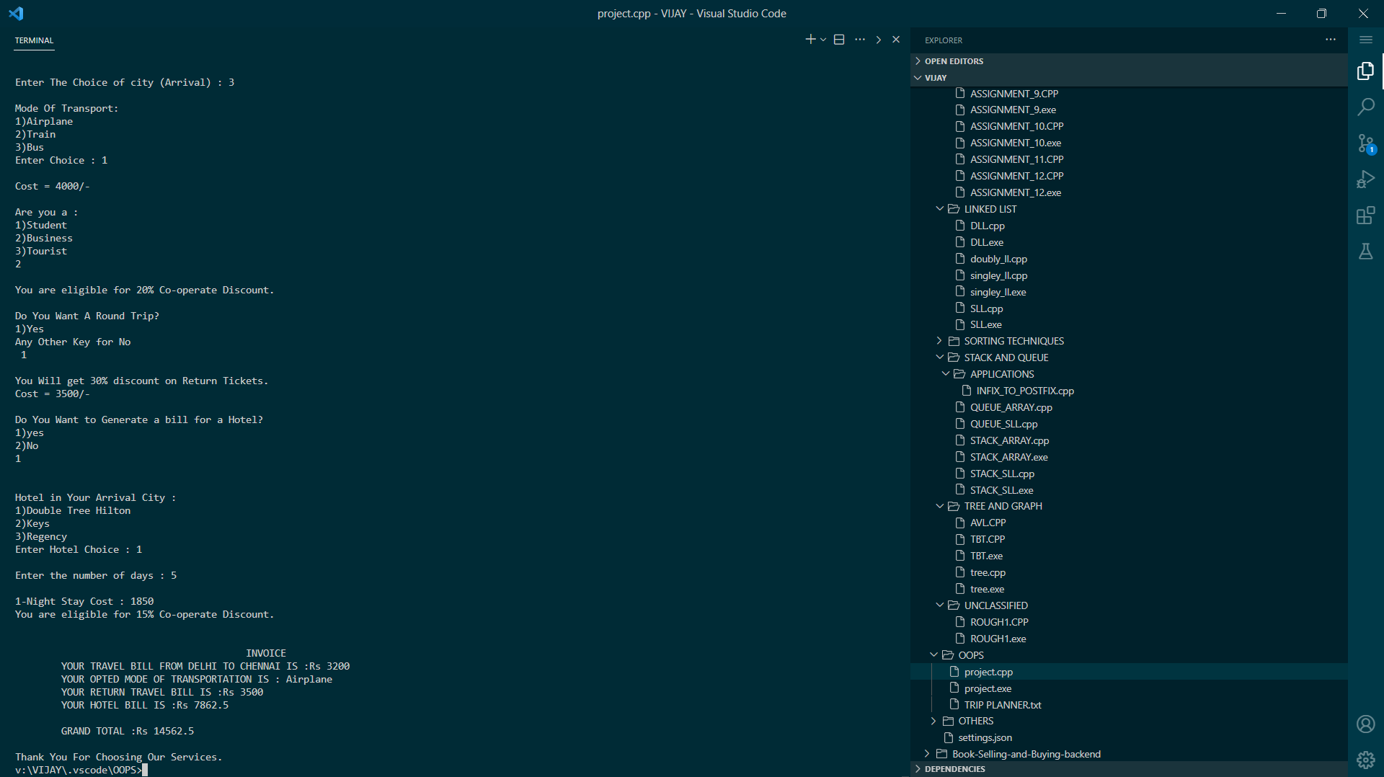
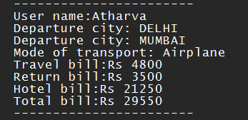

Slide 11
THANK YOU!

