Slide 1
visualize
File created on: 5/24/20 1:40:22 PM PDT

Slide 2
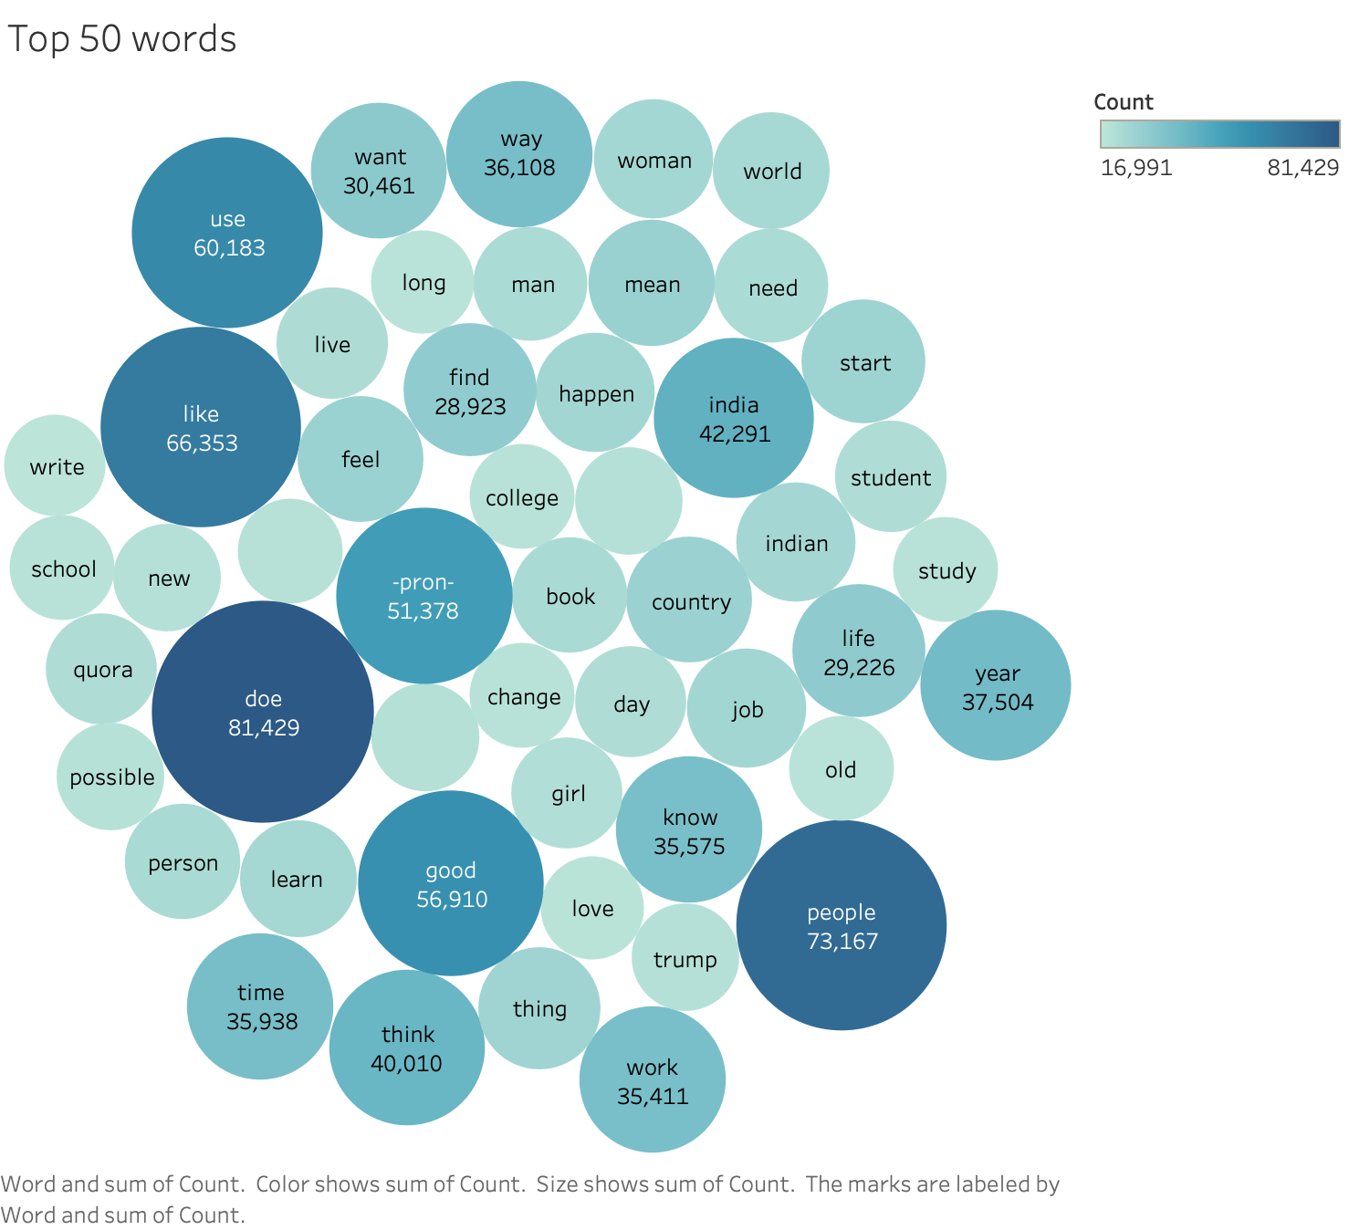

Slide 3
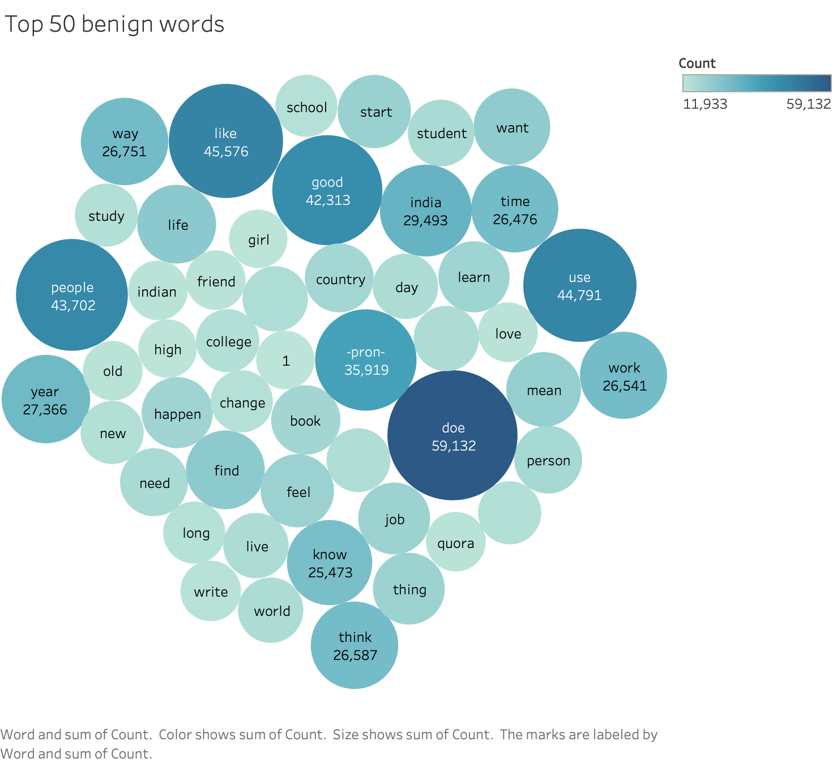

Slide 4
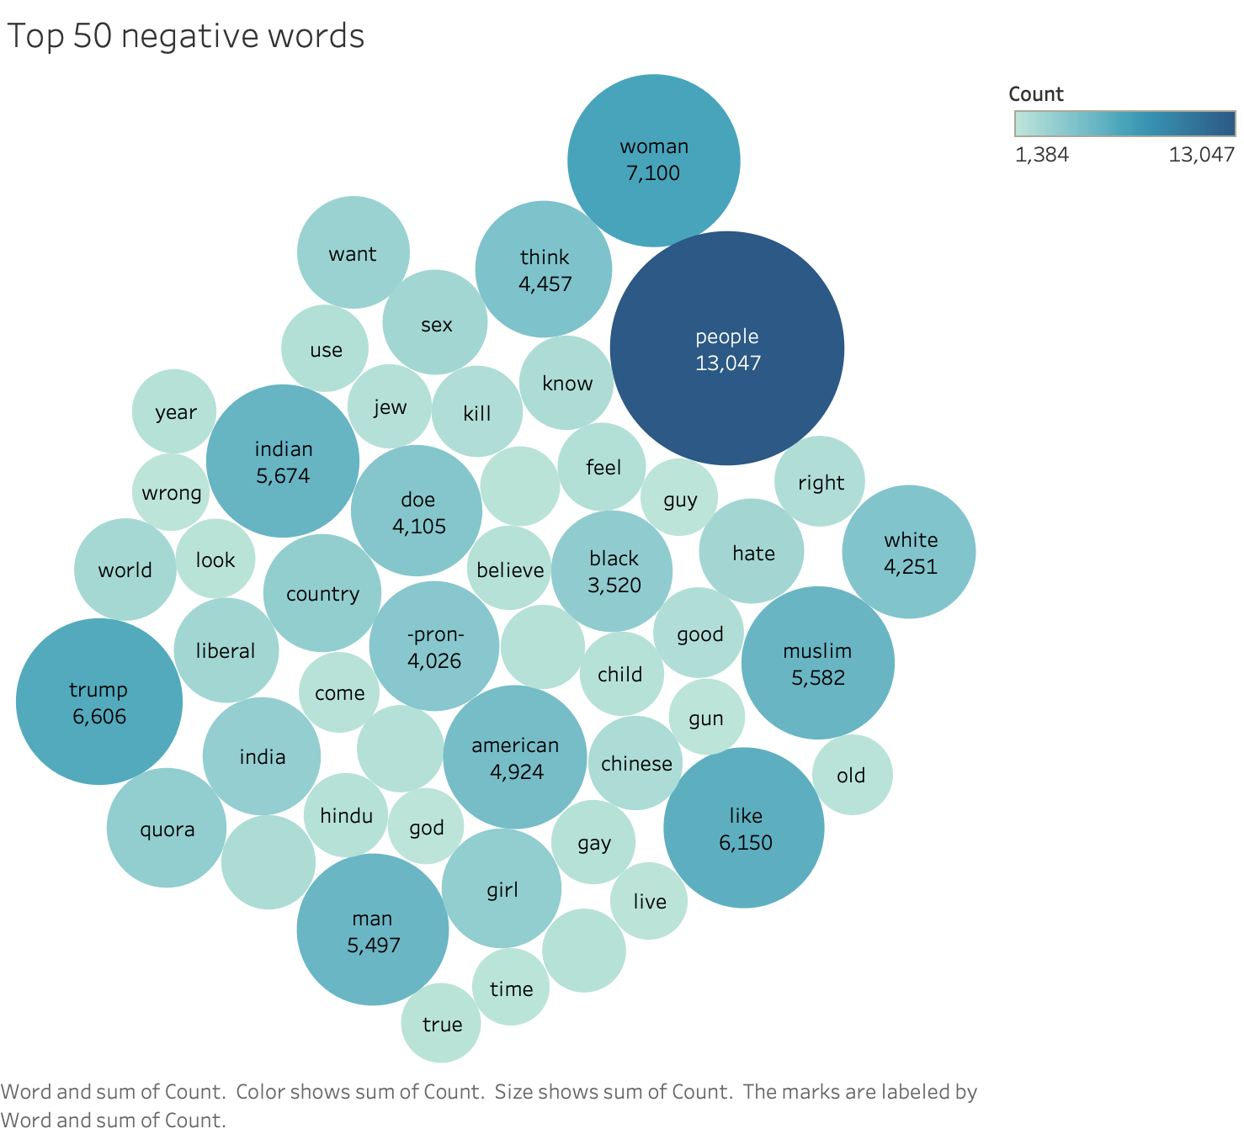

Slide 5
